Slide 1
Querying Wikidata with SPARQL for Absolute Beginners https://www.youtube.com/watch?v=kJph4q0Im98
2021.02.21

Slide 2
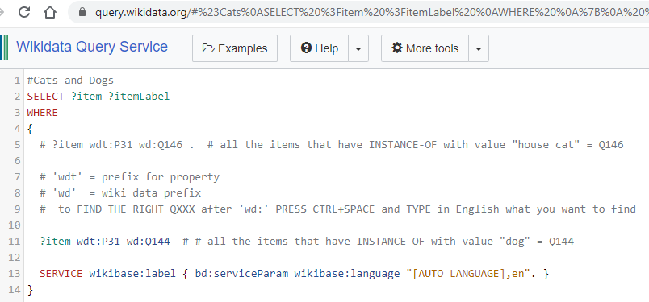
#Cats and Dogs
Notes:
#Cats and Dogs
SELECT ?item ?itemLabel
WHERE
{
# ?item wdt:P31 wd:Q146 . # all the items that have INSTANCE-OF with value "house cat" = Q146
# 'wdt' = prefix for property
# 'wd' = wiki data prefix
# to FIND THE RIGHT QXXX after 'wd:' PRESS CTRL+SPACE and TYPE in English what you want to find
?item wdt:P31 wd:Q144 # # all the items that have INSTANCE-OF with value "dog" = Q144
SERVICE wikibase:label { bd:serviceParam wikibase:language "[AUTO_LANGUAGE],en". }
}

Slide 3
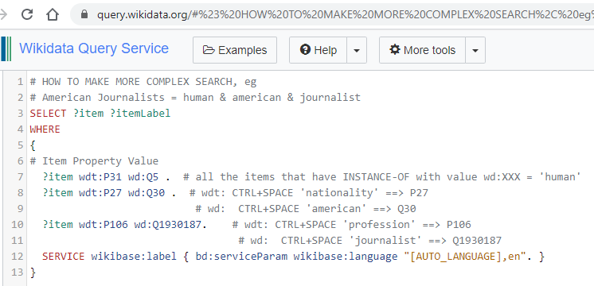
Human + American + journalist
Notes:
# HOW TO MAKE MORE COMPLEX SEARCH, eg
# American Journalists = human & american & journalist
SELECT ?item ?itemLabel
WHERE
{
# Item Property Value
?item wdt:P31 wd:Q5 . # all the items that have INSTANCE-OF with value wd:XXX = 'human'
?item wdt:P27 wd:Q30 . # wdt: CTRL+SPACE 'nationality' ==> P27
# wd: CTRL+SPACE 'american' ==> Q30
?item wdt:P106 wd:Q1930187. # wdt: CTRL+SPACE 'profession' ==> P106
# wd: CTRL+SPACE 'journalist' ==> Q1930187
SERVICE wikibase:label { bd:serviceParam wikibase:language "[AUTO_LANGUAGE],en". }
}

Slide 4
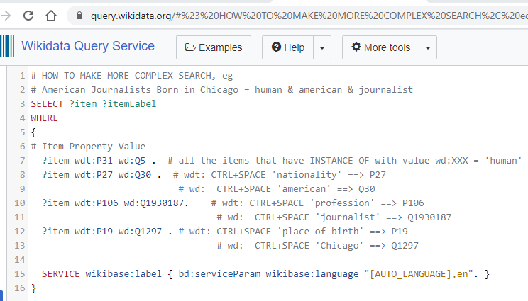
American journalist born in Chicago
Notes:
# HOW TO MAKE MORE COMPLEX SEARCH, eg
# American Journalists Born in Chicago = human & american & journalist
SELECT ?item ?itemLabel
WHERE
{
# Item Property Value
?item wdt:P31 wd:Q5 . # all the items that have INSTANCE-OF with value wd:XXX = 'human'
?item wdt:P27 wd:Q30 . # wdt: CTRL+SPACE 'nationality' ==> P27
# wd: CTRL+SPACE 'american' ==> Q30
?item wdt:P106 wd:Q1930187. # wdt: CTRL+SPACE 'profession' ==> P106
# wd: CTRL+SPACE 'journalist' ==> Q1930187
?item wdt:P19 wd:Q1297 . # wdt: CTRL+SPACE 'place of birth' ==> P19
# wd: CTRL+SPACE 'Chicago' ==> Q1297
SERVICE wikibase:label { bd:serviceParam wikibase:language "[AUTO_LANGUAGE],en". }
}

Slide 5
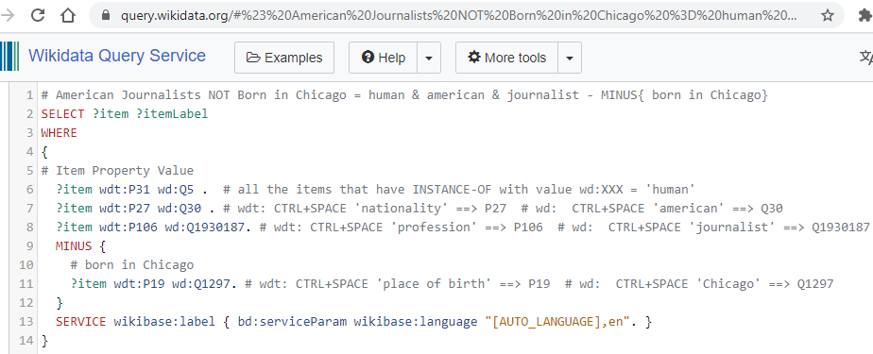
American Journalists NOT Born in Chicago = human & American & journalist - MINUS{ born in Chicago} https://w.wiki/$mx https://w.wiki/$m$ (results only)
Notes:
# American Journalists NOT Born in Chicago = human & american & journalist - MINUS{ born in Chicago}
SELECT ?item ?itemLabel
WHERE
{
# Item Property Value
?item wdt:P31 wd:Q5 . # all the items that have INSTANCE-OF with value wd:XXX = 'human'
?item wdt:P27 wd:Q30 . # wdt: CTRL+SPACE 'nationality' ==> P27 # wd: CTRL+SPACE 'american' ==> Q30
?item wdt:P106 wd:Q1930187. # wdt: CTRL+SPACE 'profession' ==> P106 # wd: CTRL+SPACE 'journalist' ==> Q1930187
MINUS {
# born in Chicago
?item wdt:P19 wd:Q1297. # wdt: CTRL+SPACE 'place of birth' ==> P19 # wd: CTRL+SPACE 'Chicago' ==> Q1297
}
SERVICE wikibase:label { bd:serviceParam wikibase:language "[AUTO_LANGUAGE],en". }
}

Slide 6
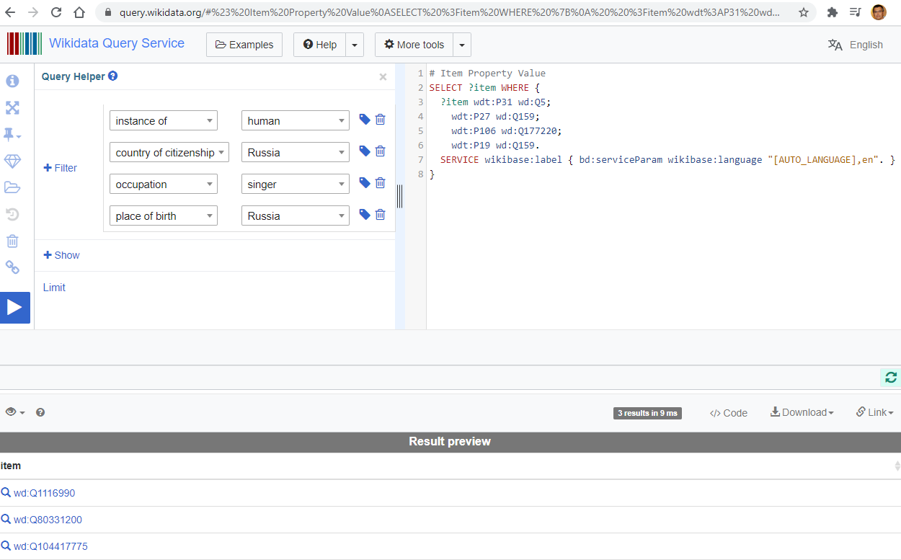
Use Help
HELP
TINY URL
https://w.wiki/$nV
RESULTS URL
https://w.wiki/$nY
Notes:
# Item Property Value
SELECT ?item WHERE {
?item wdt:P31 wd:Q5;
wdt:P27 wd:Q159;
wdt:P106 wd:Q177220;
wdt:P19 wd:Q159.
SERVICE wikibase:label { bd:serviceParam wikibase:language "[AUTO_LANGUAGE],en". }
}

