Slide 1

CYBER SHIELD
// WOMEN TECHSTERS BOOTCAMP · COHORT 5.0 · GROUP 45
01 / 10
WOMEN TECHSTERS BOOTCAMP BY TECH4DEV
// GROUP 45 — CAPSTONE PROJECT
· COHORT 5.0
— 2026
CYBER SHIELD
HUMAN FIREWALL CHALLENGE
AI Scam Simulator + Immunity Trainer
SDG 4 EDUCATION
SDG 9 INNOVATION
SDG 16 JUSTICE

Slide 2


CYBER SHIELD
// WOMEN TECHSTERS BOOTCAMP · COHORT 5.0 · GROUP 45
02 / 11
// GROUP 45 — TEAM MEMBERS
Meet the Team
# | FULL NAME | EMAIL ADDRESS | STUDENT ID
01 | Osazee Osaghae | Osazeeaimua@gmail.com | WTB/2026/5.0/1183
02 | Alinafe Milley Manyamba | alinafemanyamba03@gmail.com | WTB/2026/5.0/0135
03 | Muhammad Hafsat | Hafsatmuhammad2020@gmail.com | WTB/2026/5.0/0184
04 | Oyedunmade Mariam Damola | Mariamdamoladamola@gmail.com | WTB/2026/5.0/1891
05 | Bello Fathia Ayomide | Fathiabello48@gmail.com | WTB/2026/5.0/1439
06 | Tumeka Dyakopu | dyakoputumeka36@gmail.com | WTB/2026/5.0/1075
07 | Tasneem Mahomed | tasneem@live.com | WTB/2026/5.0/0046
08 | Machiridza Tinotenda | tinotendaphyllis@gmail.com | WTB/2026/5.0/2719
09 | Cynthia Agwuncha | Agwunchacynthia12@gmail.com | WTB/2026/5.0/2313
10 | Njemanze Adadobi | Njemanzeadaobi@gmail.com | WTB/2026/5.0/2601
11 | Dorcas Johnson | deejonsen23@gmail.com | WTB/2026/5.0/2663
12 | Juliet Chidiogo Okonkwo | julietchidiogo3@gmail.com | WTB/2026/5.0/1691
13 | Chibuzor Stella Bekee | bububekee@gmail.com | WTB/2026/5.0/0018
14 | Agnes Asante | nanamasante@hmail.com | WTB/2026/5.0/0651
15 | Purine Wambita | purinewambita@gmail.com | WTB/2026/5.0/2460
16 | Helen Amuche Okeke | nellie869@yahoo.com | WTB/2026/5.0/2158
17 | Daramola Opeyemi Oyindamolami | daramolaopeyemi65@gmail.com | WTB/2026/5.0/2146
18 | Odumade Aishat Abiola | orilonise1986@gmail.com | WTB/2026/5.0/0077

Slide 3
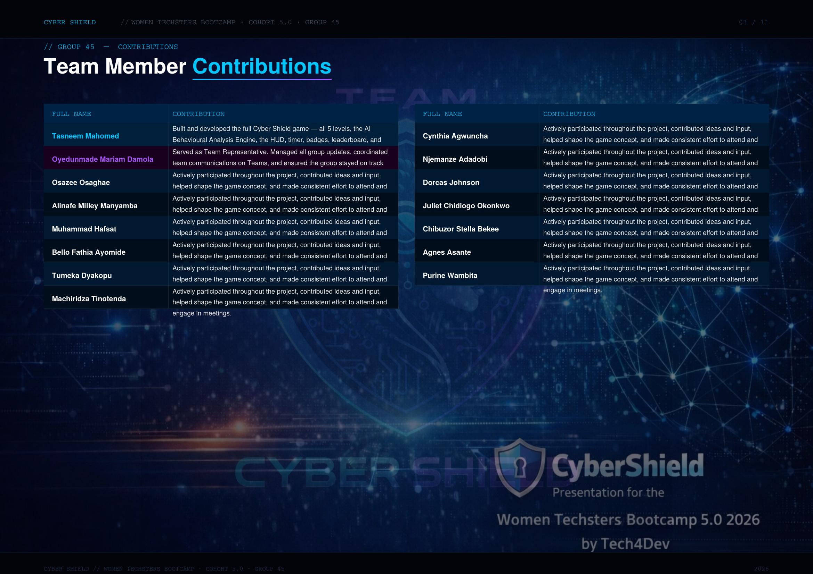
Helen Amuche Okeke Actively participated throughout the project, contributed ideas and input, helped shape the game concept, and made consistent effort to attend and engage in meetings.
Daramola Opeyemi Oyindamolami Actively participated throughout the project, contributed ideas and input, helped shape the game concept, and made consistent effort to attend and engage in meetings.
Odumade Aishat Abiola Actively participated throughout the project, contributed ideas and input, helped shape the game concept, and made consistent effort to attend and engage in meetings.

Slide 4
CYBER SHIELD
// WOMEN TECHSTERS BOOTCAMP · COHORT 5.0 · GROUP 45
03 / 10
// THE PROBLEM
Why Does This Matter?
Online scams are becoming increasingly sophisticated. The human factor remains the weakest link in cybersecurity — and most training is boring, passive, and forgettable.
FINANCIAL LOSSES
Cybercrime costs Africa billions annually through phishing, fraud and identity theft.
HUMAN ERROR
Over 70% of cyber attacks exploit human behaviour — not technical vulnerabilities.
INEFFECTIVE TRAINING
Most awareness training is static, theoretical, and fails to create lasting behaviour change.
"People learn best through realistic, high-stakes experience — not slideshows."

Slide 5
CYBER SHIELD
// WOMEN TECHSTERS BOOTCAMP · COHORT 5.0 · GROUP 45
04 / 10
// OUR SOLUTION
What Is Cyber Shield?
An AI-powered, gamified cybersecurity escape room that builds genuine immunity against scams through simulation.
PHISHING SIMULATIONS
Realistic email, WhatsApp & login scam scenarios.
ESCAPE ROOM GAMEPLAY
5 escalating levels with countdown timer pressure.
AI BEHAVIOURAL ENGINE
Tracks decisions and computes your Human Risk Score.
REAL-TIME FEEDBACK
Instant explanation after every decision with tips.
BADGES & LEADERBOARD
Gamified progression system with achievements.
VIRTUAL STAKES
$50,000 in virtual money at risk — decisions have real cost.

Slide 6
CYBER SHIELD
// WOMEN TECHSTERS BOOTCAMP · COHORT 5.0 · GROUP 45
05 / 10
// GAME DESIGN
5-Level Escape Room
Each level presents a realistic scenario UI with timer pressure, multiple choices, and consequences.
LVL 01
PHISHING EMAIL
Fake PayPal suspension notice
45 sec
LVL 02
FAKE WHATSAPP
'Hi Mum' impersonation scam
35 sec
LVL 03
FAKE LOGIN PAGE
Fraudulent bank portal
40 sec
LVL 04
VISHING CALL
Tax authority arrest threat
30 sec
LVL 05
MULTI-STEP ATTACK
Fake recruitment scam
55 sec

Slide 7
CYBER SHIELD
// WOMEN TECHSTERS BOOTCAMP · COHORT 5.0 · GROUP 45
06 / 10
// AI COMPONENT
Behavioural Analysis Engine
The core AI system that tracks, analyses, and scores every player decision in real time.
01 //
SCENARIO GENERATION
Structured intelligent variation creates realistic phishing emails, scam messages & fake pages across 5 threat levels.
02 //
BEHAVIOURAL ANALYSIS
Monitors click patterns, hesitation time, authority bias, and urgency susceptibility across all decisions.
03 //
HUMAN RISK SCORE
Calculates a personalised risk score (0-100) showing exactly how vulnerable the user is to cyber attacks.
04 //
PERSONALISED TRAINING
Recommends tailored safety tips and security insights based on detected weaknesses after every decision.
HYPER-VIGILANT
CAUTIOUS BUT VULNERABLE
TOO TRUSTING
HIGH RISK BEHAVIOUR
0% wrong — Elite cyber defender
Under 30% wrong — Generally safe
Under 60% wrong — Needs training
60%+ wrong — Highly vulnerable

Slide 8
CYBER SHIELD
// WOMEN TECHSTERS BOOTCAMP · COHORT 5.0 · GROUP 45
07 / 10
// IMPACT & SDG ALIGNMENT
Who Does This Protect?
COMPANIES
Staff cybersecurity awareness and phishing resistance training.
SCHOOLS
Digital safety education integrated into curricula.
FAMILIES
Child online protection & parental scam guidance.
ELDERLY
Accessible scam awareness for the most vulnerable.
SDG 4
QUALITY EDUCATION
SDG 9
INNOVATION
SDG 16
PEACE & JUSTICE
Digital literacy through interactive, gamified learning.
AI-driven cybersecurity training innovation.
Reducing cybercrime by strengthening human defences.

Slide 9
CYBER SHIELD
// WOMEN TECHSTERS BOOTCAMP · COHORT 5.0 · GROUP 45
08 / 10
// AI TOOLS & RESEARCH METHODOLOGY
How We Built This
This project was built using a combination of AI tools, combined research, and collaborative development — each contributing a unique strength to the final product.
CLAUDE (ANTHROPIC)
PRIMARY DEVELOPMENT AI
Frontend development, game logic, Behavioural Analysis Engine, UI/UX design, documentation, and presentation structure.
CHATGPT (OPENAI)
CONTENT & IDEATION
Brainstorming scam scenarios, refining problem statements, drafting initial proposal content and game narrative ideas.
GOOGLE GEMINI
RESEARCH & VALIDATION
Cross-referencing cybersecurity statistics, validating scam patterns, and supporting SDG alignment research across Africa.
GOOGLE RESEARCH
DATA & STATISTICS
Sourcing cybercrime statistics, real-world scam examples, and best practices in cybersecurity awareness training.
COMBINED AI + HUMAN INTELLIGENCE APPROACH
Multiple AI tools were used collaboratively alongside team research and human insight — ensuring accuracy, realism, and impact.

Slide 10





CYBER SHIELD
// WOMEN TECHSTERS BOOTCAMP · COHORT 5.0 · GROUP 45
09 / 10
// FUTURE ROADMAP
What's Next?
_{PHASE 1} Current: 5-level game with Behavioural Analysis Engine — fully functional
_{PHASE 2} Real-time AI via Claude API for dynamic scenario generation
_{PHASE 3} Multiplayer competitive mode — teams compete in real time
_{PHASE 4} School curriculum integration + digital certificate system
_{PHASE 5} React Native mobile app — available on iOS & Android

Slide 11
CYBER SHIELD
// WOMEN TECHSTERS BOOTCAMP · COHORT 5.0 · GROUP 45
10 / 10
// CLOSING STATEMENT
HUMAN FIREWALL
CHALLENGE ACCEPTED
"Cyber Shield doesn't just detect scams — it trains users to resist them."
— TEAM CYBER SHIELD · GROUP 45 · WOMEN TECHSTERS BOOTCAMP · COHORT 5.0 · 2026
github.com/ftlcollective/Cybershield_project_WTB5.0_grp45

