Slide 1
Dueling Network Architectures for Deep Reinforcement Learning
2016-06-28
Taehoon Kim
Fateme Tavakoli

Slide 2
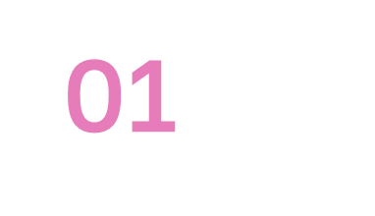
Table of contents
01
Introduction
02
Background
03
Dueling DQN
04
Experiment and results

Slide 3
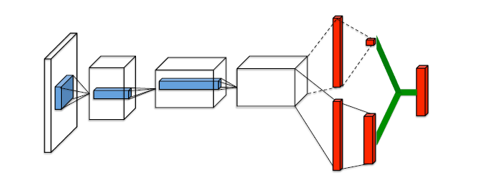
Introduction
Single Q-network with two streams
Produce separate estimations of value func and advantage func
without any extra supervision
Which state are (or are not) valuable without having to learn the effect of each action for each state

Slide 4
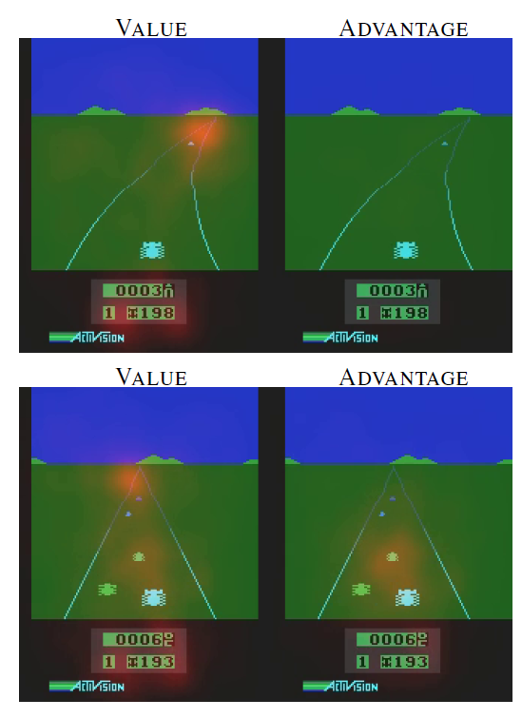
The value stream learns to pay attention to the road and in particular to the horizon.
The advantage stream learns to pay attention only when there are cars immediately in front, so as to avoid collisions.

Slide 5
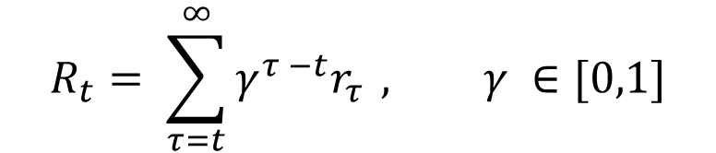
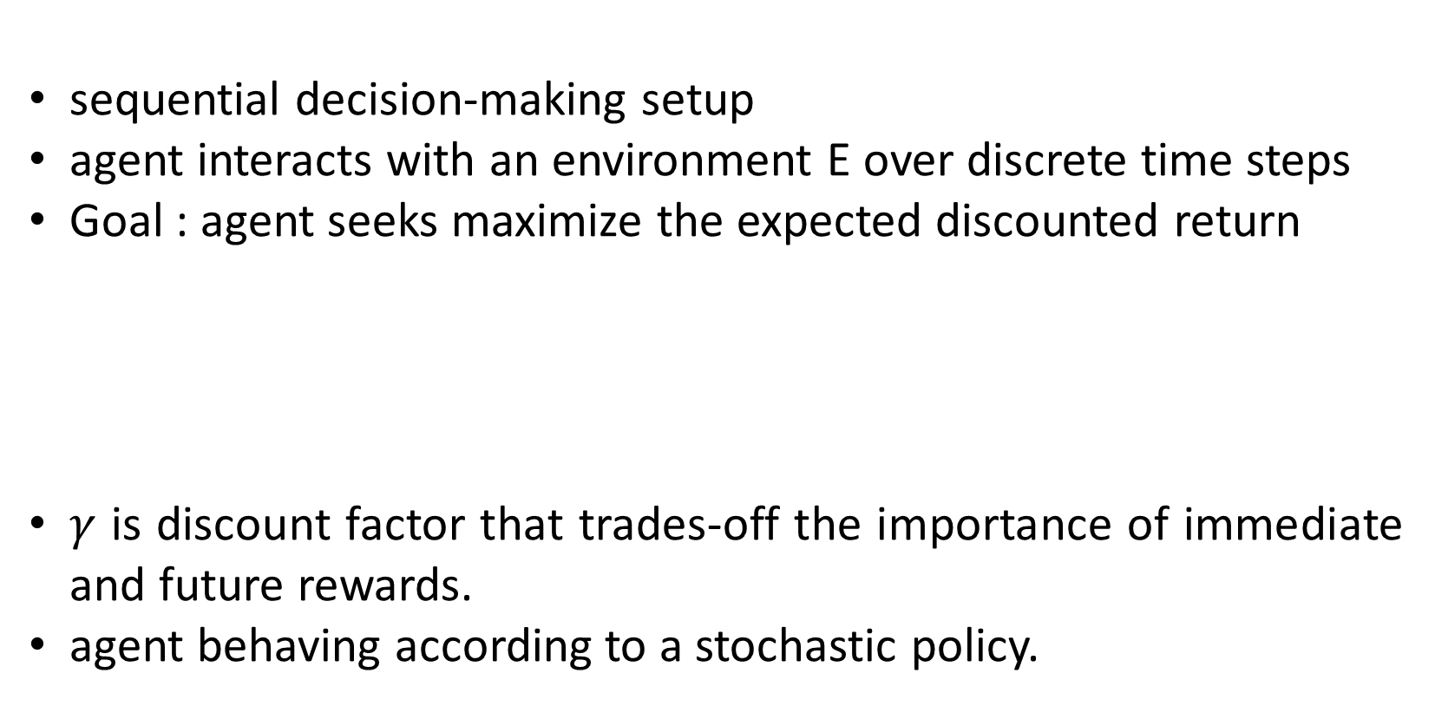
02
Background
sequential decision-making setup
agent interacts with an environment E over discrete time steps
Goal : agent seeks maximize the expected discounted return
$γ$ is discount factor that trades-off the importance of immediate and future rewards.
agent behaving according to a stochastic policy.
$$R_{t}= \sum_{τ=t}^{∞}{γ^{τ −t}r_{τ}} , γ ∈[0,1]$$

Slide 6





02
Background
State-action (Q-value):
State-value :
Q function can compute recursively with dynamic programming :
Optimal Q :
policy

Slide 7



02
Follows:
The optimal Q function satisfies the Bellman equation:
Advantage function:
V(s) measure how good is to be in a particular state s
Q function measure the value of choosing a particular action in this state
Advantage function to obtain a relative measure of the importance of each action

Slide 8
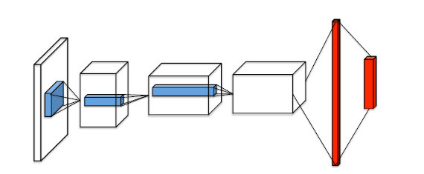
02
Deep Q-networks
Model Free
• states and rewards are produced by the environment
Off-policy
• states and rewards are obtained with a behavior policy (epsilon greedy)
• different from the online policy that is being learned

Slide 9

02
The DQN algorithm is given in the following steps:
1. Initialize the main network parameter 𝜃 with random values
2. Initialize the target network parameter 𝜃′ by copying the main network parameter 𝜃
3. Initialize the replay buffer 𝒟
4. For N number of episodes, perform step 5
5. For each step in the episode, that is, for t = 0, . . ., T-1:
1. Observe the state s and select an action using the epsilon-greedy policy, that is, with probability epsilon, select random action a and with probability 1-epsilon, select the action a

Slide 10



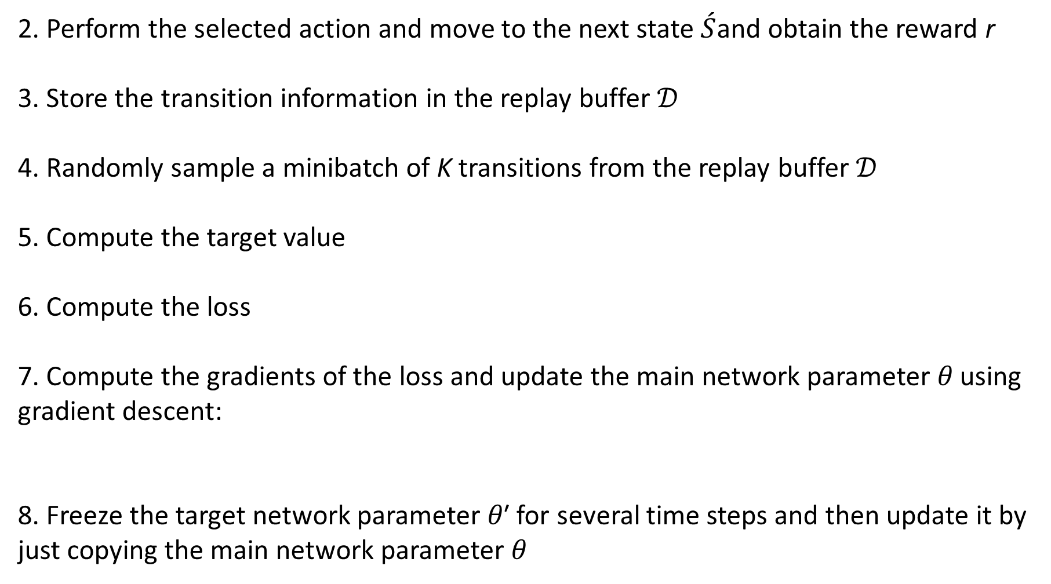
02
2. Perform the selected action and move to the next state $\acute{S}$and obtain the reward r
3. Store the transition information in the replay buffer 𝒟
4. Randomly sample a minibatch of K transitions from the replay buffer 𝒟
5. Compute the target value
6. Compute the loss
7. Compute the gradients of the loss and update the main network parameter 𝜃 using gradient descent:
8. Freeze the target network parameter 𝜃′ for several time steps and then update it by just copying the main network parameter 𝜃

Slide 11
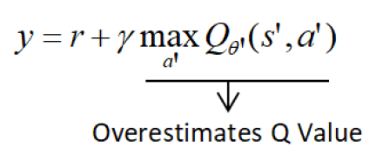

02
Double Deep Q-networks
One of the problems with a DQN is that it tends to overestimate the Q value of the next state-action pair in the target
modifying our target value computation as
As we can observe, now we have two Q functions in our target value computation.

Slide 12
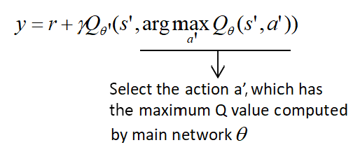
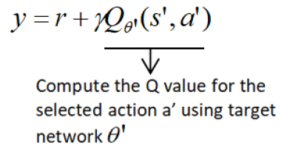
02
Action selection: First, we compute the Q values of all the next state-action pairs using the main network parameterized by 𝜃 , and then we select action 𝑎′, which has the maximum Q value
Q value computation: Once we have selected action 𝑎′, then we compute the Q value using the target network parameterized by 𝜃′ for the selected action 𝑎′:

Slide 13
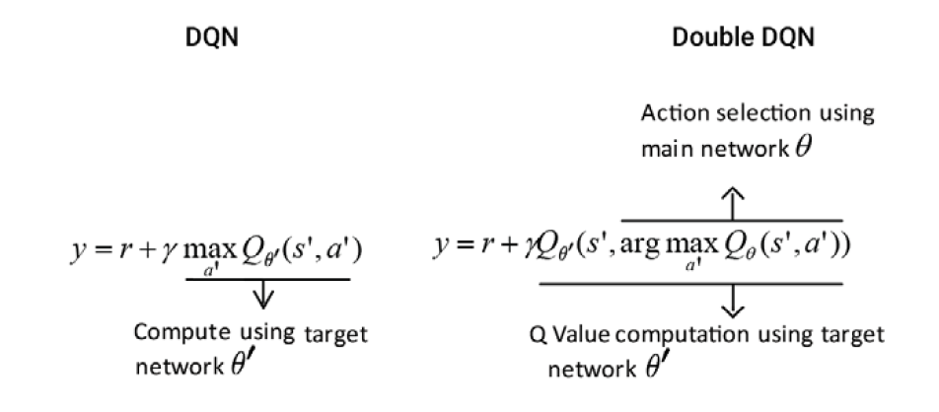
02

Slide 14

02
Prioritized Replay
The TD error 𝛿 is the difference between the target value and the predicted value
A transition that has a high TD error means transition is not correct and need to learn more about that transition to minimize the error.
A transition that has a low TD error implies that the transition is already good.
we also add priority p and store the transition with the priority in our replay buffer as (𝑠,a,r,𝑠′,𝑝 )
We can prioritize our transition using the following two methods:
• Proportional prioritization
• Rank-based prioritization

Slide 15
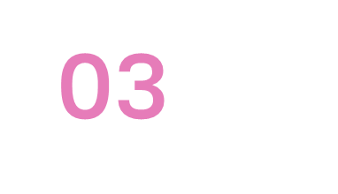


Dueling Network Architecture
For many states
unnecessary to estimate the value of each action choice
For example, move left or right only matters when a collision is eminent
In most of states, the choice of action has no affect on what happens
For bootstrapping based algorithm
the estimation of state value is of great importance for every state
bootstrapping: update estimates on the basis of other estimates.
As mentioned earlier:

Slide 16
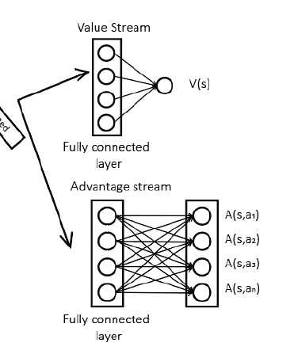
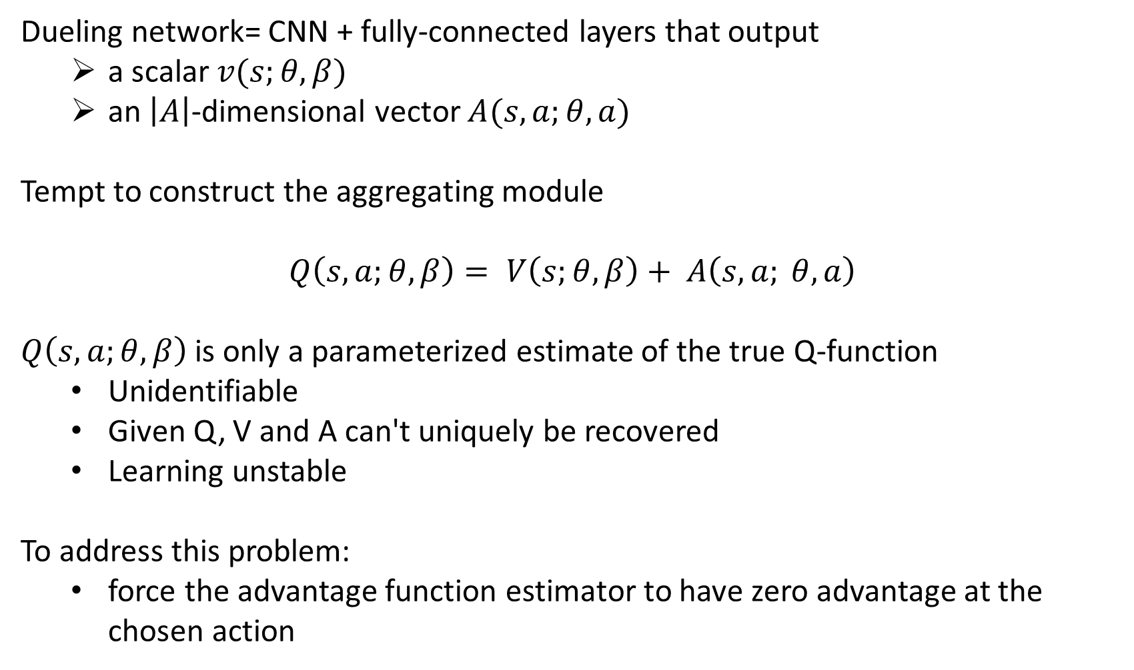
Dueling network= CNN + fully-connected layers that output
a scalar $v(s;θ,β)$
an $\left|A\right|$-dimensional vector $A(s,a;θ,a)$
Tempt to construct the aggregating module
$$Q\left(s, a;θ,β\right)= V\left(s;θ, β\right)+ A\left(s, a; θ, a\right)$$
$Q\left(s, a;θ,β\right)$is only a parameterized estimate of the true Q-function
Unidentifiable
Given Q, V and A can't uniquely be recovered
Learning unstable
To address this problem:
force the advantage function estimator to have zero advantage at the chosen action

Slide 17
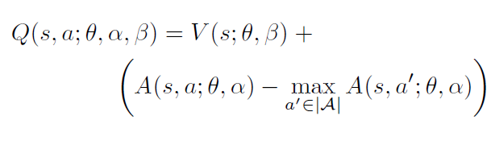



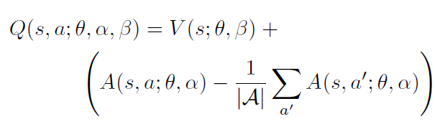
1. Subtract max
2.Subtract average

Slide 18
Subtracting mean is the best
not change the relative rank of A (and hence Q)
Aggregation module is a part of the network not a algorithmic step
training of dueling network requires only back-propagation
Because the output of dueling network is Q function
DQN
DDQN
SARSA

Slide 19
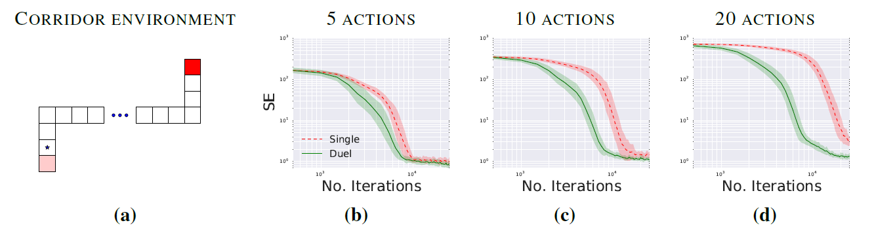
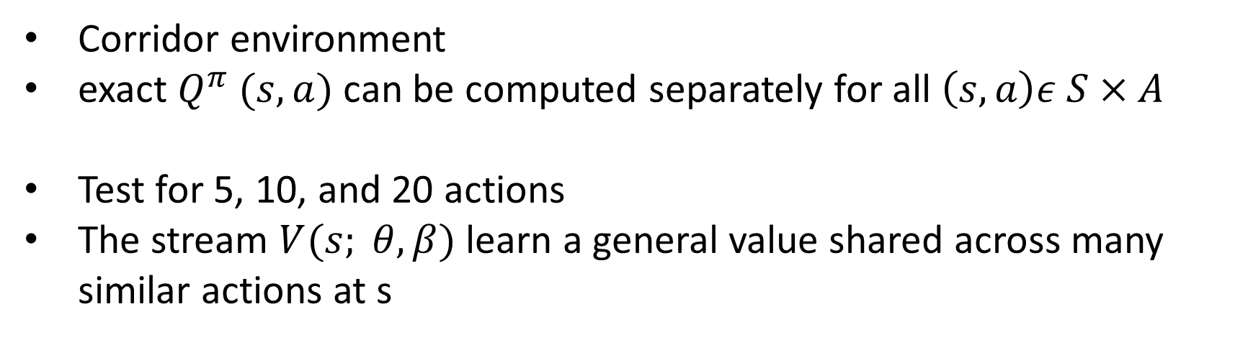
04
Experiment and results
Corridor environment
exact $Q^{π} (s, a)$can be computed separately for all $\left(s,a\right)ε S×A$
Test for 5, 10, and 20 actions
The stream $V(s; θ,β)$learn a general value shared across many similar actions at s

Slide 20
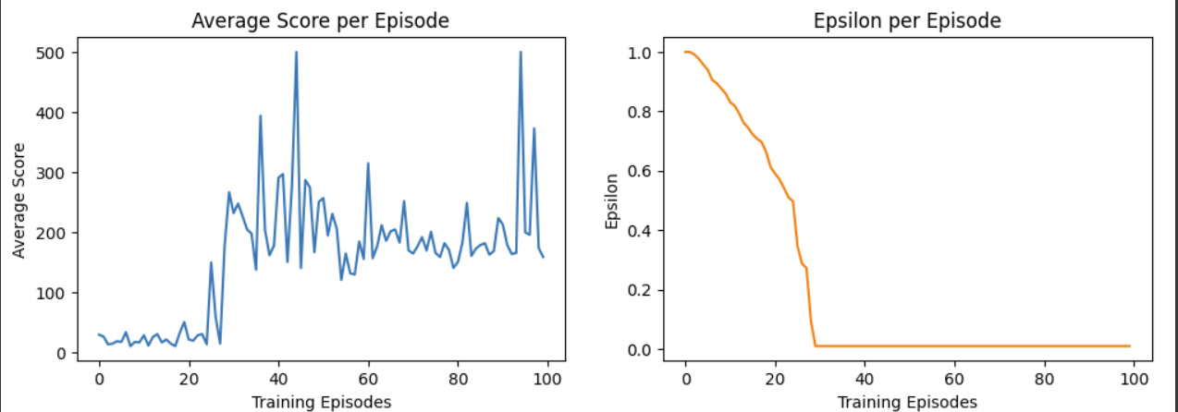
04
Dueling DQN

Slide 21
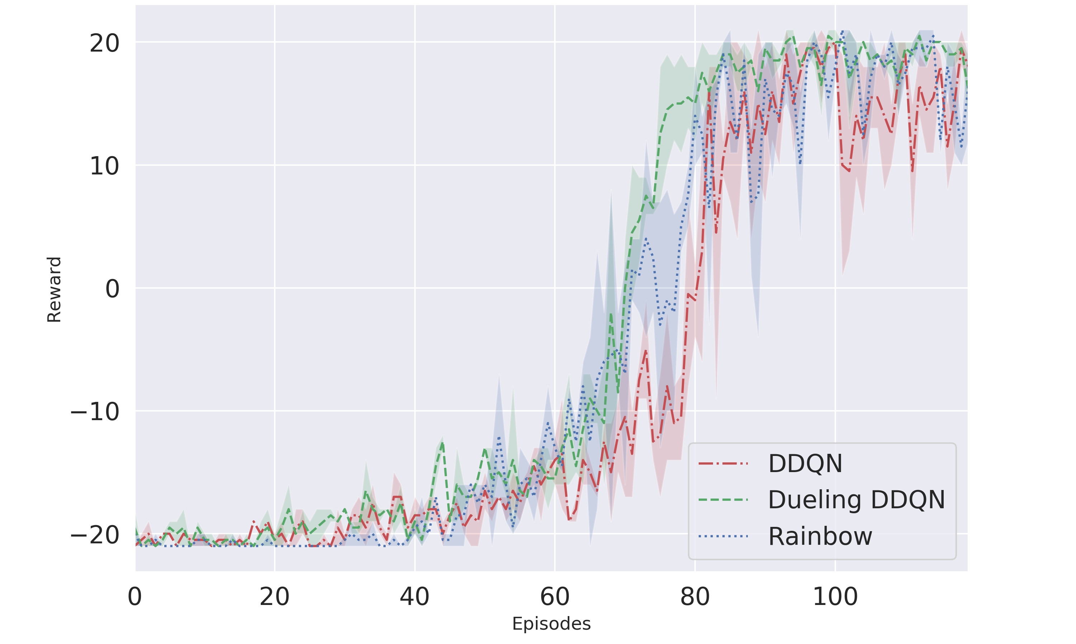
04
DQN vs Dueling DQN and Rainbow

Slide 22
04
Suggestions :
1. Prioritized Experience Replay
2.Combine multiple enhancements, such as prioritized experience replay, double Q-learning, dueling networks, and distributional reinforcement learning, into a single unified framework to leverage the benefits of each approach.
3. Regularization Techniques: Apply regularization methods like dropout or L2 regularization to prevent overfitting and improve generalization.
4. Hyperparameter Optimization: Perform systematic hyperparameter tuning using techniques like grid search, random search, or more advanced methods like Bayesian optimization or genetic algorithms. Tune parameters such as learning rate, batch size, discount factor, and target network update frequency.

Slide 23
References
[Wang, 2015] Wang, Z., de Freitas, N., & Lanctot, M. (2015). Dueling network architectures for deep reinforcement learning. arXiv preprint arXiv: 1511. 06581.
[Van, 2015] Van Hasselt, H., Guez, A., & Silver, D. (2015). Deep reinforcement learning with double O-learning. CoRR, abs/1509. 06461.
[Schaul, 2015] Schaul, T., Quan, J., Antonoglou, I., & Silver, D. (2015). Prioritized experience replay. arXiv preprint arXiv: 1511. 05952.
[Sutton, 1998] Sutton, R. S., & Barto, A. G. ( 1998). Reinforcement learning: An introduction(Vol. 1, No. 1). Cambridge: MIT press.
Book Deep Reinforcement Learning with Python: Master Classic RL, Deep RL, Distributional RL, Inverse RL, and More with OpenAI Gym and TensorFlow, 2nd Edition,2020,Packt Publishing

