Slide 1
Topic and Affiliation Analysis of Publications in Computer Science Field
Fatma Dogan
Sona Hasani
March 8th 2015

Slide 2
Agenda
Objective
Data Collection
Data Analysis
Visualization
Future work
Feedback

Slide 3
Objective
Study the affiliation of the authors of the published papers in Computer science field and find the amount of collaboration between them
Study the keywords of the published papers and retrieve the activity areas of the research organizations
Find the similarity between research organizations based on the keywords of the papers

Slide 4
Phases
Data Collection, Cleaning
Data Analysis
Visualization
Webpage

Slide 5
Data Collection
ACM Digital Library
A crawler was developed in Python using BeautifulSoup Library

Slide 6
Challenges of Data Collection
non-English characters
Null values
Miss-match between number of authors and affiliations
Limits on the amount of data that can be collected
Multiple name formatting for a single affiliation

Slide 7
Collected Data
In total we collected the information of 74316 papers which is 1/6 of the total papers in ACM digital library today.
Total number of papers in ACM: 430,000

Slide 8
Collected Data
VLDB : 2352
KDD : 2457
SIGMOD/POD : 507
CIKM : 4692
SIGMOD : 3116
PODC : 1638
ANLC : 291
WWW : 3392
ISSS : 360
SIGIR : 3450
GIS : 1204
SIGGRAPH : 11135
SIGDOC: 1046
POPL:1706
ICCAD:3024
LNCS:19993
HPDC: 1202
ICSE : 7245
ISCA : 1780
ICMI : 1122
ICS : 1307
CCS : 2194

Slide 9
Data Sample
journal_name: Null
publisher_name: ACM
Authors: Fram, David M.; Almenoff, June S.; DuMouchel, William
Title: Empirical Bayesian data mining for discovering patterns in post-marketing drug safety
Date: 8/24/2003
Volume:Null Issue:Null Issn:Null
first_page: 359 last_page: 368
Keywords: association rules; data mining; empirical Bayes methods; pharmacovigilance; post-marketing surveillance
author_info: ['David M. Fram', '81546930756', 'June S. Almenoff', '81100442362', 'William DuMouchel', '81100642918']
affiliation_info: ['GlaxoSmithKline, Research Triangle Park, NC', '60020649', 'AT&amp;T; Shannon Laboratory, Florham Park, NJ', '60008383']
Tags:['association rules', 'data mining', 'data mining', 'empirical bayes methods', 'pharmacovigilance', 'post-marketing surveillance', 'scientific databases']

Slide 10
Data Preparation
Removed 11247 records with no affiliation information.
Combined keywords and tags associated with each paper and removed the duplicates.
The different departments of the same organization share the same unique ID associated with that organization.

Slide 11
Data Analysis
Collaboration
Similarity

Slide 12
Collaboration
Most collaborative organizations
Count the papers that are published in collaboration with other organizations
Count the papers that are published with collaboration of both organizations

Slide 13
Most Collaborative
 | Organization Name | Published papers | Collaborated papers
1 | Microsoft Research | 1169 | 835
2 | Carnegie Mellon University | 1407 | 665
3 | IBM Thomas J. Watson Research Center | 949 | 615
4 | U. C. Berkeley | 855 | 441
5 | Stanford University | 900 | 433
6 | University of Illinois at Urbana-Champaign | 918 | 432
7 | International Business Machines Corporation | 674 | 406
8 | Microsoft Research Asia | 457 | 396
9 | Microsoft Corporation | 598 | 389
10 | M.I.T. | 725 | 378

Slide 14
Similarity

Slide 15
Keywords Vector
Vector of keywords for each affiliation
Value for each keyword calculated with TF-IDF value
Keyword TF-IDF value = log (1+ Keyword frequency) X log(Total Organizations/ Related Organizations)

Slide 16
Keyword frequency: number of the papers containing this keyword that is published by organization X.
Total Organizations: total number of the organizations (3371)
Related Organizations: number of the organizations that have published at least one paper containing the keyword

Slide 17
Sample Vector
{'learning': 3.4167411292366348, 'database applications': 3.316248743082616, 'data mining': 1.2943521879888784, 'selection process': 4.926078230015925, 'concept learning': 13.009898915170263, 'design': 1.076110408677922, 'software engineering education': 21.590896071984695, 'measurement': 1.3023285422348032, 'management': 1.3913285031660745, 'biology and genetics': 5.899837880135352, 'uml': 7.5168304843205975, 'languages': 1.6753914058958146, 'unified modeling language': 63.42325721145504, 'object-oriented programming': 9.142091129579105, 'performance': 1.501738613522447, 'life and medical sciences': 59.692477375487094, 'theory': 1.4868455903051732, 'curriculum': 13.009898915170263, 'case tools': 112.75245726480895, 'query formulation': 2.8910886478156144, 'human factors': 1.5230830962689226, 'learning styles': 507.3860576916403, 'algorithms': 0.6264025403600497, 'computer-aided software engineering': 13.713136694368657}

Slide 18
Similarity Results
Organization 1 | Organization2 | Similarity %
Microsoft Research | Microsoft Corporation | 2.86479255
Microsoft Research | University of Washington | 1.420650028
Microsoft Research | University of Illinois at Urbana-Champaign | 1.384128809
Microsoft Research | Carnegie Mellon University | 1.260034066
Microsoft Research | University of Washington | 1.051137762
Microsoft Research | Stanford University | 0.784094234
Microsoft Research | Georgia Institute of Technology | 0.75474802
Microsoft Research | Microsoft Research Ltd. United Kingdom | 0.705397517
Microsoft Research | U. C. Berkeley | 0.60524045

Slide 19
Visualization
Bootstrap for creating the website
D3 for our graphic visualization
Collaboration
Most collaborative universities
Collaborations over 10 papers
Similarity
10 most similar universities

Slide 20
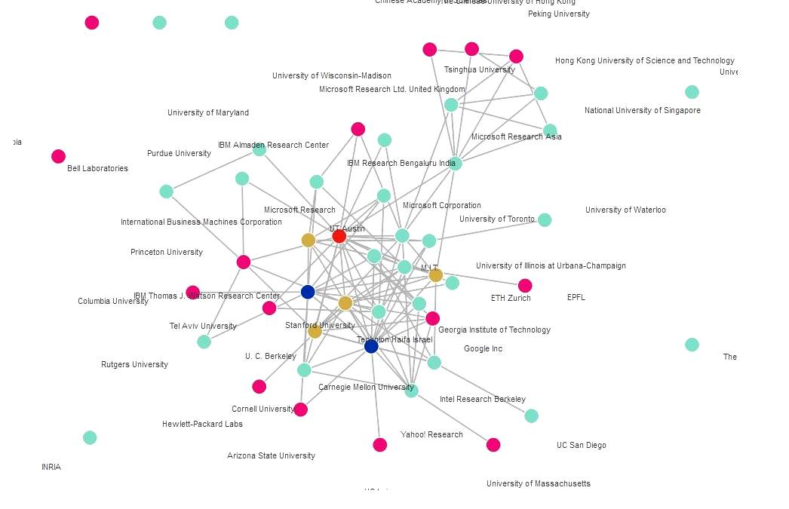


Slide 21
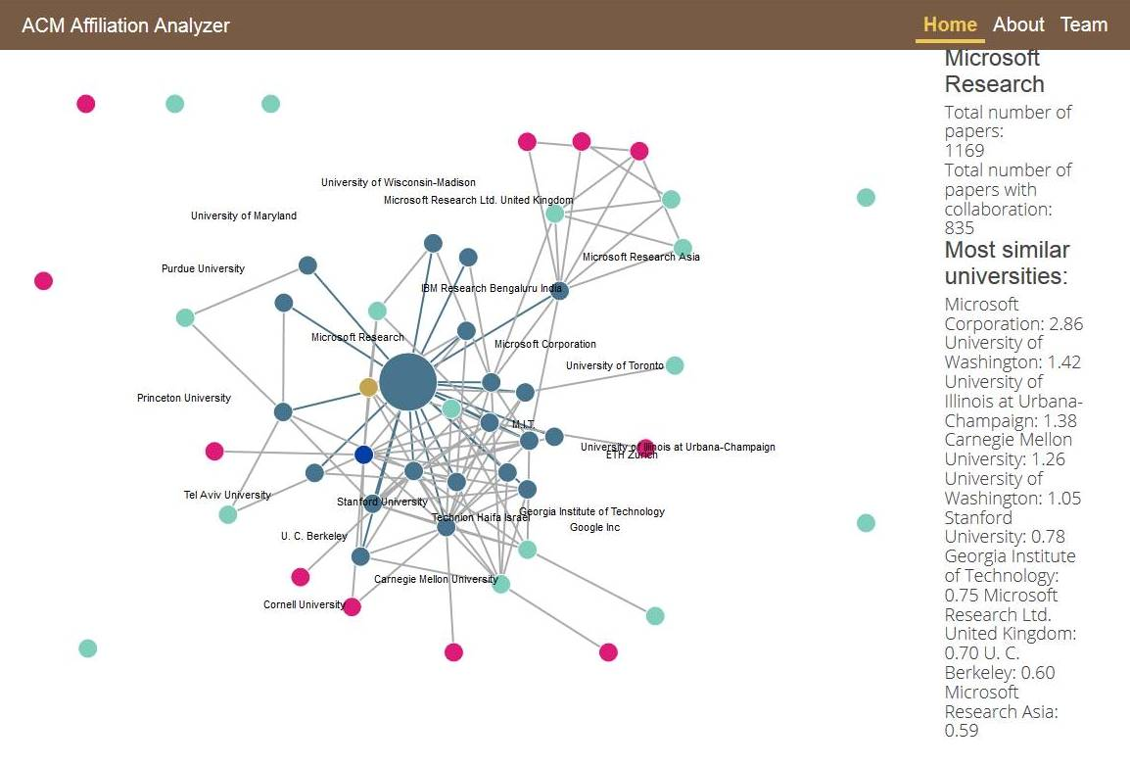

Slide 22
Interesting Results
The most similar organization to Microsoft research is Microsoft Corporation
IBM Corporation has significantly high collaboration with IBM Almaden Research
University of Waterloo and University of Toronto have high collaboration (Both in Canada)

Slide 23
Future Work
Study the specialized research collaboration on different research areas.
Study the relationship between the collaboration and physical distance of the organizations
Find the connected components or semi connected components in the graph to find the group of organizations that are most likely to collaborated with each other than other organizations.

Slide 24
Thank You.

