Slide 1

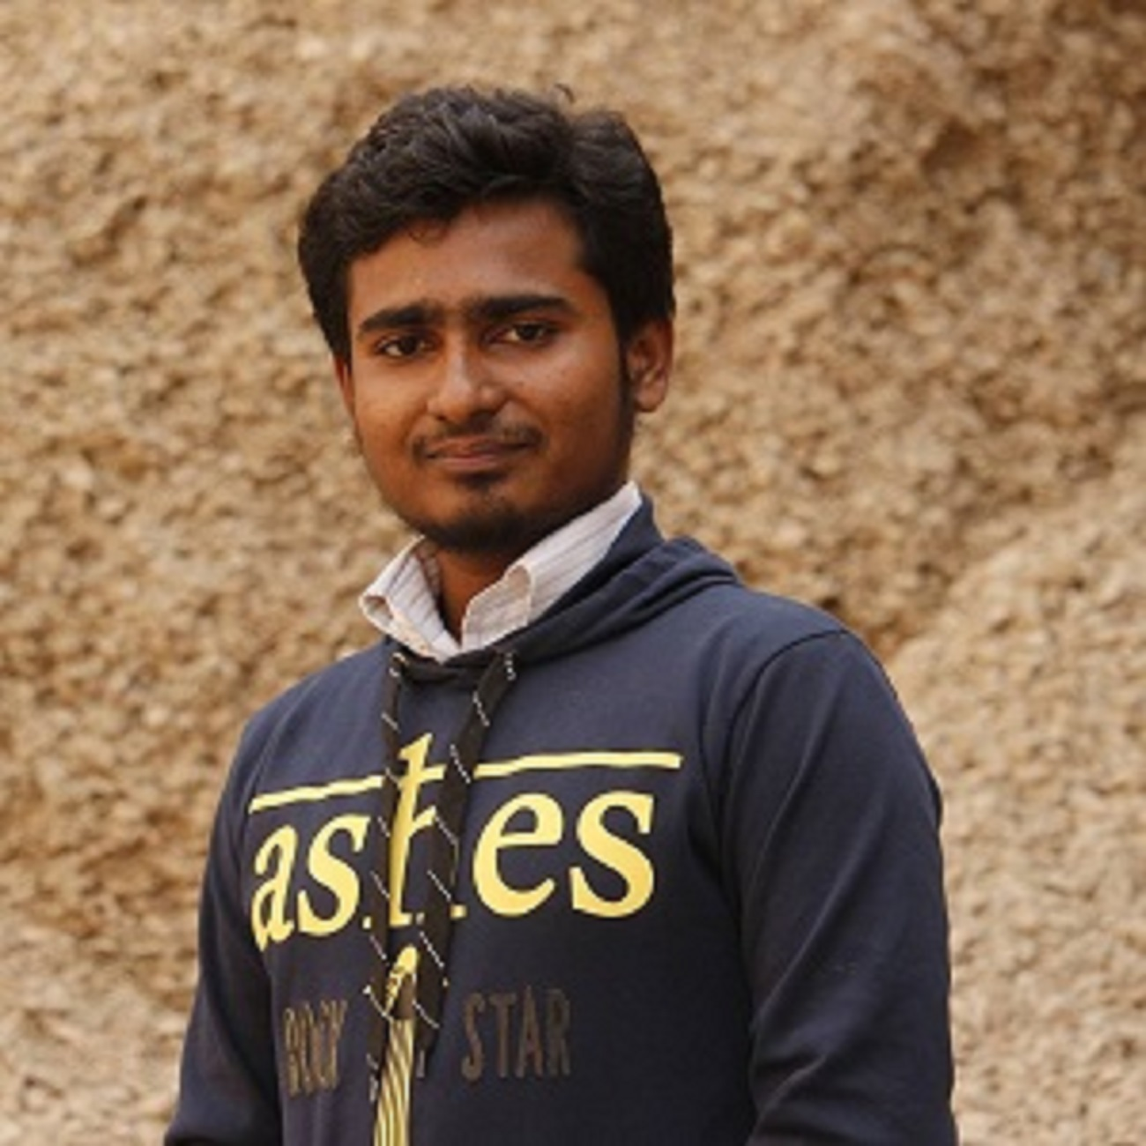
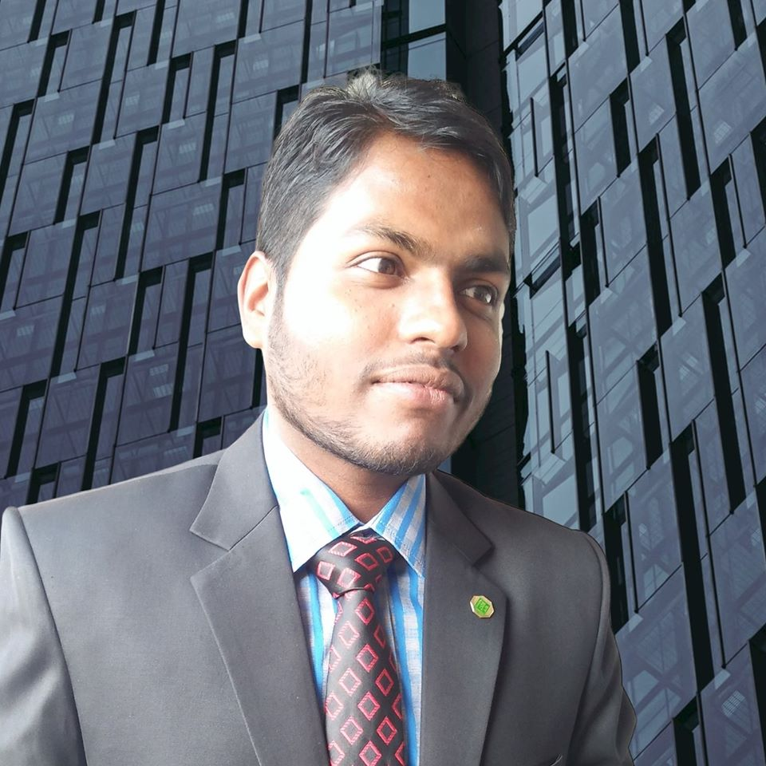
Team Name : Omolin
Nahid Hassan Polok
Undergraduate Student,
University of Rajshahi
Md. Mustafizur Rahman
Undergraduate Student,
University of Rajshahi
Md Fatin Ishmam
Undergraduate Student,
University of Rajshahi

Slide 2
Topic: Health Risk & Toxic Effluent Monitoring System in Tannery

Slide 3



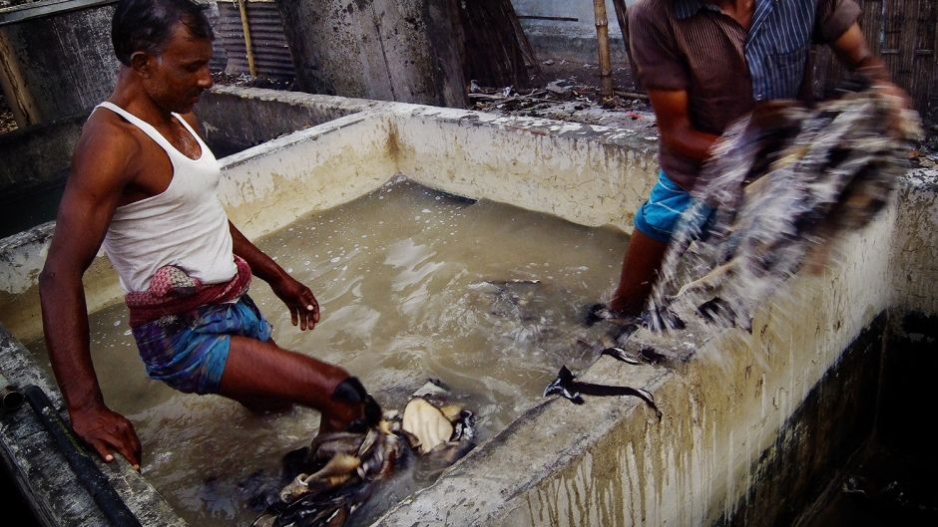

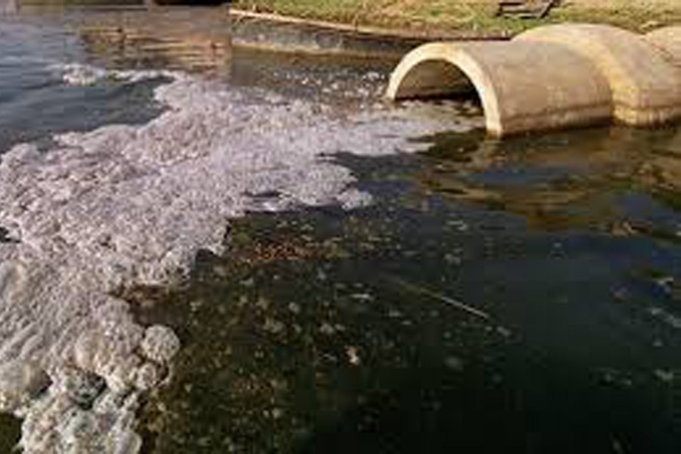
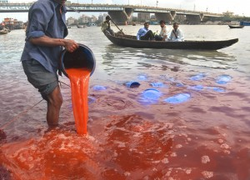
Problematic Scenario
around 75k workers
160 tanneries
BUT
Most of them work in hazardous environment without proper safety Measures
Sometimes Waste are dumped untreated

Slide 4


Slide 5
Our Solution for Health Risk Minimization
Every toxic chemical has a TLV-Ceiling Limit
Main Working Principle:
It is the maximum level of exposure to a chemical substance day after day without suffering any adverse effects
Entry of Worker
Detection of Worker in Each House
Start Timer
Can Continue Working
No
TLV-C Exceeds?
Yes
Notify Authority

Slide 6

Our Solution (Example)
Authority Ends Monitor
Worker No. | Chemical TLV-Ceiling Limit | Time Expend | Remaining Time
Worker 1 | Cr+ (8h/day) | 2 | 2
 | … | … | ..
Worker 2 | Cr+ (8h/day) | 4 | 0
 | … | … | ..
Worker 3 | Cr+ (8h/day) | 3 | 1
 | … | … | ..
Worker 1
Detector
Worker 3
Worker 2
Tanning House

Slide 7
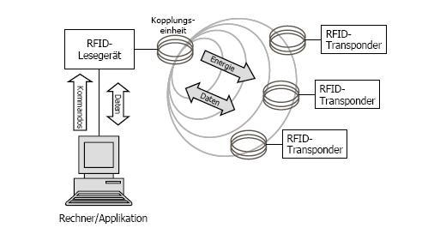
Our Technology in Health Risk Minimization
Detector
Worker End
Authority Ends Monitor

Slide 8


Our Solution for Toxic Effluent Monitoring
Discharge of Effluent
Sensing of Effluent Chemical Constituent
Effluent Constituents safety level exceed?
No
Yes
Notify Corresponding Authority

Slide 9

Our Solution for Toxic Effluent Monitoring
Monitor
Compound Name. | Discharge Amount | Safe Amount
Cr(vi) | ……….. | …........
NaCl | …........ | …........
……… | …........ | …........
………. | …........ | …........
Receiver
Tannery
Sensor

Slide 10
FINANCE & MARKETING
Estimate Budget (For 100 workers & 10 house)
Revenue Plan
Device | Price in BDT (approx.)
Processor (Raspberry Pi-4) | 6,666.00
RFID Receiver (per house) | 200 *10
RFID active tags(per worker) | 100*100
Sensors | 10,000.00
Wireless Connection | 5,000.00
Server | 3,000.00
Unit Cost | 36,666.00
Installation Cost | 100,000.00
Maintenance (per year) | 120,000.00
Total | 256,666.00
Approximate Selling Price | 555,000.00

Slide 11
SWOT ANALYSIS
STRENGTH
WEAKNESS
New System
Low durability in highly chemical Environment.
Simple Technology
Our diversity in technical background
Ease of installation
OPPORTUNITY
THREAT
Cost Efficient
Competitor Advantage
Human Resource
Industrial Automation
Need of regulation

Slide 12
Expectation from the Startup Bangladesh- iDEA project

Slide 13


