Slide 1
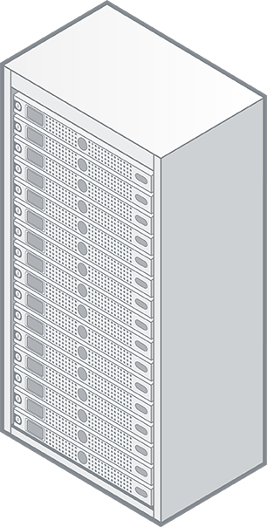
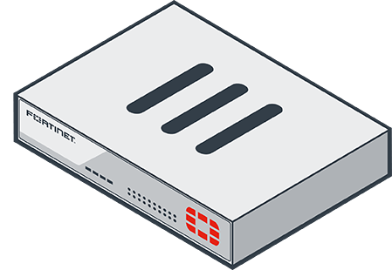

Scenario: Malicious URL Access Protection
Client attempts to access a website via the FortiGate.
FortiGate uses FortiGuard to rate the URL, which returns an Unrated verdict. The FortiGate blocks the traffic.
User requests the URL be recategorised which notifies FortiSOAR.
FortiSOAR requests categorisation by 3rd Party CTI
FortiSOAR determines the URL category either automatically or manually and updates the FortiGate’s Block or Allow list automatically.
3rd Party CTI
4
Web Server
Internet
2
5
FortiSOAR
Infrastructure
3
FortiGate
1
Client Machine
Client Network

