Slide 1

Overall Topology
DMZ
INTERNET
3rd party Device
FortiGate-Edge:
10.200.3.1/24
FortiSIEM
FortiSOAR
Customer Network
10.200.3.0/24
SoC

Slide 2
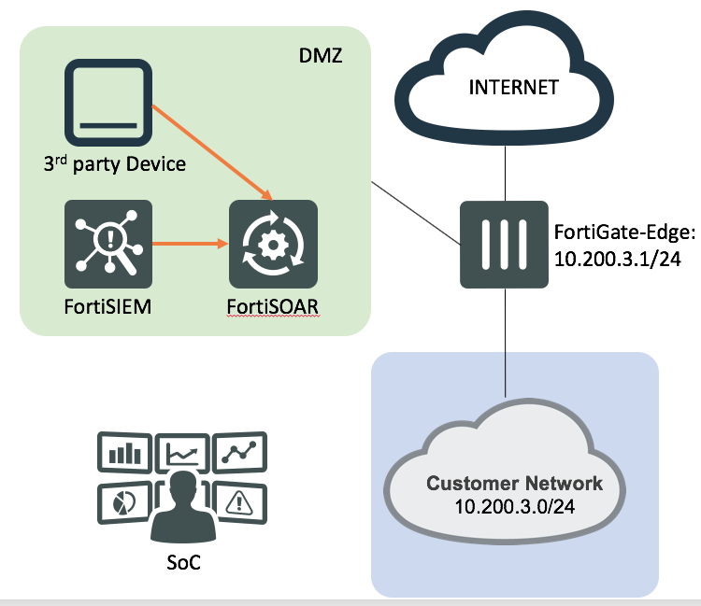
Use Case Components
Use Case Title: Multi-stage APT data exfltration
Use Case Description: An Attacker compromises an web server
After successfully identifying a vulnerability via a web scanner.
The attacker then drops a malware on the compromized server
And sends a Phishing email to the employees with a link to the
Dropped malware file.
Template File
Description Image/Video
Loop: Step trigger / Description
Diagram/Video
Step1:
Web scanner alert: Show the alert details
Step2:
Remote Exploit: show alert/run investigation playbook1

