Slide 1
BePretty
By Faith Too
Almodad Mutinda
Patricia Chebet

Slide 2
Abstract
BePretty is an application that connects clients to beauty artists.
Currently clients depend on referrals by friends to beauty artists who can provide the services they need and this at times is not assured.
It provides a platform for beauty artists to display their previous work and location making it possible for clients to find and book for best beauty services around them.

Slide 3
Background
It is the desire for any lady to look good and presentable and therefore a platform that enables them to find the best beauty services will be of benefit to them.

Slide 4
Problem
Clients find it hard getting quality beauty services within their location e.g. braiding, manicure, pedicure, massage, makeup.

Slide 5
Solution
BePretty is an Application that will contain the following features:
Portfolio creation and display.
Search for beauty artists based on location and beauty service.
Booking of beauty services.
Rating and review of beauty artists.

Slide 6
Architecture
Server
Web service
iOS Application
Database

Slide 7
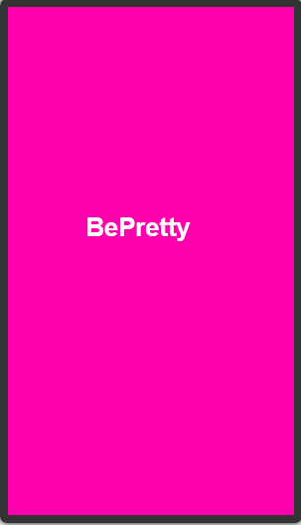
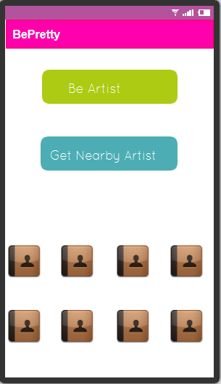

Slide 8
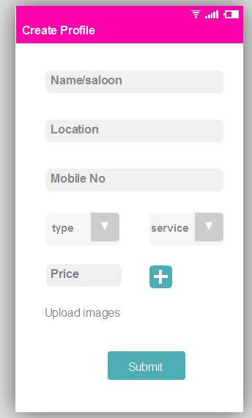
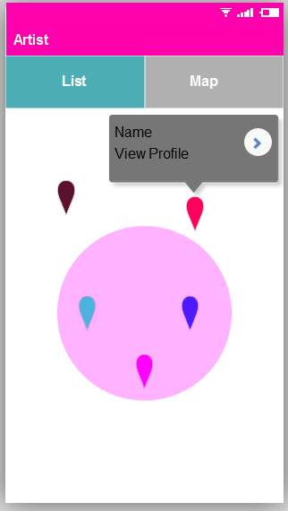

Slide 9
