Slide 1
Fault-tolerant dataflow platform
Federico Toschi, Claudio Galimberti and Davide Giannubilo

Slide 2
Agenda
Introduction
Network configuration
Fail/Restart management
Ping messages
Data elaboration
ChangeKey function
Termination conditions & protocol
Performance
Conclusion

Slide 3
Introduction
The goal of the project is to implement a distributed dataflow platform for processing large amount (big-data) of key-value pairs, where keys and values are integers.
The platform includes a coordinator and multiple workers running on multiple nodes of a distributed system.

Slide 4
Introduction
It is capable of running programs composed of a combination of 4 operators:
map(f: int → int): for each input tuple <k, v>, it outputs a tuple <k, f(v)>
filter(f: int → boolean: for each input tuple <k, v>, it outputs the same tuple <k, v> if f(v) is true, otherwise it drops the tuple
changeKey(f: int → int): for each input tuple <k, v>, it outputs a tuple <f(v), v>
reduce(f: list<int> → int): takes in input the list V of all values for key k, and outputs a single tuple <k, f(V)>

Slide 5
Introduction
The coordinator accepts dataflow programs specified as an arbitrarily long sequence of the above operators. It assigns individual tasks to workers and guides the computation.

Slide 6
Introduction (assumptions)
Workers may fail at any time, while we assume the coordinator to be reliable.
Network links, when present, are reliable. The same for the storage of each node.
You may assume input data to be stored in one or more csv files, where each line represents a <k, v> tuple.
You may assume that a set of predefined function exists and they can be referenced by name (for instance, function ADD(5) is the function that takes in input an integer x and returns integer x+5)

Slide 7
Network configuration
Full mesh topology
One leader node and a fixed number of worker nodes.
The first outbound port of each worker is connected to the leader
We have also established some parameters:
numWorkers
batchSize
failureProbabilty

Slide 8
Fail/Restart management
The return value of the Bernoulli function, which has the crash probability as parameter, determines the failure. If it is true, the worker fails and deallocates all its variables, if it is false, the computation goes ahead
The restart is done by using a “restartMessage”
When a worker receives a “restartMessage”, it starts to reinitialize itself, resetting all the variables and copying the entire schedule and recover the execution from the line of the file where it crashed.

Slide 9
Ping messages
To ensure correctness and reliability:
Leader node sends every fixed amount of time a ping message to all workers
They respond to it with an ACK
If they do not respond within a time window, the leader sends a “restartMessage” as mentioned before

Slide 10
Data elaboration
There are two modules, “BatchLoader” and “InsertManager”, that respectively handles local data and changeKey data
Self-message have been used to achieve a full temporized operations
Each self-message causes the execution of one operation on one data point
This enables workers to handle incoming messages during the elaboration (non-blocking execution)
Failure probability for each operation

Slide 11
changeKey function
DataInsert message is used to send a data point between two workers
With information about the current schedule step and an incremental requestID
The sender sets a timeout and sends the message until the receiver sends back an ACK
The receiver check for duplicate using the requestID: if there is no duplicate, it goes ahead persisting the new entry on a file
If a worker crashes during a batch of changeKey data and receives more data, it must recover the initial batch without the new data (avoid duplication)
changeKey formula
int ckValue = data % (static_cast<int>((1/(probability)) * numWorkers));

Slide 12
Termination conditions
Leader manages the evaluation of the termination conditions
All workers have finished their local elaboration
The number all changeKey sent and received by the workers, in total, must be the same
Checking that there is no pending changeKey messages from crashed workers

Slide 13
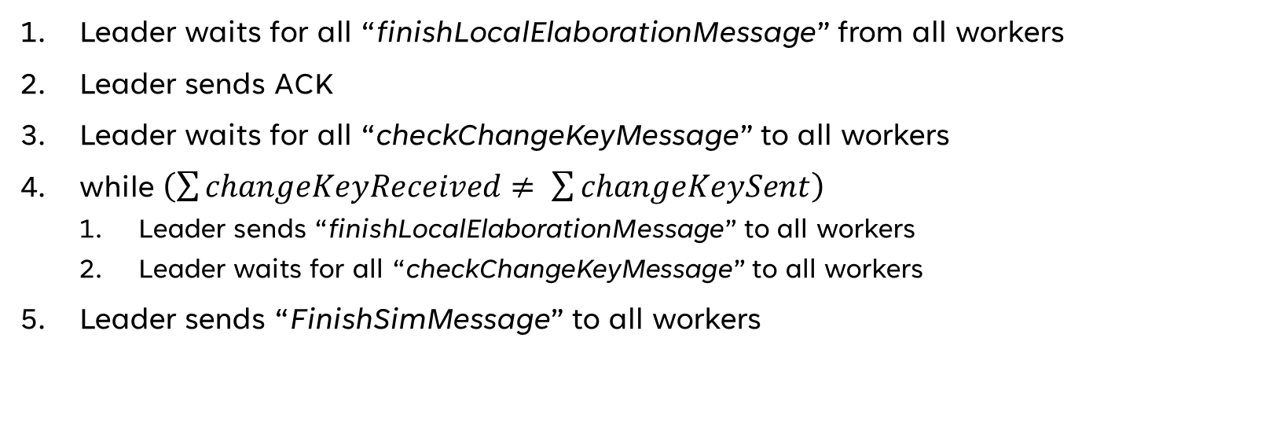
Termination protocol
Leader waits for all “finishLocalElaborationMessage” from all workers
Leader sends ACK
Leader waits for all “checkChangeKeyMessage” to all workers
while $\left(\sum{changeKeyReceived≠ \sum{changeKeySent}}\right)$
Leader sends “finishLocalElaborationMessage” to all workers
Leader waits for all “checkChangeKeyMessage” to all workers
Leader sends “FinishSimMessage” to all workers

Slide 14
Performance

Slide 15
Timeline
Schedule-level temporization
No self-message
Batch-level temporization
One self-message per batch
Full temporization
One self-message per operation per data point

Slide 16
Conclusion

Slide 17
Thank you
Federico Toschi
Claudio Galimberti
Davide Giannubilo

Slide 18
Primary goals
Annual revenue growth

Slide 19
Areas of growth
 | B2B | Supply chain | ROI | E-commerce
Q1 | 4.5 | 2.3 | 1.7 | 5.0
Q2 | 3.2 | 5.1 | 4.4 | 3.0
Q3 | 2.1 | 1.7 | 2.5 | 2.8
Q4 | 4.5 | 2.2 | 1.7 | 7.0

Slide 20
Business opportunities are like buses. There's always another one coming.
“
”
Richard Branson

Slide 21




Meet our team
Takuma Hayashi
Mirjam Nilsson
President
Chief Executive Officer
Flora Berggren
Rajesh Santoshi
Chief Operation Officer
VP Marketing

Slide 22








The full team
Takuma Hayashi
Mirjam Nilsson
Flora Berggren
Rajesh Santoshi
President
Chief Executive Officer
Chief Operations Manager
VP Marketing
Graham Barnes
Rowan Murphy
Elizabeth Moore
Robin Kline
VP Product
SEO Strategist
Product Designer
Content Developer

Slide 23
Plan for product launch
Deploy strategic networks with compelling e-business needs
Planning
Synergise scalable e-commerce
Marketing
Disseminate standardised metrics
Design
Co-ordinate
Foster holistically superior methodologies
Launch
Strategy
e-business applications
1
2
3
4
5

