Slide 1
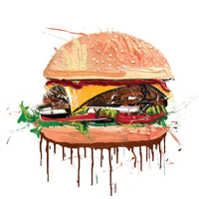
Food Order Center
Mid Semester Presentation. (WHO)
Developers: Hila Mefano, Dror Baum
Supervise : Genady Paikin
20.12.2012

Slide 2
Overview
WHY - motivation
WHAT - use cases
HOW
Google App Engine
Google Web Toolkit
Android SDK
System Diagram
High Level Class Diagrams
WOW – demonstration
WHEN – gnatt
WHERE - links

Slide 3
Motivation (WHY)
Company employees can order their food easily.
Simplify the process of money handling for both the companies and the restaurants.
Free of service charges for this client server application.
Free Android SDK
Free Google services will be used as much as possible.

Slide 4
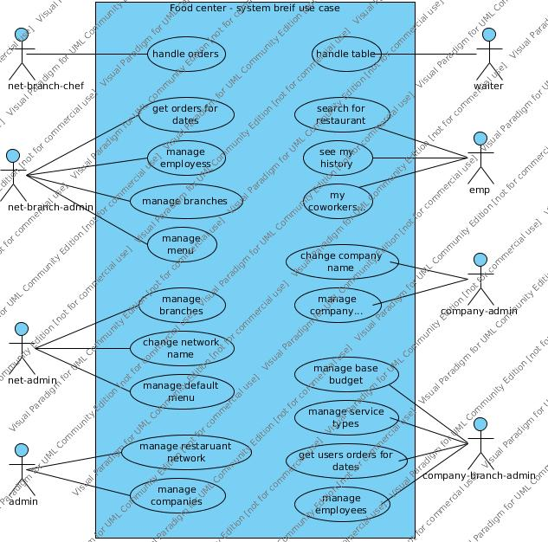
USE CASE DIAGRAm (WhaT)

Slide 5
Google APP EnginE (HOW)
Free JAVA servlet container.
Easy development.
Eclipse plugin.
Big web community.
Easy to access Admin panel.
Easy integration with other Google services.
Google Data store.
Google user verification.
Google Cloud Messaging

Slide 6
Google Data store (HOW)
Free Data Base.
Easy development.
Native java driver
JDO implementation
JPA implementation
Easy integration with Google App engine.

Slide 7
GOOgle web toolkit (HOW)
Free Light weight RPC for web client and Android applications.
Easy to create Dynamic HTML pages – without the use of AJAX and JAVASCRIPT and minimal HTML scripting.
Easy Development integration
Eclipse plugin

Slide 8
Android sdk (HOW)
Easy development integration
Eclipse plugin
Huge web community.
Every Android phone is already associated to a Google account.

Slide 9
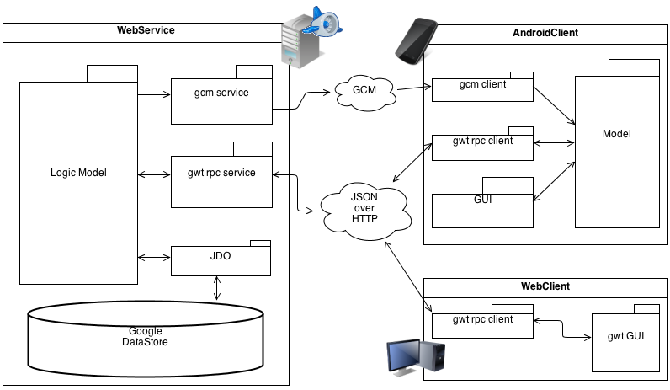
System diagram (HOW)

Slide 10
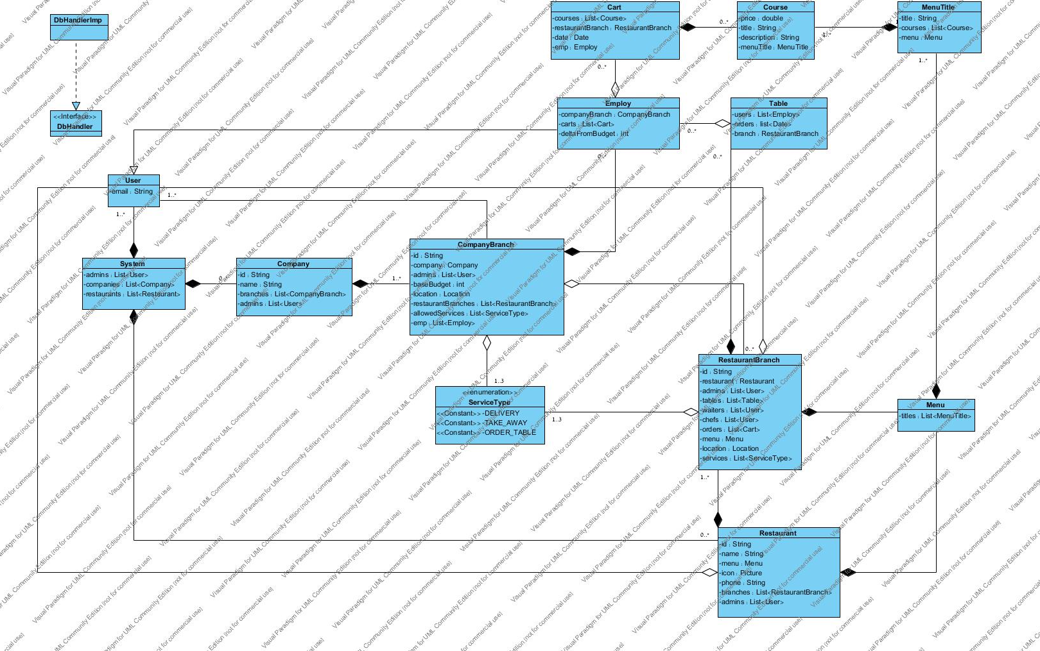
High level db class diagram (HOW)

Slide 11
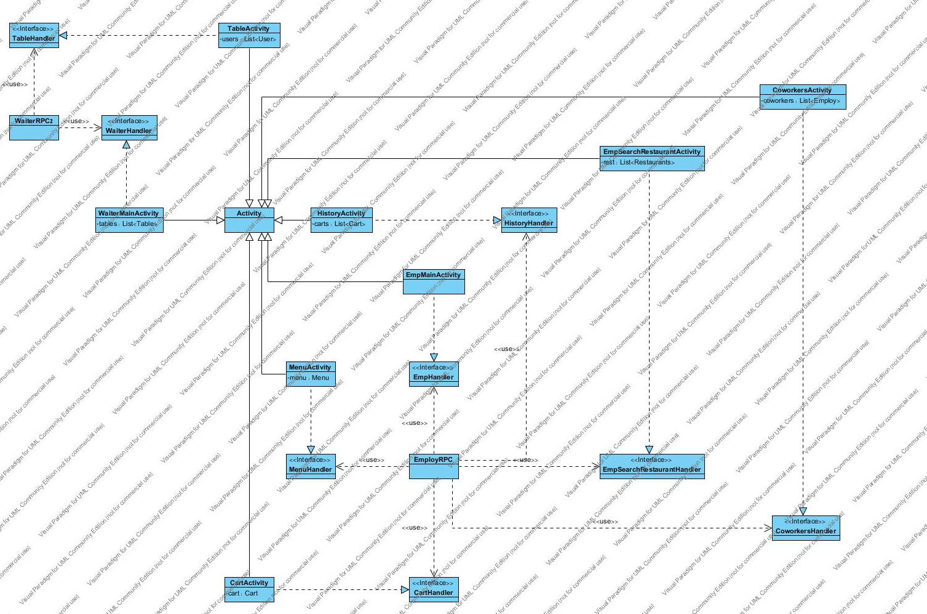
HIGH level android class diagram(how)

Slide 12
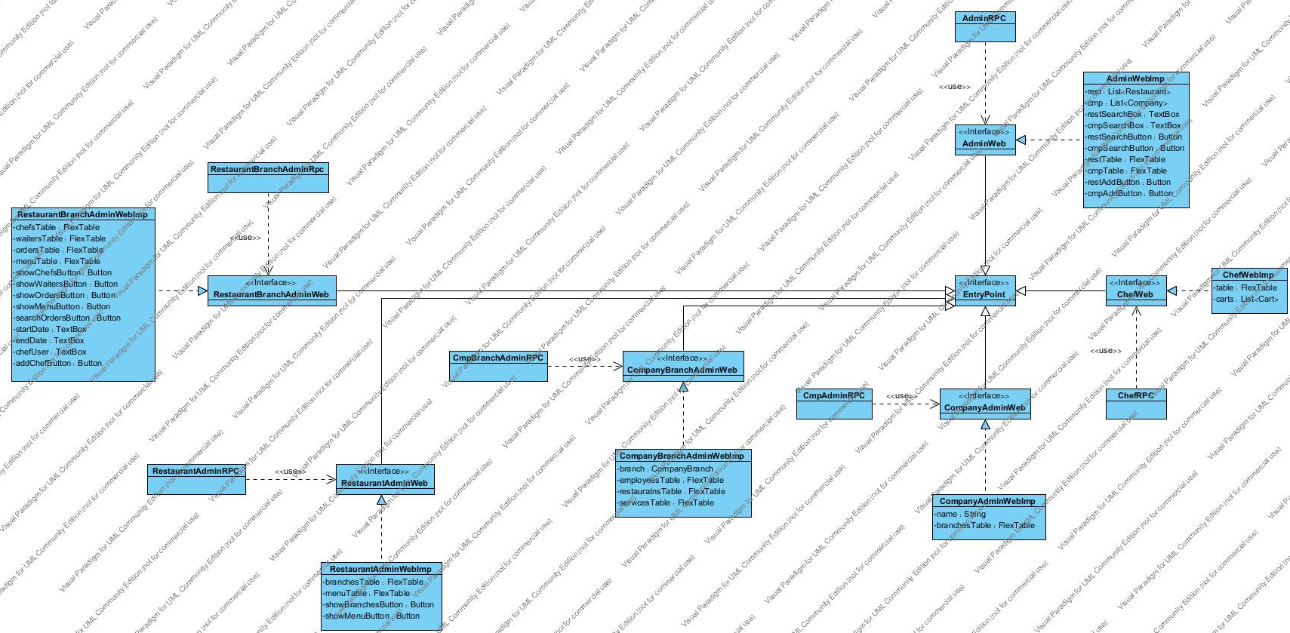
High level web class diagram (HOW)

Slide 13
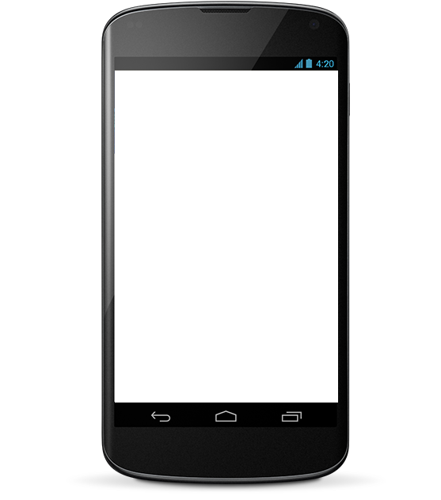
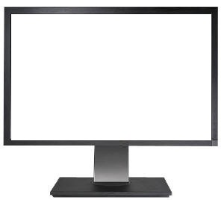
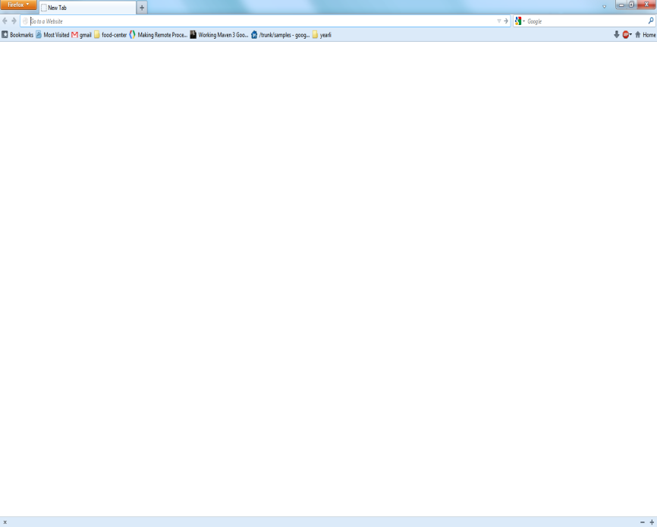

App Demonstration (WOW)
Internet
Welcome to food order center
SERVER
Food order center
Restaurant Example – Chefs screen
Search for restaurants
 | Course | Service
 | Pasta with chicken | delivery
 | Shrimps | Table 5
DONE
DONE
My history
DONE
My coworkers

Slide 14

App Demonstration (WOW)
Internet
Food order center
Search
SERVER
Food order center
Hastekia | Buba Gamp
Basarella | Japaninca
Mina Tomey | Zesty
Restaurant Example – Chefs screen
 | Course | Service
 | Pasta with chicken | delivery
 | Shrimps | Table 5
DONE
DONE
DONE
14

Slide 15
App Demonstration (WOW)
Internet
About
Menu
Restaurant: example
SERVER
Food order center
Business
Beaff steak 28nis
Pasta With Chicken 30nis
Shrimps 50nis
Additions
Rice 12nis
House Salad 12nis
Drinks
Coca-Cola 8nis
Water 8nis
Restaurant Example – Chefs screen
 | Course | Service
 | Pasta with chicken | delivery
 | Shrimps | Table 5
DONE
DONE
DONE
15

Slide 16

App Demonstration (WOW)
Internet
My Cart
SERVER
Food order center
Beaf Steak 30nis
Coca-Cola 8nis
Restaurant Example – Chefs screen
 | Course | Service
 | Pasta with chicken | Delivery (company a)
 | Shrimps | Table 5
Order Done!
DONE
DONE
DONE
 | Beaf Steak | Delivery (company b)
 | Coca-Cola | Delivery (company b)
DONE
DONE

Slide 17
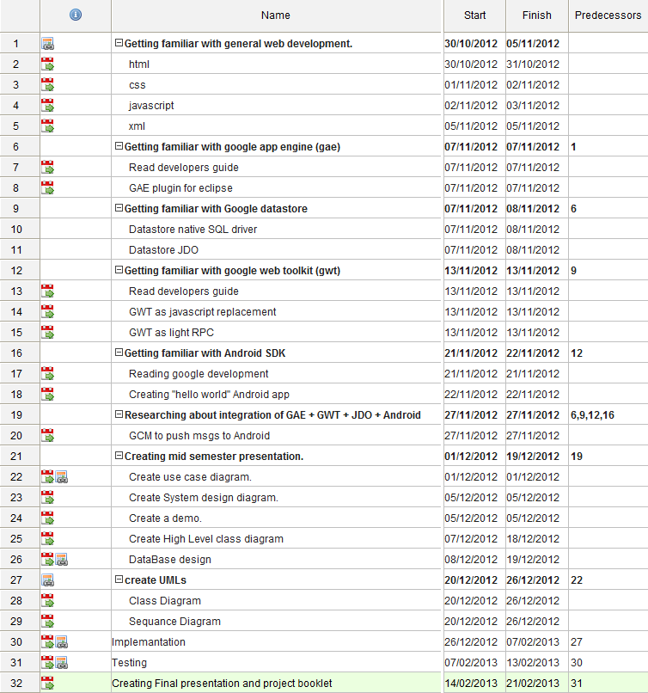
Gantt (WHEN)

Slide 18
Links (where)
Eclipse : http://www.eclipse.org/
Google App Engine: https://developers.google.com/appengine/
Google Web Toolkit: https://developers.google.com/web-toolkit/
Android SDK: http://developer.android.com/sdk/index.html
Google Cloud Messaging: http://developer.android.com/google/gcm/index.html
Visual Paradigm for UML: http://www.visual-paradigm.com/
System Diagram: http://www.diagram.ly/
Gantter: https://app.gantter.com/
SVN: http://code.google.com/p/food-center/
Google app: http://food-center.appspot.com/

