Slide 1
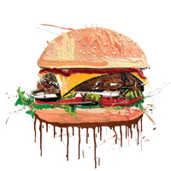
Food Order Center
Mid Semester Presentation. (WHO)
Developers: Hila Mefano, Dror Baum
Supervise : Genady Paikin
20.12.2012

Slide 2
Overview
WHY - motivation
WHAT - use cases
HOW
Google App Engine
Google Web Toolkit
Android SDK
System Diagram
WOW – demonstration
WHEN – gnatt
WHERE - links

Slide 3
Motivation (WHY)
Company employees can order their food easily.
Simplify the process of money handling for both the companies and the restaurants.
Free of service charges for this client server application.
Free Android SDK
Free Google services will be used as much as possible.

Slide 4
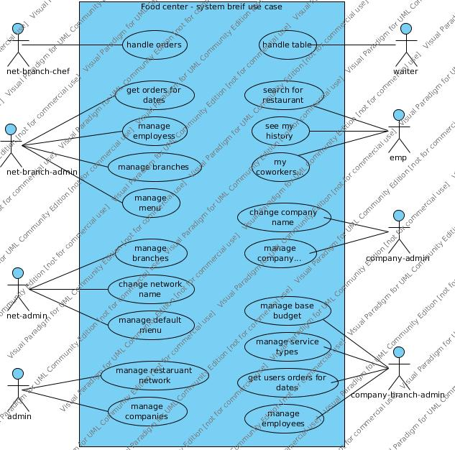
USE CASE DIAGRAm (WhaT)

Slide 5
Google APP EnginE (HOW)
Free JAVA servlet container.
Easy development.
Eclipse plugin.
Big web community.
Easy to access Admin panel.
Easy integration with other Google services.
Google Data store.
Google user verification.
Google Cloud Messaging

Slide 6
GOOgle web toolkit (HOW)
Free Light weight RPC for web client and Android applications.
Easy to create Dynamic HTML pages – without the use of AJAX and JAVASCRIPT and minimal HTML scripting.
Easy Development integration
Eclipse plugin

Slide 7
Android sdk (HOW)
Easy development integration
Eclipse plugin
Huge web community.
Every Android phone is already associated to a Google account.

Slide 8
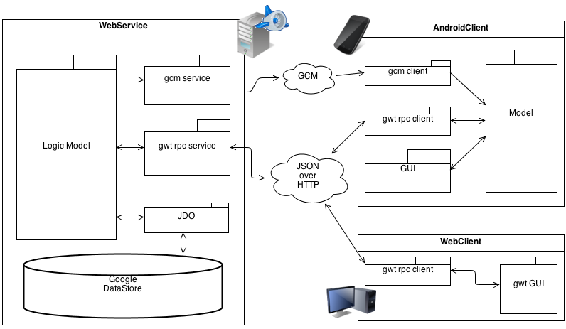
System diagram (HOW)

Slide 9
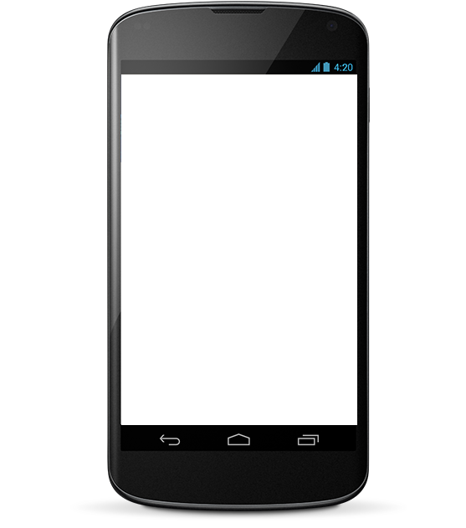
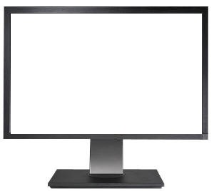
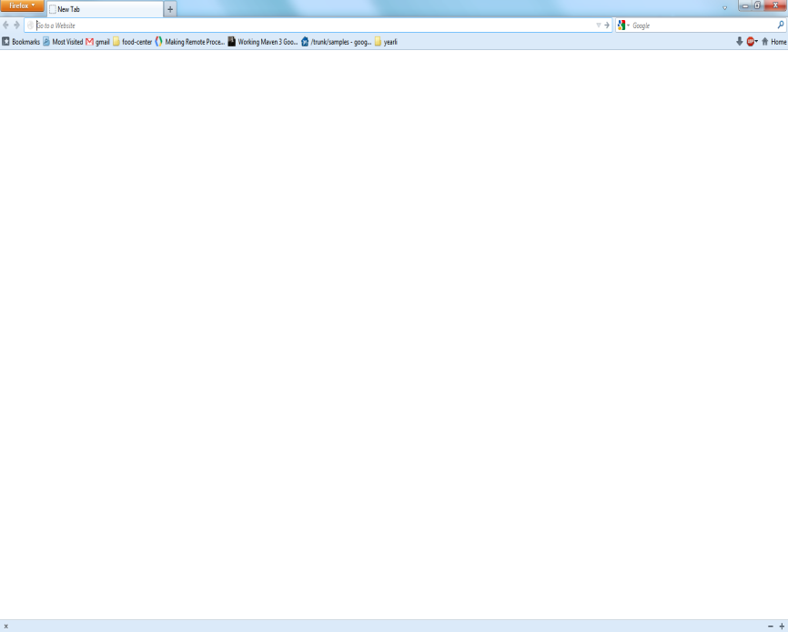

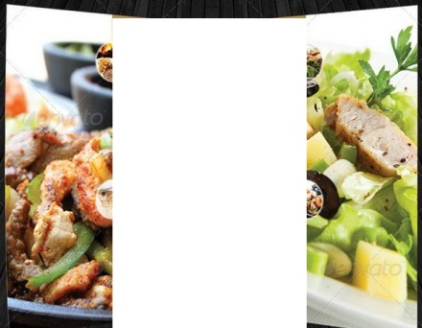
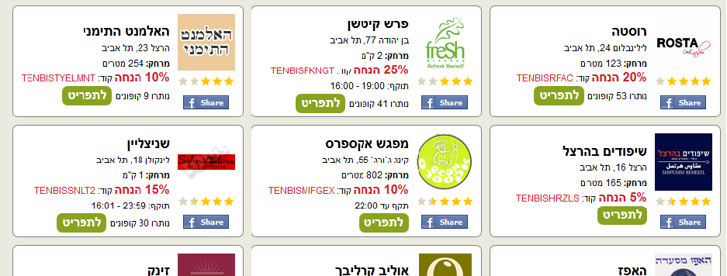
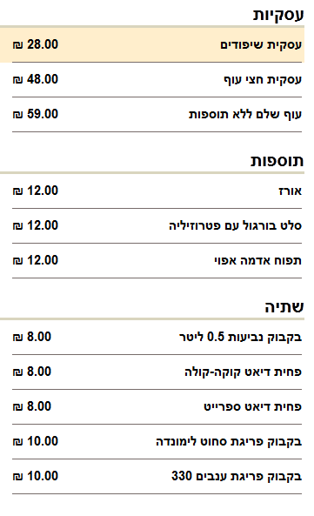

App Demonstration (WOW)
Internet
Food order center
Welcome to food order center
אודות המסעדה
תפריט
חיפוש מסעדה
SERVER
מסעדת דוגמא
Food order center
מסעדת דוגמא
Search for restaurants
DONE
DONE
My history
My coworkers

Slide 10
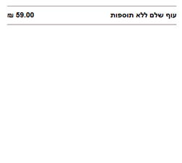

App Demonstration (WOW)
Internet
אודות המסעדה
תפריט
My Cart
מסעדת דוגמא
SERVER
מסעדת דוגמא
מסעדת דוגמא
DONE
ההזמנה בוצעה!
DONE
DONE

Slide 11
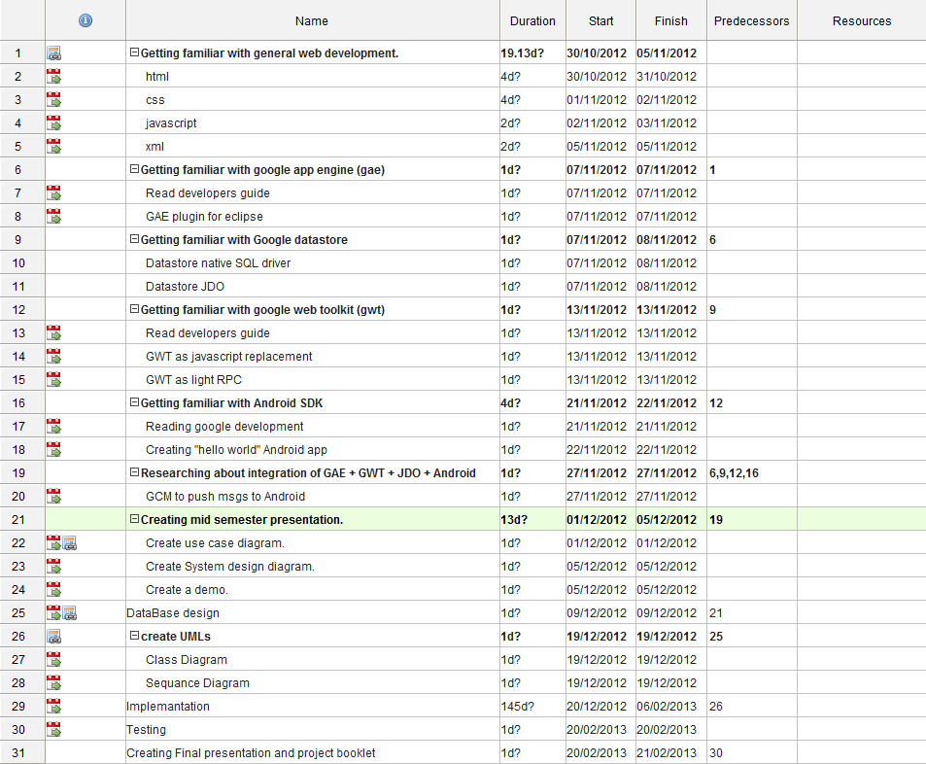
Gantt (WHEN)

Slide 12
Links (where)
Eclipse : http://www.eclipse.org/
Google App Engine: https://developers.google.com/appengine/
Google Web Toolkit: https://developers.google.com/web-toolkit/
Android SDK: http://developer.android.com/sdk/index.html
Google Cloud Messaging: http://developer.android.com/google/gcm/index.html
Visual Paradigm for UML: http://www.visual-paradigm.com/
System Diagram: http://www.diagram.ly/
Gantter: https://app.gantter.com/
SVN: http://code.google.com/p/food-center/
Google app: http://food-center.appspot.com/

