Slide 1
Md. Faysal Rahman
Half Graduate(Year 3, Term 1)
Institute of Information Sciences
Noakhali Science & Technology University

Slide 2
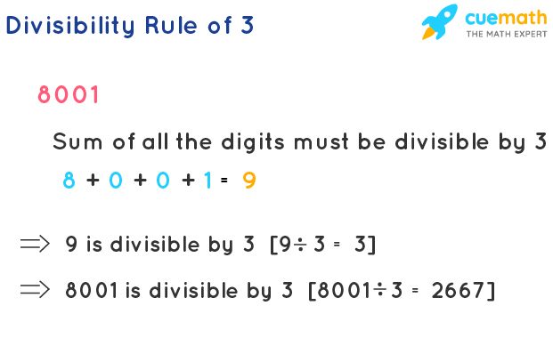
Is "220077" divisible by 3?

Slide 3
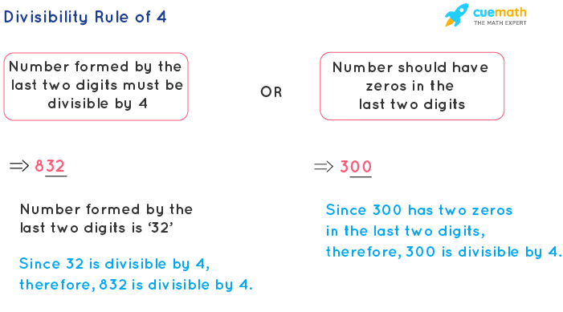
Is "148936" divisible by 4?
Is "14161700" divisible by 4?

Slide 4
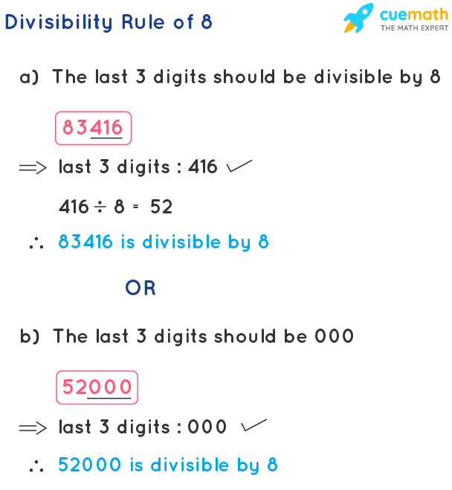
Is "4832" divisible by 8?

Slide 5
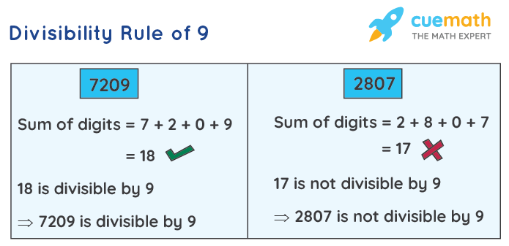
Is "459072" divisible by 9?

Slide 6
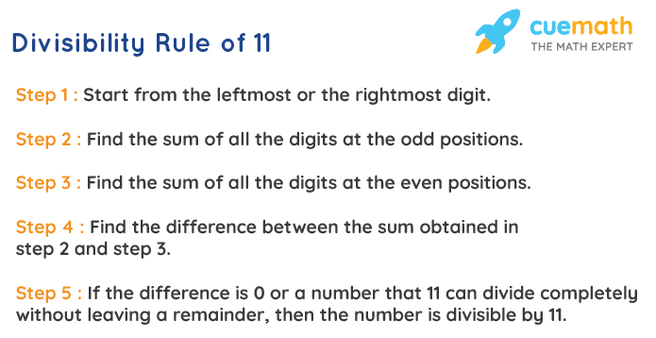
Is "764852" divisible by 11?

Slide 7
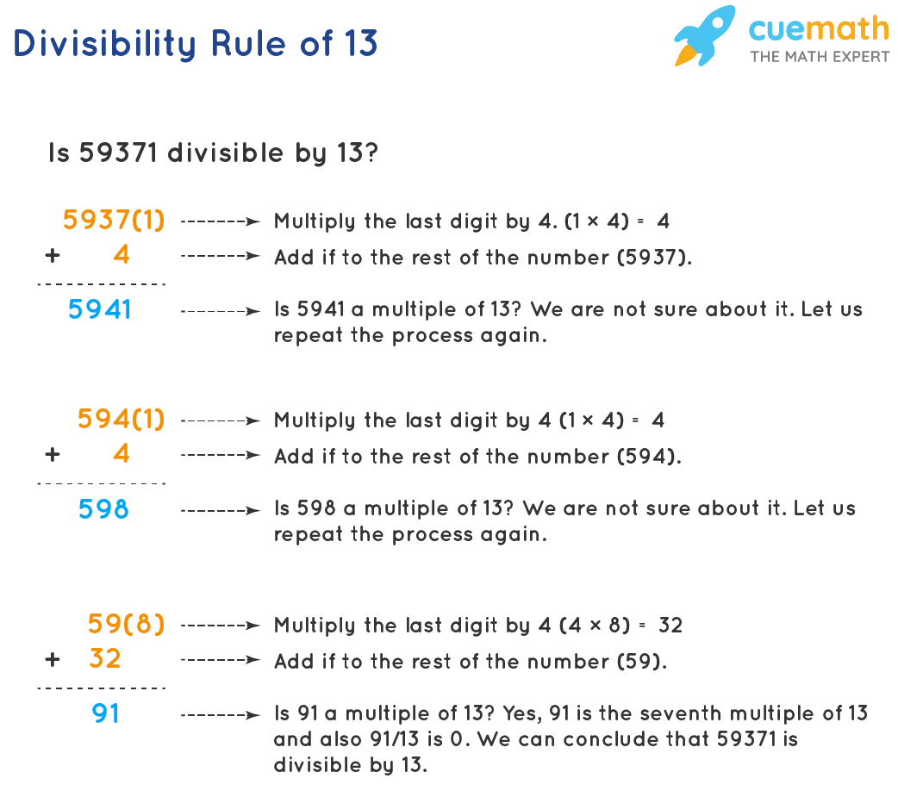
Is "1139502" divisible by 13?

Slide 8
sum of all even numbers from 1 to n
2 = 2 = (1*1)+1
2+4 = 6 = (2*2)+2
2+4+6 = 13 = (3*3)+3
2+4+6+8 = 16 = )4*4)+4
...

Slide 9
sum of all odd numbers from 1 to n
1 = 1 = 1*1
1+3 = 4 = 2*2
1+3+5 = 9 = 3*3
1+3+5+7 = 16 = 4*4
...

Slide 10
Difference between average of (1 to n) and (1 to n+1)
N=1 sum of n =1 sum of n+1 = 3 average of n = 1 average of n+1 = 1.5
N=2 sum of n =3 sum of n+1 = 6 average of n = 1.5 average of n+1 = 2
N=3 sum of n =6 sum of n+1 = 10 average of n = 2 average of n+1 = 2.5
N=4 sum of n =10 sum of n+1 = 15 average of n = 2.5 average of n+1 = 3
N=5 sum of n =15 sum of n+1 = 21 average of n = 1 average of n+1 = 3.5
...

Slide 11
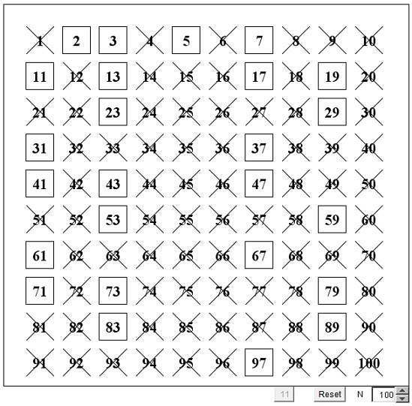
Prime Number

Slide 12
Search
1. Ternary Search
2. Binary Search
Unsorted Array
21 | 1 | 20 | 2 | 17 | 3 | 6 | 13 | 8 | 10
Sorted Array
1 | 2 | 3 | 6 | 8 | 10 | 13 | 17 | 20 | 21

Slide 13
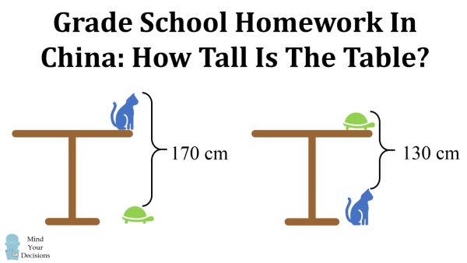

Slide 14
Math is hard
So is life
Get over it.

