Slide 1
History of Autonomous Driving 1980s
PROMETHEUS project started 1986 in Europe and involved
more than 13 vehicle manufacturers, several research units from
governments and universities of 19 European countries.
      One of the first projects in the United States was Navlab (Thorpe et al.) (1988) by the Carnegie Mellon University
Challenges
        reflections, wet road, direct sunshine, tunnels and shadows
urban scenes and traffic signs
Computer Vision for Autonomous Vehicles:
Problems, Datasets and State-of-the-Art Andreas Geiger et al

Slide 2
Improving from the beginning 1990’s
Franke et al depth-based obstacle detection and tracking from stereo as well as a framework for monocular de-tection and recognition of relevant objects such as traffic signs.
A major milestone in 1995, by completing the first autonomous drive from Pittsburgh, PA and Sand Diego, CA.
1996 Addresses urban scenes drove from Washington DC to San Diego in the ’No hands across America’ tour with 98% automated steering yet manual longitudinal control
Computer Vision for Autonomous Vehicles:
Problems, Datasets and State-of-the-Art Andreas Geiger et al

Slide 3
2000s to 2010
2010 able to drive from Italy to china. The onboard system allows to detect obstacles, lane marking, ditches,berms and identify the presence and position of a preceding ve-hicle.
The information produced by the sensing suite is used to perform different tasks such as leader-following and stop & go
Google started their self-driving car project in 2009
Computer Vision for Autonomous Vehicles:
Problems, Datasets and State-of-the-Art Andreas Geiger et al

Slide 4
This decade
Able to enrich an openly licensed map with in-formation about the maneuver to be managed (e.g. pedestrian crossing, traffic light, . . . ). The vehicle was able to handle complex situations such as roundabouts, intersections, priority roads, stops, tunnels, crosswalks, traffic lights, highways, and urban roads without any human intervention
Tesla Autopilot is an advanced driver assistant system de-veloped by Tesla which was first rolled out in 2015 with version 7 of their software. The automation level of the system allows full automation but requires the full attention of the driver to take control if necessary
(google) Different sensors (i.a. cameras, radars, LiDAR, wheel encoder, GPS) allow to detect pedestrians, cyclists, vehicles, road work and more in all directions. According to their accident reports, Google’s self-driving cars were involved only in 14 collisions while 13 times were caused by others. split off to Waymo, an independent self-driving technology company.
Computer Vision for Autonomous Vehicles:
Problems, Datasets and State-of-the-Art Andreas Geiger et al

Slide 5
The Future
Although performs impressively, the general assumption of precisely annotated road maps as well as pre-recorded maps for localization demonstrates that autonomous systems are still far from human capabilities
Most importantly, robust perception from visual information but also general artificial intelligence are required to reach human level reliability and react safely even in complex innercity situations.
Computer Vision for Autonomous Vehicles:
Problems, Datasets and State-of-the-Art Andreas Geiger et al

Slide 6
Data sets
They allow quantitative evaluation of approaches providing key insights about their capacities and limitations.
current progress and remaining challenges can be easily identified by the research community.
Cityscapes datase and KITTI dataset
Computer Vision for Autonomous Vehicles:
Problems, Datasets and State-of-the-Art Andreas Geiger et al

Slide 7
Real World Data Set Categories
Stereo and 3D Reconstruction (two cameras)
Optical Flow - provides sequences with non-rigid motion, synthetic sequences and a subset of the Middlebury stereo benchmark sequences (static scenes) for the evaluation of optical flow Methods
Object Recognition and Segmentation - consists of challenging consumer photographs collected from Flickr with high quality annotations and contains large variability in pose, illumination and occlusion
Tracking - (annotations for three object classes are provided: moving or standing pedestrians, people that are not in an upright position and other)
Aerial Image Datasets - aerial images with orientation parameters, digital surface model (DSM), orthophoto mosaic and airborne laser scans are provided
Autonomous Driving - The dataset has been captured from an autonomous driving platform and comprises six hours of recordings using high resolution color and grayscale stereo cameras, a Velodyne 3D laser scanner and high-precision GPS/IMU inertial navigation system.
Long-Term Autonomy - address challenges of long-term autonomy, as for examples environmental changes over time.
Computer Vision for Autonomous Vehicles:
Problems, Datasets and State-of-the-Art Andreas Geiger et al

Slide 8
Synthetic Data sets
Creating realistic virtual content is a time consuming and expensive process itself and the trade-off be- tween real and synthetic (or augmented) data is not clear yet.
MPI Sintel - Sintel, a short animated film, to render scenes of varying complexity with optical flow ground truth.
Flying Chairs and Flying Things - provides everyday 3D/2D objects flying along randomized 3D trajectories in a randomly created scene.
Game Engines - present an efficient real-to-virtual world cloning method to create realistic proxy worlds. A cloned virtual world allows to vary conditions such as weather or illumination and to use different camera set (rendered a virtual city with the Unity Engine and have used GTA 5).
Computer Vision for Autonomous Vehicles:
Problems, Datasets and State-of-the-Art Andreas Geiger et al

Slide 9
Cameras Models & Calibration
Calibration - the problem of estimating intrinsic and extrinsic parameters of these sensors to relate 2D image points to 3D world points and represent sensed information in a common coordinate system in case of multiple sensors
  Fiducial markings on checkerboard patterns are the standard tool for calibration.
  Reprojection error which is the pixel distance between a projected point and a measured one, is used as a way of measuring accuracy quantitatively.
  Besides accuracy, other desired qualities in a calibration system are speed, robustness to varying imaging conditions, full automation, minimum restrictions in terms of assumptions such as overlapping field of view or information required such as an initial guess of the parameters.
Computer Vision for Autonomous Vehicles:
Problems, Datasets and State-of-the-Art Andreas Geiger et al

Slide 10
Omnidirectional Cameras
A panoramic field of view is desirable in autonomous driving to gain maximum information about the surrounding area for safe navigation. (360 degree view) Omnidirectional cameras are being used more and more in autonomous driving because large field of view enables extraction and matching of interesting points from all around the car.
  Catadioptric cameras ( combine a standard camera with a shaped mirror, such as a paraboli)
  Dioptric cameras (dioptric fisheye lenses)
  Polydioptric cameras (multiple cameras with over-lapping field of view to provide a full spherical field of view.)
Classifications
  Central - the optical rays to the viewed, intersect in a single point in 3D which is known as the single effective viewpoint property.
  Noncentral - built by choosing the mirror shape and the distance between the camera and the mirror ( computationally demanding).
Computer Vision for Autonomous Vehicles:
Problems, Datasets and State-of-the-Art Andreas Geiger et al

Slide 11
Event Cameras
This kind of data is sparse in nature, thus reducing redundancy in transmission and processing. (instead of a constant video stream.)
Less processing is required as data is only generated at a high frame rate when if needed at an event.
Events are brightened pixels in the image
Standard computer-vision algorithms cannot be applied directly to the output of event-based vision sensors (algorithms should ideally exploit the high rate at which events are generated.).
Event-based SLAM does not suffer from motion blur due to high speed motions and very high dynamic range scenes which can be challenging for standard camera approaches.
Computer Vision for Autonomous Vehicles:
Problems, Datasets and State-of-the-Art Andreas Geiger et al

Slide 12
Representations
Variables or parameters can be associated directly with 2D pixels in an image or describe high-level primitives in 3D space. Pixels are amongst the most fine-grained representations, but are harder to relate to physical properties of our 3D world.
Superpixels - compact representations based on grouping of pixels. obtained by a segmentation of the image into atomic regions which are ideally similar in color and texture, and respect image boundaries.
Stixels - presented as a medium level representation of 3D traffic scenes with the goal to bridge the gap between pixels and objects
3D Primitives - Atomic regions which are geometrically meaningful allow the shape of urban objects to be better preserved
Computer Vision for Autonomous Vehicles:
Problems, Datasets and State-of-the-Art Andreas Geiger et al

Slide 13
Superpixels
pixel-based representations increase complexity of inference algorithms due to the large number of variables in high resolution images. As a consequence, many approaches model only local interactions between pixels.
The implicit assumption each superpixel-based method makes is that certain properties of interest remain constant within a super-pixel, e.g., the semantic class label or the slant of a surface.
Boundary adherence with respect to these properties is easily violated, especially for cluttered images when relying on standard segmentation algorithms which leverage color or intensity cues.
depth information can be leveraged as valuable feature for accurate superpixel extraction
Computer Vision for Autonomous Vehicles:
Problems, Datasets and State-of-the-Art Andreas Geiger et al

Slide 14
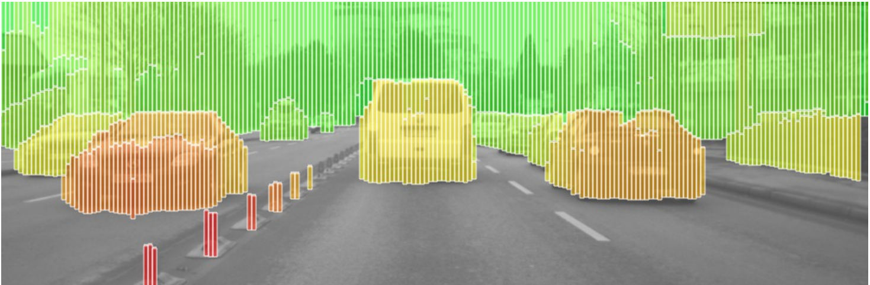
Stixels
Stixels are represented by a set of rectangular sticks standing vertically on the ground to approximate these surfaces. Assuming a constant width, each stixel is defined by its 3D position relative to the camera and its height.
Stixel example:
Green > far
Yellow > middle
Red > close
Computer Vision for Autonomous Vehicles:
Problems, Datasets and State-of-the-Art Andreas Geiger et al
Computer Vision for Autonomous Vehicles:
Problems, Datasets and State-of-the-Art Andreas Geiger et al
Computer Vision for Autonomous Vehicles:
Problems, Datasets and State-of-the-Art Andreas Geiger et al
Computer Vision for Autonomous Vehicles:
Problems, Datasets and State-of-the-Art Andreas Geiger et al

Slide 15
Object Detection
Detection in urban areas is hard because of the wide variety of object appearances and occlusions caused by other objects or the object of interest itself. In addition, the resemblance of objects to each other or to the background and physical effects like cast shadows or reflections can make the distinction difficult.
  Sensors – cameras (visible spectrum, infrared spectrum, Thermal infrared) Active sensors
  Standard Pipeline
  Classification
  Part-based Approaches
Computer Vision for Autonomous Vehicles:
Problems, Datasets and State-of-the-Art Andreas Geiger et al

Slide 16
  Standard Pipeline
traditional detection pipeline consists of the following steps:
  Preprocessing - tasks such as exposure and gain adjustment, camera calibration and image rectification.
  region of interest extraction (ROI) - extracted using a sliding window approach which shifts a detector over over the image at different scales. Assumes a certain ratio, size and position of candidate bounding boxes (for speed). can be leveraged for focusing the search on the relevant regions.
  object classification - limited in number of image regions which need to be classified fast decision is necessary which quickly discards candidates in the background region of the image. deep learning, convolutional neural networks have automated this task while significantly boosting performance
  Verification refinement - The idea of part-based approaches is to split the complex appearance of non-rigidly moving objects like humans into simple parts and to represent any articulation using these parts. This provides greater flexibility and reduces the number of training examples required for learning the object appearance. Usually, a separate context model is learned to handle occlusions
Computer Vision for Autonomous Vehicles:
Problems, Datasets and State-of-the-Art Andreas Geiger et al

Slide 17
Object classification
2D Object Detection-standard 2D image detection (best kitty numbers)
3D Object Detection from 2D Images- used CAD designed 3D models and matches them to the detected 2D one. While these 3D representations provide more faithful descriptions of objects they can not yet compete with state-of-theart detectors using 2D bounding boxes
3D Object Detection from 3D Point Clouds – the 3D cloud is generated by LiDAR and processed in conjunction with RGB images for best KITTI results.
Remaining major problems across tasks are detection of small objects and highly occluded objects.
major source of errors are crowds of pedestrians, groups of cyclists and lines of cars that cause many occlusions and lead to missing detections for all methods
Computer Vision for Autonomous Vehicles:
Problems, Datasets and State-of-the-Art Andreas Geiger et al

Slide 18
  Standard Pipeline
traditional detection pipeline consists of the following steps:
  Preprocessing - tasks such as exposure and gain adjustment, camera calibration and image rectification.
  region of interest extraction (ROI) - extracted using a sliding window approach which shifts a detector over over the image at different scales. Assumes a certain ratio, size and position of candidate bounding boxes (for speed). can be leveraged for focusing the search on the relevant regions.
  object classification - limited in number of image regions which need to be classified fast decision is necessary which quickly discards candidates in the background region of the image. deep learning, convolutional neural networks have automated this task while significantly boosting performance
  Verification refinement - The idea of part-based approaches is to split the complex appearance of non-rigidly moving objects like humans into simple parts and to represent any articulation using these parts. This provides greater flexibility and reduces the number of training examples required for learning the object appearance. Usually, a separate context model is learned to handle occlusions
Computer Vision for Autonomous Vehicles:
Problems, Datasets and State-of-the-Art Andreas Geiger et al

Slide 19
Person Detection
The detection of people is particularly difficult because of the large variety of appearances due to different clothing and articulated poses.
The articulation and interaction of pedestrians can strongly affect the appearance of pedestrians in case of partial occlusion
the pedestrian detection of an autonomous car needs to be flawless
pedestrian detection system needs to be robust against all weather conditions and efficient for real-time detection.
today all state-of-the-art pedestrian detection systems use convolutional neural networks and learn feature representations in an end-to-end fashion
The enlargement of training data allows to train sophisticated models for the detection problem.
Computer Vision for Autonomous Vehicles:
Problems, Datasets and State-of-the-Art Andreas Geiger et al

Slide 20
Human Pose Estimation
Pose and gaze of a person provides important information to the autonomous vehicle about the behavior and intention of the person.
challenging since the pose space is very large and typically people can only be observed on low resolutions, because of their size and distance to the vehicle.
Traditionally, a two-staged approach was used by first detecting body parts and then estimating the pose.
  problematic in cases when people are in proximity of each other because body-parts can be wrongly assigned to different instances.
CNN DeepCut model jointly estimates the poses of all people in an image and estimates the 3D pose and 3D shape of a human body from a single unconstrained image.
Computer Vision for Autonomous Vehicles:
Problems, Datasets and State-of-the-Art Andreas Geiger et al

Slide 21
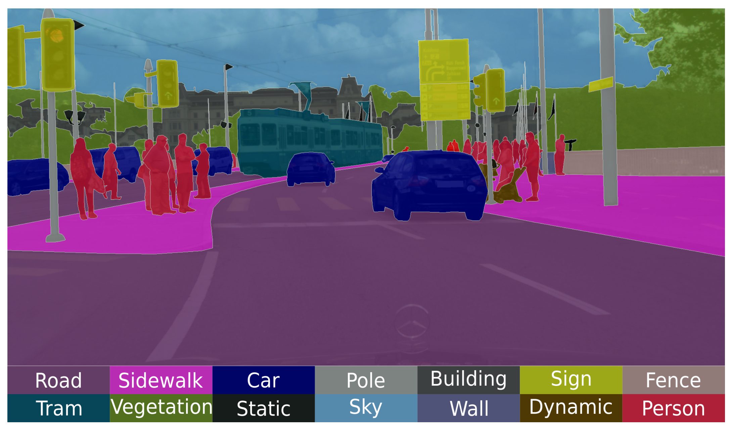
Semantic Segmentation
A fundamental topic in computer vision where the program assign each pixel in the image a label from a predefined set of categories.
Challenges of semantic segmentation arise from the complexity of the scene and the size of the label space
Semantic segmentation of a scene from the Cityscapes dataset by
Cordts et al. (2016) recorded in Zurich.
Computer Vision for Autonomous Vehicles:
Problems, Datasets and State-of-the-Art Andreas Geiger et al

Slide 22
Semantic Instance Segmentation
goal of semantic instance segmentation is simultaneous detection, segmentation and classification of every individual object in an image.
Unlike semantic segmentation, it provides information about the position, semantics, shape and count of individual objects
exist two major lines of research
  Proposal-based
  proposal-free instance segmentation.
Computer Vision for Autonomous Vehicles:
Problems, Datasets and State-of-the-Art Andreas Geiger et al

Slide 23
Proposal-based Instance Segmentation
methods that use proposals in the form of bounding boxes to predict a binary segmentation mask are sensitive to errors in the proposal generation process including wrongly scaled or shifted bounding boxes.
Computer Vision for Autonomous Vehicles:
Problems, Datasets and State-of-the-Art Andreas Geiger et al

