Slide 1
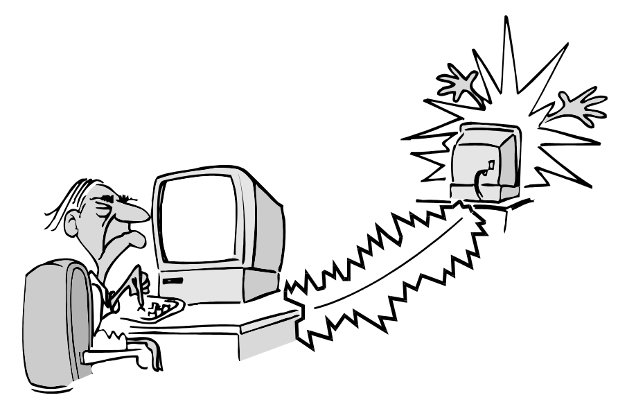
IPtables
Objectives
  to learn the basics of iptables
Contents
  Start and stop IPtables
  Checking IPtables status
  Input and Output chain
  Pre and Post routing
  Forward of address and port
  Firewall standard rules
  Lading/Unloading kernel driver modules
  Connection tracking modules
Practicals
  working with iptables
Summary
Notes:
This chapter introduces the US DoD Internet suite known as TCP/IP (Transmission Control Protocol/Internet Protocol). It covers TCP/IP as a set of protocols and how they fit them into a communications model, the addressing scheme used for Interhost/Internetwork communication (IP addressing) and finally at some applications that use them.

Slide 2
What Is iptables?
Stateful packet inspection.
  The firewall keeps track of each connection passing through it, This is an important feature in the support of active FTP and VoIP.
Filtering packets based on a MAC address IPv4 / IPv6
  Very important in WLAN’s and similar enviroments.
Filtering packets based the values of the flags in the TCP header
  Helpful in preventing attacks using malformed packets and in restricting access.
Network address translation and Port translating NAT/NAPT
  Building DMZ and more flexible NAT enviroments to increase security.
Source and stateful routing and failover functions
  Route traffic more efficiant and faster than regular IP routers.
System logging of network activities
  Provides the option of adjusting the level of detail of the reporting
A rate limiting feature
  Helps to block some types of denial of service (DoS) attacks.
Packet manipulation (mangling) like altering the TOS/DSCP/ECN bits of the IP header
  Mark and classify packets dependent on rules. First step in QoS.
Notes:
What is netfilter/iptables?
netfilter and iptables are building blocks of a framework inside the Linux 2.4.x and 2.6.x kernel. This framework enables packet filtering, network address [and port] translation (NA[P]T) and other packet mangling. It is the re-designed and heavily improved successor of the previous Linux 2.2.x ipchains and Linux 2.0.x ipfwadm systems.

Slide 3
Download And Install The Iptables Package
Most Linux dialects already have iptables
  Usally iptables is classified by and dependent on kernel versions:
    Pre 2.4 lack some modern functionality, still popular in soho routers
    2.4 mainstream of iptables, most popular and well tested
    2.6 latest versions
Download from:
  http://www.netfilter.org/downloads.html
Documentation:
  http://www.netfilter.org/documentation/index.html
Install from sources or rpm:
  # rpm –ivh iptables-1.2.9-1.0.i386.rpm
  # tar xvfz iptables-1.2.9.tar.gz ; ./configure ; make ; make install
Modules to add functionallity to IPtables:
  Variour proxy modules, for example ftp and h323
  Modules must be loaded into kernel
  # modprobe module
  # insmod module
Patch-o-Matic (updated and modules)
  http://ftp.netfilter.org/pub/patch-o-matic-ng/snapshot/
Notes:
A large number of plugins/modules kept in 'patch-o-matic' repository. Note that Iptables is heavely dependent on you linux kernel.
Addons and functionallity in iptables is often on kernel level, which make them very sencitive to kernel version.

Slide 4
How To Start iptables
Best practise is to make firewall start/stop scripts yourself, then you get them as you like.
Practical can be to begin make a service command like:
  After you successfully made your service script, place
  it in /usr/local/sbin/service
Then make your firewalls script iptables like:
  And put it in /etc/init.d
  Starting IP tables
  service iptables start
  Stopping IP tables
  service iptables stop
  Restaring IP tables
  service iptables restart
  Checking IP tables status (rulechains)
  service iptables status
To get iptables configured to start at boot, use the chkconfig command:
  chkconfig iptables on
iptables itself is a command which we will see soon.
To show all current rule chains:
  iptables –-list
To drop all current rule chains:
  iptables –-flush
  #!/bin/bash
  /etc/init.d/$1 $2
  #!/bin/bash
  case $1 in
  start) echo "Load ruleset";;
  stop) echo "Stopping"; iptables --flush;;
  restart) echo "Restarting";;
  status) iptables --list --verbose;;
  *) echo "Syntax start/stop/restart/status";;
  esac
Notes:
The service iptables start/stop and chkconfig commands is working on all firewalls based on redhat distributions. Other uses scripts. SuSE professional workstation is not supposed to act as server, its firewall script is operated by:
rcSuSEfirewall2 start
rcSuSEfirewall2 stop
rcSuSEfirewall2 status
Etc...
Note when making your own scripts dont forget to make them executable with chmod a+x /usr/local/sbin/service
and chmod a+x /etc/init.d/iptables

Slide 5
Packet Processing In iptables
IP tables is complex for the beginner.
Three builtin tables (queues) for processing:
  1. MANGLE: manipulate QoS bits in TCP header
  2. FILTER: packet filtering, has three builtin chains (your firewall policy rules)
  Forward chain: filters packets to servers protected by firewall
  Input chain: filters packets destinated for the firewall
  Output chain: filters packets orginating from the firewall
  3. NAT: network adress translation, has two builtin chains
  Pre-routing: NAT packets when destination address need changes
  Post-routing: NAT packets when source address need changes
Notes:
All packets inspected by iptables pass through a sequence of built-in tables (queues) for processing. Each of these queues is dedicated to a particular type of packet activity and is controlled by an associated packet transformation/filtering chain.
There are three tables in total. The first is the mangle table which is responsible for the alteration of quality of service bits in the TCP header. This is hardly used in a home or SOHO environment.
The second table is the filter queue which is responsible for packet filtering. It has three built-in chains in which you can place your firewall policy rules.
The third table is the nat queue which is responsible for network address translation. It has two built-in chain

Slide 6
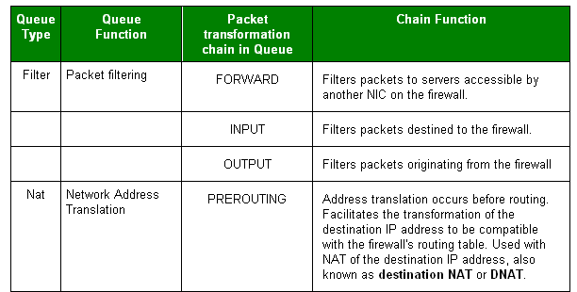
Processing For Packets Routed By The Firewall 1/2
Notes:
You need to specify the table and the chain for each firewall rule you create. There is an exception: Most rules are related to filtering, so iptables assumes that any chain that's defined without an associated table will be a part of the filter table. The filter table is therefore the default.

Slide 7
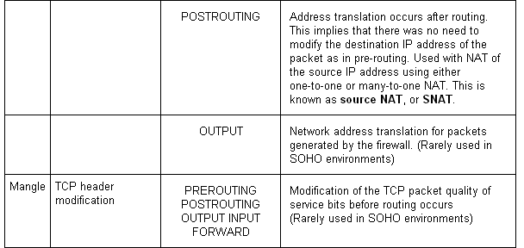
Processing For Packets Routed By The Firewall 2/2
Notes:
Postrouting rules can make packages leaving the firewall, appair as coming from selected source addresses, SNAT.

Slide 8
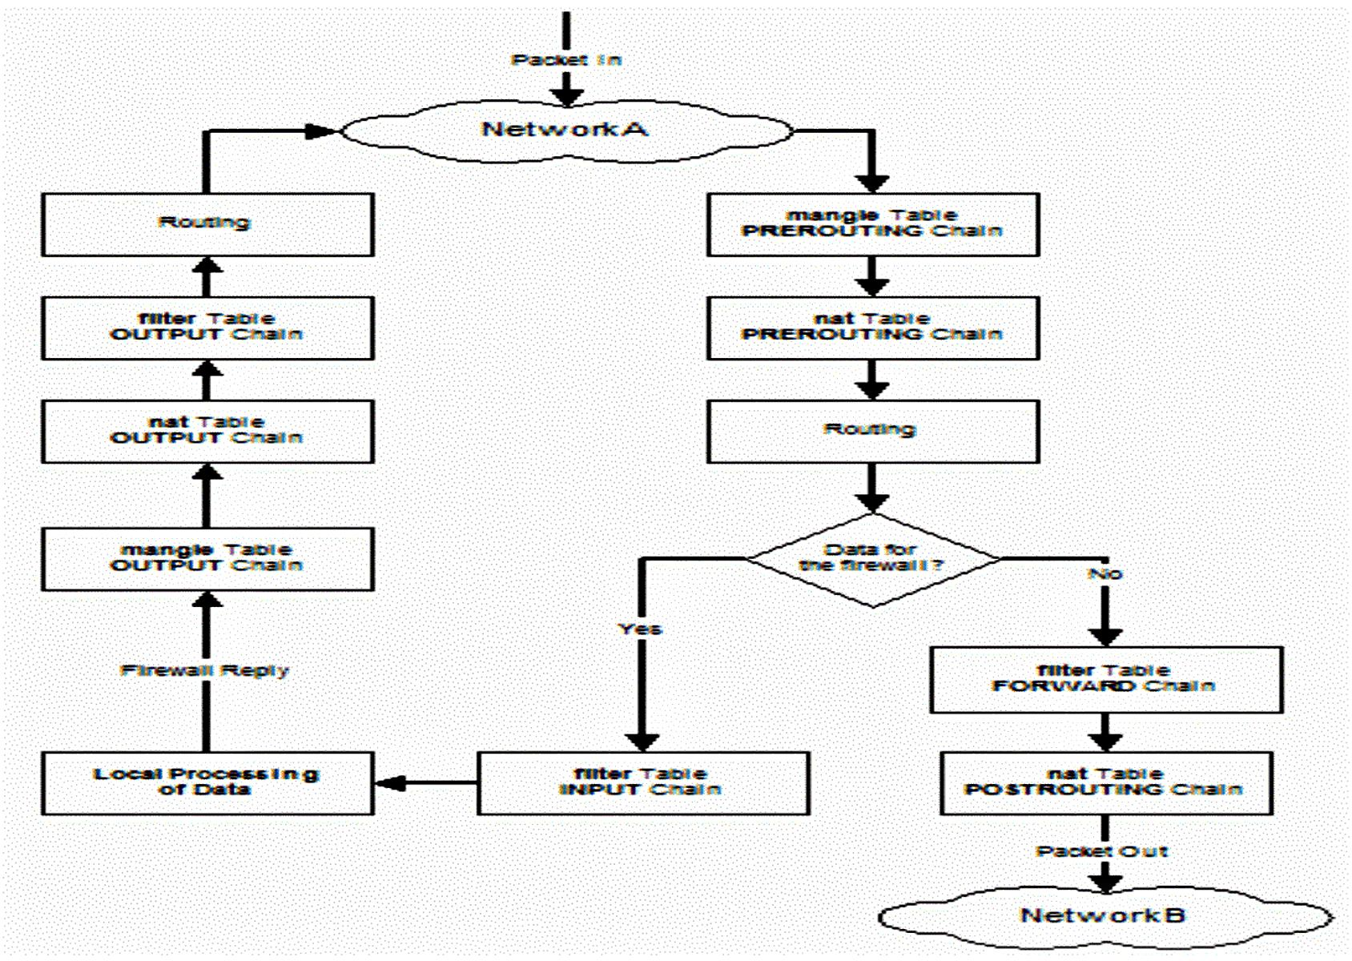
Notes:
To help understand iptables, take a look at the way packets are handled by iptables. In figure a TCP packet from the Internet arrives at the firewall's interface on Network A to create a data connection.
The packet is first examined by your rules in the mangle table's PREROUTING chain, if any. It is then inspected by the rules in the nat table's PREROUTING chain to see whether the packet requires DNAT. It is then routed.
If the packet is destined for a protected network, then it is filtered by the rules in the FORWARD chain of the filter table and, if necessary, the packet undergoes SNAT before arriving at Network B. When the destination server decides to reply, the packet undergoes the same sequence of steps.
If the packet is destined for the firewall itself, then it is filtered by the rules in the INPUT chain of the filter table before being processed by the intended application on the firewall. At some point, the firewall needs to reply. This reply is inspected by your rules in the OUTPUT chain of the mangle table, if any. The rules in the OUTPUT chain of the nat table determine whether address translation is required and the rules in the OUTPUT chain of the filter table are then inspected before the packet is routed back to the Internet.

Slide 9
Targets And Jumps 1/2
ACCEPT
  iptables stops further processing.
  The packet is handed over to the end application or the operating system for processing
DROP
  iptables stops further processing.
  The packet is blocked.
LOG
  The packet information is sent to the syslog daemon for logging.
  iptables continues processing with the next rule in the table.
  You can't log and drop at the same time ->use two rules.
  --log-prefix ”reason"
REJECT
  Works like the DROP target, but will also return an error message to the host sending the packet that the packet was blocked
  --reject-with qualifier Qualifier is an ICMP message
Notes:
Each firewall rule inspects each IP packet and then tries to identify it as the target of some sort of operation. Once a target is identified, the packet needs to jump over to it for further processing.

Slide 10
Targets And Jumps 2/2
SNAT
  Used to do source network address translation rewriting the source IP address of the packet
  The source IP address is user defined
  --to-source <address>[-<address>][:<port>-<port>]
DNAT
  Used to do destination network address translation. ie. rewriting the destination IP address of the packet
  --to-destination ipaddress
MASQUERADE
  Used to do Source Network Address Translation.
  By default the source IP address is the same as that used by the firewall's interface
    [--to-ports <port>[-<port>]]
Notes:
Masquerade is the way of doing classing NAT, it is actually built upon the SNAT and DNAT.
The SNAT, DNAT makes the logical DMZ possible. It is not advisable to do SNAT and DNAT for certain ports into the controlled zones.

Slide 11
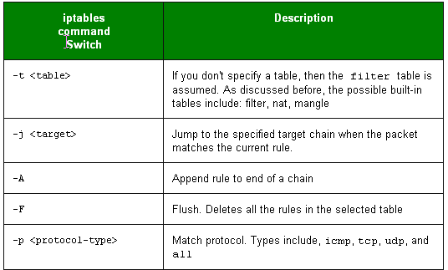
Important Iptables Command Switch Operations 1/2
Notes:
Firewall rules is stored in scripts or databases, most common is scripts.
One row example:
iptables -A INPUT -s 0/0 -i eth0 -d 192.168.1.1 -p TCP -j ACCEPT
Each line of an iptables script not only has a jump, but they also have a number of command line options that are used to append rules to chains that match your defined packet characteristics, such the source IP address and TCP port. There are also options that can be used to just clear a chain so you can start all over again.

Slide 12
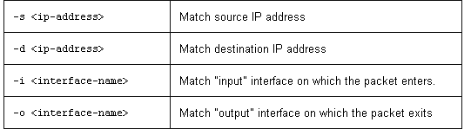
Important Iptables Command Switch Operations 2/2
We try to define a rule that will accept all packages on interface eth0 that uses TCP and has destination address 192.168.1.1.
We first define the MATCH criterias:
  Use default filter table (absense of –t )
  Append a rule to end of INPUT chain (-A INPUT )
  Match on source address can be any 0/0 address (-s 0/0 )
  Input interface used is eth0 (-i eth0 )
  Match on destination address 192.168.1.1 (-d 192.168.1.1)
  Match Protocol TCP (-p TCP )
  If all matches is fulfilled, then jump to ACCEPT chain. (-j ACCEPT )
iptables -A INPUT -s 0/0 -i eth0 -d 192.168.1.1 -p TCP -j ACCEPT
Notes:
iptables is being configured to allow the firewall to accept TCP packets coming in on interface eth0 from any IP address destined for the firewall's IP address of 192.168.1.1. The 0/0 representation of an IP address means any

Slide 13
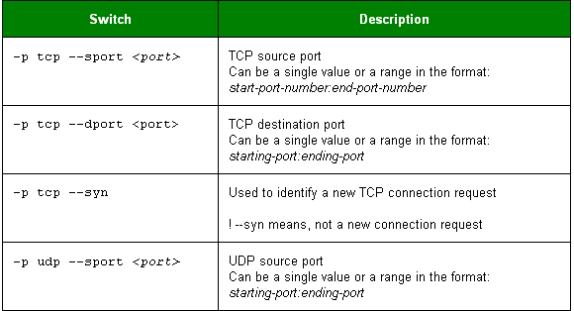
Common TCP and UDP Match Criteria
Notes:
Example:
iptables -A FORWARD -s 0/0 -i eth0 -d 192.168.1.58 -o eth1 -p TCP \
--sport 1024:65535 --dport 80 -j ACCEPT
iptables is being configured to allow the firewall to accept TCP packets for routing when they enter on interface eth0 from any IP address and are destined for an IP address of 192.168.1.58 that is reachable via interface eth1. The source port is in the range 1024 to 65535 and the destination port is port 80 (www/http).

Slide 14
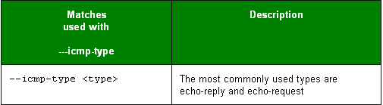
Common ICMP (Ping) Match Criteria
Allow ping request and reply
  iptables is being configured to allow the firewall to send ICMP echo-requests (pings) and in turn, accept the expected ICMP echo-replies.
  iptables -A OUTPUT -p icmp --icmp-type echo-request -j ACCEPT
  iptables -A INPUT -p icmp --icmp-type echo-reply -j ACCEPT
Put limit on ping to prevent flood pings
  iptables -A INPUT -p icmp --icmp-type echo-request \
  -m limit --limit 1/s -i eth0 -j ACCEPT
Notes:
To stop ICMP traffic can result in that TCP protocol and UDP protocol builtin and applicaton dependend throttle functions are knocked out. As result, the network can be instable during heavy load.
Ping is not important for network stability in most cases, and can be turned off if you want to stop ping-scans for live hosts!
The limit feature in iptables specifies the maximum average number of matches to allow per second. You can specify time intervals in the format /second, /minute, /hour, or /day, or you can use abbreviations so that 3/second is the same as 3/s.
In the limit example, ICMP echo requests are restricted to no more than one per second. When tuned correctly, this feature allows you to filter unusually high volumes of traffic that characterize denial of service (DOS) attacks and Internet worms.

Slide 15
Defense for SYN flood attacks
–m limit sets maximum number of SYN packets
  iptables is being configured to allow the firewall to accept maxim 5 TCP/SYN packeds per second on interface eth0.
  iptables -A INPUT -p tcp --syn -m limit --limit 5/s -i eth0 -j ACCEPT
  If more than 5 SYN packets per second, the packets are dropped.
  If source/destination sence dropped packets, it will resend three times
  If drops continue after 3 reset packets, source will reduce packet speed.
Notes:
You can expand on the limit feature of iptables to reduce your vulnerability to certain types of denial of service attack. Here a defense for SYN flood attacks was created by limiting the acceptance of TCP segments with the SYN bit set to no more than five per second.

Slide 16
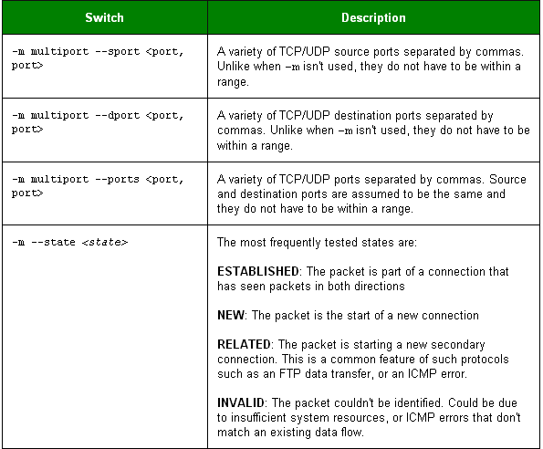
Common Extended Match Criteria 1/2

Slide 17
Common Extended Match Criteria 2/2
Allow both port 80 and 443 for the webserver on inside:
  iptables -A FORWARD -s 0/0 -i eth0 -d 192.168.1.58 -o eth1 -p TCP \
  --sport 1024:65535 -m multiport --dport 80,443 -j ACCEPT
The return traffic from webbserver is allowed, but only of sessions are opened:
  iptables -A FORWARD -d 0/0 -o eth0 -s 192.168.1.58 -i eth1 -p TCP \
  -m state --state ESTABLISHED -j ACCEPT
If sessions are used, you can reduce an attack called half open
  Half open is known to consume server all free sockets (tcp stack memory) and is senced as a denial of service attack, but it is not.
  Sessions are usally waiting 3 minutes.
Notes:
Here iptables is being configured to allow the firewall to accept TCP packets to be routed when they enter on interface eth0 from any IP address destined for IP address of 192.168.1.58 that is reachable via interface eth1. The source port is in the range 1024 to 65535 and the destination ports are port 80 (www/http) and 443 (https). The return packets from 192.168.1.58 are allowed to be accepted too. Instead of stating the source and destination ports, you can simply allow packets related to established connections using the -m state and --state ESTABLISHED options.

Slide 18
Using User Defined Chains
Define fast input queue:
  iptables -A INPUT -i eth0 -d 206.229.110.2 -j fast-input-queue
Define fast output queue:
  iptables -A OUTPUT -o eth0 -s 206.229.110.2 -j fast-output-queue
Use defined queues and define two icmp queue’s:
  iptables -A fast-input-queue -p icmp -j icmp-queue-in
  iptables -A fast-output-queue -p icmp -j icmp-queue-out
Finally we use the queue’s to define a two rules:
  iptables -A icmp-queue-out -p icmp --icmp-type echo-request \
  -m state --state NEW -j ACCEPT
  iptables -A icmp-queue-in -p icmp --icmp-type echo-reply -j ACCEPT
Notes:
You can configure iptables to have user-defined chains. This feature is frequently used to help streamline the processing of packets. For example, instead of using a single, built-in chain for all protocols, you can use the chain to determine the protocol type for the packet and then hand off the actual final processing to a user-defined, protocol-specific chain in the filter table. In other words, you can replace a long chain with a stubby main chain pointing to multiple stubby chains, thereby shortening the total length of all chains the packet has to pass through.
Use user defined queues, improved throughput speed due to more efficiant memory handling and queue processing inside the kernel.

Slide 19
Saving Your iptables Scripts
RedHat / SuSE based distributions:
  /etc/sysconfig/iptables /etc/sysconfig/SuSEfirewall2
Other distributions uses:
  There is no specific favourite place, one is:
  /etc/rc.d/rc.firewall
  And maby this is the most common is:
  /etc/init.d/rc.firewall
RedHat / Fedora's iptables Rule Generator:
  lokkit yast firewall
There are three iptable commands:
  iptables (The kernel insert rule command)
  iptables-save > rc.firewall.backup
  iptables-restore < rc.firewall.backup
Can you extend your script with this function’s ? :
  service iptables save service iptables restore
Notes:
For RedHat based distrubutions:
The service iptables save command permanently saves the iptables configuration in the /etc/sysconfig/iptables file. When the system reboots, the iptables-restore program reads the configuration and makes it the active configuration.
The format of the /etc/sysconfig/iptables file is slightly different from that of the scripts shown in this chapter. The initialization of built-in chains is automatic and the string "iptables" is omitted from the rule statements.
Fedora comes with a program called lokkit that you can use to generate a very rudimentary firewall rule set. It prompts for the level of security and then gives you the option of doing simple customizations. It is a good place for beginners to start on a test system so that they can see a general rule structure.
Like the service iptables save command, lokkit saves the firewall rules in a new /etc/sysconfig/iptables file for use on the next reboot.
Once you have become familiar with the iptables syntax, it's best to write scripts that you can comment and then save it to /etc/sysconfig/iptables. It makes them much more manageable and readable.

Slide 20
Loading Kernel Modules Needed By iptables
Loading kernel modules extends it functionallity
  Generally kernel modules is like plugins, they add functionallity:
  /lib/modules/<kernelversion>/kernel/net/
Manually loading/unloading modules
  modprobe <module> (search for module and dependencies)
  insmod <module> (force load module, dont care)
  rmmod <module> (remove module)
  lsmod (List modules loaded)
Load some common modules:
  modprobe ip_conntrack (tracking connections)
  modprobe ip_conntrack_ftp (transparent proxy for active ftp)
  modprobe iptable_nat (for all kind of NAT operations)
  modprobe ip_nat_ftp (for ftp server behind nat)
Notes:
The iptables application requires you to load certain kernel modules to activate some of its functions. Whenever any type of NAT is required, the iptable_nat module needs to be loaded. The ip_conntrack_ftp module needs to be added for FTP support and should always be loaded with the ip_conntrack module which tracks TCP connection states. As most scripts probably will keep track of connection states, the ip_conntrack module will be needed in any case. The ip_nat_ftp module also needs to be loaded for FTP servers behind a NAT firewall.

Slide 21
Basic Firewall settings
Most basic firewall settings
  Everything from inside is allowed to pass out
  Everything from outside is denied to pass in
Optionally firewalls directly offer security levels
  More or less protocols are accepted, most common is
  SSH SMTP WWW VPN
  FTP DHCP SMB TELNET
Optionally firewalls directly offer security levels
  Levels are usally 3:
  No security Medium High
  No Security=Firewall is passing everything or is disables
  Medium=SMTP, SSH, DHCP, FTP
  HIGH=SSH
Notes:
This is in practical life arranged by supplying various factory built scripts with the rules and modules

Slide 22
LOKKIT & WEBMIN configuration file
/etc/sysconfig/iptables
Here we allow ipsec, ah and ssh from outside and everything from inside and out
*filter
:INPUT ACCEPT [0:0]
:FORWARD ACCEPT [0:0]
:OUTPUT ACCEPT [144:12748]
:RH-Firewall-1-INPUT - [0:0]
-A INPUT -j RH-Firewall-1-INPUT
-A FORWARD -j RH-Firewall-1-INPUT
-A RH-Firewall-1-INPUT -i lo -j ACCEPT
-A RH-Firewall-1-INPUT -p icmp -m icmp --icmp-type 255 -j ACCEPT
-A RH-Firewall-1-INPUT -p esp -j ACCEPT
-A RH-Firewall-1-INPUT -p ah -j ACCEPT
-A RH-Firewall-1-INPUT -m state --state RELATED,ESTABLISHED -j ACCEPT
-A RH-Firewall-1-INPUT -p tcp -m state --state NEW -m tcp --dport 22 -j ACCEPT
-A RH-Firewall-1-INPUT -j REJECT --reject-with icmp-host-prohibited
COMMIT
Notes:
LOKKIT and WEBMIN does not use clear text iptables rules, they have a special script engine to read in the ruleset.
Most firewall plateforms make use of various script engines, or are heavely dependent on user defined queues. This makes life hard for the enthusiast trying to edit the ruleset files manually in notepad.
It is never a good idea to edit this script directly because it is always overwritten by the save command and it doesn't save any comments at all, which can also make it extremely difficult to follow. For these reasons, you're better off writing and applying a customized script and then using the service iptables save command to make the changes permanent.

Slide 23
Basic Operating System Defense
All firewalls must have an operating system
The operating system must be hardened by removing all unessesary nitty gritty
If your firewall is Unix based, you have to use this settings in /etc/sysctl.conf:
In Windows 2003 server you find the same entries in the registry.
You will need to reboot your server after doing the hardening above
net/ipv4/conf/all/rp_filter = 1
net/ipv4/conf/all/log_martians = 1
net/ipv4/conf/all/send_redirects = 0
net/ipv4/conf/all/accept_source_route = 0
net/ipv4/conf/all/accept_redirects = 0
net/ipv4/tcp_syncookies = 1
net/ipv4/icmp_echo_ignore_broadcasts = 1
net/ipv4/ip_forward = 1
Notes:
You can do several things before employing your firewall script to improve the resilience of your firewall to attack. For example, the Linux operating system has a number of built-in protection mechanisms that you should activate by modifying the system kernel parameters in the /proc filesystem via the /etc/sysctl.conf file
This is what the entries do, from first line and down:
1. Disable routing triangulation. Respond to queries out the same interface, not another. Helps to maintain state. Also protects against IP spoofing.
2. Enable logging of packets with malformed IP addresses
3. Disable redirects
4. Disable source routed packets
5. Disable acceptance of ICMP redirects
6. Turn on protection from Denial of Service (DOS) attacks
7. Disable responding to ping broadcasts
8. Enable IP routing. Required if your firewall is protecting a network, NAT included

Slide 24
Basic iptables Initialization
Load modules for FTP connection tracking and NAT
  Most linux based firewalls uses file
  /etc/rc.local or /etc/init.d/rc.firewall:
Initialize all the chains by removing all the rules:
  Most linux based firewalls uses
  the same file as modules are loaded from:
All user defined chains should be deleted:
modprobe ip_conntrack
modprobe ip_nat_ftp
modprobe ip_conntrack_ftp
modprobe iptable_nat
iptables --flush
iptables -t nat --flush
iptables -t mangle --flush
iptables --delete-chain
iptables -t nat --delete-chain
iptables -t mangle --delete-chain
Notes:
It is a good policy, in any iptables script you write, to initialize your chain and table settings with known values. The filter table's INPUT, FORWARD, and OUTPUT chains should drop packets by default for the best security. It is not good policy, however, to make your nat and mangle tables drop packets by default. These tables are queried before the filter table, and if all packets that don't match the nat and mangle table rules are dropped, then they will not reach the INPUT, FORWARD, and OUTPUT chains for processing.
Additional ALLOW rules should be added to the end of this script snippet.

Slide 25
Basic iptables ruleset
If a packet doesn't match one of the built in chains,
The policy should
be to drop it :
The loopback interface should accept all traffic :
Initialize our user-defined chains :
  valid-src, valid source
  valid-dst, valid destination
Verify valid source and destination addresses for all packets :
iptables --policy INPUT DROP
iptables --policy OUTPUT DROP
iptables --policy FORWARD DROP
iptables -t nat --policy POSTROUTING ACCEPT
iptables -t nat --policy PREROUTING ACCEPT
iptables -N valid-src
iptables -N valid-dst
iptables -A INPUT -i lo -j ACCEPT
iptables -A OUTPUT -o lo -j ACCEPT
iptables -A INPUT -i eth0 -j valid-src
iptables -A FORWARD -i eth0 -j valid-src
iptables -A OUTPUT -o eth0 -j valid-dst
iptables -A FORWARD -o eth0 -j valid-dst
Notes:
The script also uses multiple user-defined chains to make the script shorter and faster as the chains can be repeatedly accessed. This removes the need to repeat the same statements over and over again.

Slide 26
Source and Destination Address Sanity Checks
The loopback interface should accept all traffic :
Drop packets from networks covered in RFC 1918 (private nets)
Drop packets from external interface IP address
iptables -A INPUT -i lo -j ACCEPT
iptables -A valid-src -s 10.0.0.0/8 -j DROP
iptables -A valid-src -s 172.16.0.0/12 -j DROP
iptables -A valid-src -s 192.168.0.0/16 -j DROP
iptables -A valid-src -s 224.0.0.0/4 -j DROP
iptables -A valid-src -s 240.0.0.0/5 -j DROP
iptables -A valid-src -s 127.0.0.0/8 -j DROP
iptables -A valid-src -s 0.0.0.0/8 -j DROP
iptables -A valid-src -d 255.255.255.255 -j DROP
iptables -A valid-src -s 169.254.0.0/16 -j DROP
iptables -A valid-src -s $EXTERNAL_IP -j DROP
iptables -A valid-dst -d 224.0.0.0/4 -j DROP
Notes:
The external interface IP address is your WAN adapter IP address (red network), this should not pass to inside.

Slide 27
Allowing fundamental services
Allowing DNS Access To Your Firewall :
Allow previously established connections :
Allow port 80 (www) and 22 (SSH) connections to the firewall :
iptables -A OUTPUT -p udp -o eth0 --dport 53 --sport 1024:65535 \
-j ACCEPT
iptables -A INPUT -p udp -i eth0 --sport 53 --dport 1024:65535 \
-j ACCEPT
iptables -A OUTPUT -o eth0 -m state --state ESTABLISHED,RELATED \
-j ACCEPT
iptables -A INPUT -p tcp -i eth0 --dport 22 --sport 1024:65535 \
-m state --state NEW -j ACCEPT
iptables -A INPUT -p tcp -i eth0 --dport 80 --sport 1024:65535 \
-m state --state NEW -j ACCEPT
Notes:
You'll almost certainly want your firewall to make DNS queries to the Internet.
DNS) The two statements will apply not only for firewalls acting as DNS clients but also for firewalls working in a caching or regular DNS server role.
Estabilished connections) This sample snippet is for a firewall that doubles as a web server that is managed remotely by its system administrator via secure shell (SSH) sessions. Inbound packets destined for ports 80 and 22 are allowed thereby making the first steps in establishing a connection. It isn't necessary to specify these ports for the return leg as outbound packets for all established connections are allowed. Connections initiated by persons logged into the Web server will be denied as outbound NEW connection packets aren't allowed.

Slide 28
Allowing Your Firewall To Access The Internet
Allow port 80 (www) and 443 (https) connections from the firewall :
Allow previously established connections :
iptables -A OUTPUT -j ACCEPT -m state \
--state NEW,ESTABLISHED,RELATED -o eth0 -p tcp \
-m multiport --dport 80,443 -m multiport --sport 1024:65535
iptables -A INPUT -j ACCEPT -m state --state ESTABLISHED,RELATED \
-i eth0 -p tcp
Notes:
This iptables script enables a user on the firewall to use a Web browser to surf the Internet. HTTP traffic uses TCP port 80, and HTTPS uses port 443. Allowing users on the firewall is tactical dangerous, should be avoided if possible!
Note: HTTPS (secure HTTP) is used for credit card transactions frequently, 5 minute cryptos.

Slide 29
Allow Your protected Network To Access The Firewall
Allow all bidirectional traffic from your firewall to the protected network :
Allow client access based MAC.
I outgoing traffic is subject for regulating, there is need to additional rules.
  As exercise, allow only users in green network to access webservers
  Put a limit of 1000 packets per second on incoming webtraffic
  Lock user clients with MAC address in green network
iptables -A INPUT -j ACCEPT -p all -s 192.168.1.0/24 -i eth1
iptables -A OUTPUT -j ACCEPT -p all -d 192.168.1.0/24 -o eth1
iptables -A INPUT –i eth1 --mac-source 00:0B:DB:45:56:42 \
–j ACCEPT
Notes:
In this example, eth1 is directly connected to a trusted network using IP addresses from the 192.168.1.0 network. All traffic between this network and the firewall is simplistically assumed to be trusted and allowed.
Further rules will be needed for the interface connected to the Internet to allow only specific ports, types of connections and possibly even remote servers to have access to your firewall and trusted network.

Slide 30
Masquerading (Many to One NAT)
Allow masquerading :
Prior to masquerading, the packets are routed via the filter table's FORWARD chain :
iptables -A POSTROUTING -t nat -o eth0 -s 192.168.1.0/24 -d 0/0 \
-j MASQUERADE
iptables -A FORWARD -t filter -o eth0 -m state \
--state NEW,ESTABLISHED,RELATED -j ACCEPT
iptables -A FORWARD -t filter -i eth0 -m state \
--state ESTABLISHED,RELATED -j ACCEPT
Notes:
Masquerading is another name for what many call many to one NAT. In other words, traffic from all devices on one or more protected networks will appear as if it originated from a single IP address on the Internet side of the firewall.
Note: If you configure your firewall to do masquerading, then if should be the used as the default gateway for all your servers on the network.
Note: The masquerade IP address always defaults to the IP address of the firewall's main interface. The advantage of this is that you never have to specify the NAT IP address. This makes it much easier to configure iptables NAT with DHCP.
You can configure many to one NAT to an IP alias, using the POSTROUTING and not the MASQUERADE statement. An example of this can be seen in the static NAT section that follows.
Keep in mind that iptables requires the iptables_nat module to be loaded with the modprobe command for the masquerade feature to work. Masquerading also depends on the Linux operating system being configured to support routing between the internet and private network interfaces of the firewall. This is done by enabling IP forwarding or routing by giving the file /proc/sys/net/ipv4/ip_forward the value 1 as opposed to the default disabled value of 0.

Slide 31
Port Forwarding Type NAT
port 80 forwarded to port 8080 on server 192.168.1.200 :
After DNAT, the packets are routed via the filter table's FORWARD chain :
Connections on port 80 to the target machine on the private network must be allowed.
iptables -t nat -A PREROUTING -p tcp -i eth0 -d $external_ip \
--dport 80 --sport 1024:65535 -j DNAT --to 192.168.1.200:8080
iptables -A FORWARD -p tcp -i eth0 -o eth1 -d 192.168.1.200 \
--dport 8080 --sport 1024:65535 -m state --state NEW -j ACCEPT
iptables -A FORWARD -t filter -o eth0 -m state \
--state NEW,ESTABLISHED,RELATED -j ACCEPT
iptables -A FORWARD -t filter -i eth0 -m state \
--state ESTABLISHED,RELATED -j ACCE
Notes:
$external_ip is the firewall external ip address on eth0
If a Linux firewall is also your interface to the Internet and you want to host a Web site on one of the NAT protected home servers, then you will have to use port forwarding. Here the combination of the firewall's single IP address, the remote server's IP address, and the source/destination port of the traffic can be used to uniquely identify a traffic flow. All traffic that matches a particular combination of these factors may then be forwarded to a single server on the private network.
Port forwarding is handled by the PREROUTING chain of the nat table. As in masquerading, the iptables_nat module has to be loaded and routing has to be enabled for port forwarding to work. Routing too must be allowed in iptables with the FORWARD chain, this includes all NEW inbound connections from the Internet matching the port forwarding port plus all future packets related to the ESTABLISHED connection in both directions:

Slide 32
Static NAT / Source NAT
Connections originating from the Internet :
Connections originating from the home network servers :
Connections originating from the entire home network :
For connections originating from the Internet. Notice how you use the real IP addresses here :
iptables -t nat -A PREROUTING -d 97.158.253.26 -i eth0 \
-j DNAT --to-destination 192.168.1.100
iptables -t nat -A POSTROUTING -s 192.168.1.100 -o eth0 \
-j SNAT --to-source 97.158.253.26
iptables -t nat -A POSTROUTING -s 192.168.1.0/24 \
-j SNAT -o eth0 --to-source 97.158.253.29
iptables -A FORWARD -p tcp -i eth0 -o eth1 -d 192.168.1.100 \
-m multiport --dport 80,443,22 \
-m state --state NEW -j ACCEPT
Notes:
In this example, all traffic to a particular public IP address, not just to a particular port, is translated to a single server on the protected subnet. Because the firewall has more than one IP address, I can't recommend MASQUERADE; it will force masquerading as the IP address of the primary interface and not as any of the alias IP addresses the firewall may have. Instead, use SNAT to specify the alias IP address to be used for connections initiated by all other servers in the protected network.
Note: Although the nat table NATs all traffic to the target servers (192.168.1.100 to 102), only connections on ports 80,443 and 22 are allowed through by the FORWARD chain. Also notice how you have to specify a separate -m multiport option whenever you need to match multiple non-sequential ports for both source and destination.
In this example the firewall:
o Uses one to one NAT to make the server 192.168.1.100 on your home network appear on the Internet as IP addresses 97.158.253.26.
o Creates a many to one NAT for the 192.168.1.0 home network in which all the servers appear on the Internet as IP address 97.158.253.29. This is different from masquerading

Slide 33
Static NAT / Source NAT
Allow forwarding for all New and Established SNAT connections originating on the home network AND already established DNAT connections :
Allow forwarding for all NAT connections originating on the Internet that have already passed through the NEW forwarding statements above :
You will have to create alias IP addresses for each of these public Internet IPs for one to one NAT to work.
This is the basic technology of the logical DMZ
iptables -A FORWARD -t filter -o eth0 -m state \
--state NEW,ESTABLISHED,RELATED -j ACCEPT
iptables -A FORWARD -t filter -i eth0 -m state \
--state ESTABLISHED,RELATED -j ACCEPT
Notes:
Exercise) With SNAT expose one client fully in the trusted green network.
Exercise) Force ALL client to one WWW server only, regardless which WWW they try to access.

Slide 34
Troubleshooting iptables LOG (/var/log/messages)
Log and drop all other packets to file /var/log/messages :
Firewall denies replies to DNS queries (UDP port 53) destined to server 192.168.1.102 on the home network.
Firewall denies Windows NetBIOS traffic (UDP port 138)
iptables -A OUTPUT -j LOG
iptables -A INPUT -j LOG
iptables -A FORWARD -j LOG
iptables -A OUTPUT -j DROP
iptables -A INPUT -j DROP
iptables -A FORWARD -j DROP
Feb 23 20:33:50 bigboy kernel: IN=wlan0 OUT= MAC=00:06:25:09:69:80:00:a0:c5:e1:3e:88:08:00 SRC=192.42.93.30 DST=192.168.1.102 LEN=220 TOS=0x00 PREC=0x00 TTL=54 ID=30485 PROTO=UDP SPT=53 DPT=32820 LEN=200
Feb 23 20:43:08 bigboy kernel: IN=wlan0 OUT= MAC=ff:ff:ff:ff:ff:ff:00:06:25:09:6a:b5:08:00 SRC=192.168.1.100 DST=192.168.1.255 LEN=241 TOS=0x00 PREC=0x00 TTL=64 ID=0 DF PROTO=UDP SPT=138 DPT=138 LEN=221
Notes:
A number of tools are at your disposal for troubleshooting iptables firewall scripts. One of the best methods is to log all dropped packets to the /var/log/messages file.
You track packets passing through the iptables list of rules using the LOG target. You should be aware that the LOG target:
o Logs all traffic that matches the iptables rule in which it is located.
o Automatically writes an entry to the /var/log/messages file and then executes the next rule.
If you want to log only unwanted traffic, therefore, you have to add a matching rule with a DROP target immediately after the LOG rule. If you don't, you'll find yourself logging both desired and unwanted traffic with no way of discerning between the two, because by default iptables doesn't state why the packet was logged in its log message.

