Slide 1
Network Flow &
Linear Programming
Thinking about Algorithms Abstractly
Optimization Problems
Network Flow Def^{n}
Simple Example
Application: Matching
Flow Strategy
Hill Climbing
Augmenting Flow
Primal-Dual Hill Climbing
Min Cut
Max Flow = Min Cut
Running Time
Linear Programming
Jeff Edmonds York University
Lecture 5
COSC 3101

Slide 2
Optimization Problems
Ingredients:
  Instances: The possible inputs to the problem.
  Solutions for Instance: Each instance has an exponentially large set of solutions.
  Cost of Solution: Each solution has an easy to compute cost or value.
Specification
  <preCond>: The input is one instance.
  <postCond>: A valid solution with optimal cost. (minimum or maximum)

Slide 3

Network Flow
Instance:
  A Network is a directed graph G
  Edges represent pipes that carry flow
  Each edge <u,v> has a maximum capacity c_{<u,v>}
  A source node s out of which flow leaves
  A sink node t into which flow arrives
Goal:
Max Flow

Slide 4
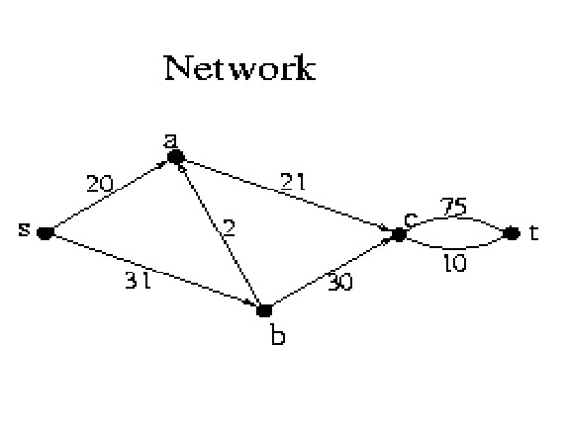
Network Flow
Instance:
  A Network is a directed graph G
  Edges represent pipes that carry flow
  Each edge <u,v> has a maximum capacity c_{<u,v>}
  A source node s out of which flow leaves
  A sink node t into which flow arrives

Slide 5
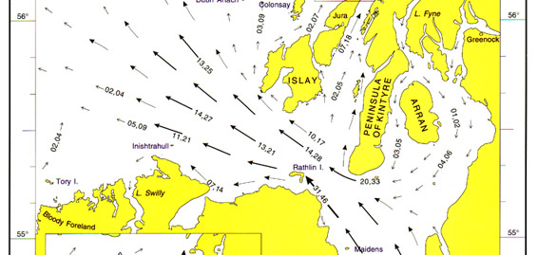
Network Flow
For some edges/pipes,
it is not clear which direction the flow should go
in order to maximize the flow from s to t.
Hence we allow flow in both directions.

Slide 6

Network Flow
This edge/pipe allows
download at a rate of 1719kbps
OR upload at a rate of 244kbps
1719
u
v
Not both
simultaneously
244

Slide 7
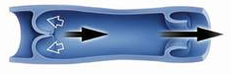
Network Flow
This edge/pipe allows flow
to the right at a rate of 75 L/sec
OR to the left right at a rate of 10 L/sec
75
u
v
10

Slide 8
Network Flow
This edge/pipe allows flow
to the right at a rate of 75 L/sec
OR to the left right at a rate of 10 L/sec
15/75
u
v
0/10
Currently the flow is
to the right at 15 L/sec

Slide 9
Network Flow
This edge/pipe allows flow
to the right at a rate of 75 L/sec
OR to the left right at a rate of 10 L/sec
0/75
u
v
5/10
Currently the flow is
to the left at 5 L/sec

Slide 10
Network Flow
Solution:
  The amount of flow F_{<u,v>} through each edge.
  Flow can’t exceed capacity i.e. F_{<u,v>} ≤ c_{<u,v>}.
  Unidirectional flow
    F_{<u,v>} ≥ 0 and F_{<v,u>} = 0
    or
    F_{<u,v>} = 0 and F_{<v,u>} ≥ 0
Some texts:
F_{<u,v>} = -F_{<v,u>}

Slide 11

Network Flow
Solution:
  The amount of flow F_{<u,v>} through each edge.
  Flow F_{<u,v>} can’t exceed capacity c_{<u,v>}.
  Unidirectional flow
  No leaks, no extra flow.

Slide 12
Network Flow
Solution:
  The amount of flow F_{<u,v>} through each edge.
  Flow F_{<u,v>} can’t exceed capacity c_{<u,v>}.
  Unidirectional flow
  No leaks, no extra flow.
    For each node v: flow in = flow out
  ∑_{u} F_{<u,v>} = ∑_{w} F_{<v,w>}
Except for s and t.

Slide 13
Network Flow
Value of Solution:
  Flow from s into the network
  minus flow from the network back into s.
  rate(F) = ∑_{u} F_{<s,u>}
  = flow from network into t
  minus flow back in.
  = ∑_{u} F_{<u,t>} - ∑_{v} F_{<t,v>}
- ∑_{v} F_{<v,s>}
What about
flow back into s?
Goal:
Max Flow

Slide 14
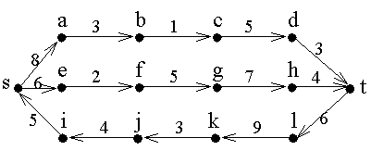
Network Flow
A network
with its edge capacities
What is the maximum that can flow from s to t?

Slide 15
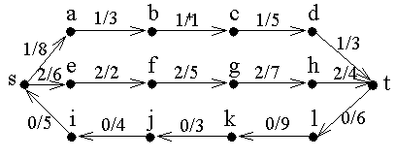
Network Flow
A network
with its edge capacities
The max total rate of the flow is 1+2-0 = 3.
flow/capacity = 2/5
Prove that total can not be higher.

Slide 16
Network Flow
No more flow can be pushed
along the top path because the
edge <b,c> is at capacity.
Similarly, the edge <e,f>.
No flow is pushed along the bottom path because this would decrease the total from s to t.

Slide 17
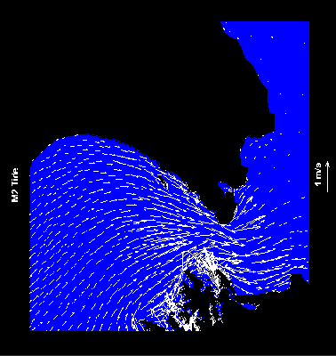
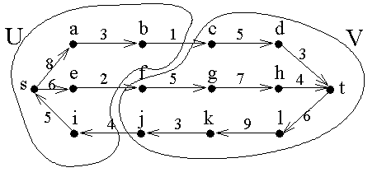
Network Flow
<U,V> is a minimum cut
Its capacity is the sum of the capacities crossing the cut
= 1+2 = 3.
<i,j> is not included in because it is going in the wrong direction.

Slide 18
Network Flow
The edges crossing forward across the cut are at capacity
those crossing backwards have zero flow.
This is always true.

Slide 19
Network Flow
The maximum flow is 1+2=3
The minimum cut is 1+2=3.
These are always equal.

Slide 20
An Application: Matching
Sam | Mary
Bob | Beth
John | Sue
Fred | Ann
3 matches
Can we do better?
4 matches
Who loves whom.
Who should be matched with whom
so as many as possible matched
and nobody matched twice?

Slide 21
An Application: Matching
s
t
1
1
u
v
c_{<s,u>} = 1
  Total flow out of u = flow into u ≤ 1
  Boy u matched to at most one girl.
c_{<v,t>} = 1
  Total flow into v = flow out of v ≤ 1
  Girl v matched to at most one boy.

Slide 22
Network Flow
Strategy:
  Push flow into s.
  Must make decisions.
  Get stuck and must backtrack.
  Difficult and time consuming.
c=100
c=1
c=100
f=100
s
f=100
c=100

Slide 23
Network Flow
Strategy:
  Find a path for a single drop.
  Push as much flow through as fits.
  w = augment = Min_{<u,v> ∈ Path} c_{<u,v>}

Slide 24
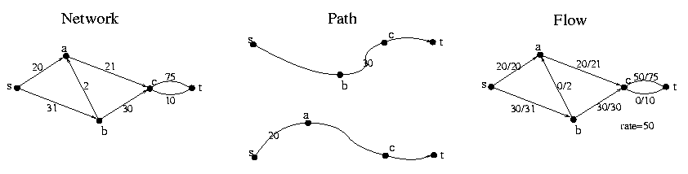
Network Flow
Strategy:
  Find a path for a single drop.
  Push as much flow through as fits.
  w = augment = Min_{<u,v> ∈ Path} c_{<u,v>}
flow/capacity = 20/21

Slide 25

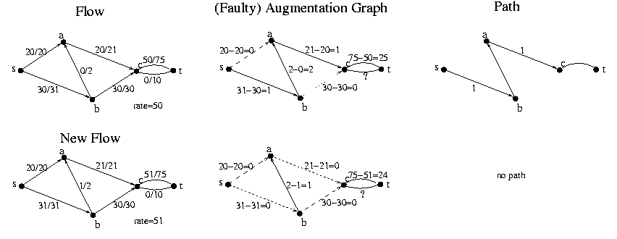
Network Flow
+w
+w
+w
+w
Given Flow F
  Construct Augmenting Graph G_{F}
  Find path P using BFS, DFS,
  or generic search algorithm
  Let w be the max amount flow
  can increase along path P.
  Increase flow along path P by w.
  i.e newF = oldF + w × P

Slide 26
Network Flow
Given Flow F
  Construct Augmenting Graph G_{F}
  Find path P using BFS, DFS,
  or generic search algorithm
  No path
  Stop.

Slide 27

Hill Climbing
We have a valid solution.
(not necessarily optimal)
measure
progress
Value of our solution.
Take a step that goes up.
Make small local changes to your solution to
construct a slightly better solution.
Initially have the “zero
Global Max
Exit
Can't take a step that goes up.
Local Max
Problems:
Running time?
Can our Network Flow
Algorithm get stuck
in a local maximum?
If you take small step,
could be exponential time.

Slide 28
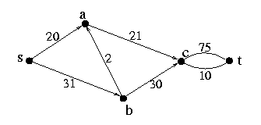
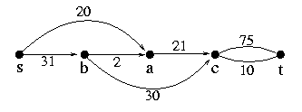
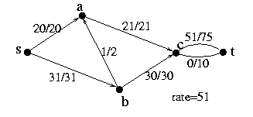
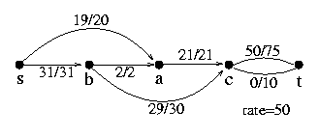
Network Flow
Can our Network Flow Algorithm
get stuck in local max?
Yes!
Need only one example.
Previous Input
Same Input
Previous Output
Worse Output

Slide 29
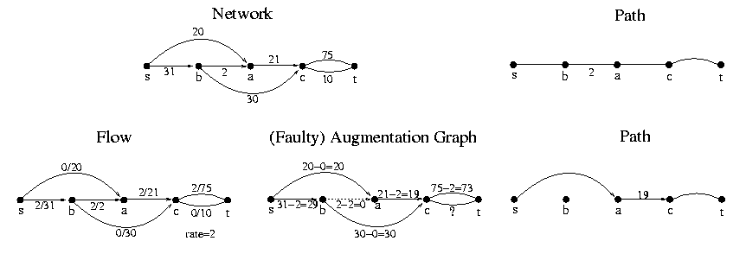
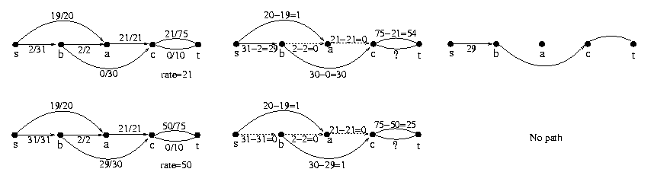
Network Flow

Slide 30
Network Flow
Yes! Our Network Flow
Algorithm can get stuck.
Need only one example.
Previous Input
Same Input
Previous Output
Worse Output

Slide 31
Hill Climbing
Avoiding getting stuck
in a local maximum
Bad Execution
Good Execution
Made better choices of direction
  Hard
Back up an retry
  Exponential time
Define a bigger step

Slide 32
Hill Climbing
Different
Solutions
Alg defines
to where alg can step
i.e. what small local
changes can be made to
current solution
Current
Solution
This defines
the topography

Slide 33
Hill Climbing
Different
Solutions
Define a slightly
bigger step
Current
Solution
This defines
the topography
Perhaps removes some local maxima

Slide 34
Network Flow
Mistake?
Putting 2 through
this edge
Previous Input
Same Input
Previous Output
Worse Output

Slide 35
Network Flow
Mistake?
We need to decrease the flow in this edge.
But if we decrease the total flow then
the algorithm might run exponentially
or forever.
We need to decrease the flow in this edge
AND increase the total flow.
Putting 2 through
this edge

Slide 36
Network Flow
Let us focus on how much
we can CHANGE
the rate of flow
through a given edge.

Slide 37
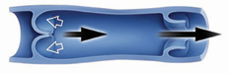
Network Flow
This edge/pipe allows flow
to the right at a rate of 75 L/sec
OR to the left right at a rate of 10 L/sec
15/75
u
v
0/10
Currently the flow is
to the right at 15 L/sec

Slide 38
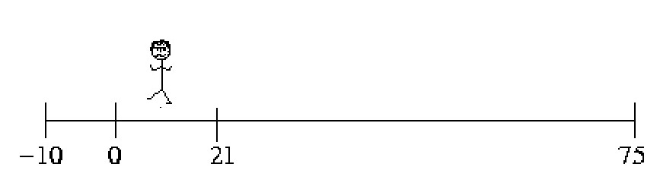
Network Flow
15
Eqv Flow Graph
F_{<u,v>}∈[-10,75]
u
v
F_{<u,v>} = 15
15/75
u
v
0/10
Currently the flow is
to the right at 15 L/sec

Slide 39
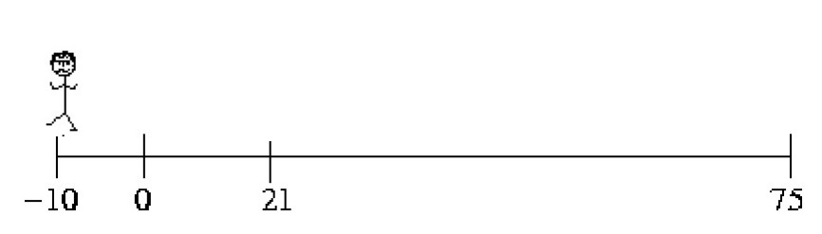
Network Flow
15
Eqv Flow Graph
F_{<u,v>}∈[-10,75]
u
v
F_{<u,v>} = -10
0/75
u
v
10/10
Currently the flow is
to the left at 10 L/sec

Slide 40

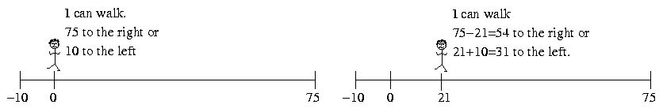
Network Flow
Current Flow
Resulting Flow
15
20
Eqv Flow Graph
Eqv Flow Graph
F_{<u,v>}∈[-10,75]
F_{<u,v>}∈[-10,75]
u
v
u
v
F_{<u,v>} = 15
F_{<u,v>} = 20
Add 5 flow to right

Slide 41
Network Flow
Current Flow
Resulting Flow
15
10
Eqv Flow Graph
Eqv Flow Graph
F_{<u,v>}∈[-10,75]
F_{<u,v>}∈[-10,75]
u
v
u
v
F_{<u,v>} = 15
F_{<u,v>} = 10
Add -5 flow to right
Equivalent
Add 5 flow to left

Slide 42
Network Flow
Current Flow
Resulting Flow
15
-5
Eqv Flow Graph
Eqv Flow Graph
F_{<u,v>}∈[-10,75]
F_{<u,v>}∈[-10,75]
u
v
u
v
F_{<u,v>} = 15
F_{<u,v>} = -5
Add -20 flow to right
Equivalent
Add 20 flow to left

Slide 43
Network Flow
Resulting Flow
-5
Eqv Flow Graph
F_{<u,v>}∈[-10,75]
u
v
F_{<u,v>} = -5
Flow Graph
Flow Graph
-5/75
0/75
u
v
u
v
0/10
Equivalent
5/10

Slide 44
Network Flow
Allowed change
to the right
15
75-15 = 60
Eqv Flow Graph
F_{<u,v>}∈[-10,75]
u
v
F_{<u,v>} = 15
Walking Δ
New Flow Graph
15+Δ ≤ 75
F_{<u,v>}+Δ ≤ c_{<u,v>}
Δ ≤ c_{<u,v>}-F _{<u,v>}
15+Δ /75
u
v
0/10

Slide 45
Network Flow
Allowed change
to the left
15
15+10=25
Eqv Flow Graph
F_{<u,v>}∈[-10,75]
Allowed Flow
≠
Allowed Change in Flow
u
v
F_{<u,v>} = 15
Walking Δ
15-Δ ≥ -10
F_{<u,v>}-Δ ≥ -c_{<v,u>}
Δ ≤ F _{<u,v>} + c_{<v,u>}
New Flow Graph
15- Δ /75
u
v
0/10

Slide 46
Network Flow
Allowed change
to the left
Allowed change
to the right
15
75-15 = 60
15+10=25
Eqv Flow Graph
F_{<u,v>}∈[-10,75]
u
v
F_{<u,v>} = 15
Augmentation Graph
Δ ≤ c_{<u,v>}-F _{<u,v>}
u
v
Δ ≤ F _{<u,v>} + c_{<v,u>}

Slide 47
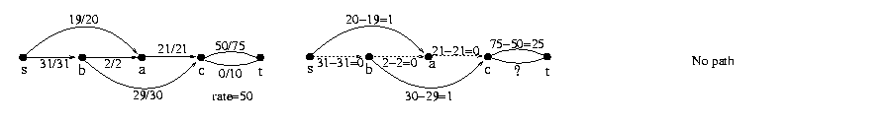
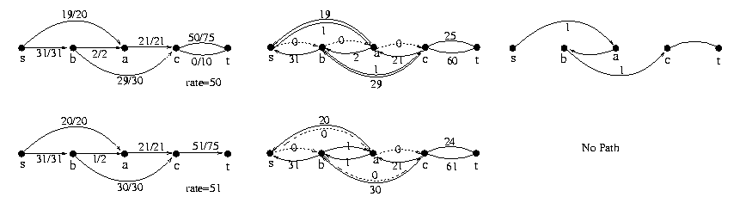
Network Flow
Where we got stuck before
Old
New
Given Flow F
  Construct Augmenting Graph G_{F}
  Find path P

Slide 48
Network Flow
+w
?
+w
-w
+w
Given Flow F
  Construct Augmenting Graph G_{F}
  Find path P
  Let w be the max amount flow
  can increase along path P.
  Increase flow along path P by w.
  i.e newF = oldF + w × P

Slide 49
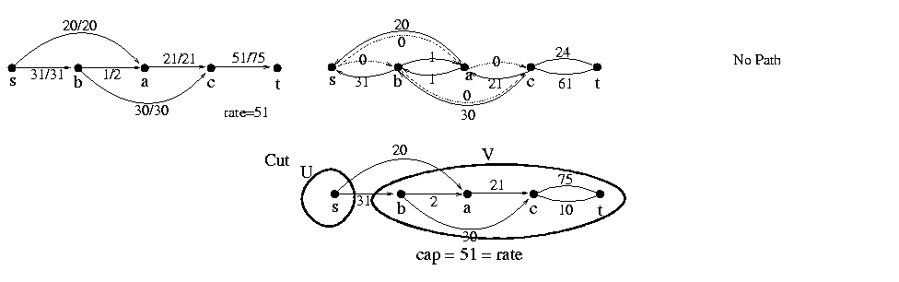
Network Flow
Given Flow F
  Construct Augmenting Graph G_{F}
  Find path P using BFS, DFS,
  or generic search algorithm
  No path
  Stop.

Slide 50
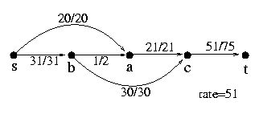
Network Flow
Previous Input
Same Input
Previous Output
Worse Output
Same Output

Slide 51
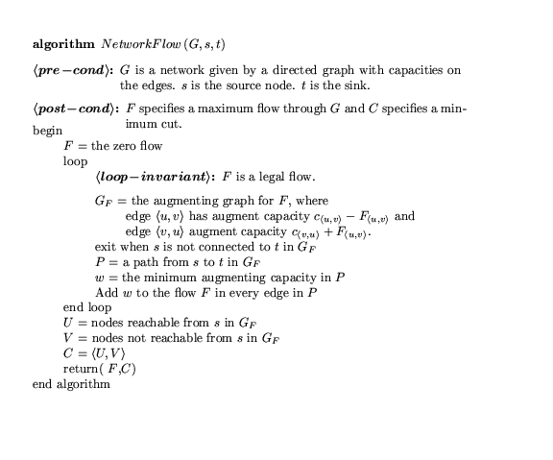

Slide 52
An Application: Matching
Sam | Mary
Bob | Beth
John | Sue
Fred | Ann
3 matches
Can we do better?
4 matches
Who loves whom.
Who should be matched with whom
so as many as possible matched
and nobody matched twice?

Slide 53
An Application: Matching
Flow
New Flow
s
t
s
t
Augmentation Graph
Augmentation Path
Alternates
  adding edge
  removing edge
  adding edge
  removing edge
  adding edge
Extra edge added
s
t

Slide 54
An Application: Matching
Sam | Mary
Bob | Beth
John | Sue
Fred | Ann
3 matches
Can we do better?
4 matches
Who loves whom.
Who should be matched with whom
so as many as possible matched
and nobody matched twice?

Slide 55
Network Flow
Can our Network Flow Algorithm
get stuck in local max?
No!
Need to prove
  for every input network
  for every choice of augmenting paths
Maximum Flow is found!
How?

Slide 56
Primal-Dual Hill Climbing
Mars settlement has hilly landscape
and many layers of roofs.

Slide 57
Primal-Dual Hill Climbing
Primal Problem:
Exponential # of locations to stand.
Find a highest one.
Dual problem:
Exponential # of roofs.
Find a lowest one.

Slide 58
Primal-Dual Hill Climbing
Prove:
Every roof is above every location to stand.
∀ R ∀ L height(R) ≥ height(L)
⇒ height(R_{min}) ≥ height(L_{max})
Is there a gap?

Slide 59
Primal-Dual Hill Climbing
Prove:
For every location to stand either:
  the alg takes a step up or
  the alg gives a reason that explains why not
  by giving a roof of equal height.
  i.e. ∀ L [∃ L’ height(L’) > height(L) or
∃ R height(R) = height(L)]
or
No Gap
But ∀ R ∀ L height(R) ≥ height(L)

Slide 60
Primal-Dual Hill Climbing
Prove:
For every location to stand either:
  the alg takes a step up or
  the alg gives a reason that explains why not
  by giving a roof of equal height.
  i.e. ∀ L [∃ L’ height(L’) > height(L) or
∃ R height(R) = height(L)]
or
?
Can't go up from this location
and no matching roof.
Can't happen!

Slide 61
Primal-Dual Hill Climbing
Prove:
For every location to stand either:
  the alg takes a step up or
  the alg gives a reason that explains why not
  by giving a roof of equal height.
  i.e. ∀ L [∃ L’ height(L’) > height(L) or
∃ R height(R) = height(L)]
or
No local maximum!

Slide 62
Primal-Dual Hill Climbing
Exit
Claim: Primal and dual have the same optimal value.
height(R_{min}) = height(L_{max})
Proved: ∀ R ∀ L, height(R) ≥ height(L)
Proved: Alg runs until it provides L_{alg} and R_{alg}
height(R_{alg}) = height(L_{alg})
height(R_{min}) ≤
height(R_{alg}) =
height(L_{alg}) ≤
height(L_{max})
height(R_{min}) ≥
height(L_{max})
No Gap
L_{alg} witness that height(L_{max}) is no smaller.
R_{alg} witness that height(L_{max}) is no bigger.

Slide 63
Network Flow
A network
with its edge capacities
What is the maximum that can flow from s to t?

Slide 64
Network Flow
A network
with its edge capacities
The max total rate of the flow is 1+2-0 = 3.
flow/capacity = 2/5
Prove that total can not be higher.

Slide 65
Network Flow
No more flow can be pushed
along the top path because the
edge <b,c> is at capacity.
Similarly, the edge <e,f>.
No flow is pushed along the bottom path because this would decrease the total from s to t.

Slide 66
Network Flow
<U,V> is a minimum cut
Its capacity is the sum of the capacities crossing the cut
= 1+2 = 3.
<i,j> is not included in because it is going in the wrong direction.

Slide 67
Network Flow
The edges crossing forward across the cut are at capacity
those crossing backwards have zero flow.
This is always true.

Slide 68
Network Flow
The maximum flow is 1+2=3
The minimum cut is 1+2=3.
These are always equal.

Slide 69
Primal-Dual Network Flow
Primal Problem: Max Flow
Dual Problem:
What are the roofs to the flows?
Min Cut

Slide 70
Min Cut
Instance:
  A Network is a directed graph G
  Special nodes s and t.
  Edges represent pipes that carry flow
  Each edge <u,v> has a maximum capacity c_{<u,v>}
s
t

Slide 71
Min Cut
Instance:
  A Network is a directed graph G
  Special nodes s and t.
  Edges represent pipes that carry flow
  Each edge <u,v> has a maximum capacity c_{<u,v>}

Slide 72
Min Cut
Solution:
C = partition of nodes <U,V> with s∈U, t∈V.
U
= Canada
s
V
= USA
York
t
UC Berkeley

Slide 73
Min Cut
Solution:
C = partition of nodes <U,V> with s∈U, t∈V.
s
York
Ontario
t
UC Berkeley

Slide 74
Min Cut
Solution:
C = partition of nodes <U,V> with s∈U, t∈V.
Toronto
s
York
t
UC Berkeley

Slide 75
Min Cut
Solution:
C = partition of nodes <U,V> with s∈U, t∈V.
York
s
York
t
UC Berkeley

Slide 76
Min Cut
Solution:
C = partition of nodes <U,V> with s∈U, t∈V.
s
York
UCB
t
UC Berkeley

Slide 77
Min Cut
Solution:
C = partition of nodes <U,V> with s∈U, t∈V.
s
York
Berkeley
t
UC Berkeley

Slide 78
Min Cut
Solution:
C = partition of nodes <U,V> with s∈U, t∈V.
U
s
York
V
t
UC Berkeley

Slide 79
Min Cut
Value Solution C=<U,V>:
cap(C) = how much can flow from U to V
= ∑_{u∈U,v∈V} c_{<u,v>}
Goal:
Min Cut
U
s
V
u
v
t

Slide 80
Max Flow = Min Cut
Theorem:
  For all Networks Max_{F} rate(F) = Min_{C} cap(C)
Prove: ∀ F,C rate(F) ≤ cap(C)
Exit
Prove: ∀ flow F, alg either
  finds a better flow F
  or finds cut C such that rate(F) = cap(C)
Alg stops with an F and C for which rate(F) = cap(C)
  F witnesses that the optimal flow can't be less
  C witnesses that it can't be more.
U
V
u
v

Slide 81
Max Flow = Min Cut
Prove: ∀ flow F, cut C rate(F) ≤ cap(C)
cap(C) = how much can flow from U to V
= ∑_{u∈U,v∈V} c_{<u,v>}
rate(F,C) = Flow from U to V minus flow V to U
= ∑_{u∈U,v∈V} F_{<u,v>} - F_{<v,u>}
Lemma: rate(F) = rate(F,C) ≤ cap(C)
No leaks, no extra flow.
F_{<u,v>} ≤ c_{<u,v>} & F_{<v,u>} ≥ 0
U
= Canada
s
V
= USA
York
+
-
t
UC Berkeley

Slide 82
Max Flow = Min Cut
Lemma: ∀F,C rate(F,C) = rate(F)
Proof: By induction on the size of U.
Base case: C = <{s},G-{s}>
rate(F) = Flow from s into the network
minus flow from the network back into s
  = ∑_{u} F_{<s,u>} - ∑_{v} F_{<v,t>}
  = rate(F,C) where C = <{s},G-{s}>
+
s
York
-
t
UC Berkeley

Slide 83
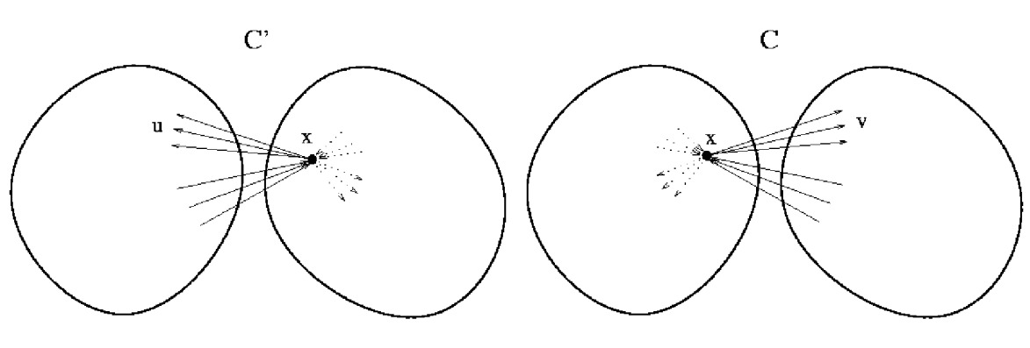
Max Flow = Min Cut
Lemma: ∀F,C rate(F,C) = rate(F)
Proof: By induction on the size of C.
Base case: C = <{s},G-{s}>
Inductive step: Move nodes across C one at a time.
Flow into x = Flow out.
Hence, flow across cut does not change.
rate(F) = rate(F,C) ≤ cap(C)

Slide 84
Max Flow = Min Cut
Theorem:
  For all Networks Max_{F} rate(F) = Min_{C} cap(C)
Prove: ∀ F,C rate(F) ≤ cap(C)
Prove: ∀ flow F, alg either
  finds a better flow F
  or finds cut C such that rate(F) = cap(C)
U
V
u
v

Slide 85
Max Flow = Min Cut
+w
-w
+w
+w
Given Flow F
  Construct Augmenting Graph G_{F}
  Find path P
  Let w be the max amount flow
  can increase along path P.
  Increase flow along path P by w.
  i.e newF = oldF + w × P

Slide 86
Max Flow = Min Cut
Given Flow F
  Construct Augmenting Graph G_{F}
  Find path P using BFS, DFS,
  or generic search algorithm
  No path
  Stop

Slide 87
Max Flow = Min Cut
Bad example because
U might contain
more than s.
  Let F_{alg} be this final flow.
  Let cut C_{alg}=<U,V>,
    where U are the nodes reachable from s
    in the augmented graph
    and V not.
  Claim: rate(F_{alg}) = cap(C_{alg})

Slide 88
Max Flow = Min Cut
Prove: rate(F_{alg}) = cap(C_{alg})
=
Prove: rate(F_{alg},C_{alg}) = cap(C_{alg})

Slide 89
Max Flow = Min Cut
Prove: rate(F_{alg},C_{alg}) = cap(C_{alg})
cap(C) = how much can flow from U to V
= ∑_{u∈U,v∈V} c_{<u,v>}
rate(F,C) = Flow from U to V minus flow V to U
= ∑_{u∈U,v∈V} F_{<u,v>} - F_{<v,u>}
Flow Graph
U
V
+
F_{<u,v>}/c_{<u,v>}
u
v
-
F_{<u’,v’>}/c_{<u’,v’>}
v’
u’

Slide 90
Max Flow = Min Cut
Prove: rate(F_{alg},C_{alg}) = cap(C_{alg})
cap(C) = how much can flow from U to V
= ∑_{u∈U,v∈V} c_{<u,v>}
rate(F,C) = Flow from U to V minus flow V to U
= ∑_{u∈U,v∈V} F_{<u,v>} - F_{<v,u>}
Flow Graph
U
V
need equal
+
F_{<u,v>}/c_{<u,v>}
u
v
need zero
-
F_{<u’,v’>}/c_{<u’,v’>}
v’
u’

Slide 91
Max Flow = Min Cut
Prove: rate(F_{alg},C_{alg}) = cap(C_{alg})
cap(C) = how much can flow from U to V
= ∑_{u∈U,v∈V} c_{<u,v>}
rate(F,C) = Flow from U to V minus flow V to U
= ∑_{u∈U,v∈V} F_{<u,v>} - F_{<v,u>}
Flow Graph
Augmentation Graph
U
V
reachable from s =
U
V
= not
need equal
not edges
+
F_{<u,v>}/c_{<u,v>}
c_{<u,v>}-F_{<u,v>}
=0
u
v
u
v
need zero
-
F_{<u’,v’>}/c_{<u’,v’>}
v’
u’
v’
u’
F_{<u’,v’>}+c_{<v’,u’>}
=0

Slide 92
Max Flow = Min Cut
Theorem:
  For all Networks Max_{F} rate(F) = Min_{C} cap(C)
Prove: ∀ F,C rate(F) ≤ cap(C)
Prove: ∀ flow F, alg either
  finds a better flow F
  or finds cut C such that rate(F) = cap(C)
Alg stops with an F and C for which rate(F) = cap(C)
  F witnesses that the optimal flow can't be less
  C witnesses that it can't be more.
U
V
u
v

Slide 93
Hill Climbing
Problems:
Can our Network Flow
Algorithm get stuck
in a local maximum?
Global Max
No!
Local Max

Slide 94
Hill Climbing
Problems:
Running time?
If you take small step,
could be exponential time.

Slide 95
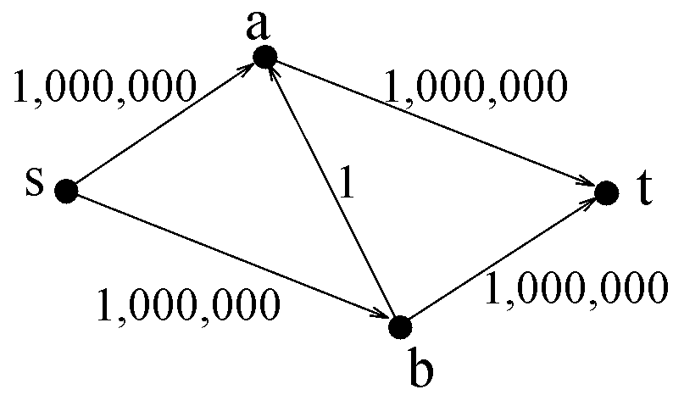
Network Flow

Slide 96
Network Flow
Add flow 1

Slide 97
Network Flow
Add flow 1

Slide 98
Hill Climbing
Problems:
Running time?
If each iteration you take
the biggest step possible,
  Alg is poly time
    in number of nodes
    and number of bits in capacities.
If each iteration you take
path with the fewest edges
  Alg is poly time
    in number of nodes

Slide 99
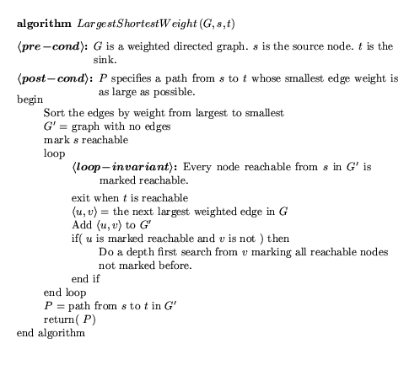
Taking the biggest step possible

Slide 100
Taking the biggest step possible
m = # edges
l = # bits to specify capacities.
The flow F_{t} must increase from 0 to up to
To be poly time, we could have F_{t} double each iteration.
But it does not ☹
m×2^{l}
F_{T} = m×2^{l}
T = log(m) + l
F₀ = 0

Slide 101
Taking the biggest step possible
R_{t} = How much the flow can increase by
= MaxFlow - F_{t}
To be poly time, we could have R_{t} half each iteration.
Or decrease by a (1-1/m) factor
R_{T} = 0
R₀ = m×2^{l}
= 0

Slide 102
Taking the biggest step possible
R_{t} = How much the flow can increase by
= MaxFlow - F_{t}
Choose any cut C = ⟨U,V⟩.
R_{t} ≤ Σ_{e∈C} augment_{e}
U
s
V
u
v
t

Slide 103
Taking the biggest step possible
Let w_{t} = amount F_{t} increases
= the min augment in augmenting path
Let Cut = ⟨U,V⟩
where nodes u∈U are reachable from s
with edges with augment amount > w_{t},
i.e. the last graph in previous algorithm
for which s is not reachable from t.
Σ_{e∈C} augment_{e} ≤ Σ_{e∈C} w_{t} ≤ m w_{t}
(where m = # edges in graph)
U
s
V
u
v
t

Slide 104
Taking the biggest step possible
R_{t} = MaxFlow – F_{t}
≤ Σ_{e∈C} augment_{e}
≤ m w_{t} ≤ m × amount F_{t} increases
≤ m × amount R_{t} decreases
R_{t+1} = R_{t} - amount R_{t} decreases
≤ R_{t} – ¹/_{m} R_{t}
= (1– ¹/_{m}) R_{t}
Decreasing by an m^{th}!
Does this stop after m iterations?
No because as decreases,
the decrease decreases.

Slide 105
Taking the biggest step possible
R_{t} = How much the flow can increase by
= MaxFlow - F_{t}
To be poly time, we could have R_{t}
decrease by a (1-1/m) factor each iteration
R_{t+1} ≤ (1– ¹/_{m}) R_{t}
R_{T} = 0
End game: ¹/₂, ¹/₄, ¹/₈, ¹/₁₆, …. ?
All flows are integers.
Hence, decreasing R_{T} < 1 is good enough.
R₀ = m×2^{l}
= 0

Slide 106
Taking the biggest step possible
R_{t+1} ≤ (1– ¹/_{m}) R_{t}
R_{T} ≤
(1– ¹/_{m})^{T} R₀
< 1

Slide 107
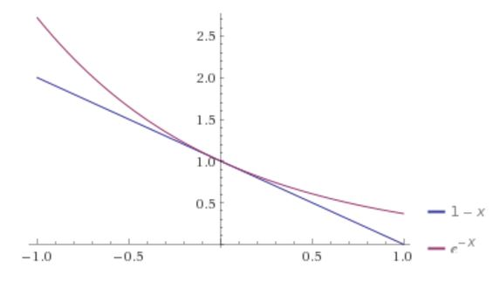
Taking the biggest step possible
(1– ¹/_{m})^{T} R₀
< 1
(e^{-1/m})^{T} R₀

Slide 108
Taking the biggest step possible
(1– ¹/_{m})^{T} R₀
< 1
(e^{-1/m})^{T} R₀
(e^{-T/m}) R₀
-^{T}/_{m} + ln(R₀) = ln(1) = 0
T = m ln(R₀)
= m ln(m×2^{l})
= m (l + ln m)
m = # edges
l = # bits to specify capacities.

Slide 109
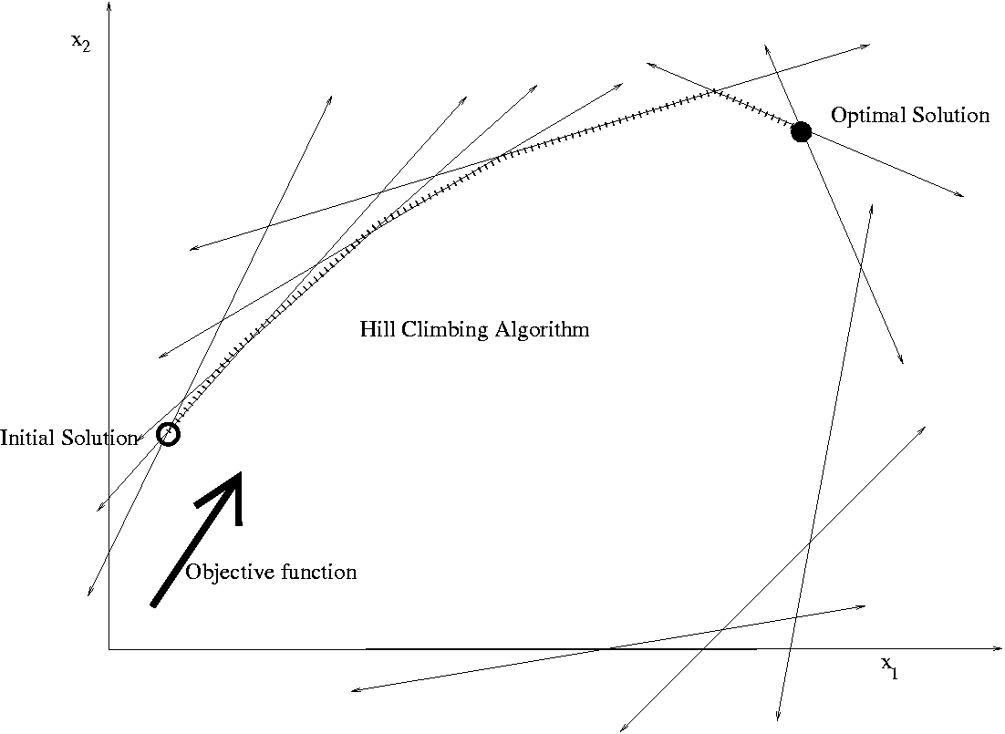
Linear Programming

Slide 110
A Hotdog
A combination of pork, grain, and sawdust, …

Slide 111
Constraints:
  Amount of moisture
  Amount of protein,
  …

Slide 112
The Hotdog Problem
Given today’s prices,
what is a fast algorithm
to find the cheapest hotdog?

Slide 113
Abstract Out Essential Details
sawdust
grain
pork
water
Amount to add: x₁, x₂, x₃, x₄
Cost: 29, 8, 1, 2
Cost of Hotdog:
29x₁ + 8x₂ + 1x₃ + 2x₄
Constraints:
  moisture
  protein,
  …
3x₁ + 4x₂ – 7x₃ + 8x₄ ≤ 12
2x₁ - 8x₂ + 4x₃ - 3x₄ ≤ 24
-8x₁ + 2x₂ – 3x₃ - 9x₄ ≤ 8
x₁ + 2x₂ + 9x₃ - 3x₄ ≤ 31

Slide 114
Abstract Out Essential Details
Minimize:
29x₁ + 8x₂ + 1x₃ + 2x₄
Subject to:
3x₁ + 4x₂ – 7x₃ + 8x₄ ≤ 12
2x₁ - 8x₂ + 4x₃ - 3x₄ ≤ 24
-8x₁ + 2x₂ – 3x₃ - 9x₄ ≤ 8
x₁ + 2x₂ + 9x₃ - 3x₄ ≤ 31

Slide 115
A Fast Algorithm
For decades people thought that there was no fast algorithm.
≈
Then one was found!
Minimize:
29x₁ + 8x₂ + 1x₃ + 2x₄
Theoretical Computer Science
finds new algorithms every day.
Subject to:
3x₁ + 4x₂ – 7x₃ + 8x₄ ³ 12
2x₁ - 8x₂ + 4x₃ - 3x₄ ³ 24
-8x₁ + 2x₂ – 3x₃ - 9x₄ ³ 8
x₁ + 2x₂ + 9x₃ - 3x₄ ³ 31

Slide 116
Network Flow as a
Linear Program
Given an instance of Network Flow: <G,c_{<u,v>}>
express it as a Linear Program:
  The variables:
  Maximize:
  Subject to:
  Flows f_{<u,v>} for each edge.
rate(F) = ∑_{u} F_{<s,u>} - ∑_{v} F_{<v,s>}
∀<u,v>: F_{<u,v>} ≤ c_{<u,v>}. (Flow can't exceed capacity)
∀v: ∑_{u} F_{<u,v>} = ∑_{w} F_{<v,w>} (flow in = flow out)

Slide 118
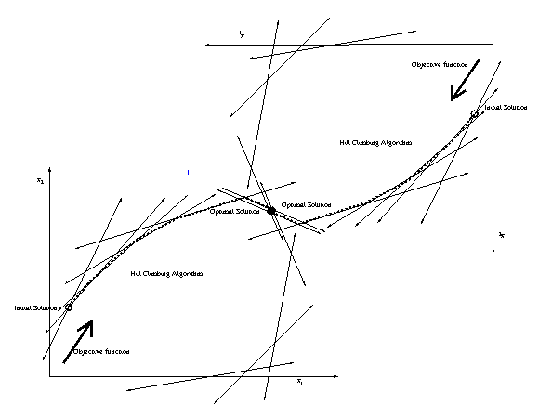
Dual
Primal

Slide 119
End

Slide 120
Network Flow
Locally in each edge,
we see how much we can change the flow.
Allowed Flow ≠ Allowed Change in Flow
People find this hard.
This is my first attempt to explain it.

Slide 121
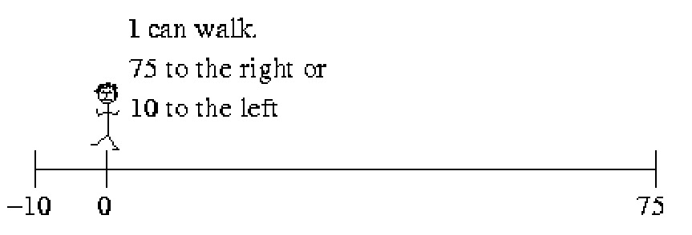
Network Flow
Old Flow Graph
0/75
u
v
0/10
Walking 10
New Flow Graph
10/75
u
v
0/10

Slide 122
Network Flow
Old Flow Graph
0/75
u
v
0/10
Walking 10
New Flow Graph
0/75
u
v
10/10

Slide 123
Network Flow
Same
Old Flow Graph
0/75
u
v
0/10
Walking -10
Walking 10
New Flow Graph
New Flow Graph
-10/75
Not allowed
0/75
u
v
u
v
0/10
10/10

Slide 124
Network Flow
Same
Eqv Flow Graph
F_{<u,v>}∈[-10,75]
u
v
F_{<u,v>} = -10
Walking -10
Walking 10
New Flow Graph
New Flow Graph
-10/75
Not allowed
0/75
u
v
u
v
0/10
10/10

Slide 125
Network Flow
Eqv Flow Graph
F_{<u,v>}∈[-10,75]
u
v
F_{<u,v>} = 10
Walking Δ
New Flow Graph
10+Δ ≤ 75
F_{<u,v>}+Δ ≤ c_{<u,v>}
Δ ≤ c_{<u,v>}-F _{<u,v>}
10+Δ /75
u
v
0/10

Slide 126
Network Flow
Eqv Flow Graph
F_{<u,v>}∈[-10,75]
u
v
F_{<u,v>} = 10
Walking Δ
10-Δ ≥ -10
F_{<u,v>}-Δ ≥ -c_{<v,u>}
Δ ≤ F _{<u,v>} + c_{<v,u>}
New Flow Graph
10- Δ /75
u
v
0/10

Slide 127
Network Flow
Eqv Flow Graph
F_{<u,v>}∈[-10,75]
u
v
F_{<u,v>} = 10
Augmentation Graph
Δ ≤ c_{<u,v>}-F _{<u,v>}
u
v
Δ ≤ F _{<u,v>} + c_{<v,u>}

Slide 128
Network Flow
Locally in each edge,
we see how much we can change the flow.
Allowed Flow ≠ Allowed Change in Flow
People find this hard.
This is my second attempt to explain it.

Slide 129
Network Flow
Flow Graph
0/75
u
v
0/10
Augmentation Graph
75
u
v
10

Slide 130
Network Flow
Walking
Flow Graph
21+2=23
21/75
u
v
0/10
Augmentation Graph
75-21=54
u
v
2

Slide 131
Network Flow
Walking -10
Walking 10
Flow Graph
21-10=11
21/75
u
v
0
10
Edge shouldn’t
have flow in
both directions.
0/10
Augmentation Graph
75-21=54
u
v
10
10
?

Slide 132
Network Flow
Flow Graph
11/75
u
v
Capacity of 10 not met
0/10
Augmentation Graph
75-21=54
u
v
10
10
?

Slide 133
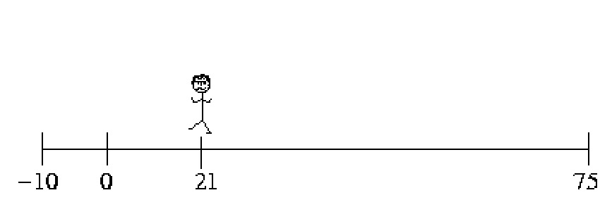
Network Flow
Flow Graph
21/75
u
v
Capacity of 10 exceeded
21
0/10
Augmentation Graph
75-21=54
u
v
21
10
?

Slide 134
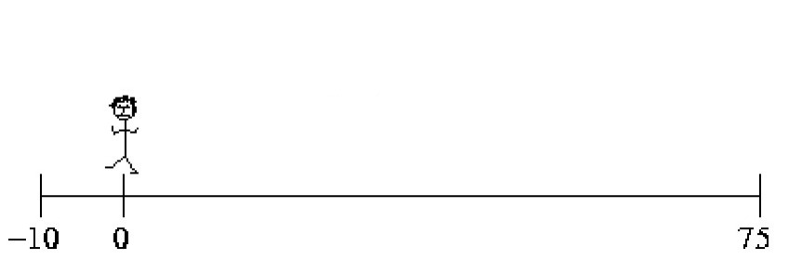
Network Flow
Walking -21
Walking 21
Flow Graph
21-21=0
21/75
u
v
Capacity of 10 not met
0/10
Augmentation Graph
75-21=54
u
v
21
10
?

Slide 135
Network Flow
Walking 21
and another 10
Flow Graph
21-21=0
21/75
u
v
Capacity of 10 met
10
0/10
Augmentation Graph
75-21=54
u
v
21+10
10
?
21+10=31

Slide 136
Network Flow
Walking 25
Flow Graph
21-25=-4
0
21/75
u
v
4
0/10
Augmentation Graph
75-21=54
u
v
25
21+10=31

Slide 137
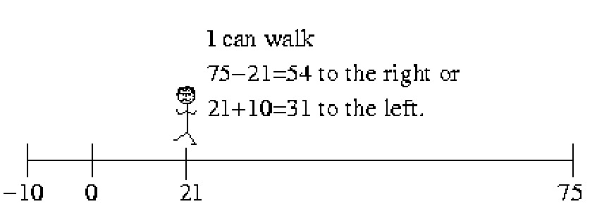
Network Flow
Walking
c_{<v,u>}
F_{<u,v>}
c_{<u,v>}
Flow Graph
Augmentation Graph
F_{<u,v>}+w
F_{<u,v>}/c_{<u,v>}
c_{<u,v>}-F_{<u,v>}
u
v
u
w
v
0/c_{<v,u>}
F_{<u,v>}+c_{<v,u>}

Slide 138
Network Flow
Walking
c_{<u,v>}
F_{<u,v>}
c_{<u,v>}
Flow Graph
Augmentation Graph
F_{<u,v>}-w
F_{<u,v>}/c_{<u,v>}
c_{<u,v>}-F_{<u,v>}
u
v
u
w
v
0/c_{<v.u>}
F_{<u,v>}+c_{<v,u>}

Slide 140
Network Flow
0/75
u
v
0/10
How much flow
can I have
in each direction?
Where can I stand
in each direction?

Slide 141
Network Flow
75/75
u
v
0/10
How much flow
can I have
in each direction?
Where can I stand
in each direction?
75 to the right

Slide 142
Network Flow
0/75
u
v
10/10
How much flow
can I have
in each direction?
Where can I stand
in each direction?
10 to the left
75 to the right

Slide 143
Network Flow
15/75
u
v
15
0/10
Walking 5
Add 5 flow to right
20/75
u
v
20
0/10

Slide 144
Network Flow
15/75
u
v
15
0/10
Walking 75-15=60
Add 75-15=60
flow to right
75/75
u
v
0/10

Slide 145
Network Flow
15/75
u
v
15
0/10
How much can I change
my position to the right?
How much flow can
I add to right
75-15=60
u
v
75-15=60
Augmentation Graph

Slide 146
Network Flow
f/c
u
v
15
0/10
How much can I change
my position to the right?
How much flow can
I add to right
f-c
u
v
Augmentation Graph
75-15=60

Slide 147
Network Flow
15/75
u
v
15
0/10
Walking 5
Add 5 flow to left
15/75
u
v
10
Edge shouldn’t
have flow in
both directions.
5/10

Slide 148
Network Flow
15/75
u
v
15
0/10
Walking 5
Add 5 flow to left
15-5=10/75
u
v
10
0/10

Slide 149
Network Flow
15/75
u
v
15
0/10
Walking 15
Add 15 flow to left
15-15=0/75
u
v
0/10

Slide 150
Network Flow
15/75
u
v
15
0/10
Walking 15+5=20
Add 15+5=20
flow to left
-5/75
u
v
-5
0/10
Edge shouldn’t
have negative flow.

Slide 151
Network Flow
15/75
u
v
15
0/10
Walking 15+5=20
Add 15+5=20
flow to left
0/75
u
v
-5
5/10

Slide 152
Network Flow
15/75
u
v
15
0/10
Walking 15+10=25
Add 15+10=25
flow to left
0/75
u
v
10/10

Slide 153
Network Flow
15/75
u
v
15
0/10
How much can I change
my position to the left?
How much flow can
I add to left
u
v
15
15+10=25
15+10=25
Augmentation Graph

Slide 154
Network Flow
f/75
u
v
15
0/c
How much can I change
my position to the left?
How much flow can
I add to left
u
v
15
f+c
15+10=25
Augmentation Graph

Slide 155
Network Flow
Walking
c_{<v,u>}
F_{<u,v>}
c_{<u,v>}
Flow Graph
Augmentation Graph
F_{<u,v>}+w
F_{<u,v>}/c_{<u,v>}
c_{<u,v>}-F_{<u,v>}
u
v
u
w
v
0/c_{<v,u>}
F_{<u,v>}+c_{<v,u>}

Slide 156
Network Flow
Walking
c_{<u,v>}
F_{<u,v>}
c_{<u,v>}
Flow Graph
Augmentation Graph
F_{<u,v>}-w
F_{<u,v>}/c_{<u,v>}
c_{<u,v>}-F_{<u,v>}
u
v
u
w
v
0/c_{<v.u>}
F_{<u,v>}+c_{<v,u>}

