Slide 1
Sifat-sifat Dasar Pembagian
KELOMPOK 2
FITRI MAYA SARI

Slide 2
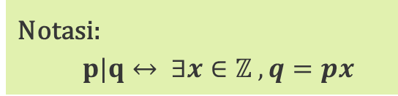
Definisi 2.1
Notasi:
$p|q↔ ∃x∈ℤ ,q=px$

Slide 3
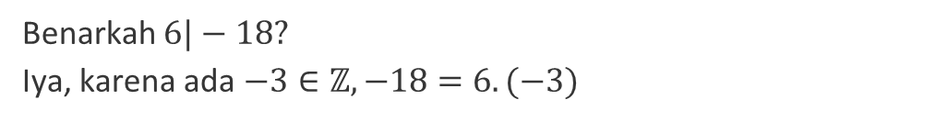
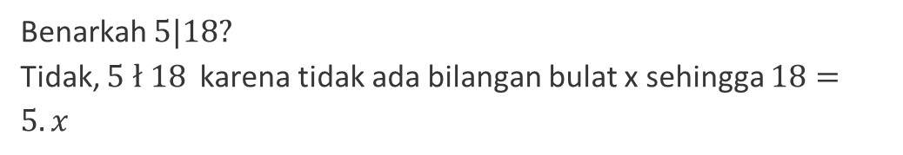
Contoh
01
02
Benarkah $6|−18?$
Iya, karena ada $−3∈ℤ, −18=6.(−3)$
Benarkah $5|18?$
Tidak, $5 ł 18$karena tidak ada bilangan bulat x sehingga $18=5.x$

Slide 4
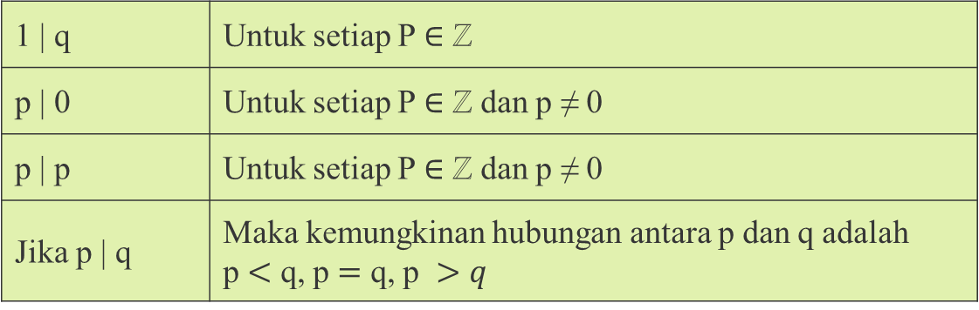
Sifat Sederhana Keterbagian
1 | q | Untuk setiap P $∈$ ℤ
p | 0 | Untuk setiap P $∈$ ℤ dan p ≠ 0
p | p | Untuk setiap P $∈$ ℤ dan p ≠ 0
Jika p | q | Maka kemungkinan hubungan antara p dan q adalah p $<$ q, p $=$ q, p $>q$

Slide 5

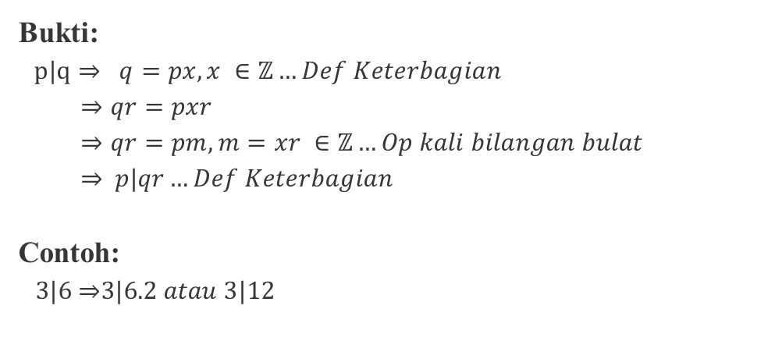
Teorema 2.1
Jika p, q, r $∈$ $ℤ$dan p | qr
Bukti:
$p|q⇒ q=px, x ∈ℤ…Def Keterbagian$
$⇒qr=pxr$
$⇒qr=pm, m=xr ∈ℤ…Op kali bilangan bulat$
⇒$p|qr…Def Keterbagian$
Contoh:
$3|6$⇒$3|6.2 atau 3|12$

Slide 6

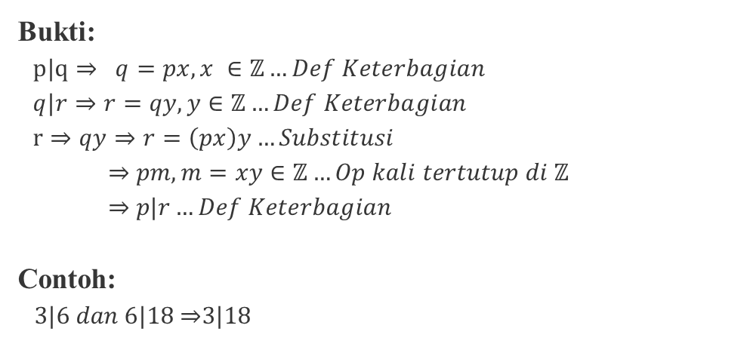
Teorema 2.2
Jika p,q,r $∈$ $ℤ$dan p | q dan q | r ⇒ p | r
Bukti:
$p|q⇒ q=px, x ∈ℤ…Def Keterbagian$
$q|r⇒r=qy, y∈ℤ…Def Keterbagian$
$r⇒qy⇒r=\left(px\right)y…Substitusi$
⇒$pm, m=xy∈ℤ…Op kali tertutup di ℤ$
⇒ $p|r…Def Keterbagian$
Contoh:
$3|6 dan 6|18$⇒$3|18$

Slide 7

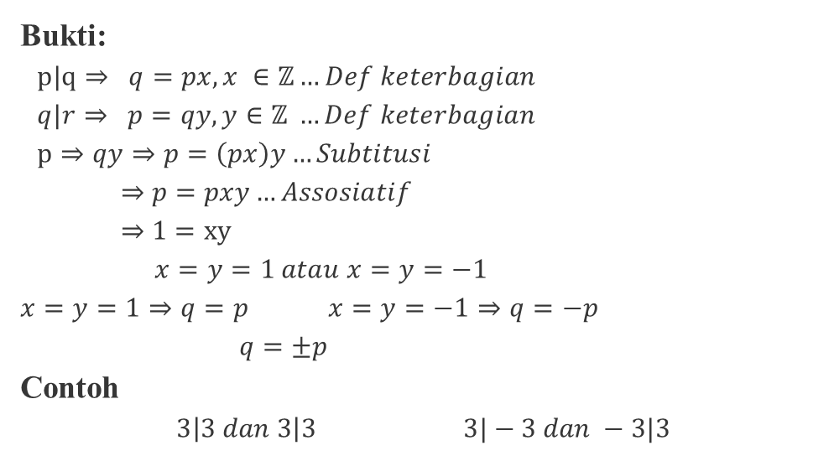
Teorema 2.3
Jika p,q,r $∈$ $ℤ$dan p | q dan q | r ⇒ p | r
Bukti:
$p|q⇒ q=px, x ∈ℤ…Def keterbagian$
$q|r⇒ p=qy, y∈ℤ …Def keterbagian$
$p⇒qy⇒p=\left(px\right)y…Subtitusi$
⇒$p=pxy…Assosiatif$
⇒ $1=xy$
$x=y=1 atau x=y=−1$
$$x=y=1⇒q=p x=y=−1⇒q=−p$$
$q=±p$
Contoh
$$3\left|3 dan 3\right|3 3|−3 dan −3|3$$

Slide 8

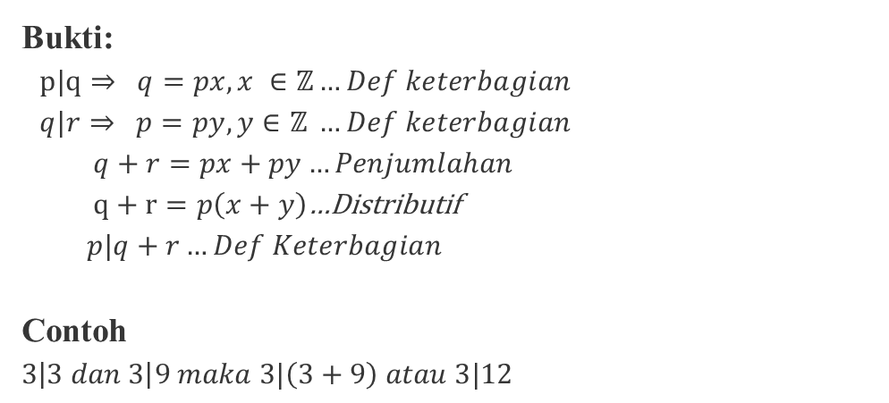
Teorema 2.4
Jika p, q, r $∈$ $ℤ$dan p | q dan p | r ⇒ p | q =r
Bukti:
$p|q⇒ q=px, x ∈ℤ…Def keterbagian$
$q|r⇒ p=py, y∈ℤ …Def keterbagian$
$q+r=px+py…Penjumlahan$
$q+r=p\left(x+y\right)$…Distributif
$p|q+r…Def Keterbagian$
Contoh
$$3\left|3 dan 3\right|9 maka 3|\left(3+9\right) atau 3|12$$

Slide 9
Algoritma Pembagian

Slide 10
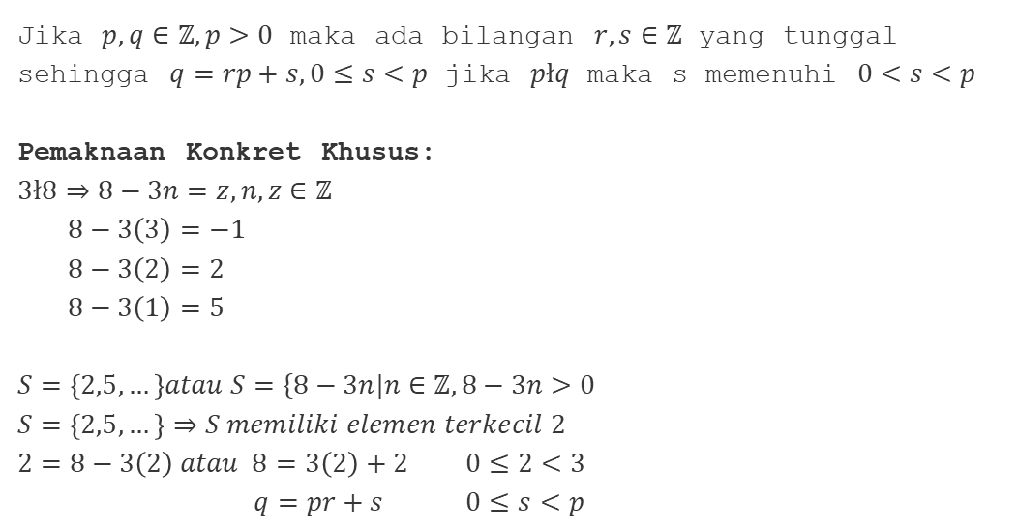
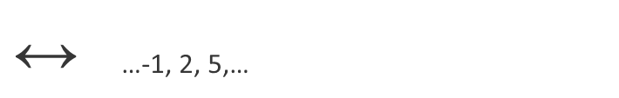
Identify author’s purpose
Jika $p,q∈ℤ,p>0$ maka ada bilangan $r,s∈ℤ$ yang tunggal sehingga $q=rp+s, 0≤s<p$ jika $płq$ maka s memenuhi $0<s<p$
Pemaknaan Konkret Khusus:
$$3ł8⇒8−3n=z, n, z∈ℤ$$
$8−3\left(3\right)=−1$
$8−3\left(2\right)=2$
$8−3\left(1\right)=5$
$$S=\left\{2,5,…\right\}atau S=\{8−3n|n∈ℤ, 8−3n>0$$
$$S=\left\{2,5,…\right\}⇒S memiliki elemen terkecil 2$$
$$2=8−3\left(2\right) atau 8=3\left(2\right)+2 0≤2<3$$
$q=pr+s 0≤s<p$
$\text{↔}$ …-1, 2, 5,…

Slide 11
What is literary analysis?
Mercury is the closest planet to the Sun and the smallest one in the entire Solar System. Contrary to popular belief, this planet's name has nothing to do with the liquid metal. Mercury was, instead, named after the famous Roman god Mercurius
Mercury takes a little more than 58 days to complete its rotation, so try to imagine how long days must be there! Since the temperatures are so extreme, albeit not as extreme as on Venus, Mercury has been deemed to be non-habitable for humans

Slide 12
Literary analysis
Meaning
Impact
Mercury is the closest planet to the Sun and the smallest one in the Solar System—it’s only a bit larger than the Moon
Venus has a beautiful name and is the second planet from the Sun. It’s hot and has a poisonous atmosphere

Slide 13
Elements of literature
Plot
Character
Mercury is the closest planet to the Sun
Jupiter is the biggest planet of them all
Theme
Symbolism
Setting
Earth is the beautiful planet on which humans live
Despite being red, Mars is actually a cold place
Neptune is the farthest planet from the Sun

Slide 14
Examining characters
Motivations
Conflicts
Arcs
Mercury is the closest planet to the Sun and the smallest of them all
Venus has a beautiful name and is the second planet from the Sun
Jupiter is a gas giant and the biggest planet in the Solar System

Slide 15
Settings
Context
Mood
Mars is actually a very cold place
Venus has extremely high temperatures
Atmosphere
Tone
Jupiter is the biggest planet of them all
Saturn is a gas giant and has several rings

Slide 16
Decoding symbolism
Analysis
Meaning
Context
Despite being red, Mars is actually a cold place
Earth is the beautiful planet on which humans live
Neptune is the farthest planet from the Sun
Interpretation
Connection
Impact
Mercury is the closest planet to the Sun
Saturn is a gas giant and has several rings
Jupiter is the biggest planet of them all

Slide 17
—Someone Famous
“This is a quote, words full of wisdom that someone important said and can make the reader get inspired”

Slide 18

A picture is worth a thousand words

Slide 19

A picture always reinforces
the concept
Images reveal large amounts of data, so remember: use an image instead of a long text. Your audience will appreciate it

Slide 20
02
Elements
You can enter a subtitle here if you need it

Slide 21
98,300,000
Big numbers catch your audience’s attention

Slide 22
9h 55m 23s
333,000
386,000 km
Jupiter's rotation period
The Sun’s mass compared to Earth’s
Distance between Earth and the Moon

Slide 23
Themes in literature
35%
25%
40%
Love
Identity
Power
Mercury is the closest planet to the Sun
Saturn is a gas giant and has several rings
Jupiter is the biggest planet of them all

Slide 24
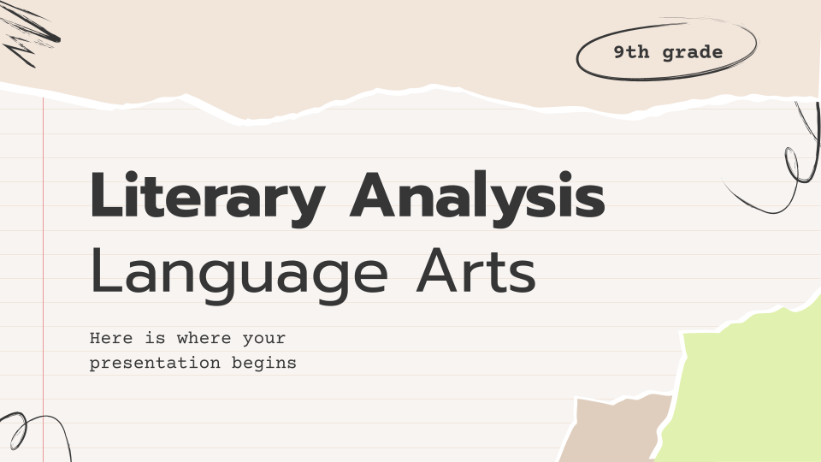
Computer mockup
You can replace the image on the screen with your own work. Just right-click on it and select “Replace image”

Slide 25
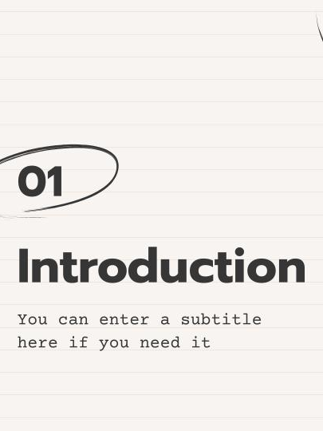
Tablet mockup
You can replace the image on the screen with your own work. Just right-click on it and select “Replace image”

Slide 26
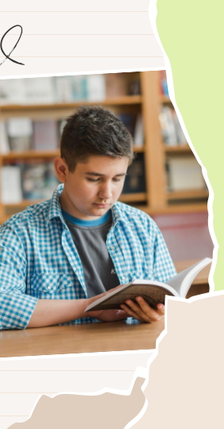
Phone mockup
You can replace the image on the screen with your own work. Just right-click on it and select “Replace image”

Slide 27
This is a map
Venus
Venus is the second planet from the Sun
Mercury
Mercury is the closest planet to the Sun

Slide 28
03
Application
You can enter a subtitle here if you need it

Slide 29
Develop & organize arguments
Venus is a very hot planet
Saturn is the ringed planet
Compare
Trace
Contrast
Debate
Mars was named after a god
Jupiter is a huge gas giant

Slide 30
Plot & conflict
Climax
Saturn is the ringed planet
Rising
Falling
Venus is a very hot planet
Jupiter is a huge gas giant
Exposition
Resolution
Mars was named after a god
Mercury is a small planet

Slide 31
Interpreting literature
Literary element | Definition | Sample questions
Characters | Venus is the second planet from the Sun | Venus is very hot Earth has life
Dialogue | Mars is actually a very cold place | We all live on Earth Mars is very cold
Plot | Neptune is far away from Earth | Jupiter is big Neptune is far away
Tone | Saturn was named after a Roman god | Saturn has rings Mars is cold

Slide 32
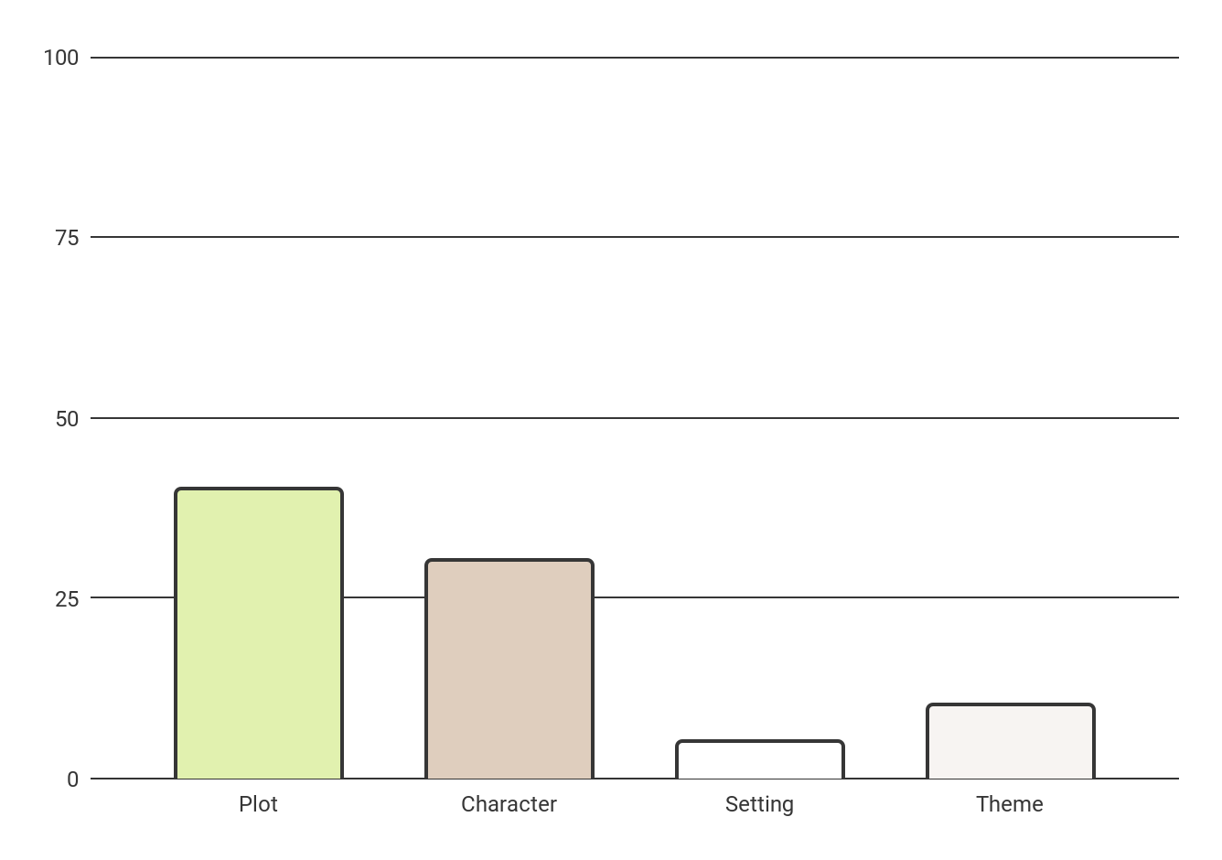
Novel literary elements
40%
5%
Plot
Setting
30%
10%
Character
Theme
Mercury is the smallest planet
Venus has very high temperatures
Jupiter is the biggest planet
Saturn is a gas giant with rings
Follow the link in the graph to modify its data and then paste the new one here. For more info, click here

Slide 33
Plot activity
List the most important parts of the plot
Plot
Exposition |  | Rising
Mercury is the smallest planet Jupiter is the biggest planet |  | Saturn is a gas giant The Moon is Earth’s satellite
Climax |  | Resolution
Venus is a very hot planet Mars was named after a god |  | Jupiter is a huge gas giant Saturn is the ringed planet

Slide 34
Creating a theme statement
Answer the following questions in the blanks
1. | What is the author’s purpose?
2. | What is the piece’s main idea?
3. | What is the author’s tone?

Slide 35
Character traits
Fill in the table with character’s traits in the blanks
Character name
What does he/she talk about? | How do I feel about him/her?
How does he/she look? | What do others say about him/her?

Slide 36
Theme activity
Identify the theme/message and provide three supporting details from the text
Theme
Write what you think is the theme or central message
Detail 1 | Detail 2 | Detail 3
Venus Mars | Mercury Jupiter | Saturn Earth

Slide 37


Our team
Luca Hill
Kaliyah Harris
You can speak a bit about this person here
You can speak a bit about this person here

Slide 38
Thanks!
Do you have any questions?
youremail@freepik.com
+34 654 321 432
yourwebsite.com
Please keep this slide for attribution

