Slide 1
GITHUB ACTIONS BASICS
Learn github actions

Slide 2
NEEDS
Github Account
Repository access right
Be aware about branching model and best practices

Slide 3
Where put the workflow in the repository
Workflows must be located in « .github/workflows » directory
The workflow file is a Yaml|yml file
YAML is case sensitive
The files should have .yml as the extension
Indentation of whitespace is used to denote structure.
Tabs are not included as indentation for YAML files.

Slide 4
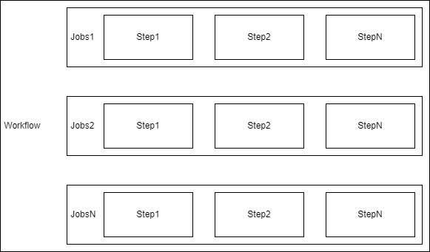
Worklow definition

Slide 5
Workflow parameters
name: < My workflow name > : The name of the workflow as it will appear in the "Actions" tab of the GitHub repository.
on: [push] : Specifies the trigger for this workflow. This example uses the push event, so a workflow run is triggered every time someone pushes a change to the repository or merges a pull request. This is triggered by a push to every branch; for examples of syntax that runs only on pushes to specific branches, paths, or tags.
runs-on: linux : Configures the job to run on a Linux runner. This means that the job will execute on a fresh virtual machine hosted by GitHub
jobs: Groups together all the jobs that run in the learn-github-actions workflow.

Slide 6
Jobs parameters
name: < My job name > : The name of the job as it will appear in the "Actions" tab of the GitHub repository.
steps: Groups together all the steps that run in the check-bats-version job. Each item nested under this section is a separate action or shell script.

Slide 7
steps parameters
name: < My step name >: The name of the step as it will appear in the "Actions" tab of the GitHub repository.
uses: actions/checkout@v3: The uses keyword specifies that this step will run v3 of the actions/checkout action. This is an action that checks out your repository onto the runner, allowing you to run scripts or other actions against your code (such as build and test tools). You should use the checkout action any time your workflow will run against the repository's code.
run: npm install -g bats : The run keyword tells the job to execute a command on the runner. In this case, you are using npm to install the bats software testing package.

Slide 8
LINKS
Official Documentation

