Slide 1
A Self-Orchestration Model for Business Collaborations with Verifiable Process History Credentials
Martin Farkas
martin.farkas@edu.bme.hu

Slide 2

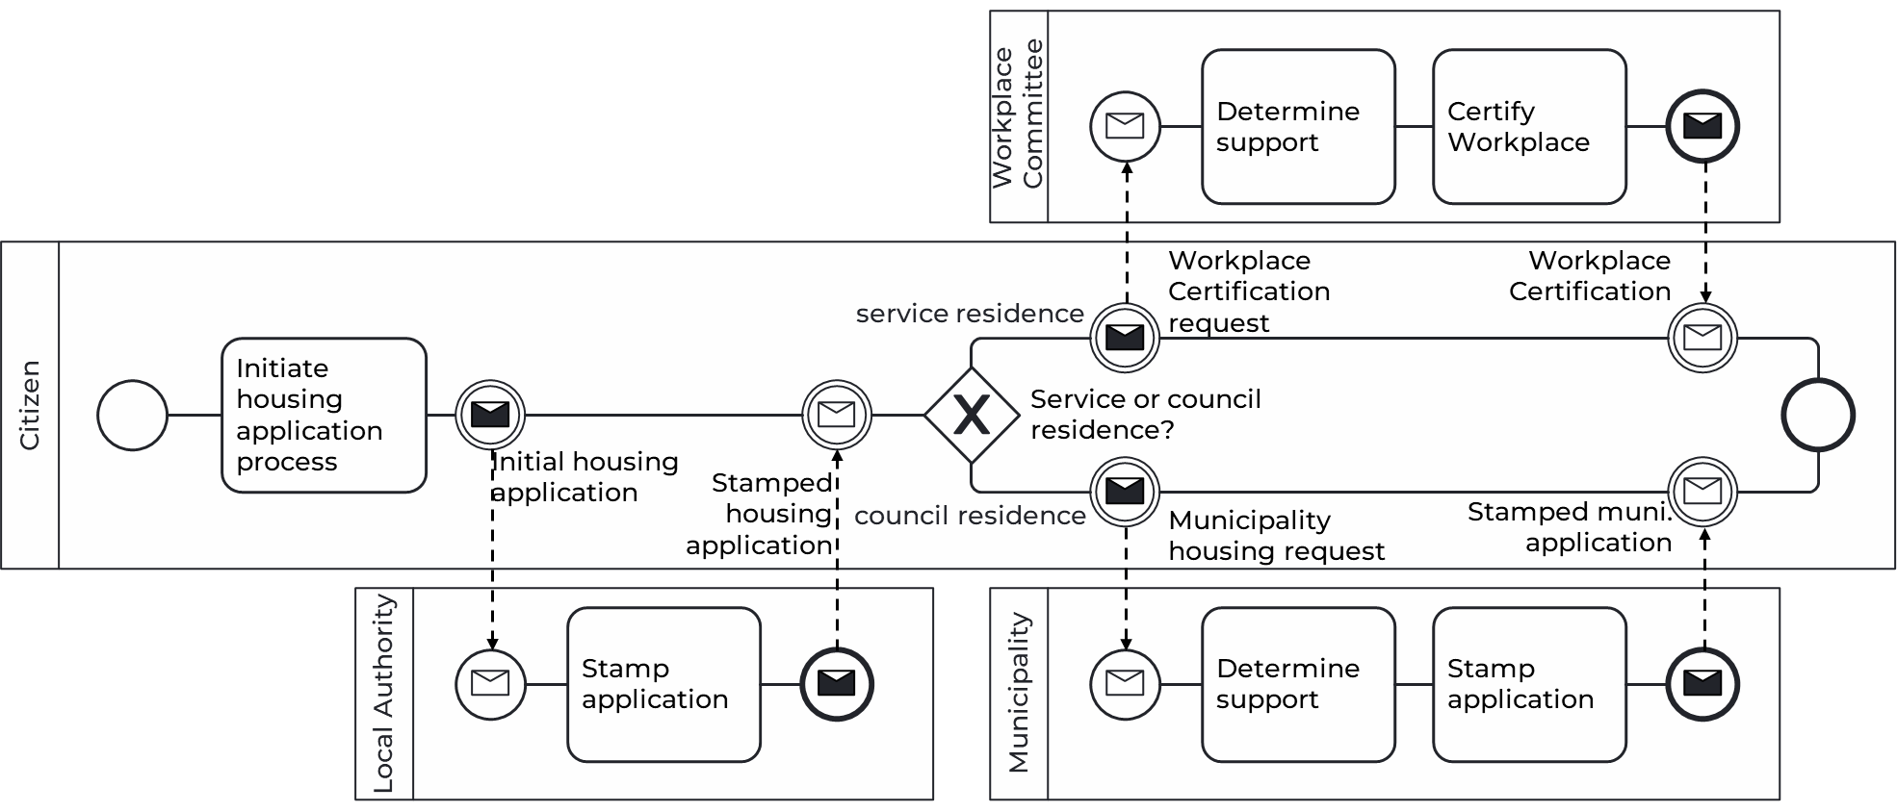
Core challenges in cross-org business process execution
Ensuring that (partially) distrusting parties all “follow the process”
  Enforcing control flow
  Establishing irrepudiability
  …
Centralized orchestration/”federated” execution problematic
Blockchain is the answer!
…or is it?

Slide 3




Decentralized “orchestration” approaches
State machine
smart contracts
Commit & check ZKP
smart contracts
Significant body of work
Petto et al.(BPM 2024)
Toldi, Kocsis (2023)
https://github.com/ftsrg/zkWF

Slide 4
Decentralized “orchestration” approaches
State machine
smart contracts
Ledger consensus & smart contracts
  Enforce the model
  Store the history
  Ensure integrity
  Prevent replay attacks
No single trusted third party
Trace + data + (pseudo)identity is public:
Confidentiality challenges
Costly to run & hard to scale
Rigid once deployed
Process can get stuck

Slide 5
Decentralized “orchestration” approaches
Commit & check ZKP
smart contracts
Checks ZKPs in a smart contract
Proofs, not states, are published.
More confidential/privacy-preserving
Costly to run & hard to scale
Part of BPMN inherently limited
Encrypted data still on-chain?
Long-term cryptanalytic threat

Slide 6

The gap and our goal
State machine
smart contracts
Commit & check ZKP
smart contracts
Collaboration
self-orchestration
Significant, hard to address gaps:
Scalability, confidentiality, flexibility…
Our Goal
An orchestration model with cryptographically verifiable execution
But peer-to-peer and confidentiality-preserving

Slide 7
Novel concept: self-orchestration
Each participant carries the process state forward by presenting a cryptographically verifiable process history to the subsequent party.
Physically AND logically distributed global state
Shift trust to only the party who has to be trusted
i.e. the one who actually claims something about the state
Provenance of process steps/traces – message passing
Fine-grained tradeoff b/w confidentiality and integrity
Presented here for BPMN collaborations

Slide 8
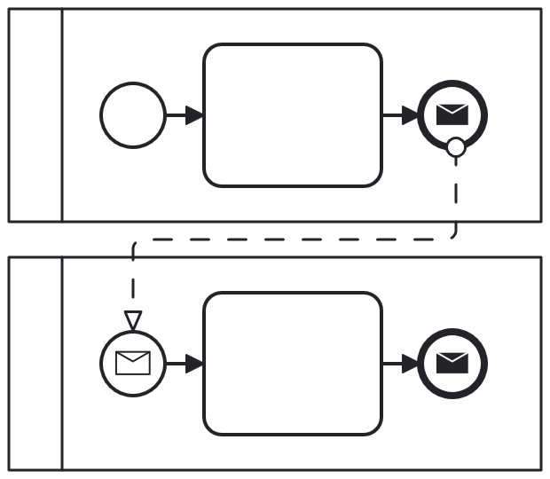
Bird’s eye view
Present claim that the recipient is the next to act
BPMNmodel
Execution trace
Execution trace
The recipient verifies the claim
Execution trace
Authentic and non-tampered
Agreed upon model
State is valid
Concludes in this transition
If the claim is valid, then they continue
Message
ProcessObjects
Same procedure with any subsequent message
Variables
Proof of split-choice
Core idea
Each pool is its own orchestrator. Collaboration “emerges” from
verifiable process histories passed directly between parties.

Slide 9


Slide 10







The Self-Sovereign Identity (SSI) trust triangle
Issue
Present
Holder
Write
Read
Verifiable Data Registry
Issuer
Verifier
Trust
Possibly (regrettably, not necessarily) blockchain/DLT

Slide 11
The Self-Sovereign Identity (SSI) trust triangle
Verifiable Credentials:
Claim(s) made by the issuer
Cryptographic guarantee of:
  Authenticity: was issued by issuer
  Integrity: was not tampered with
  Revocation status: is/is not revoked
Verifiable w/o asking the issuer

Slide 12





The Self-Sovereign Identity (SSI) trust triangle
Verifiable Credentials:
Claim(s) made by the issuer
Anonymous issuance, revocation
Selective disclosure (ZKP)
GDPR compliance
Technical and legal initiatives
Notes:
Claims can be the basis for:
Authentication
Authorization
Delegation of authorization

Slide 13


Key constructs
Verifiable process history Credentials VphCs
Claim of what happened
  Pool-internal process trace, etc.
  VphCs recieved for each message recieve event
Issued
  When transition takes place
  By the last actor
  To the next actor
Non-invoked Transition Credentials
NiTCs
Claim of what didn’t happen
  Revoked if path is taken
Issued
  Before transition takes place
  By the target
  To the initiator

Slide 14

Our proud bureaucratic tradition
Determine
support
Certify Workplace
Workplace
Committee
Workplace
Certification request
Workplace
Certification
service residence
Initiate housing
application
process
Citizen
Service or council
residence?
Initial housing
application
Stamped
housing
application
council residence
Municipality
housing request
Stamped muni.
application
Stamp
application
Determine
support
Stamp
application
Local Authority
Municipality

Slide 15

Our proud bureaucratic tradition
Workplace
Committee
If ok, issue next VphC
and continue
Present VCs: You are next, here’s why
Citizen chooses
service residence
service residence
Citizen
VphC claims:
message was sent
council residence
NiTC claims:
message still may be sent
Local Authority
Municipality

Slide 16

Avoiding double spend split brain problem
Problem
How can the Citizen convince the Committee that
they did not take another invalid path (XOR-split)?
VDR
Workplace
Committee
Citizen
Work. C.
Proposal
Munic.
Work. C.
service residence
Process internal trace, etc.
Citizen
Prev. VphCs
Exclusionary NiTCs
council residence
Verify & check revocation
Revoke NiTC
Local Authority
Municipality
Citizen
Local A.
Issue next VphC

Slide 17
Avoiding double spend split brain problem
VDR
Workplace
Committee
Citizen
Munic.
Proposal
Munic.
Work. C.
service residence
Process internal trace, etc.
Citizen
Prev. VphCs
Exclusionary NiTCs
council residence
Verify & check revocation
Local Authority
Municipality
Citizen
Local A.

Slide 18
Conclusion
Concept of self-orchestration for business collaborations
Novel collaboration/choreography/… execution model
Key characteristics
  Cryptographically verifiable – based on SSI/VCs
  P2P
  State remains with participants (confidentiality)
  Byzantine split-brain avoided through Verifiable Credential revocations
In the paper: single-attacker model (apparent properties)
Some liveness tradeoff
Further protocols/sec models: need formal (byzantine epistemic) analysis
…and some technical work on VC atomic test-and-revoke

Slide 19
Future work
Flexibility
On-the-fly replacement of actors, activities, fragments
Arbitrary (but consensual) changes to control flow and model
Dynamic process evolution: model may possibly change, if a quorum of participants agree
Correctness & Security
(Formally) modeling and verifying security requirements
Under consideration: Tamarin, TLA+, P, dedicated BPMN tools (model checkers)
Liveness

Slide 20
In summary
Present claim that the recipient is the next to act
The recipient verifies the claim
If the claim is valid, then they continue
While preventing Byzantine split-brain attacks
Core idea
Each pool is its own orchestrator. Collaboration “emerges” from
verifiable process histories passed directly between parties.

Slide 21
asd

Slide 22
Table of contents
1.
Attributes of dependability
  Reliability, availability
  Safety, integrity, maintainability
Combinatorial models for dependability analysis
  Reliability block diagrams
Stochastic models for dependability analysis
  Markov models (CTMC)
2.
3.

Slide 23
Learning outcomes
K2
Explain the attributes of dependability and
the objectives of dependability analysis
Perform dependability analysis with
reliability block diagrams
Perform dependability analysis of
simple redundancy structures with Markov chains
Identify how reward analysis can be used for
dependability analysis
K3
K3
K1

Slide 24
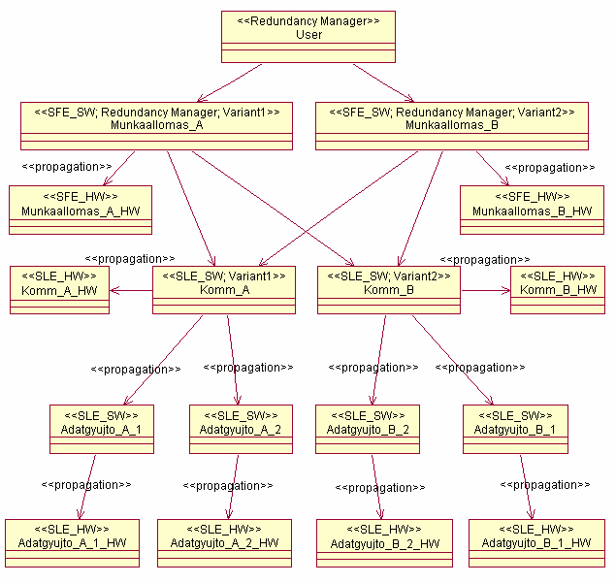
Attributes of dependability

Slide 25
Table of contents
Attributes of dependability
Combinatorial models
Stochastic models

Slide 26
Table of contents
Attributes of dependability
Combinatorial models
Stochastic models

Slide 27
Characterizing system services
Typical extra-functional characteristics
  Reliability, availability, integrity, etc.
  Characterize the faults occurring during the use of the services
Composite characteristic: Dependability
Role of dependability
  Service Level Agreements (IT service providers)
  Tolerable Hazard Rate (safety-critical systems)
Definition
Ability to provide service in which reliance can be justifiably placed
Reliance: the service satisfies the needs
Justifiably: based on analysis, evaluation, measurements

Slide 28
Characterizing system services
Typical extra-functional characteristics
  Reliability, availability, integrity, etc.
  Characterize the faults occurring during the use of the services
Composite characteristic: Dependability
Role of dependability
  Service Level Agreements (IT service providers)
  Tolerable Hazard Rate (safety-critical systems)
Definition
Ability to provide service in which reliance can be justifiably placed
Reliance: the service satisfies the needs
Justifiably: based on analysis, evaluation, measurements

Slide 29
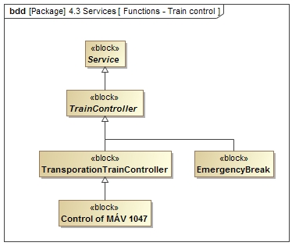
Generalization
Classification
Specification

Slide 30
Trapezoid
Use Drawing Tools → Format → Insert Shapes → Combine Shapes to Union or Intersect a triangle with a rectangle
Use the triangle from this slide to match the slope of the
capital letter A

Slide 31
Creating exact outlines
Position two copies of the (trapezoid) shape
on top of each other
  The right angled side of the trapezoid should touch
  the slide edge
For a 2.5 pt outline, reduce the size of the shape by 5 pt
  Make sure to keep the aspect ratio
Position the shape such that there is approximately 2.5 pt
between the sloped sides of the trapezoids
Create a rectangle and Union it with the smaller trapezoid
to let it touch the side of the slide again
Use Fragment to subtract the smaller shape from the outer one
A third copy of the (large) trapezoid is needed to add text inside
  Remove its fill and outline, apply 0.3 in margin to clear the text of the angled side
Use outlines like this for mild emphasis,
filled trapezoids for heavy emphasis

