Slide 1
Title
NAME
https://ftsrg.mit.bme.hu/

Slide 2
Magyar címdia
Név
https://ftsrg.mit.bme.hu/

Slide 3

Title
Zoltán Micskei
Budapest University of Technology and Economics (BME)
home.mit.bme.hu/~micskeiz
Partner or project logos, affiliations can come here

Slide 4
Main topics of the course
Overview (1)
  V&V techniques, Critical systems
Static techniques (2)
  Verifying specifications
  Verifying source code
Dynamic techniques: Testing (7)
  Developer testing, Test design techniques
  Testing process and levels, Test generation, Automation
System-level verification (3)
  Verifying architecture, Dependability analysis
  Runtime verification

Slide 5
Table of contents
1.
Attributes of dependability
  Reliability, availability
  Safety, integrity, maintainability
Combinatorial models for dependability analysis
  Reliability block diagrams
Stochastic models for dependability analysis
  Markov models (CTMC)
2.
3.

Slide 6
Learning outcomes
K2
Explain the attributes of dependability and
the objectives of dependability analysis
Perform dependability analysis with
reliability block diagrams
Perform dependability analysis of
simple redundancy structures with Markov chains
Identify how reward analysis can be used for
dependability analysis
K3
K3
K1

Slide 7
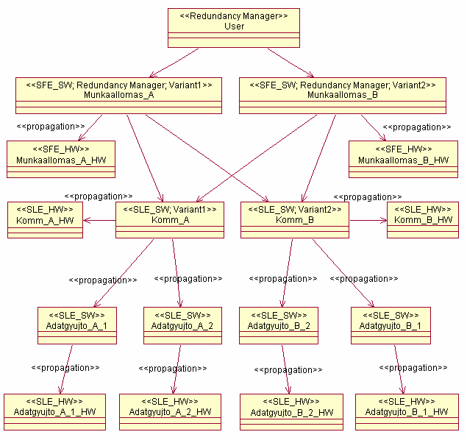
Attributes of dependability

Slide 8
Table of contents
Attributes of dependability
Combinatorial models
Stochastic models

Slide 9
Table of contents
Attributes of dependability
Combinatorial models
Stochastic models

Slide 10
Characterizing system services
Typical extra-functional characteristics
  Reliability, availability, integrity, etc.
  Characterize the faults occurring during the use of the services
Composite characteristic: Dependability
Role of dependability
  Service Level Agreements (IT service providers)
  Tolerable Hazard Rate (safety-critical systems)
Definition
Ability to provide service in which reliance can be justifiably placed
Reliance: the service satisfies the needs
Justifiably: based on analysis, evaluation, measurements

Slide 11
Characterizing system services
Typical extra-functional characteristics
  Reliability, availability, integrity, etc.
  Characterize the faults occurring during the use of the services
Composite characteristic: Dependability
Role of dependability
  Service Level Agreements (IT service providers)
  Tolerable Hazard Rate (safety-critical systems)
Definition
Ability to provide service in which reliance can be justifiably placed
Reliance: the service satisfies the needs
Justifiably: based on analysis, evaluation, measurements

Slide 12
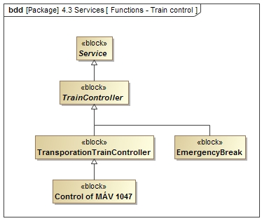
Generalization
Classification
Specification

Slide 13
Trapezoid
Use Drawing Tools → Format → Insert Shapes → Combine Shapes to Union or Intersect a triangle with a rectangle
Use the triangle from this slide to match the slope of the
capital letter A

Slide 14
Creating exact outlines
Position two copies of the (trapezoid) shape
on top of each other
  The right angled side of the trapezoid should touch
  the slide edge
For a 2.5 pt outline, reduce the size of the shape by 5 pt
  Make sure to keep the aspect ratio
Position the shape such that there is approximately 2.5 pt
between the sloped sides of the trapezoids
Create a rectangle and Union it with the smaller trapezoid
to let it touch the side of the slide again
Use Fragment to subtract the smaller shape from the outer one
A third copy of the (large) trapezoid is needed to add text inside
  Remove its fill and outline, apply 0.3 in margin to clear the text of the angled side
Use outlines like this for mild emphasis,
filled trapezoids for heavy emphasis

Slide 15



Critical Systems Research Group
ftsrg.mit.bme.hu
ftsrg
ftsrg

