Slide 1
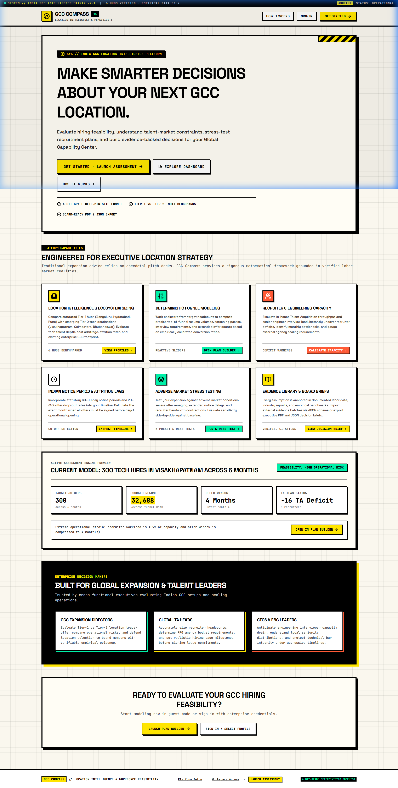
PRODUCT MANAGEMENT INTERNSHIP ASSIGNMENT
GCC COMPASS
Location Intelligence & Hiring Plan Stress Tester
Evidence-backed decision engine replacing intuitive consultancy guesswork with deterministic backward-induction funnel modeling and verified multi-city intelligence.
Deterministic Funnel: Rigorous math modeling Indian notice periods & recruiter capacity
LIVE PROTOTYPE VERIFIED ONLINE
6 Audited GCC Hubs: Tier-1 vs Tier-2 comparison with genuine company taxonomy
URL: https://ftsurya.github.io/GCC-Compass/
• Architecture: Client-Side React 19 SPA on GitHub Pages
• Validation: 111/111 Automated Tests · 0 Lint Errors
• Ecosystem: 6 Hubs · 28 Verified Entities (17 Captives)
• Invitation: Reviewers invited to explore live workflows
Audit-Grade Evidence: Transparent sources, H1 2024 benchmarks, zero hallucinations

Slide 2
PROBLEM CONTEXT
The Multi-Million Dollar Blind Spots in India GCC Setup
Why over 40% of offshore technology centre expansion plans fail to meet scheduled launch milestones
01
02
03
The 90-Day Notice Period Paradox
In India's tech ecosystem, candidate notice periods typically span 60 to 90 days. A setup targeting 300 joiners by Month 6 must lock final accepted offers by Month 3 or 4.
Traditional linear plans treat 6 months as hiring runway, resulting in catastrophic hiring cliff shortages at scheduled launch.
Unrealistic Funnel & Recruiter Capacity
Scaling a 300-headcount technical GCC requires screening ~32,600 resumes and conducting 2,860 technical interviews.
Without backward-induction math, enterprises allocate 4-5 internal recruiters (capable of ~175 interviews) against a true 715/month demand, causing massive operational collapse.
Conflated Data & Facility Hallucinations
Generic market decks conflate IT services vendor campuses (e.g., Infosys, TCS) with genuine captive GCCs.
Physical desk seating capacities are misleadingly cited as live headcounts, and stale commercial real estate benchmarks are used without transparent observation dates.

Slide 3
USER ECOSYSTEM
Target Users & Enterprise Stakeholders
Bridging the strategic disconnect between global steering committees and local talent acquisition execution
Global Head of GCC / VP Strategy
Head of Talent Acquisition / VP HR
Global CFO & Steering Committee
• Mandate: Evaluate Tier-1 (Bengaluru/Hyderabad/Pune) vs Tier-2 (Vizag/Coimbatore/Bhubaneswar) hub viability.
• Primary Need: Reliable grade-A commercial lease benchmarks, state IT policy incentives, and competitive talent saturation data.
• Pain Point: Receiving unverified consultancy slides that fail to differentiate IT service vendors from captive tech peers.
• Mandate: Structure the recruitment funnel and guarantee delivery of 200-500 engineers on strict target timelines.
• Primary Need: Deterministic backwards induction showing exact candidate sourcing pool, screening stages, and offer cutoffs.
• Pain Point: Blamed for hiring delays caused by unmodeled 90-day candidate notice periods and recruiter team under-allocation.
• Mandate: Approve multi-million dollar capital expenditure, lease commitments, and vendor RPO contracts.
• Primary Need: Stress-tested sensitivity models calculating impact of candidate reneging surges and timeline infeasibility.
• Pain Point: Committing capex based on optimistic linear spreadsheets that blow up within the first two quarters.

Slide 4
MARKET LANDSCAPE
Current Challenges vs Fragile Workarounds
How enterprise leaders navigate GCC setup decisions today, and where current tools break down
EXISTING FRAGILE WORKAROUND
GCC COMPASS SYSTEMIC FIX
1. Static Consulting Decks: 60-page PDF reports costing $50k+ from global firms that become obsolete the moment parameters change. Lack interactive sensitivity toggles.
2. Ad-hoc Excel Spreadsheets: Siloed spreadsheets with broken formulas that assume forward multiplication rather than backward induction, ignoring compound drop-offs.
3. Vendor Agency Promises: Staffing agencies pitching aggressive 4-month turnarounds without disclosing that 60-90 day notice periods consume 75% of the timeline.
4. Generic LLM Prompts: Prompting commercial AI models that hallucinate fictional GCC campus sizes and conflate third-party vendors with true captives.
1. Dynamic Web Application: Interactive, reactive application with instantaneous mathematical updates across all 5 stages of the hiring funnel.
2. Mathematical Backward Induction: Rigorous math: Target Hires / Join Rate / Acceptance Rate / Interview Pass Rate / Screen Pass Rate = Exact Pool Required.
3. Notice Period Lag Integration: Active hiring window is strictly truncated by candidate notice periods (e.g., 6 mo deadline - 2 mo notice = 4 mo cutoff).
4. Audit-Grade Evidence Base: Every claim is indexed with source provenance, collection date (H1 2024 benchmarks), and explicit confidence caveats.

Slide 5
PRODUCT STRATEGY
Prioritized Opportunities & Product Rationale
Value vs Feasibility prioritization framework guiding the GCC Compass architecture
CRITICAL FOR TRUST
FOUNDATIONAL ACCURACY
P0: Backward-Induction Funnel Engine
Why Prioritized: Hiring failure in India GCCs stems from underestimating top-of-funnel volume. A 300-hire target requires exactly 32,688 sourced resumes at benchmark conversion rates. Providing deterministic math eliminates wishful thinking.
Decision: Hardcoded deterministic mathematical model (zero hallucination risk).
P0: Epistemic Data & Entity Taxonomy
Why Prioritized: Decision-makers must distinguish true captive GCCs (e.g., Barclays, Nvidia, State Street) from IT services vendors (TCS, Infosys) and software products. Conflating them skews compensation and talent availability assumptions.
Decision: 5-way classification taxonomy + strict isolation of seating capacity from headcount.
EXECUTIVE BUY-IN
DECISION VELOCITY
P1: Notice Period Stress & Monte Carlo Testing
Why Prioritized: Executives need to understand failure modes before committing funds. Modeling reneging rate surges (up to 40%) and 90-day notice periods reveals recruiter capacity deficits in real time.
Decision: Real-time interactive sensitivity sliders with automated Infeasibility alerts.
P1: Multi-Format Audit Decision Briefs
Why Prioritized: Insights trapped in a web app don't reach boardrooms. Leaders need structured, exportable artifacts for steering committees.
Decision: Instant export in Markdown, JSON, PDF, and Clipboard formats.

Slide 6
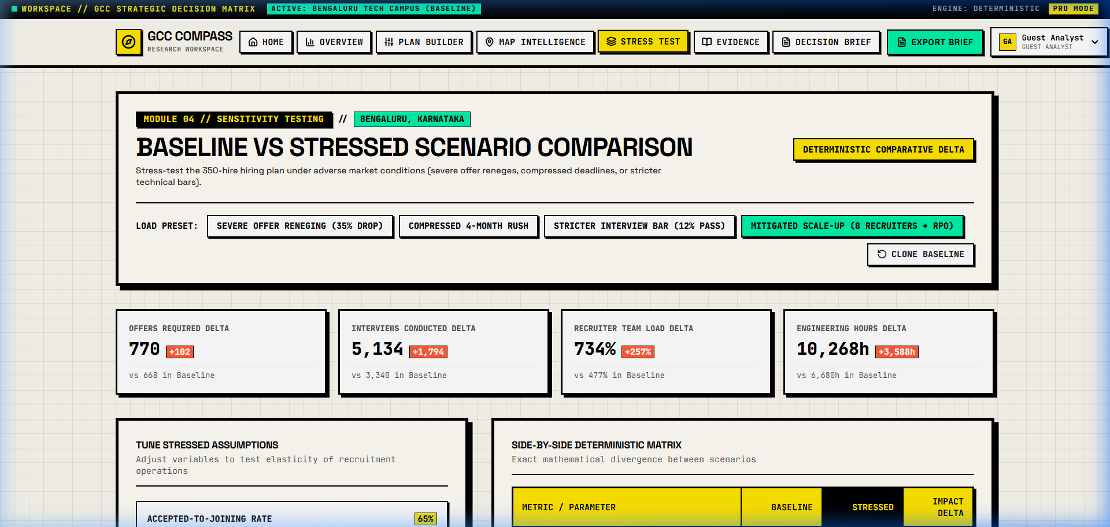
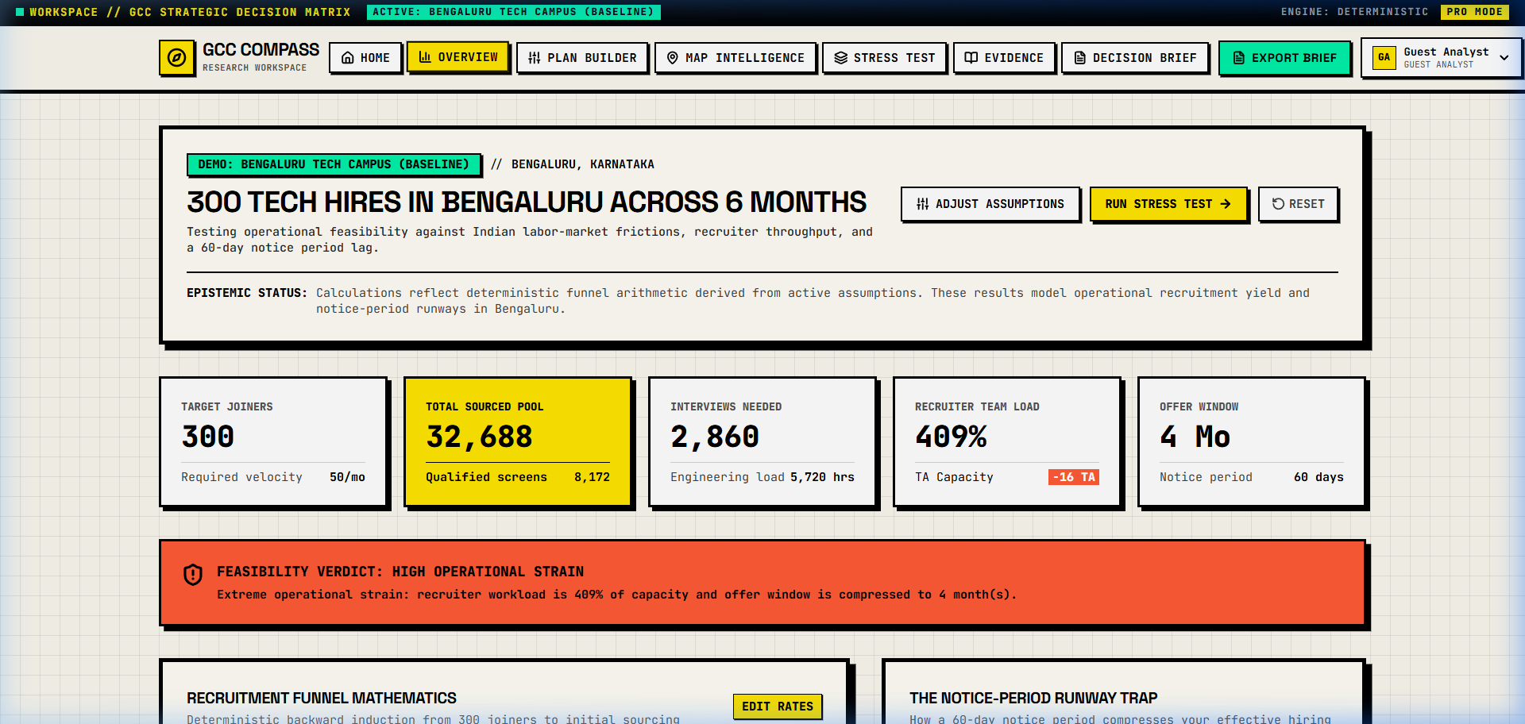
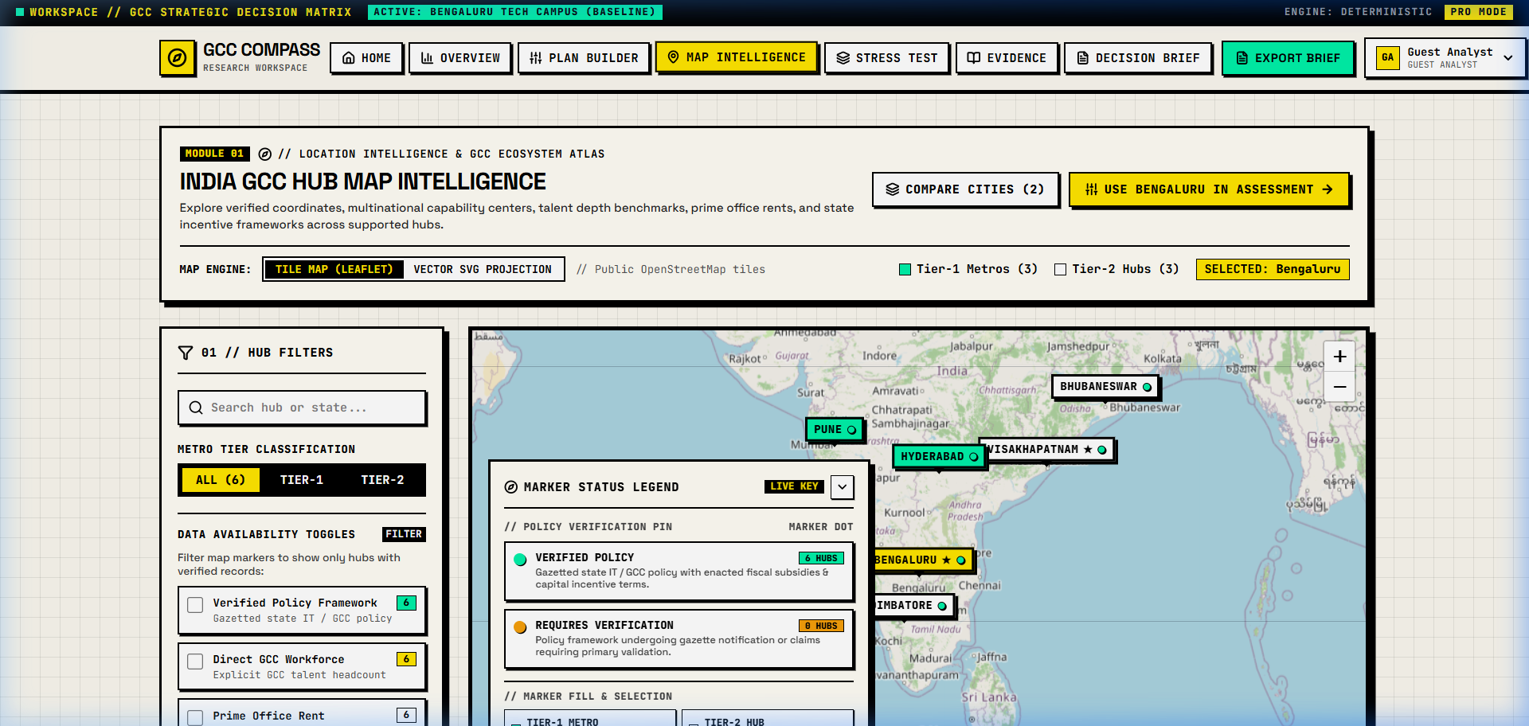
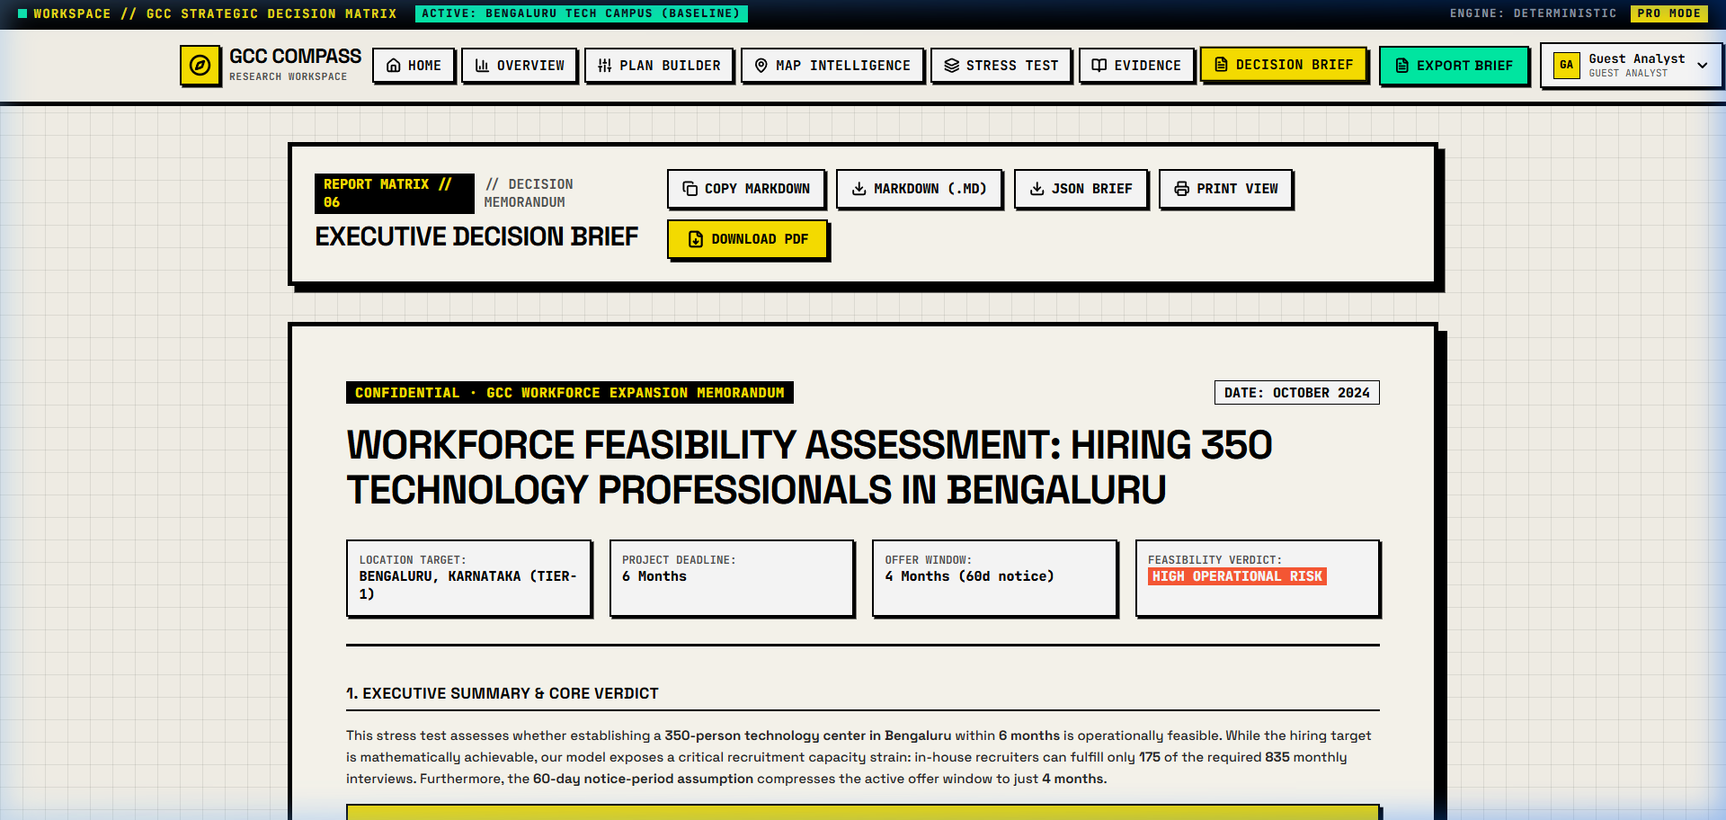
PRODUCT ARCHITECTURE
Proposed Solution & Core User Workflows
A seamless 4-stage operational workflow transforming ambiguity into board-ready hiring strategy
WORKFLOW 01
WORKFLOW 02
WORKFLOW 03
WORKFLOW 04
1. Location Intelligence
Explore 6 hubs with Grade-A lease costs (H1 2024), talent depth, and verified captive directories.
2. Deterministic Plan
Interactive funnel calculating required sourcing pool, screens, interviews, and recruiter capacity.
3. Stress Test Scenarios
Simulate candidate reneging spikes, notice period extensions, and recruiter capacity deficits.
4. Executive Brief
One-click export of audit-grade decision briefs in Markdown, PDF, or JSON format.

Slide 7
TRADE-OFF ANALYSIS
Product Decisions & Strategic Trade-Offs
Deliberate design decisions prioritizing epistemic integrity, reproducibility, and enterprise confidence
1. Deterministic Funnel Math vs Generative AI Hallucination
2. Transparent 'Data Unavailable' vs Synthetic Estimation
Decision: Enforced pure mathematical backward-induction in calculator.ts rather than using LLMs for funnel estimation.
Trade-Off: Less conversational interaction; but achieves 100% deterministic reproducibility and passes strict compliance audits.
Decision: Preserved 'Data unavailable' or 'requires_verification' for undisclosed private headcount (e.g. Nvidia Pune, Alliant Vizag).
Trade-Off: Incomplete charts on select private metrics; but guarantees zero fabricated figures, preserving institutional credibility.
3. Strict Entity Classification vs Generic Tech Aggregation
4. Assessment-First Gateway vs Unconfigured Dashboard
Decision: Separated captive GCCs (17) from IT services (8) and product firms (2); isolated seating capacity from employee headcount.
Trade-Off: More complex data schemas; but prevents dangerous talent-pool inflation (e.g. counting 1,000 Infosys desk seats as GCC hires).
Decision: Required users to select a scenario or configure parameters before displaying output recommendations.
Trade-Off: Requires an initial user click; but completely prevents unanchored, out-of-context decision making.

Slide 8
COMPETITIVE STRATEGY
Product Positioning & Alternative Comparison
How GCC Compass establishes a unique position against legacy consultancies, ATS systems, and general BI
Evaluation Criteria | GCC Compass (Our Product) | Management Consulting | Enterprise ATS | General BI (PowerBI)
Backward-Induction Funnel | Yes (Deterministic math) | No (Static forward targets) | No (Historical data only) | No (Manual DAX modeling)
Notice-Period Lag Modeling | Yes (60-90d cutoff alerts) | Qualitative caveat only | No (Tracks active stage) | No (Custom pipeline required)
Audited City Intelligence | Yes (6 hubs, strict taxonomy) | Yes (High-cost custom study) | No (Internal data only) | Requires external data feed
Interactive Stress Testing | Yes (Real-time sliders) | No (Static PowerPoint) | No (Retrospective reporting) | Partial (Parameter slicers)

Slide 9
TECHNICAL RIGOR
Prototype Validation & Verification Results
Empirical evidence of system reliability, static typing, and mathematical determinism
111 / 111
AUTOMATED TEST SUITE
0 Errors
TYPESCRIPT & STATIC LINTER
< 1.0s
PRODUCTION VITE BUILD
Verified
LIVE PUBLIC BROWSER SMOKE TEST
• 100% pass rate in tsx calculator.test.ts & regression.test.ts.
• Validates backward-induction funnel (300 hires -> 32,688 applicant pool).
• Tests 60-90d notice period lag and offer cutoff deadlines.
• Confirms all 5 enterprise demo scenarios calculate deterministically.
• Validates 6-city boundary isolation and strict company classifications.
• Strict type safety enforced with zero compilation errors in tsc --noEmit.
• GccCompany data models strictly type 5-way classification enum.
• CityProviderIndicator strictly types limitations and source dates.
• Eliminates potential runtime undefined exceptions across route states.
• Production client bundle built in ~885ms with Vite 8.3 + React 19.
• Universal relative addressing (base: './') across scripts & stylesheets.
• Automated SPA fallbacks generated (404.html, .nojekyll, _redirects).
• Pre-configured for zero-config multi-cloud static deployments.
• Verified live at https://ftsurya.github.io/GCC-Compass/.
• Validated Landing, Plan Builder, Map Intelligence, & Decision Brief.
• Tested multi-format export engine: Markdown (.md), PDF, JSON, & copy.
• Client-side React architecture running on GitHub Pages.

Slide 10
INTEGRITY & ROADMAP
Data Limitations, Assumptions & Future Roadmap
Epistemic transparency regarding current data boundaries and planned engineering horizons
CURRENT EPISTEMIC LIMITATIONS
NEXT STEPS & PRODUCT ROADMAP
1. Dated Office Cost Benchmarks (H1 2024): Commercial office lease rental rates reflect H1 2024 JLL and Colliers benchmarks. Real-time market changes in 2025/2026 require dynamic index updates.
2. Undisclosed Private Headcounts: Private multinational captives (e.g. Nvidia Pune, Alliant Vizag) do not publish isolated city headcounts. Kept as 'Data unavailable' rather than guessing.
3. Static Data Snapshot Architecture: Runs entirely client-side on GitHub Pages at https://ftsurya.github.io/GCC-Compass/. Zero server attack vectors, but relies on snapshot data files.
1. Phase 1: Live ATS Integrations: Connect directly to Greenhouse, Lever, and Workday APIs to replace industry conversion benchmarks with live company historical pass rates.
2. Phase 2: Micro-Market Commercial Real Estate: Integrate live CRE data feeds to provide neighborhood-level lease rates (e.g., Whitefield vs ORR in Bengaluru; Madhapur vs Gachibowli in Hyderabad).
3. Phase 3: Expanded City Coverage: Expand data collection to 6 additional emerging hubs: Ahmedabad, Jaipur, Kochi, Indore, Vadodara, and Chandigarh.
EXPLORE LIVE PROTOTYPE
Verified on GitHub Pages
Public Reviewer URL: https://ftsurya.github.io/GCC-Compass/
GitHub Repository: https://github.com/ftsurya/GCC-Compass | Branch: main (4e3db9c) | gh-pages (caef8a7)

