Slide 1
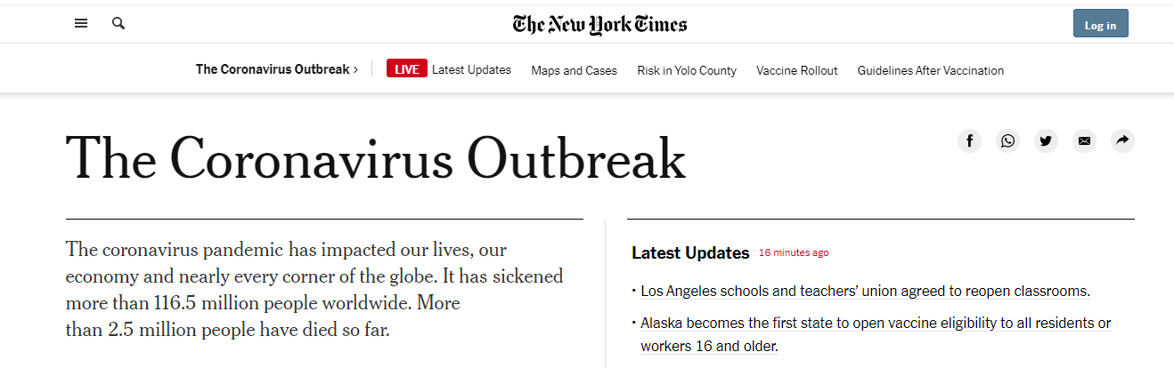
COVID-19 Background
The COVID-19 pandemic
• Firstly discovered in December 2019
• Caused by severe acute respiratory syndrome coronavirus 2 (SARS-CoV-2)
• More than 2.56 million deaths attributed to COVID-19 for now

Slide 2
WHO COVID Data
• From 3rd January 2020 on
• Worldwide new cases and new deaths
• Each country & Each single day
Data Source: https://covid19.who.int/WHO-COVID-19-global-data.csv)

Slide 3
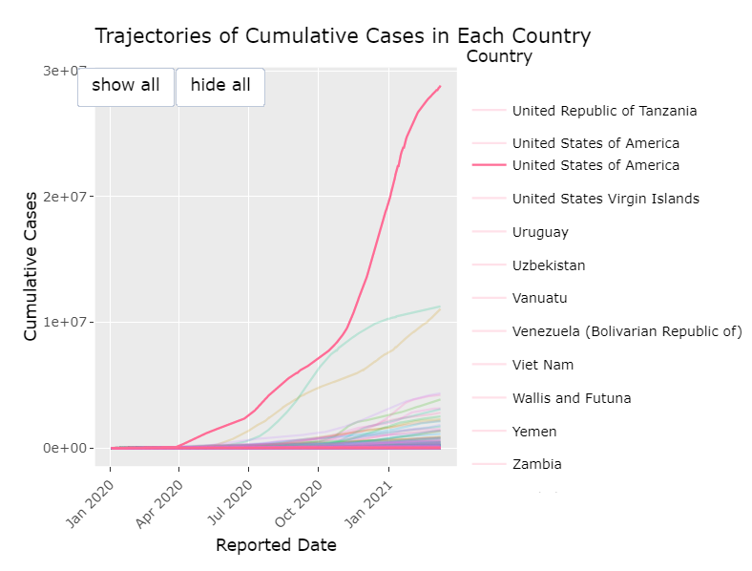
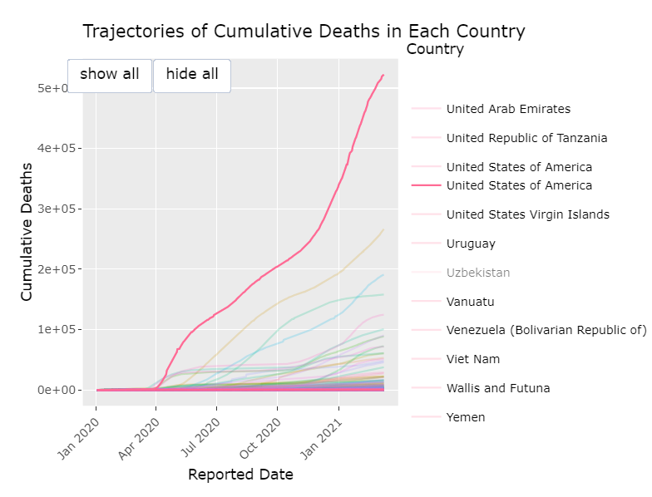
Visualization of WHO COVID Data
Cumulative Cases
Cumulative Deaths

Slide 4
Question of Interest
Is there any
official regulation
（one category of mandatory and non-pharmaceutical countermeasures）
that could significantly cause the reduction of deaths number in USA?
Need More Data!

Slide 5
Outline of Target Data Set
Lakshmi’s research: “Factors influencing the epidemiological characteristics of pandemic COVID 19:
A TISM approach”
Responsible Variable: Daily deaths
Explanatory Variables: Date,
State,
Status of Stay-at-Home order,
Status of Mask requirement,
Population density
• Instrumental Variable: Unemployment Insurance Number

Slide 6
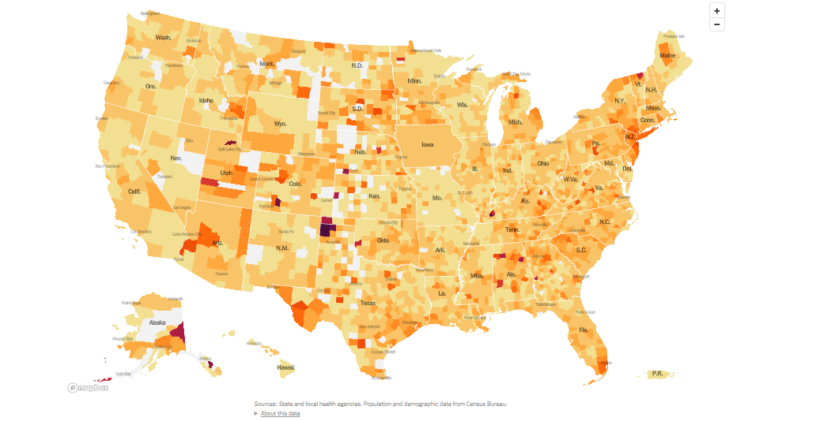
Responsible Variable
Cumulative deaths Daily deaths
Data Source: https://www.nytimes.com/interactive/2020/us/coronavirus-us-cases.html

Slide 7
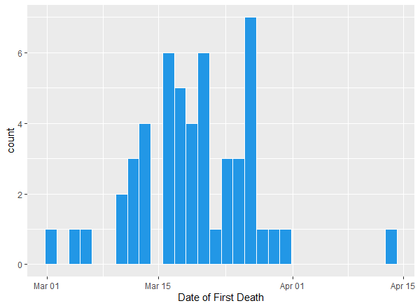
Responsible Variable
Histogram of Date of the First Death

Slide 8
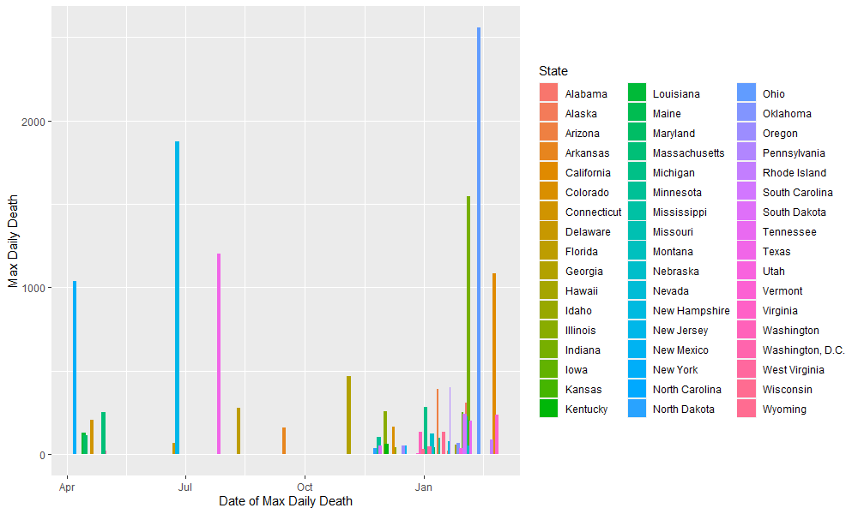
Responsible Variable
Bar plot of Date of the Max Daily Death and Corresponding Number

Slide 9
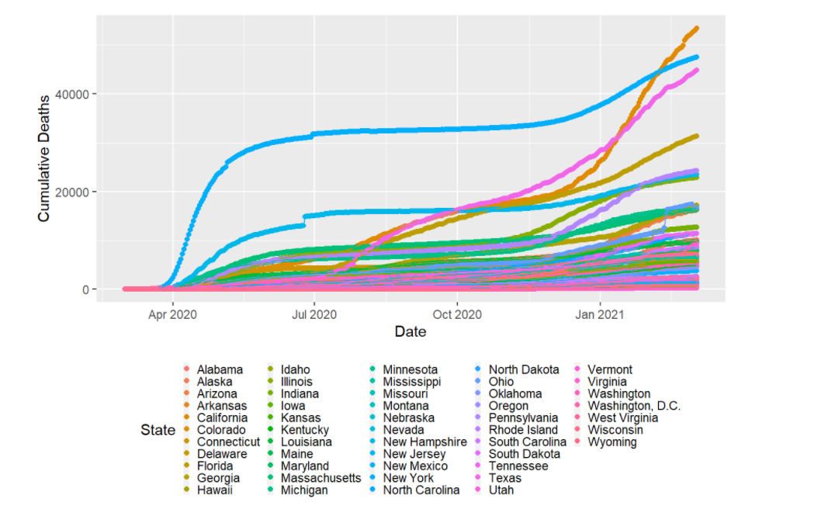
Responsible Variable

Slide 10
Explanatory Variables——Official Regulations
Two items: Stay-at-Home Order & Mask Requirement
Effect:
Minimize physical contact between individuals
Reduce the possibility for new infections
• Value: Status of that order
No
Yes
No
Order Duration

Slide 11
Explanatory Variables——Stay-at-Home Order (Order_stay)
• The mean of the length of the order duration is 55 days
• The longest duration is 312 days (California) while the shortest duration is 24 days (Mississippi)
• 7 states do not publish statewide order
Data Source: https://ballotpedia.org/Status_of_lockdown_and_stay-at-home_orders_in_response_to_the_coronavirus_(COVID-19)_pandemic,_2020#Orders_by_trifecta_status

Slide 12
Explanatory Variables——Mask Requirement (Order_mask)
• The mean of the length the mask order duration is 152 days.
• The longest duration is 323 days (New York) while the shortest duration is 14 days (Vermont).
• 39 states have published statewide order
Data Source: https://healthdata.gov/sites/default/files/state_policy_updates_20210303_0723.csvand

Slide 13
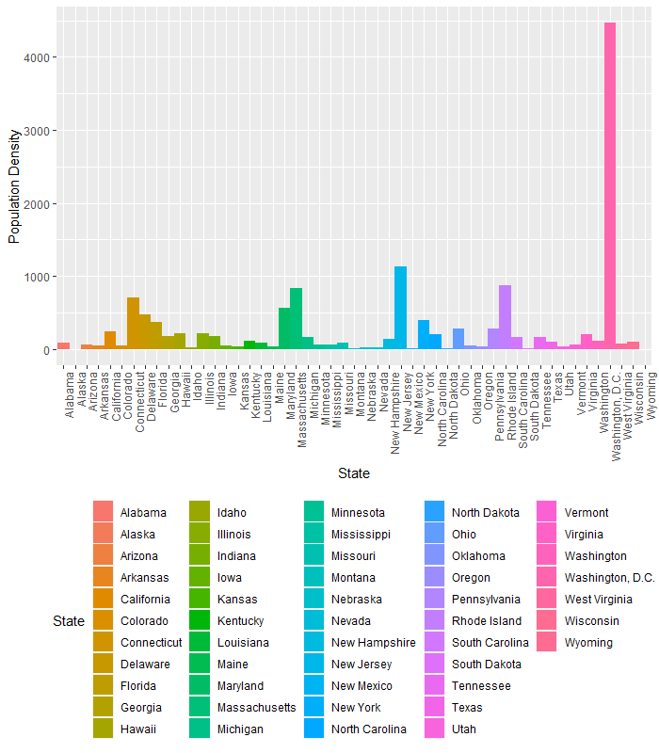
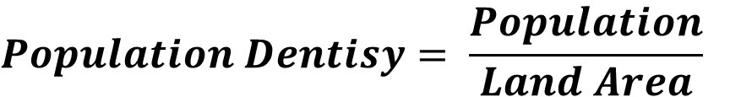
Explanatory Variables——Population Density (Pop_density)
$$Population Dentisy= \frac{Population}{Land Area}$$
Data Source: data sets (state.name & state.area) in R

Slide 14
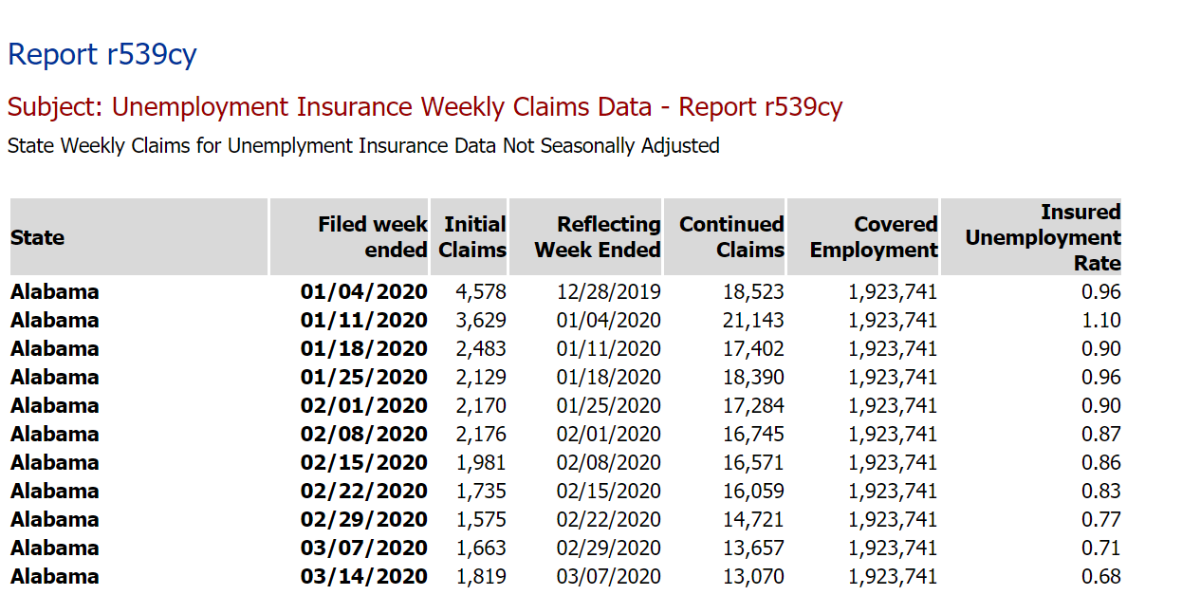
Instrumental Variable——Unemployment Insurance Number (Unemp_num)
• Weekly
• Statewide
Data Source: https://oui.doleta.gov/unemploy/claims.asp

Slide 15
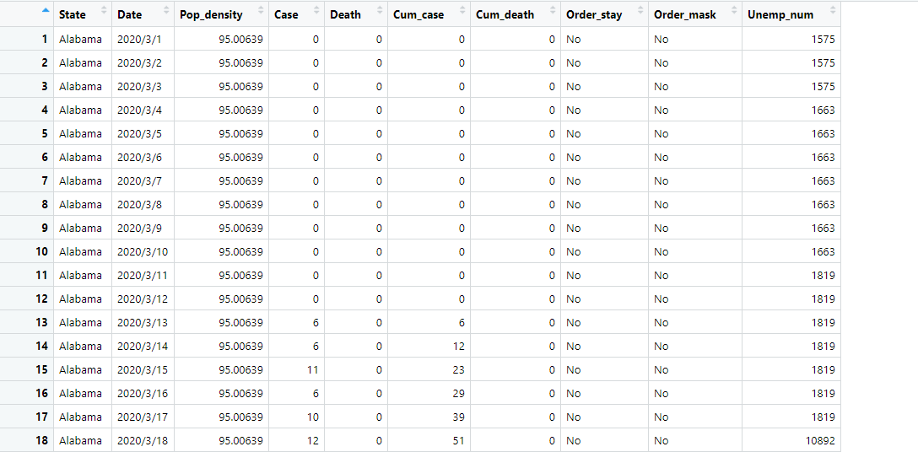
Summarized Data Set

Slide 16
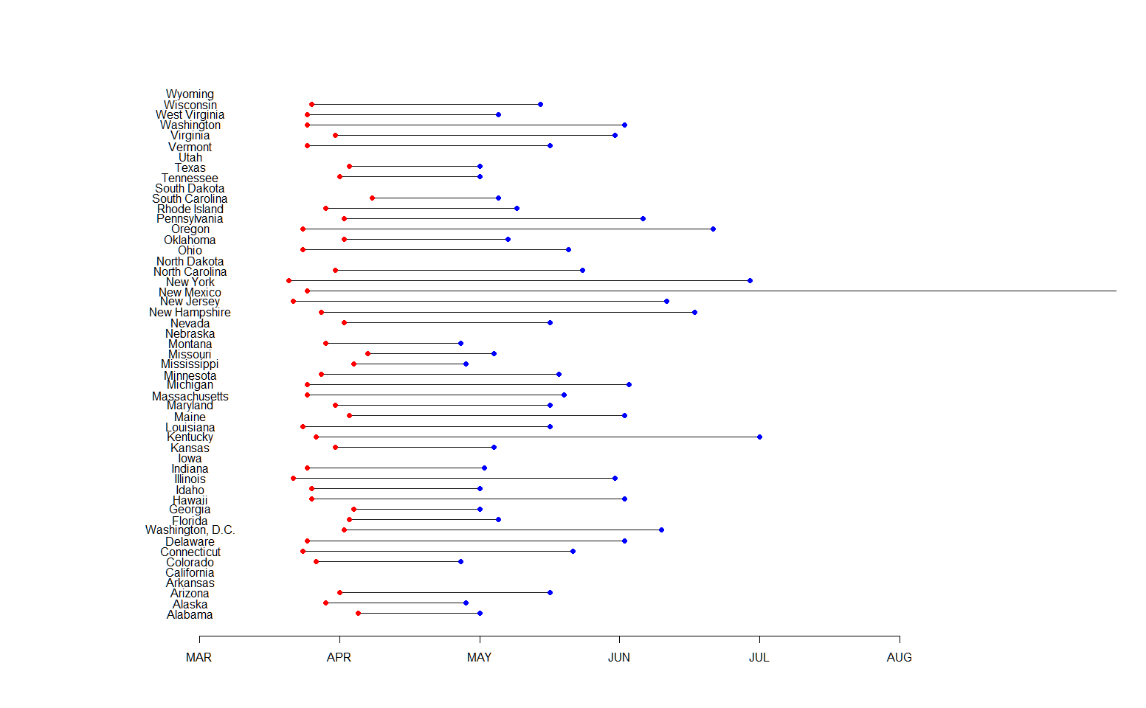
Stay-at-Home Order Duration
Most states issued Stay-at-Home orders between April and June.
The most majority of states ended their orders before August.

Slide 17
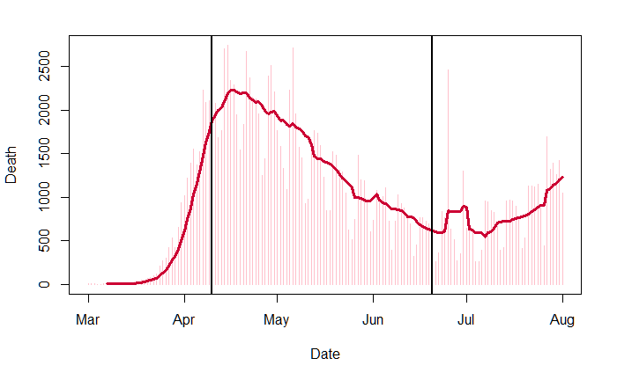
Death Number and Stay-at-Home Orders
A sharp turning can be observed when Stay-at-Home orders are issued in mid April.
The death number rises again after most states have revoked the order in late June.

Slide 18
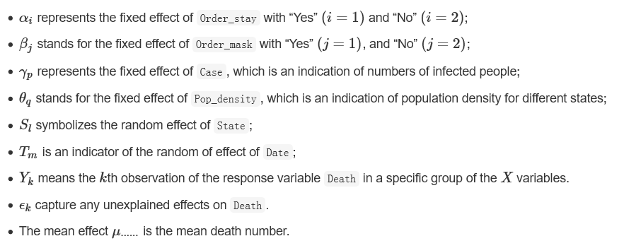
Mixed Model

Slide 19
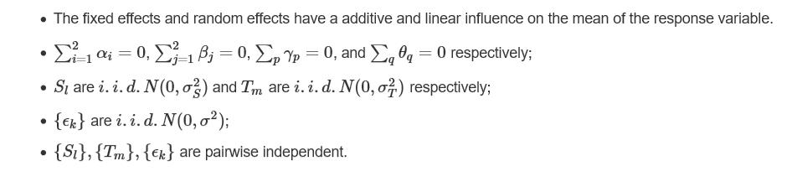
Model Assumptions
Q1:If the normal assumption is not satisfied, how would you deal with this issue?

Slide 20
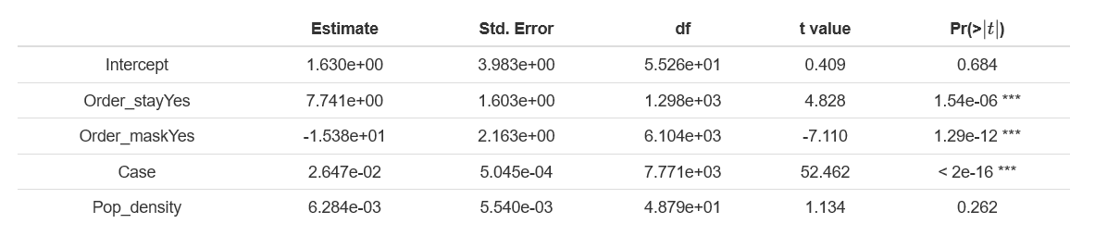
Model Fitting
The significance of both mandatory orders agree with previous analysis.
The significance of Cases varibale is trival.
The population density variable is not significant.
Q2:Intuitively, population density in each state will affect the difficulty to carry out Stay_at_home orders. How would you explain it not being significant?

Slide 21
Propensity Score Weighting
Balance analysis prior to the implementation of propensity score
Propensity Score weighting implementation
Balance analysis after the implementation of propensity score
Causal inference analysis
Model diagnostics
1) Selection model: Logistic Regression Model estimates the effect of selection bias on the treatment variable.
2) Outcome model: Mixed-effects model explores the effect of the treatment variable and covariates.

Slide 22
DAG
I
Y: outcome
Z: treatment
C: confounder
I: instrumental variable
M: mediator
Z
M
Y
Y: Deaths
Z: Lockdown Order
C: Cases and Mask Requirement
I: Weekly Unemployment Insurances
C
Q3: Why Unemployment Insurance?
Lockdown order exacerbates economic disruption with rising unemployment claims

Slide 23
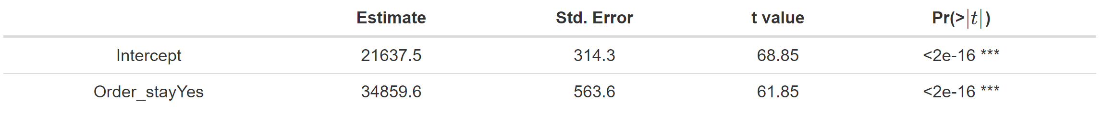
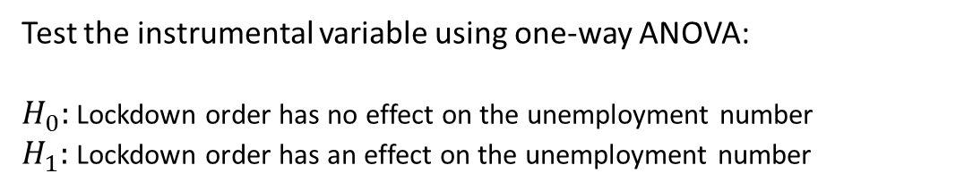
Balance Analysis Prior to The Implementation of Propensity Score
Test the instrumental variable using one-way ANOVA:
$H_{0}:$ Lockdown order has no effect on the unemployment number
$H_{1}:$ Lockdown order has an effect on the unemployment number

Slide 24
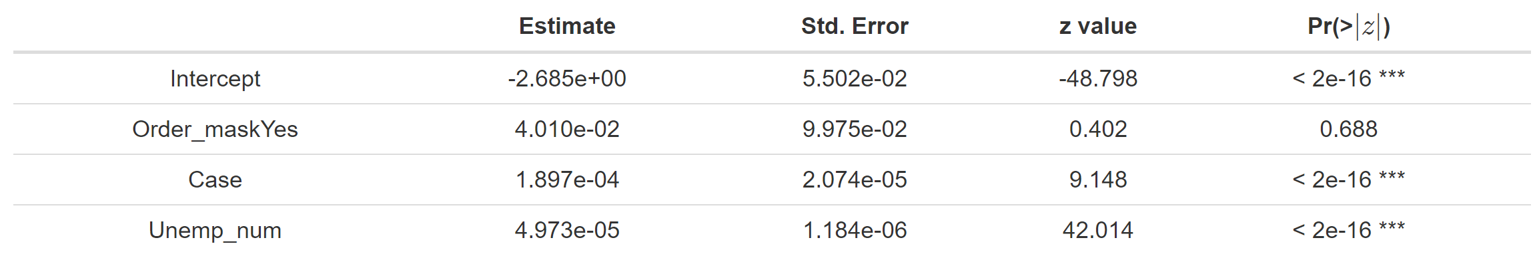
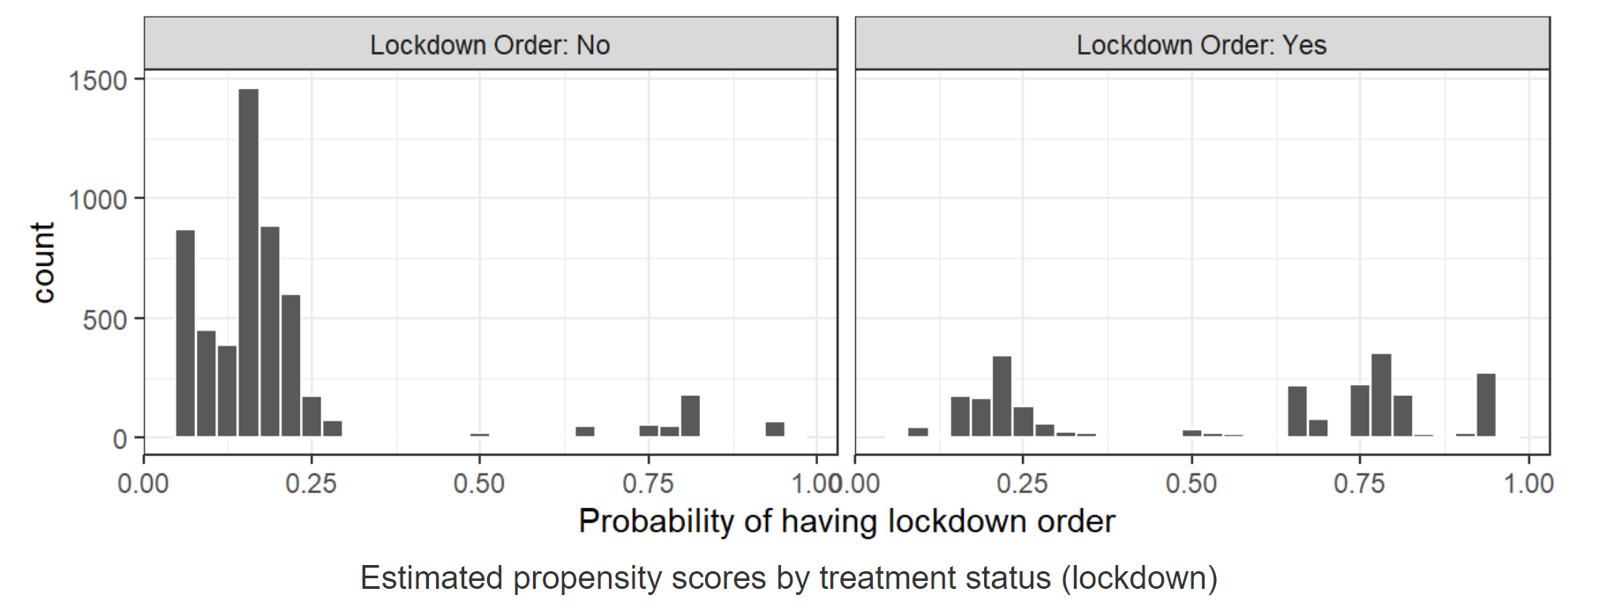
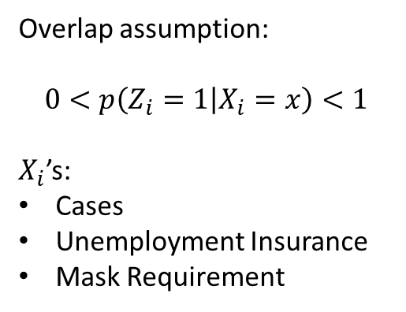
Propensity Score Weighting
Overlap assumption:
$$0<p\left(Z_{i}=1 | X_{i}=x\right)<1$$
$X_{i}$’s:
Cases
Unemployment Insurance
Mask Requirement

Slide 25
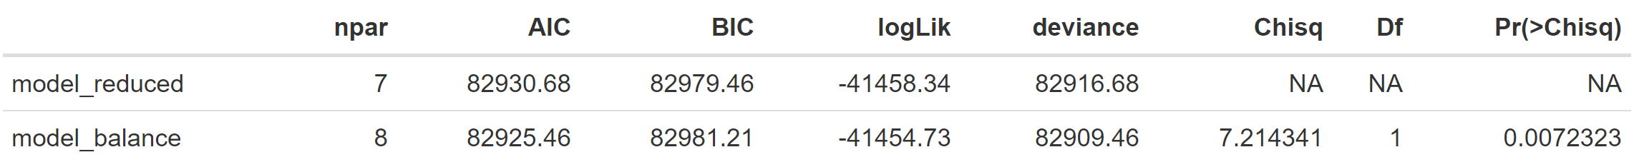
Imbalance Check
Using the same one-way ANOVA method:
Causal Inference
F-test to do significance analysis:

Slide 26
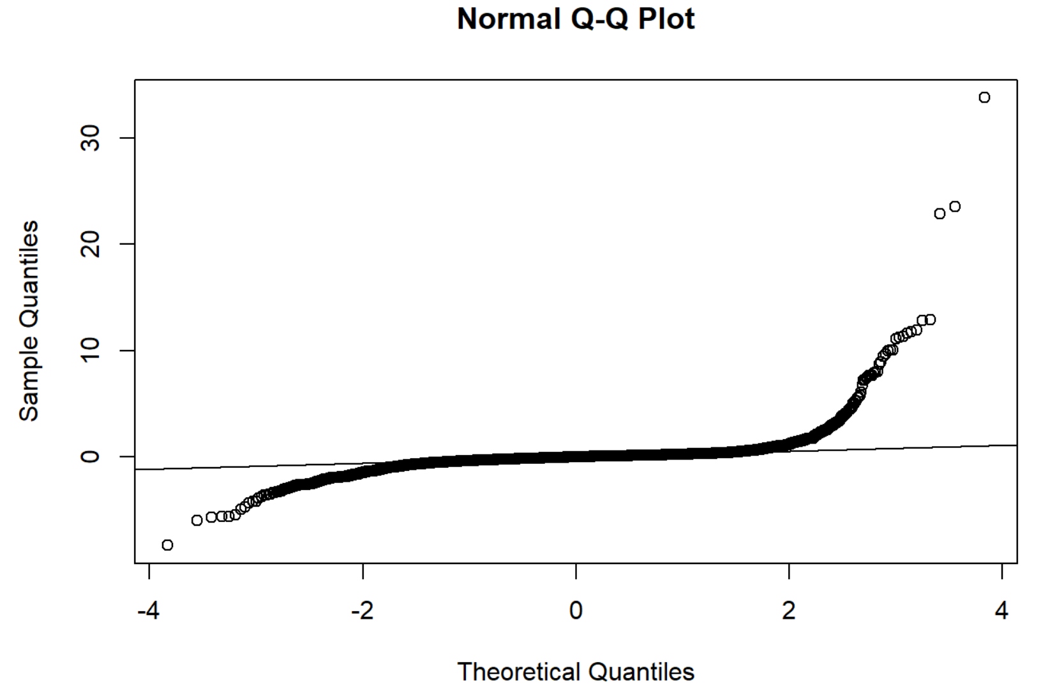
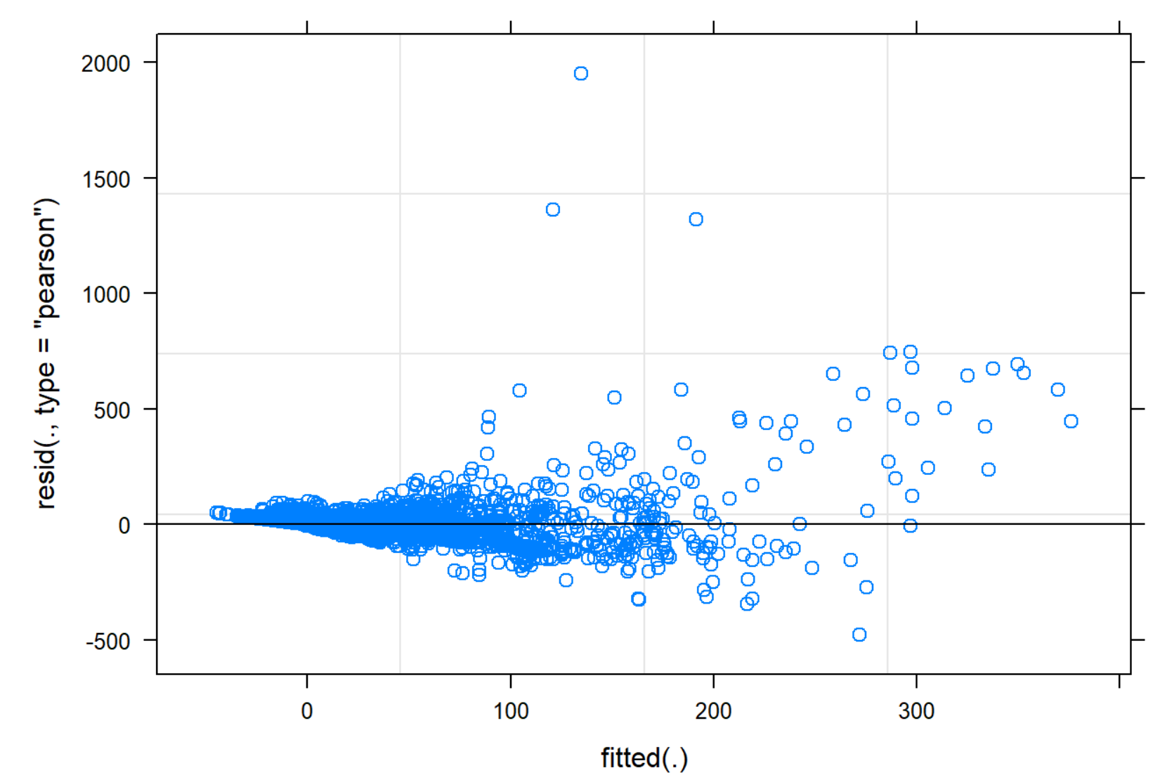
Model Diagnostics

Slide 27
Conclusions & Future Research
Lockdown order is an efficient and scientific tool to save people’s lives
Mask requirement and cases have significant effect on death numbers
Complex variables would be introduced to investigate the causal inference thoroughly
Data transformation may need to be implemented
Remaining Questions
Q4: The report under review used logistic regression to compute the propensity score. Have you considered other ways like Generalized Boost Model (GBM)?
Q5: The regulation usually causes a delay effect, have you ever thought about ways to remove the bias?

