Slide 1
Expanded Version of the BPA/PNNL GUI for Integrated Prony and Fourier analysis of Ringdown Signals
J. F. Hauer
Zhenyu (Henry) Huang
J. M. Johnson
Pacific Northwest National Laboratory
Richland, WA 99352
June 27, 2003

Slide 2
Extended Features in the BPA/PNNL Ringdown GUI
and Related Utilities
(June 27, 2003)
In the Ringdown GUI:
• Tandem fits to more signals (maximum of 20)
• Larger data arrays (maximum of 8190 points)
• More convenient controls for large cases
In PSM Tools:
• Optional menus to select signals passed to the GUI
• Optional repeat solutions based upon selected poles from earlier solution (launches new GUI window)
• Improved legends for mode shape "compass" plots
CAVEATS:
• This version of the GUI requires Matlab 6.1 or higher
• Increased number of signals and data may encounter unforseen problems in numerical resolution. Treat this as a "beta" version of the GUI, for expert users.

Slide 3
>> %Handy way to start things going
>> psmlaunch
%************************************************************************
In Case Script PSMlaunch:
Select case type: Options are
1 WSCCbrowser
2 PSMbrowser
3 BPA_PDCdatapost
8 PDC_Alias
9 PDCdatapost
21 PDCbrowse_Ex1
22 PPSMbrowse_Ex1
23 PSDScase_Ex1
24 PTIcase_Ex1
25 PTIcase_Ex2
41 Matlab_Ex1
42 Matlab_Ex2
43 BoxFilt_Ex1
44 SincFilt_Ex1
45 TriFilt_Ex1
61 PDCrobust_Ex1
97 keyboard
99 end case sequence
Indicate case type - enter number from list above [1]: 2
Indicated case type = 2: PSMbrowser

Slide 4
In Case Script PSMbrowser:
caseID = PTIPRNT_Ex2
Select processing type: Options are
1 Batch Plots
2 Angle/Freq Refs
3 Filter/Decimate
4 Backload Filtered
5 Fourier
6 Histograms
7 Ringdown GUI
8 Ringdown Utilities
9 AutoCorrelations
21 ModeMeter
22 EventScan
41 Phasor Utilities
42 Backload Phasor Results
51 Special Displays
94 DownSelect Signals
95 Load new data
96 save results
97 keyboard
98 Defaults on/off
99 end case
Indicate processing type - enter number from list above [1]: 7
Indicated processing type = 7: Ringdown GUI
In PSMbrowser: Launch ringdown tool? Enter y or n [ ]: y
In PSMbrowser: Close all plots? Enter y or n [y]:
In PSMbrowser: Time axis indicates 2 switching times
Ringdown analysis delayed to 1 seconds
In PSMbrowser: Do you want the keyboard first? Enter y or n [n]:
In PSMbrowser: Do you want signal selection menus? Enter y or n [ ]: y

Slide 5
Building signal extraction list: Submenu options are
001 Initial user selections
002 All channels
003 No channels--exit
004 Interactive selection of channels
005 Sort by signal type
Select submenu - enter 1 to 5 [2]: 5
Submenu 005: Sort by signal type
Add this submenu to extraction list? Enter y or n [ ]: y
In SigSelect: Sorting by signal type
In SigSelect: Sorting options are
% 1 Time
% 2 Freq
% 3 FreqR
% 4 FreqA
% 5 POWR
% 6 ANG
% 7 ANGL
% 8 ANGR
% 9 ANGA
% 10 FREQ
% 11 FREQR
% 12 FREQA
% 13 SPD
% 14 SPDR
% 15 SPDA
% 98 special type
% 99 end
Select a value from list above: [8]:

Slide 6
Extended Features in the BPA/PNNL Ringdown GUI
(June 24, 2003)
1 select all signals, then downselect individually (maximum=20)
2 apply processing controls to all selected signals
3 full length of available data
4 full volume and rate of available data
5 list of selected signals
6 reference time for analysis
7 processing controls for all selected signals
8 decimation factor (all signals)
9A default frequency span for FFT results display (all signals)
9B frequency span for FFT results display (this signal)
10 display menu for modes sorted by type
11 mode selection controls, display by mode number and type
12 select/deselect all modes on this page

Slide 7
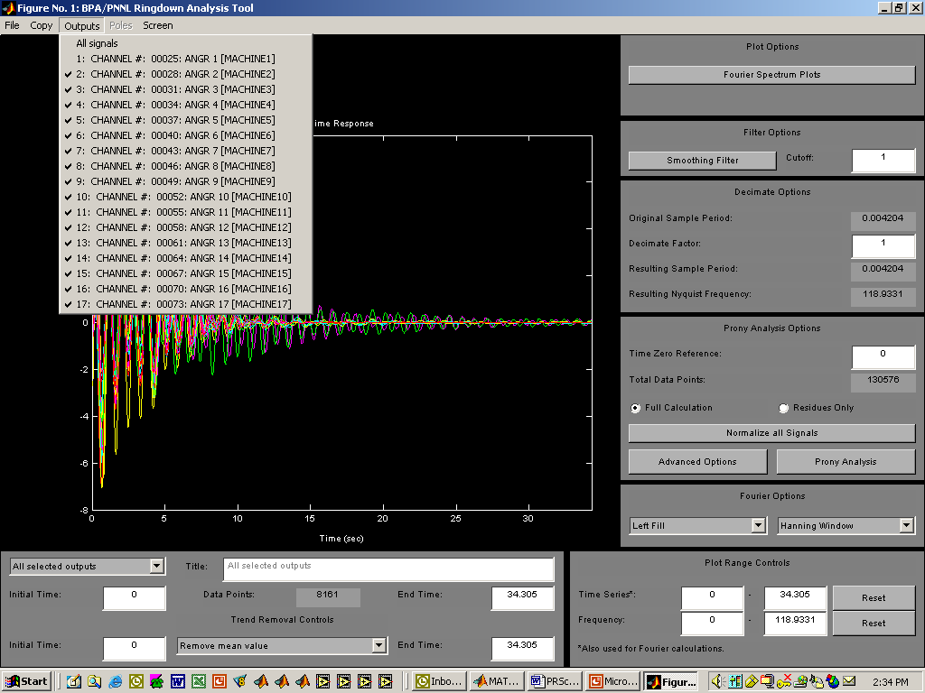
1
4
2
3

Slide 8
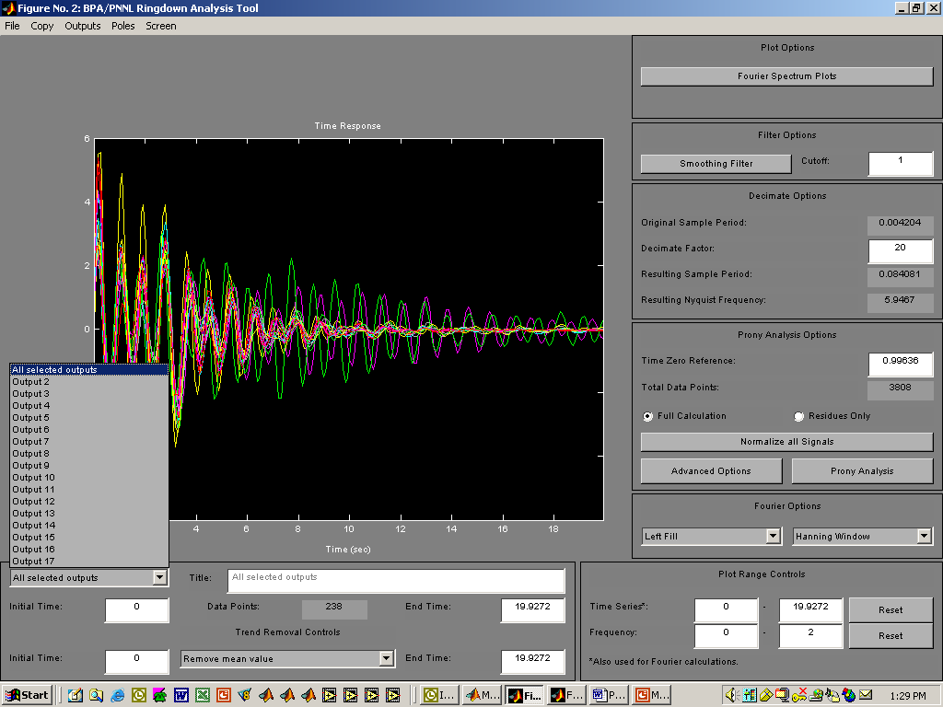
8
6
5
7
9A

Slide 9
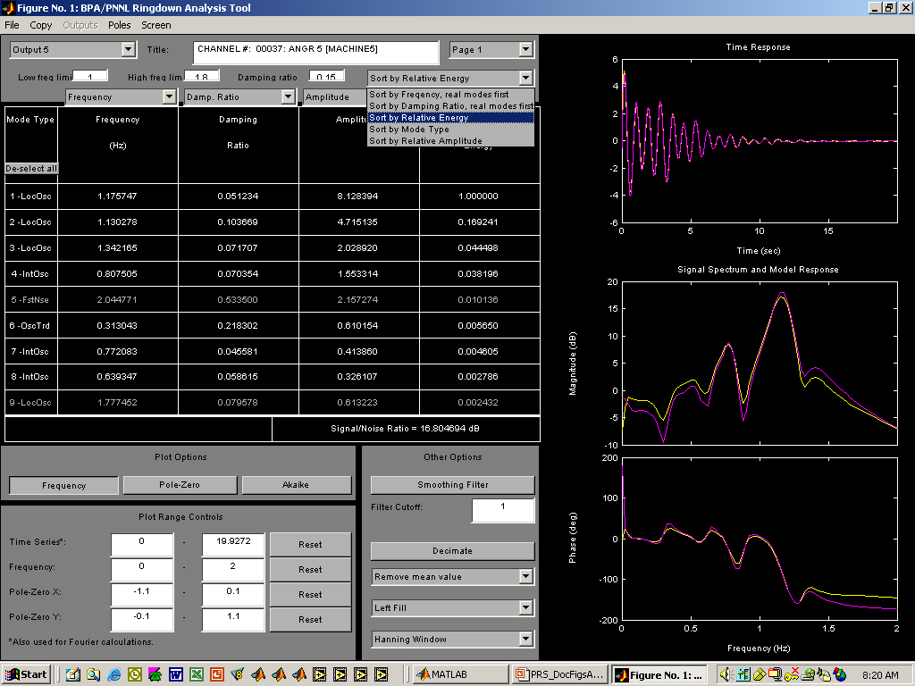
12
10
11
9B

Slide 10
In Case Script PSMbrowser:
caseID = PTIPRNT_Ex2
Select processing type: Options are
1 Batch Plots
2 Angle/Freq Refs
3 Filter/Decimate
4 Backload Filtered
5 Fourier
6 Histograms
7 Ringdown GUI
8 Ringdown Utilities
9 AutoCorrelations
21 ModeMeter
22 EventScan
41 Phasor Utilities
42 Backload Phasor Results
51 Special Displays
94 DownSelect Signals
95 Load new data
96 save results
97 keyboard
98 Defaults on/off
99 end case
Indicate processing type - enter number from list above [1]: 8
Indicated processing type = 8: Ringdown Utilities

Slide 11
In PRSdisp1: EXPERIMENTAL CODE FOR REVIEWING PRONY SOLUTION
AND CONSTRUCTING LINEAR [A B C D] MODEL
In PRSdisp1: caseID=PTIPRNT_Ex2 casetime=06/25/03_16:04:47
In PRSdisp1: Indicate figure number for Prony solution [1]:
In PRSdisp1: PRSfig = 1
Is this value ok? Enter y or n [y]:
In PRSdisp1: Full signal names are
% 1 CHANNEL #: 00028: ANGR 2 [MACHINE2]
% 2 CHANNEL #: 00031: ANGR 3 [MACHINE3]
% 3 CHANNEL #: 00034: ANGR 4 [MACHINE4]
% 4 CHANNEL #: 00037: ANGR 5 [MACHINE5]
% 5 CHANNEL #: 00040: ANGR 6 [MACHINE6]
% 6 CHANNEL #: 00043: ANGR 7 [MACHINE7]
% 7 CHANNEL #: 00046: ANGR 8 [MACHINE8]
% 8 CHANNEL #: 00049: ANGR 9 [MACHINE9]
% 9 CHANNEL #: 00052: ANGR 10 [MACHINE10]
% 10 CHANNEL #: 00055: ANGR 11 [MACHINE11]
% 11 CHANNEL #: 00058: ANGR 12 [MACHINE12]
% 12 CHANNEL #: 00061: ANGR 13 [MACHINE13]
% 13 CHANNEL #: 00064: ANGR 14 [MACHINE14]
% 14 CHANNEL #: 00067: ANGR 15 [MACHINE15]
% 15 CHANNEL #: 00070: ANGR 16 [MACHINE16]
% 16 CHANNEL #: 00073: ANGR 17 [MACHINE17]
In RootSort1:
SortType = 1
SortTrack = 1
In RootSort1: Category parameters are
FLIM1= 1.000 DLIM1=0.1500
FLIM2= 1.800
In RootSort1: Are these values ok? Enter y or n [y]:

Slide 12
In PRSdisp1: Perform repeat solution with existing poles? Enter y or n [ ]: n
In PRSdisp1: Top of display loop -- max displays = 20
Proceed with display cycle 1? Enter y or n [ ]: y
Pole display can be in basic order, or in category order
Display in category order? Enter y or n [y]:
In PRSdisp1: 46 unused Poles
Discard unused poles? Enter y or n [n]: y
Zero unused residues for each signal? Enter y or n [n]:
Do you want the keyboard? Enter y or n [n]:
In PRSdisp1: Select Poles to display
Select desired options from list below:
% 1 All Poles
% 2 All Poles in Use
% 3 none
% 4 Simple trend
% 5 Oscillatory trend
% 6 Interarea oscillation
% 7 Local oscillation
% 8 Unstable oscillation
% 9 Fast noise
Present selections shown below:
% 6 Interarea oscillation
% 7 Local oscillation
% 8 Unstable oscillation
Is this ok? Enter y or n [y]: n
Update selection vector shown below:
val=[6 7 8]
Invoking "keyboard" command - Enter "return" when you are finished
K>> val=2; return

Slide 13
In PRSdisp1: Start of PRS Table Displays
Do you want the keyboard? Enter y or n [ ]: n
Display PRS table for each signal? Enter y or n [ ]: n
Display PRS table for each pole? Enter y or n [y]: y
Compass plots of signal residues for complex poles? Enter y or n [y]: y
Compass plots of residue angles only? Enter y or n [ ]: n

Slide 14
In PRSdisp1: caseID=PTIPRNT_Ex2 casetime=06/25/03_16:04:47
•
•
•
CHANNEL #: 00070: ANGR 16 [MACHINE16] 1.17574707 0.05123434 6.69938320 -143.28658718
CHANNEL #: 00073: ANGR 17 [MACHINE17] 1.17574707 0.05123434 6.67222323 -140.52645568
Sorted PRS Table for pole24: Local oscillation
Signal Freq in Hz Damp Ratio (pu) Res Mag Res Angle
CHANNEL #: 00028: ANGR 2 [MACHINE2] 1.34216478 0.07170709 0.52073800 -26.88749004
CHANNEL #: 00031: ANGR 3 [MACHINE3] 1.34216478 0.07170709 0.45420281 -41.64704550
CHANNEL #: 00034: ANGR 4 [MACHINE4] 1.34216478 0.07170709 1.15729148 -44.37876864
CHANNEL #: 00037: ANGR 5 [MACHINE5] 1.34216478 0.07170709 2.02892004 -42.64350665
CHANNEL #: 00040: ANGR 6 [MACHINE6] 1.34216478 0.07170709 0.59907702 148.15848779
CHANNEL #: 00043: ANGR 7 [MACHINE7] 1.34216478 0.07170709 0.18751080 -139.93393220
CHANNEL #: 00046: ANGR 8 [MACHINE8] 1.34216478 0.07170709 0.61536466 64.26629366
CHANNEL #: 00049: ANGR 9 [MACHINE9] 1.34216478 0.07170709 1.24620297 -50.03386128
CHANNEL #: 00052: ANGR 10 [MACHINE10] 1.34216478 0.07170709 0.52438398 7.68386257
CHANNEL #: 00055: ANGR 11 [MACHINE11] 1.34216478 0.07170709 0.24274845 -42.12414987
CHANNEL #: 00058: ANGR 12 [MACHINE12] 1.34216478 0.07170709 1.12460604 163.29756591
CHANNEL #: 00061: ANGR 13 [MACHINE13] 1.34216478 0.07170709 0.43933574 112.08337908
CHANNEL #: 00064: ANGR 14 [MACHINE14] 1.34216478 0.07170709 0.50008280 70.99069122
CHANNEL #: 00067: ANGR 15 [MACHINE15] 1.34216478 0.07170709 0.85202768 124.14865679
CHANNEL #: 00070: ANGR 16 [MACHINE16] 1.34216478 0.07170709 0.31882493 160.11789870
CHANNEL #: 00073: ANGR 17 [MACHINE17] 1.34216478 0.07170709 0.24642524 178.15924403
Sorted PRS Table for pole26: Local oscillation
Signal Freq in Hz Damp Ratio (pu) Res Mag Res Angle
CHANNEL #: 00028: ANGR 2 [MACHINE2] 1.77745239 0.07957769 0.86295468 -59.92977481
CHANNEL #: 00031: ANGR 3 [MACHINE3] 1.77745239 0.07957769 0.18710134 -127.60169205
•
•
•

Slide 15
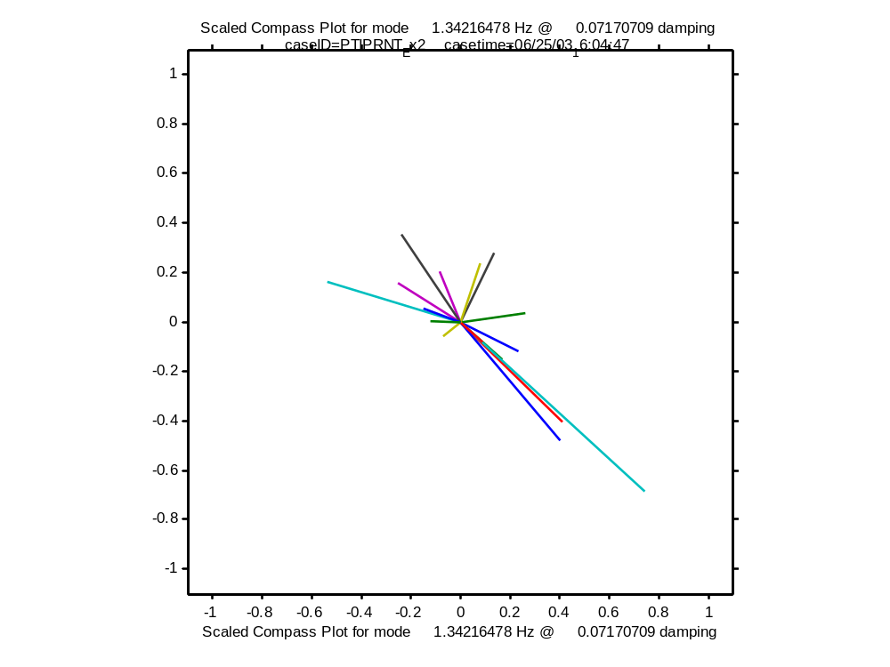

Slide 16
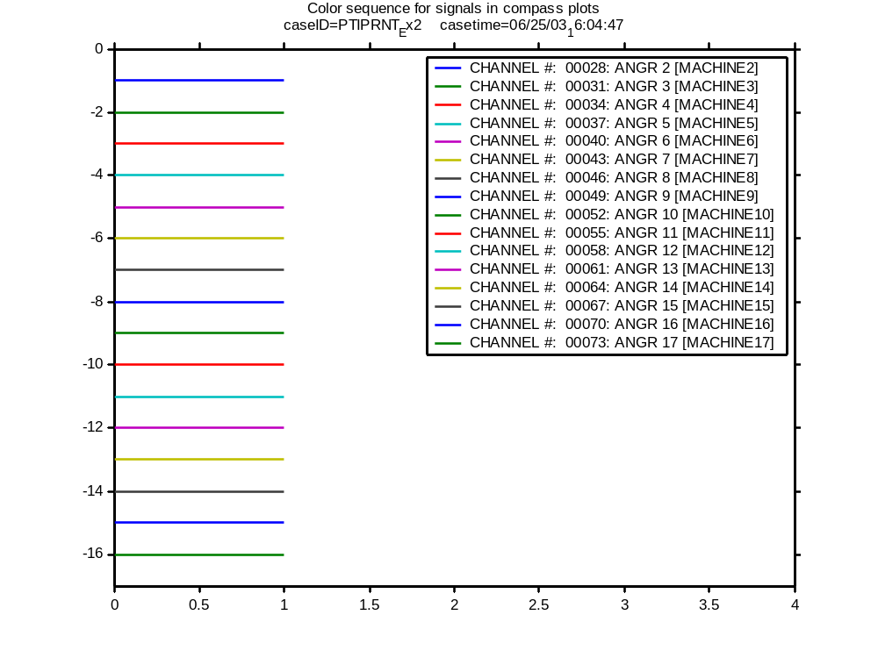

Slide 17
In PRSdisp1: caseID=PTIPRNT_Ex2 casetime=06/25/03_16:04:47
In ModeDisp1:
Sorted Mode Table for PRS Poles in use (category order):
Pole Sigma Omega Freq in Hz Damp Ratio (pu)
1 -0.05122852 0.00000000 0.00815327 N/A Simple trend
2 -0.33184829 0.28706135 0.04568723 0.75629842 Oscillatory trend
4 -0.61983437 1.40307060 0.22330562 0.40409455 Oscillatory trend
6 -0.43999350 1.96691020 0.31304348 0.21830248 Oscillatory trend
8 -0.24781659 2.89708086 0.46108474 0.08522885 Interarea oscillation
10 -0.23799914 3.59942872 0.57286687 0.06597729 Interarea oscillation
12 -0.23587075 4.01713561 0.63934699 0.05861520 Interarea oscillation
14 -0.22134863 4.85114258 0.77208332 0.04558072 Interarea oscillation
16 -0.35784290 5.07370488 0.80750521 0.07035415 Interarea oscillation
18 -0.75521033 5.92001197 0.94219917 0.12654353 Interarea oscillation
20 -0.74021669 7.10174348 1.13027758 0.10366867 Local oscillation
22 -0.37898816 7.38743671 1.17574707 0.05123434 Local oscillation
24 -0.60627164 8.43307004 1.34216478 0.07170709 Local oscillation
26 -0.89155610 11.16806272 1.77745239 0.07957769 Local oscillation
Return from ModeDisp1
In PRSdisp1: Perform repeat solution with existing poles? Enter y or n [ ]: y

Slide 18
Extended Features in the BPA/PNNL Ringdown GUI (ctd)
(June 24, 2003)
13 signals selected for repeat solution
14 default solution mode (full Prony solution)
15 fixed poles to use in repeat solution
16 special solution mode (residues for fixed poles )

Slide 19
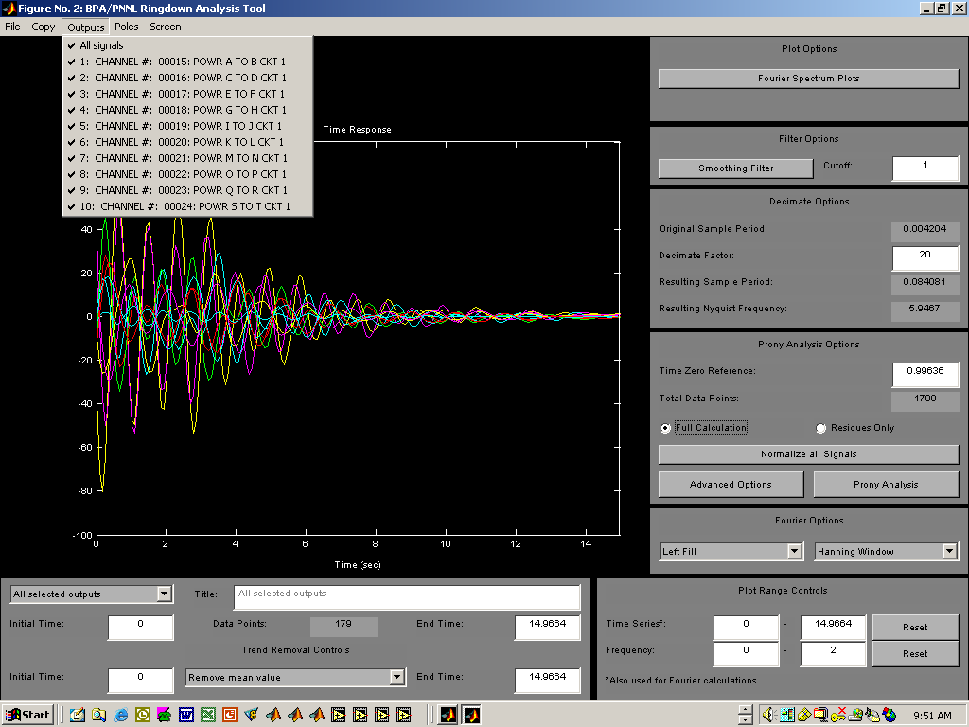
13
14

Slide 20
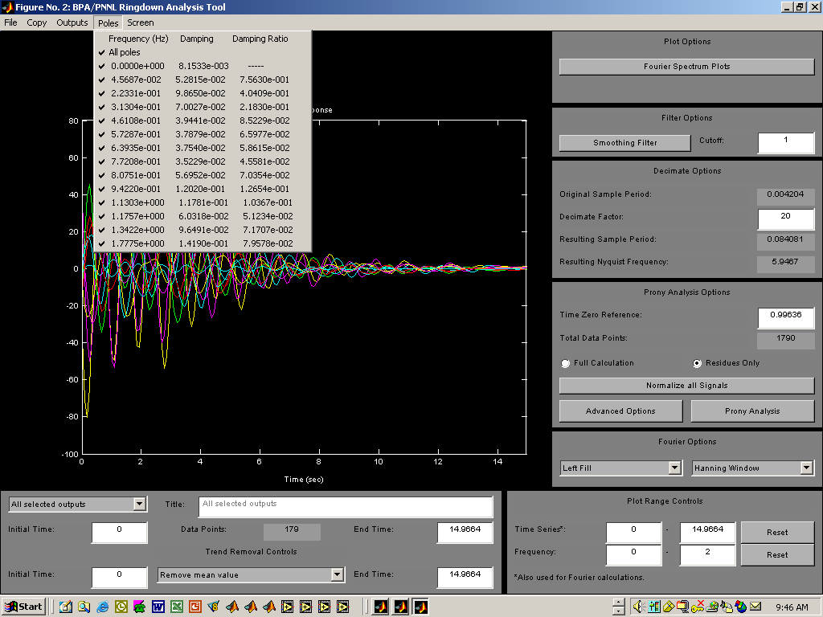
16
15

Slide 21
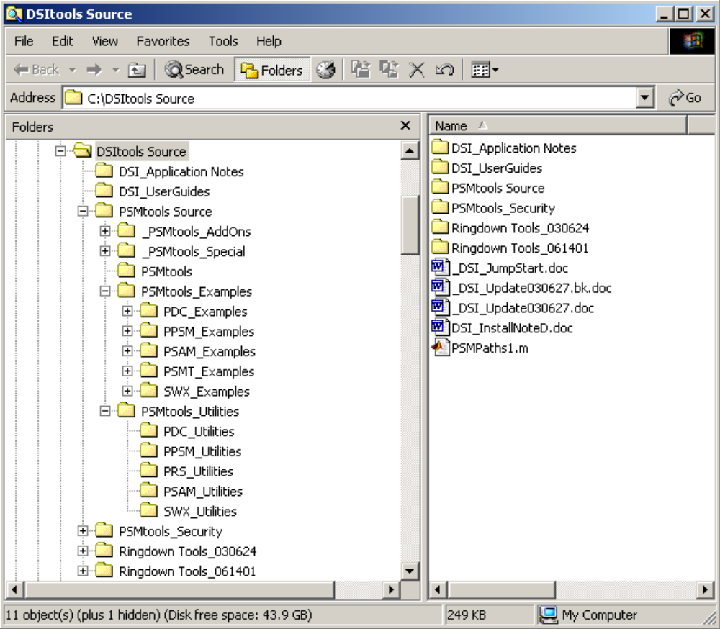
File structure of the DSI Toolbox (revision of June 27, 2003)

