Slide 1
HACKATHON
Customer Satisfaction Improvement Powered by Data
Welcome session

Slide 2
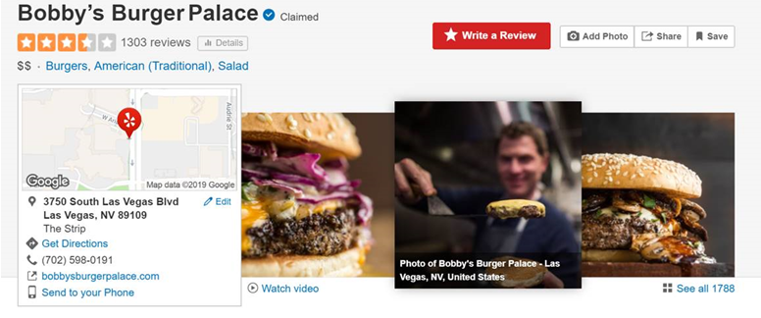
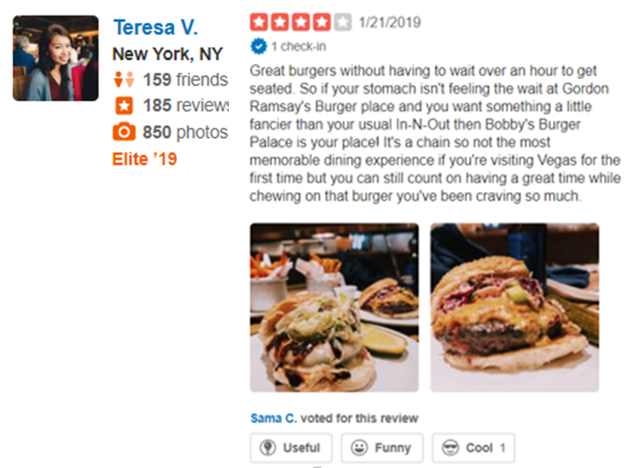

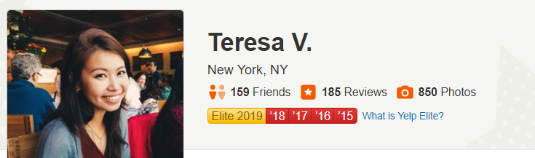
Objective
Help Mon Ami Gabi restaurant to improve its services using yelp
customers feedback
General Restaurants information
Reviews information
Reviewers information

Slide 3


Agenda
Classification Model
Predict the restaurant ratings (Binary classification)
Classification Model
Predict the restaurant ratings (Binary classification)
Recommendation
Provide visibility on strengths and weaknesses for the restaurant
Morning
Afternoon
Morning
Afternoon
Morning
Afternoon
Classification Model
Predict the restaurant ratings (Binary classification)
Recommendation
Provide visibility on strengths and weaknesses for the restaurant
Client Presentation
Presentation and questions
Feedback Session
Target: For every review of the restaurant, use the text to predict if the associated rating is positive (4 or 5) or negative (3 or less)
Evaluation: We evaluate your F1 SCORE
Use the following Kaggle link to submit your predictions :
https://www.kaggle.com/c/restaurants-ratings-prediction/overview
No limitation on the number of
submissions, do not hesitate !
Use interpretability methods to identify Strengths & Weaknesses of the restaurant and use it to make some recommendations
Prepare your presentation !
We are interested in :
Conciseness​
Clarity​
Persuasiveness​
Being innovative on the scientific approach (methodology)​
You have
20 minutes to present your slides & convince us!​
​
Free format
Be innovative !
Before leaving, do not forget to give us some feedbacks !
Wednesday, 25th
Thursday, 26th
Friday, 27th

