Slide 1
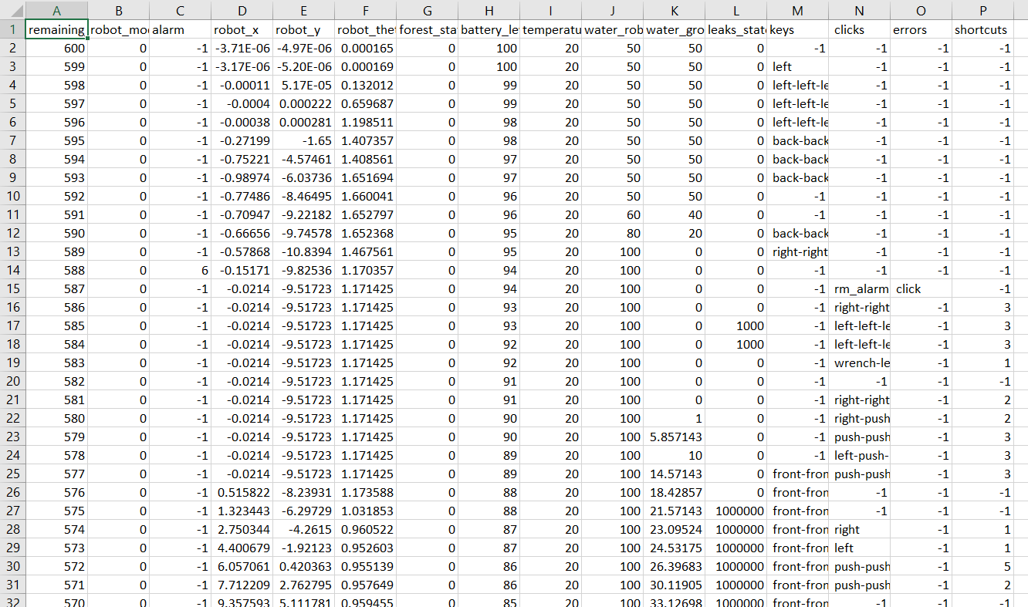
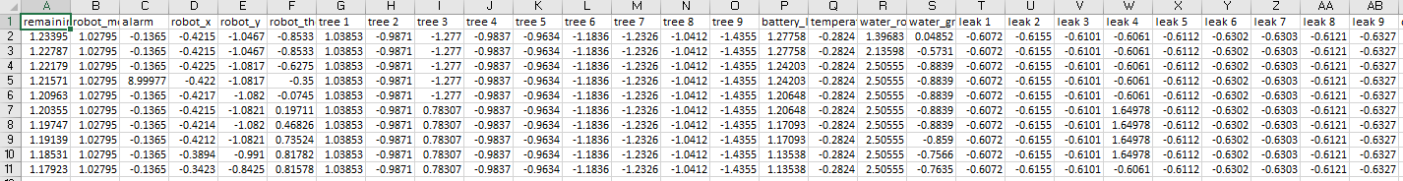

Autonomous files
14653 files with 10 secs
All data folder
Clean_Split.py
recorded_csv_data2 folder
1192 files
Human files
15421 files with 10 secs

Slide 2
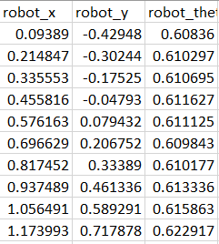
DCGAN
Discriminator
Filter =3x3
nc = 1
Ndf = 128
2*Ndf = 256
2*ngf = 256
nz = 1
ngf = 128
Generator

Slide 3
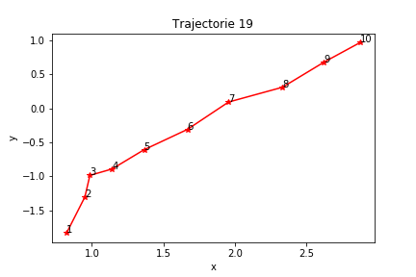
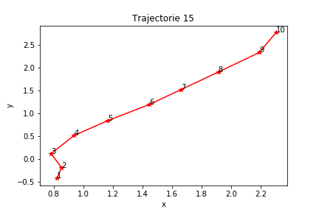
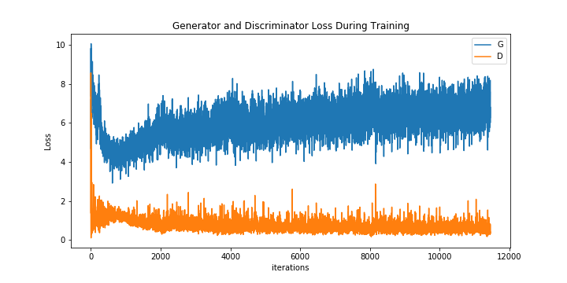
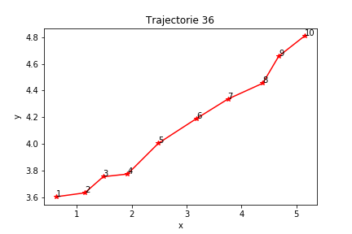
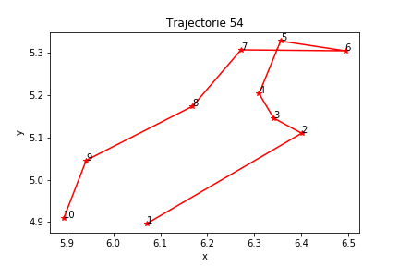
DCGAN
Cost function: BCELoss + MSE (alpha = 1)
Autonomous dataset

Slide 4
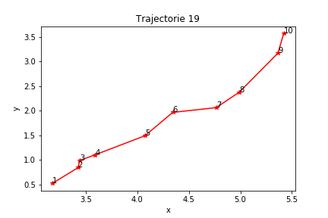
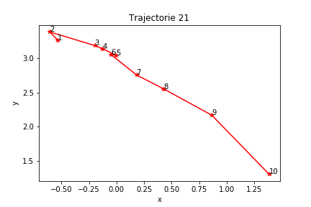
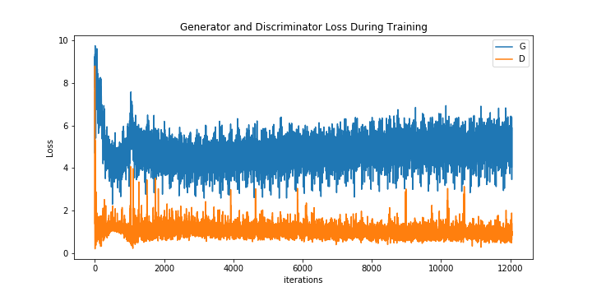
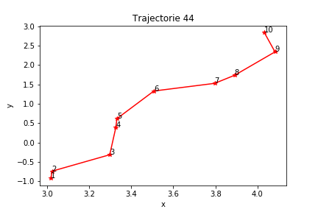
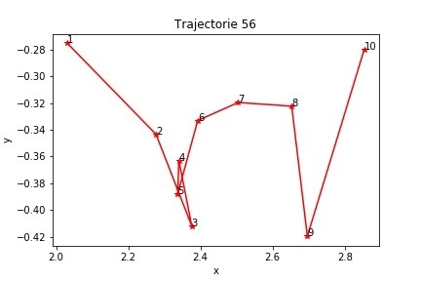
DCGAN
Cost function: BCELoss + MSE (alpha = 1)
Human dataset

Slide 5
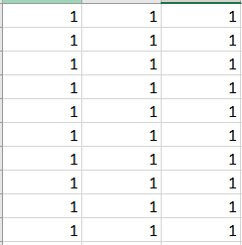
CDCGAN
Discriminator
1: autonomous
0: human
nc = 2
Ndf = 128
1: autonomous
0: human
nz + nx = 100 + 1
ngf = 128
Generator

Slide 6
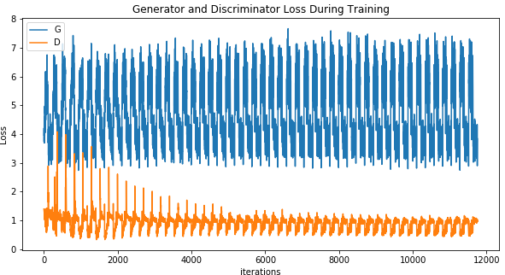
CDCGAN

Slide 7
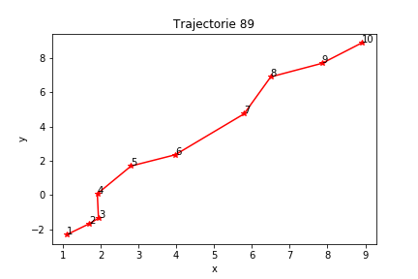
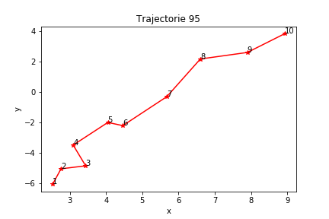
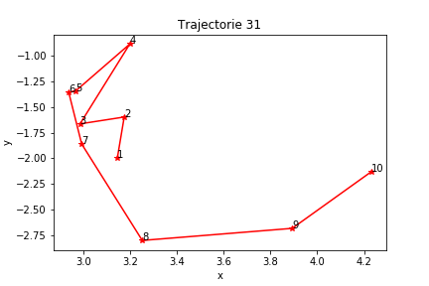
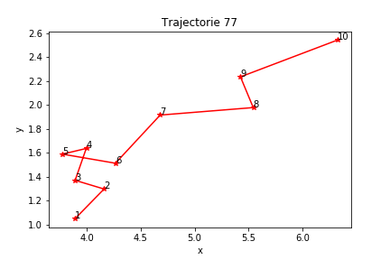
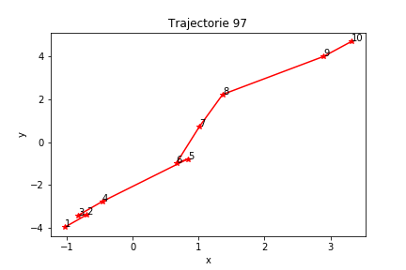
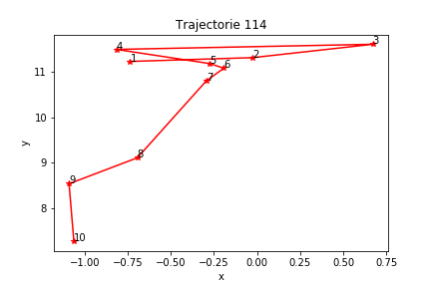
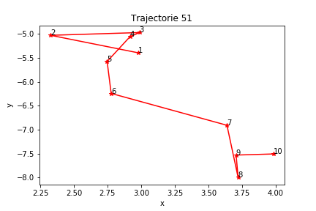
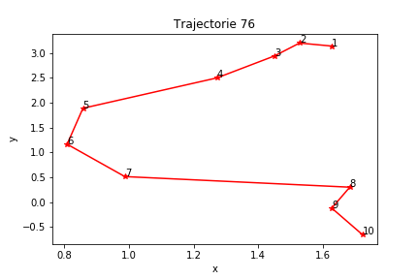
CDCGAN
Cost function: BCELoss + MSE (alpha = 1)
autonomous
human
All data (human + autonomous)

Slide 8
Next steps
Improve overall results: to achieve trajectories that are more likely to represent real situations
Add a velocity related term to the loss function : this might help avoid “long jumps” between points
Develop a metric to evaluate the produced data: how good are the generated samples? How far are they from the real data? This might give an objective function to guide and access the development of the algorithm.
Evolve the model to accommodate new features: the CDCGAN offers a viable way to implement
Add trees, keys, water reservoir etc. in the model.
CDCGAN including transition between modes
Recreate the dataset with the slide windows between autonomous and manual mode
Work a way to generate the keys pressed during the simulation

