Slide 1
Projet <DCAS-14> Improving Human-Robot Interactions with Deep Reinforcement Learning
Alois BLARRE, Felipe SILVA
Supervisors:
Caroline CHANEL
Nicolas DROUGARD

Slide 2
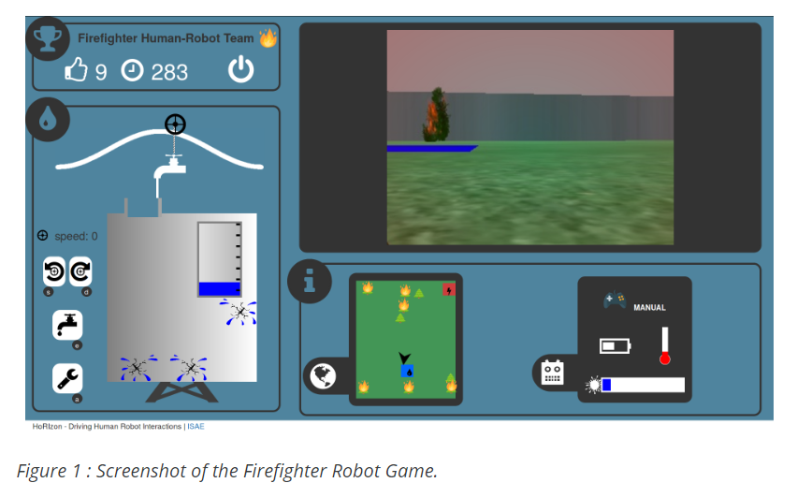


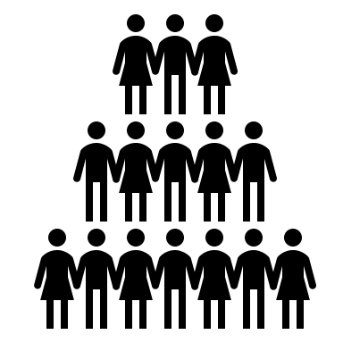
Context
To pursue the study of the interaction of human and automated systems a huge amount of data is necessary

Slide 3


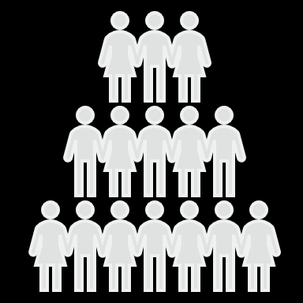
Context
To pursue the study of the interaction of human and automated systems a huge amount of data is necessary

Slide 4
Context
To pursue the study of the interaction of human and automated systems a huge amount of data is necessary

Slide 5
Context
To pursue the study of the interaction of human and automated systems a huge amount of data is necessary

Slide 6
Problem statement
To investigate whether the recent deep learning algorithms used in image and handwriting recognition can be applied to generate artificial results of simulations

Slide 7
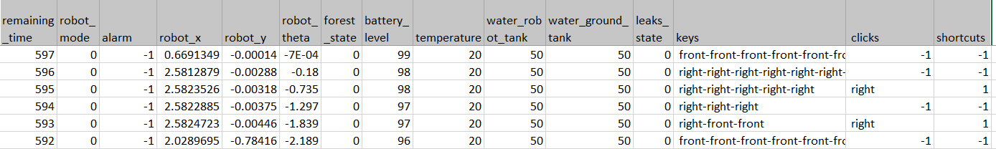
Problem statement

Slide 8
Problem statement

Slide 9
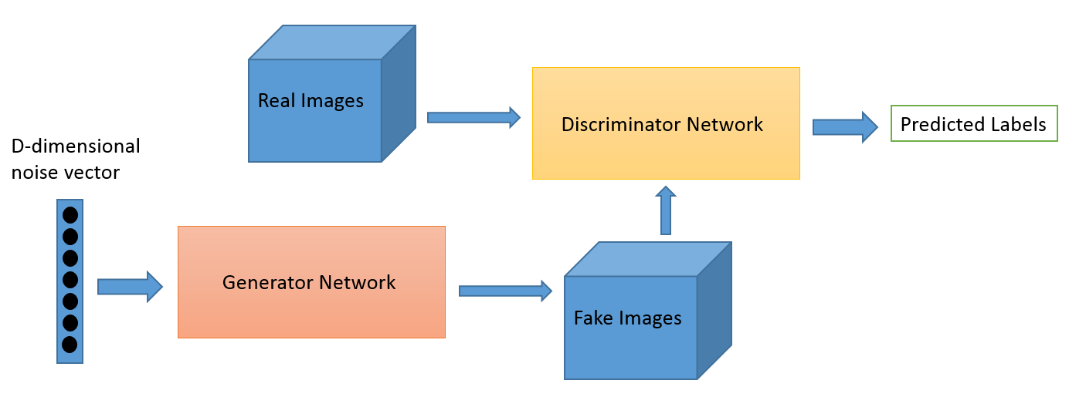
State-of-the-art
GAN
CONV NET

Slide 10
State-of-the-art
GAN
CONV NET

Slide 11
Phase 1: DATA TREATMENT
1)Adjust the data to follow.

Slide 12
Phase 1: DATA TREATMENT
1)Adjust the data to follow.
2)Divide the dataset :movements of the robot

Slide 13
Phase 1: DATA TREATMENT
1)Adjust the data to follow.
2)Divide the dataset :movements of the robot
3)Simplify

Slide 14
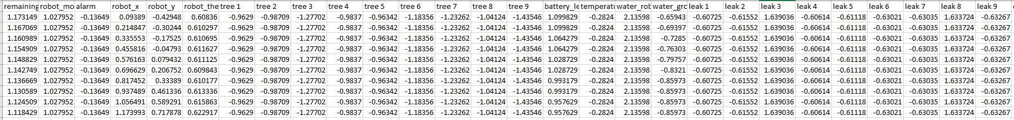
Phase 1: DATA TREATMENT

Slide 15
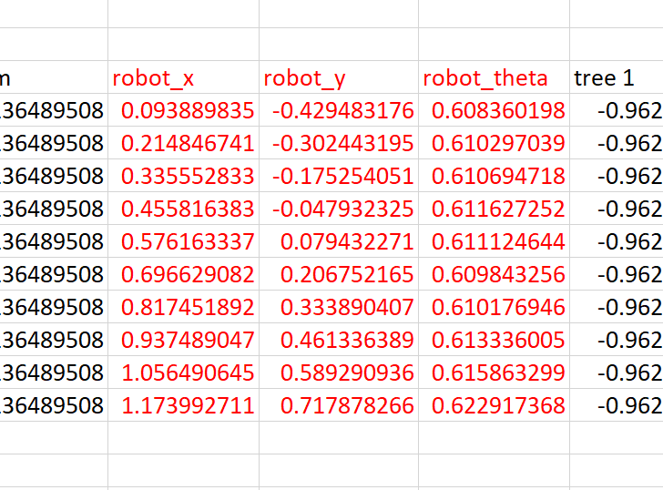
Phase 1: DATA TREATMENT

Slide 16
Phase 1: DATA TREATMENT
14.653

Slide 17
Phase 2: IMPLEMENTATION
First approach

Slide 18
Phase 2: IMPLEMENTATION
First approach

Slide 19
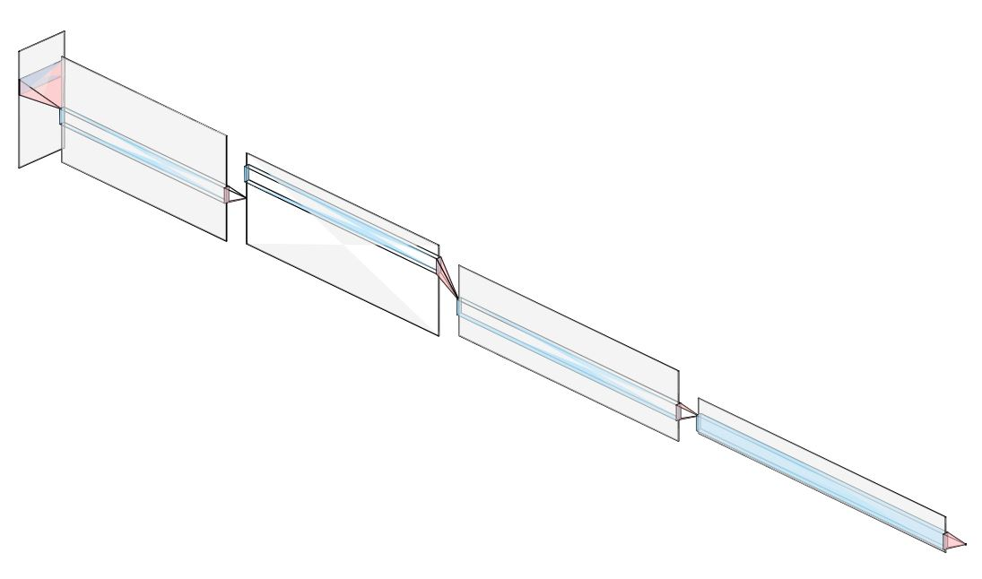
Phase 2: IMPLEMENTATION
Discriminator’s architecture

Slide 20
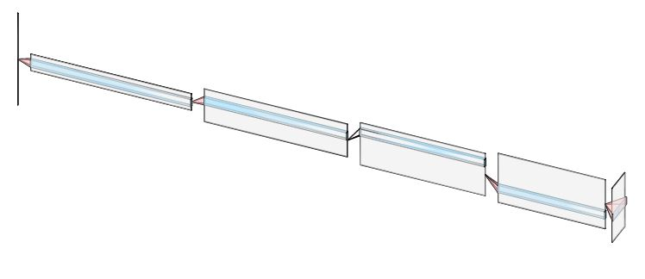
Phase 2: IMPLEMENTATION
Generator’s architecture

Slide 21
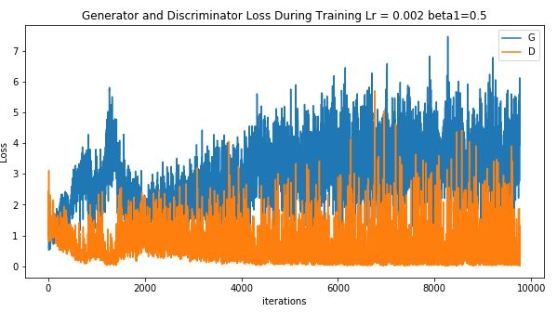
Phase 3: VALIDATION

Slide 22
Phase 3: VALIDATION

Slide 23
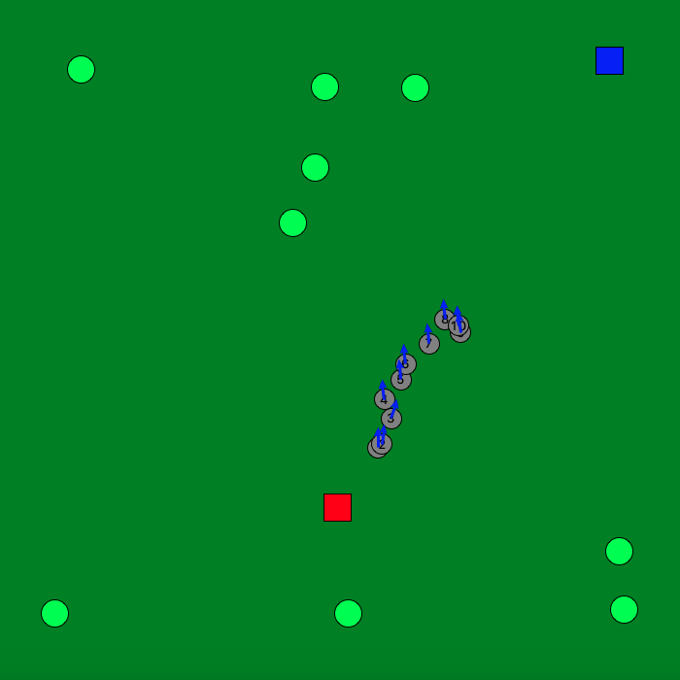
Results

Slide 24
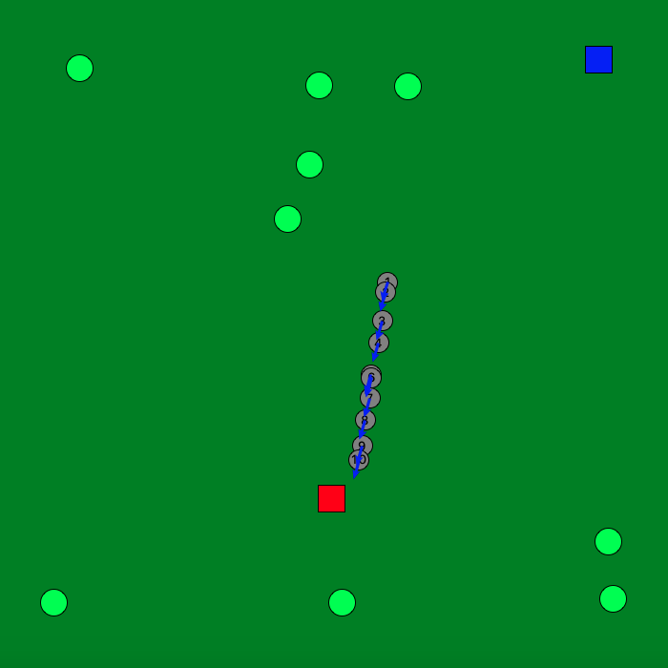
Results

Slide 25
Many thanks! Questions?

