Slide 1
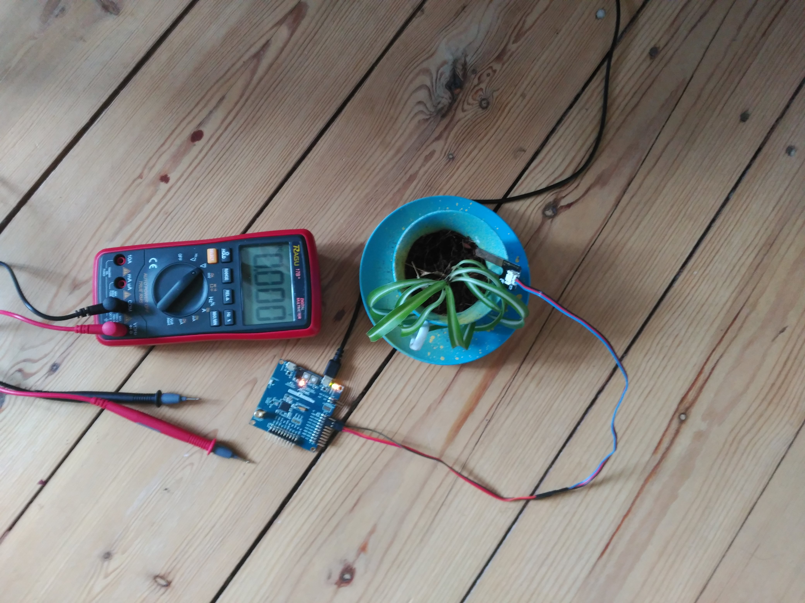
Gruppe Pflanzen 1
Albert · Jannis · Manar · Marian
Softwareprojekt
Internet-Kommunikation
Sommersemester 2018
FU Berlin · Prof Wählisch

Slide 2
contents
use case
implementation
  general setup
  modules in detail
demonstration

Slide 3
use case
humidity monitoring
  plants in separate pots
  low power consumption
automatic watering

Slide 4
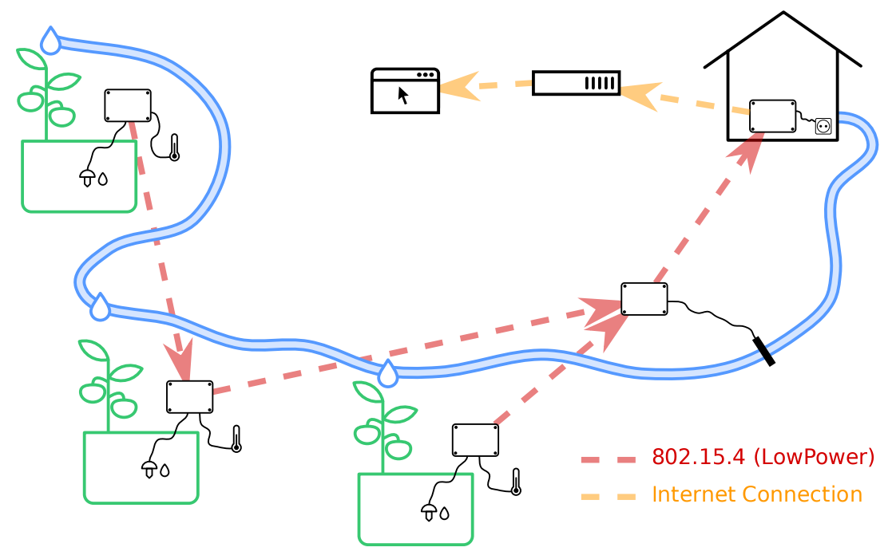
implementation

Slide 5
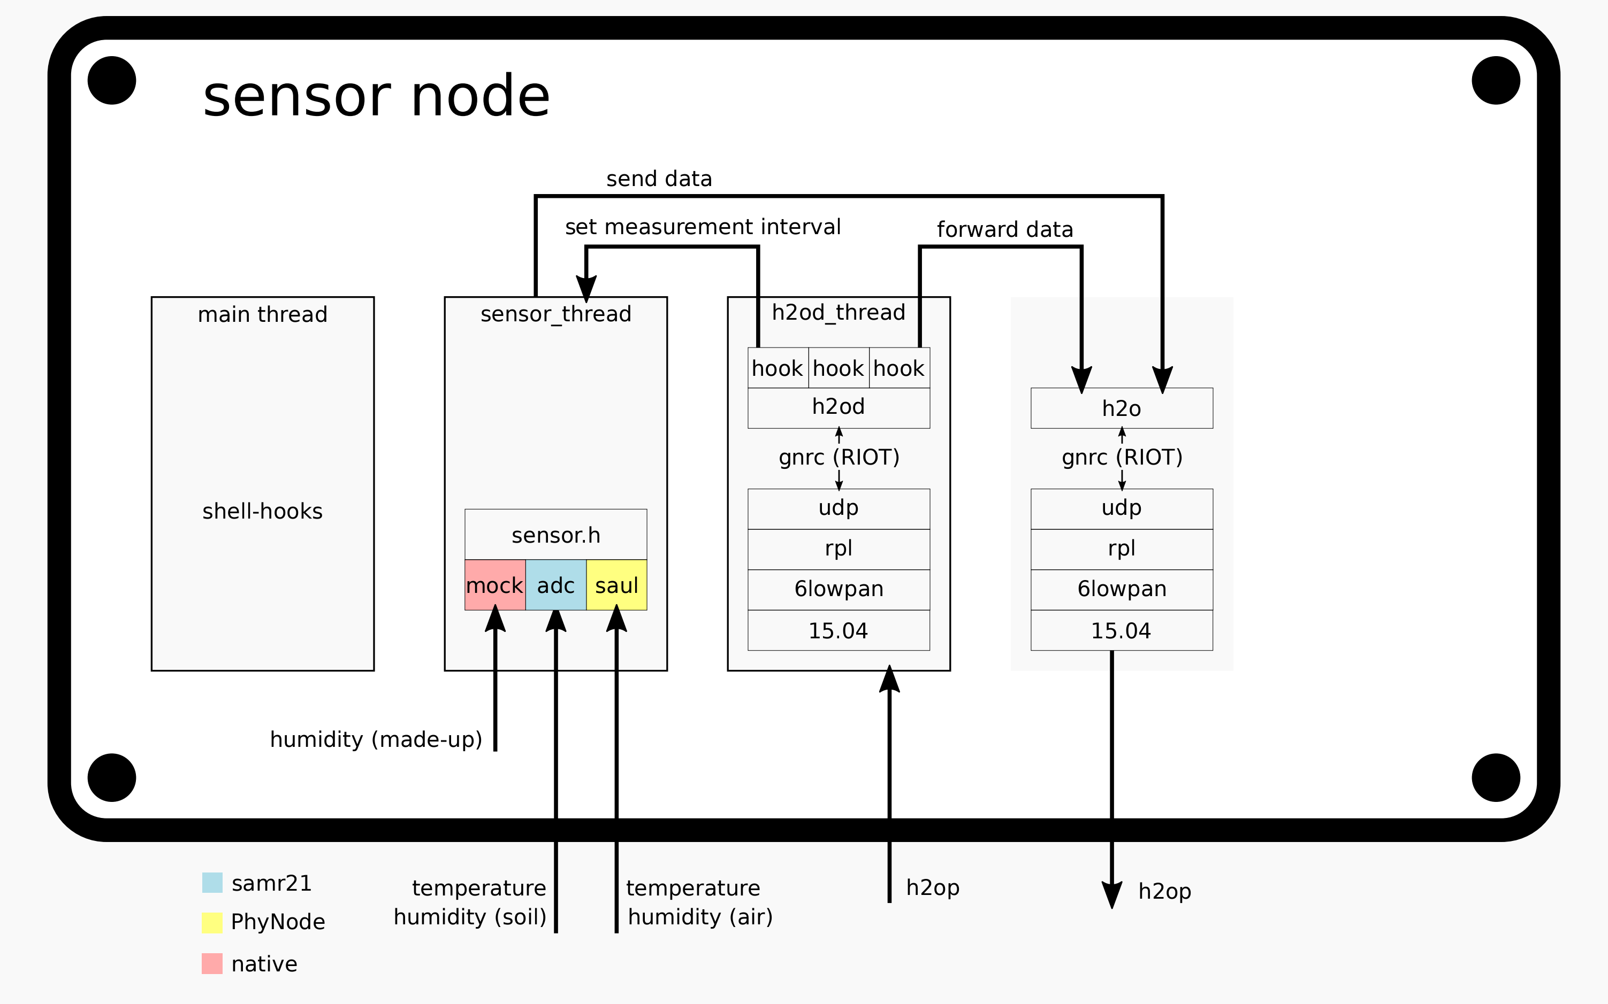

Slide 6
h2o protocol
#pragma pack(push, 1)
typedef struct {
uint8_t magic;
uint8_t version;
uint8_t len;
uint8_t type;
nodeid_t node;
uint16_t crc;
} H2OP_HEADER;
#pragma pack(pop)
typedef enum {
H2OP_DATA_TEMPERATURE = 0x11,
H2OP_DATA_HUMIDITY = 0x12,
H2OP_CONF_MEASUREMENT_\
INTERVAL = 0x31,
} H2OP_MSGTYPE;

Slide 7
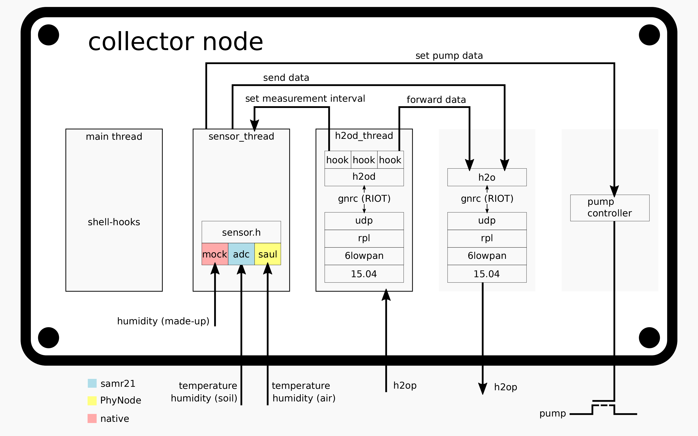

Slide 8
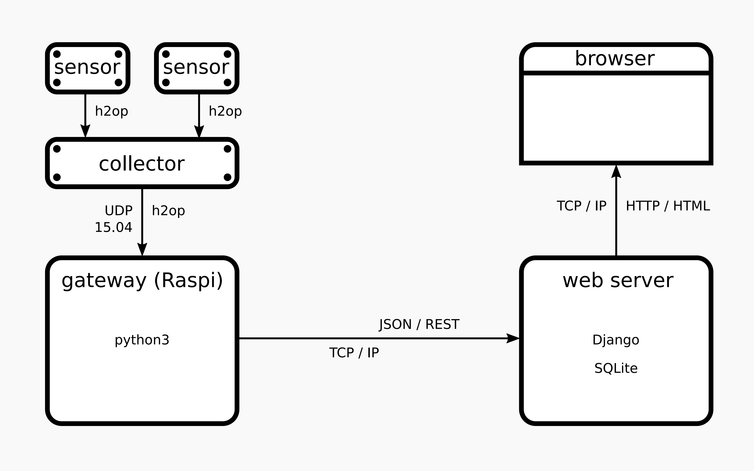
monitoring

Slide 9
demo

