Slide 1
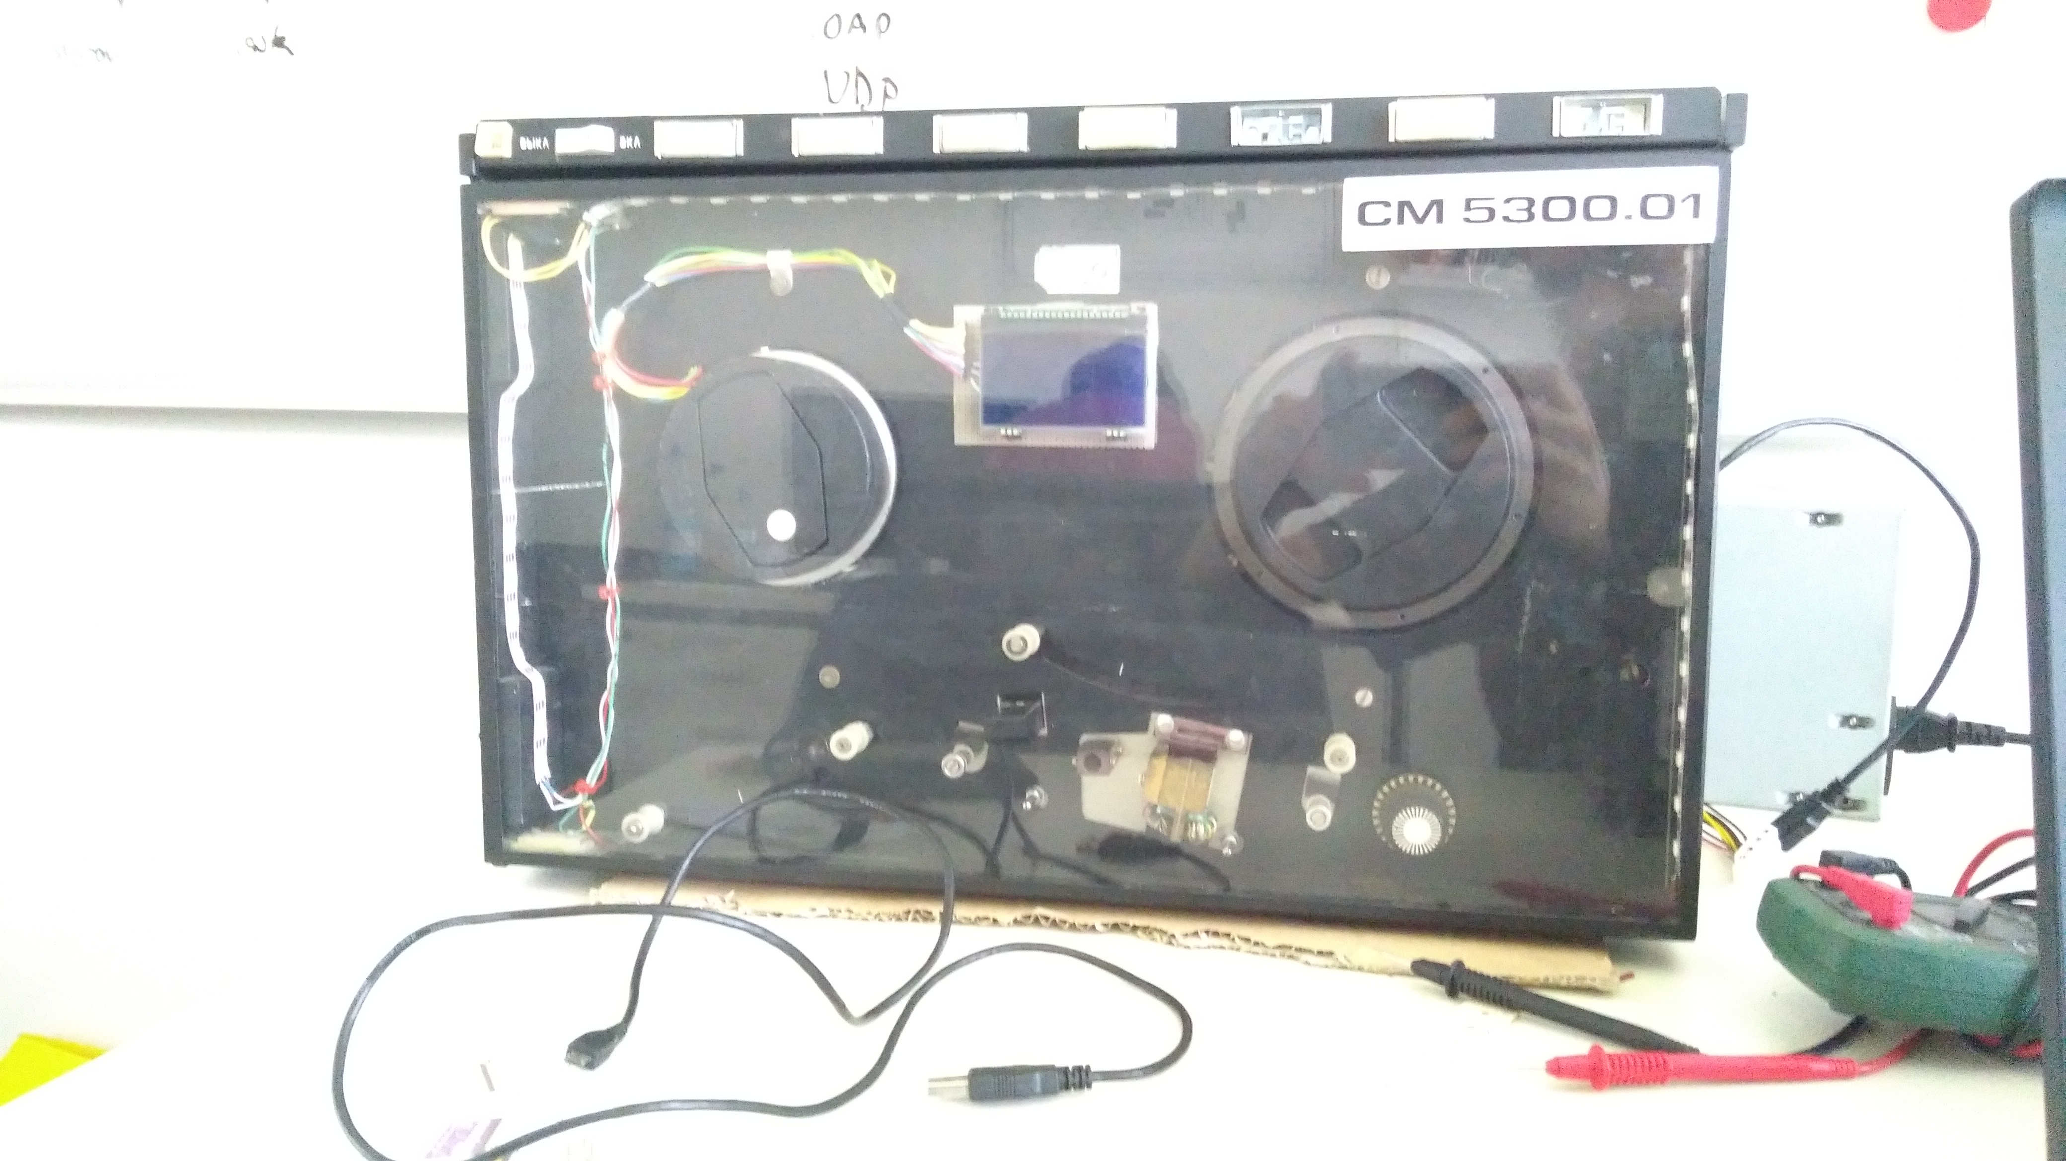
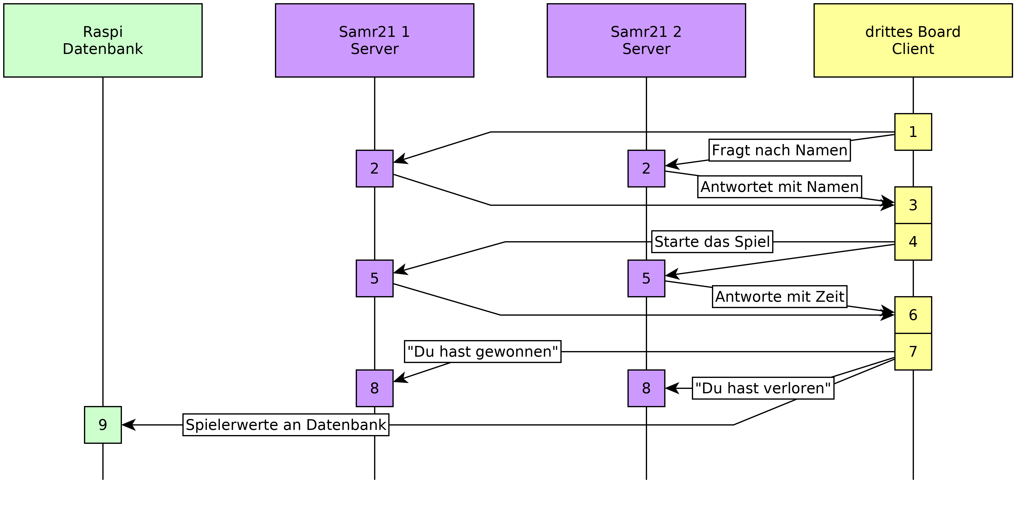
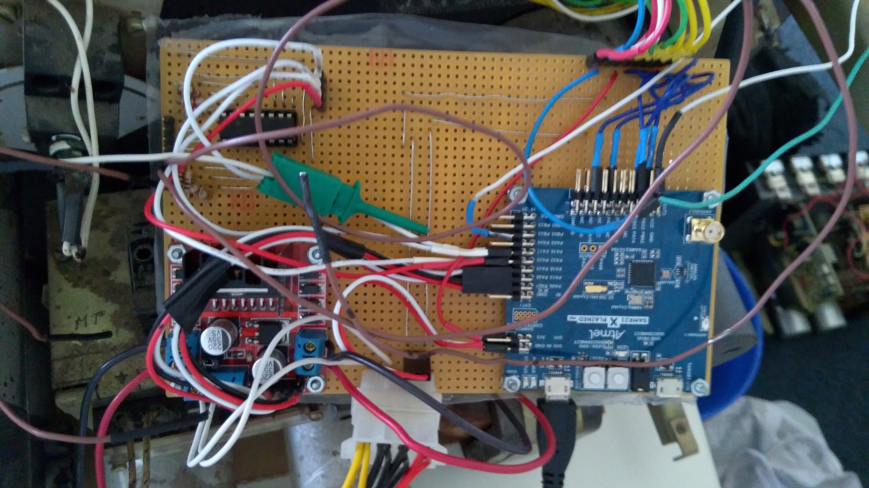
Softwareproject: Internetcommunication
Reactiongame for with Magnetic Tape Machine
Steve Dierker, Patrick Hjort, Semjon Kerner
Motivation
The intention of this project was to revive the PDP11 Servers in figure 1 located in the Freie Universität Berlin, in such a way that they attract students and brighten the hallway, even though the original purpose of the Magnetic Tape Machine is gone.
Idea
In this project we used two Magnetic Tape Machines from an old PDP11 Server and converted them into a reaction game for two players. For that purpose the given Hardware was used partly (Motors, Buttons) and was complemented by additional Parts (LCDs, LED-Stripes, H-Bridges, Multiplexer) to create a cohesive arcade game feeling.
Fig. 1: PDP11 Server Racks with converted Magnetic Tape Machines
The Hardware
The Mainboard in figure 2 combines the Mikrocontroller samr21xpro (left) that is the conceptual core of the project with a multiplexer to controll the buttons and an H-bridge (right) for driving both motors. From a Molex plug it derives 12V and 5V. Additionally a Strip connects the board to the LCD and the LED-Stripes on the front.
Abbildung 3: Netzwerkkommunikation
The Game
For this game you need one Player for each Magnetic Tape Machine. First nicknames must be entered by the Players using the Buttons to cycle through the letters. When the client has finished organizing the game, the lcd will show a countdown and then the motors will start turning.
Now its your turn: once the motors halt you have to press the glowing button as fast as you can. The faster Player will win and will be added to the highscore.
Abbildung 2: Steuerboard Samr21X mit Multiplexer und Motorsteuerung

