Slide 1
Renewable-Energy Data-Engineering PoC
Chilean renewable energy · Medallion lakehouse on Databricks
3 domains — Weather · Resource · Conglomerate
DLT · Auto Loader · Unity Catalog · AI/BI dashboards
Updated 2026-07-28

Slide 2
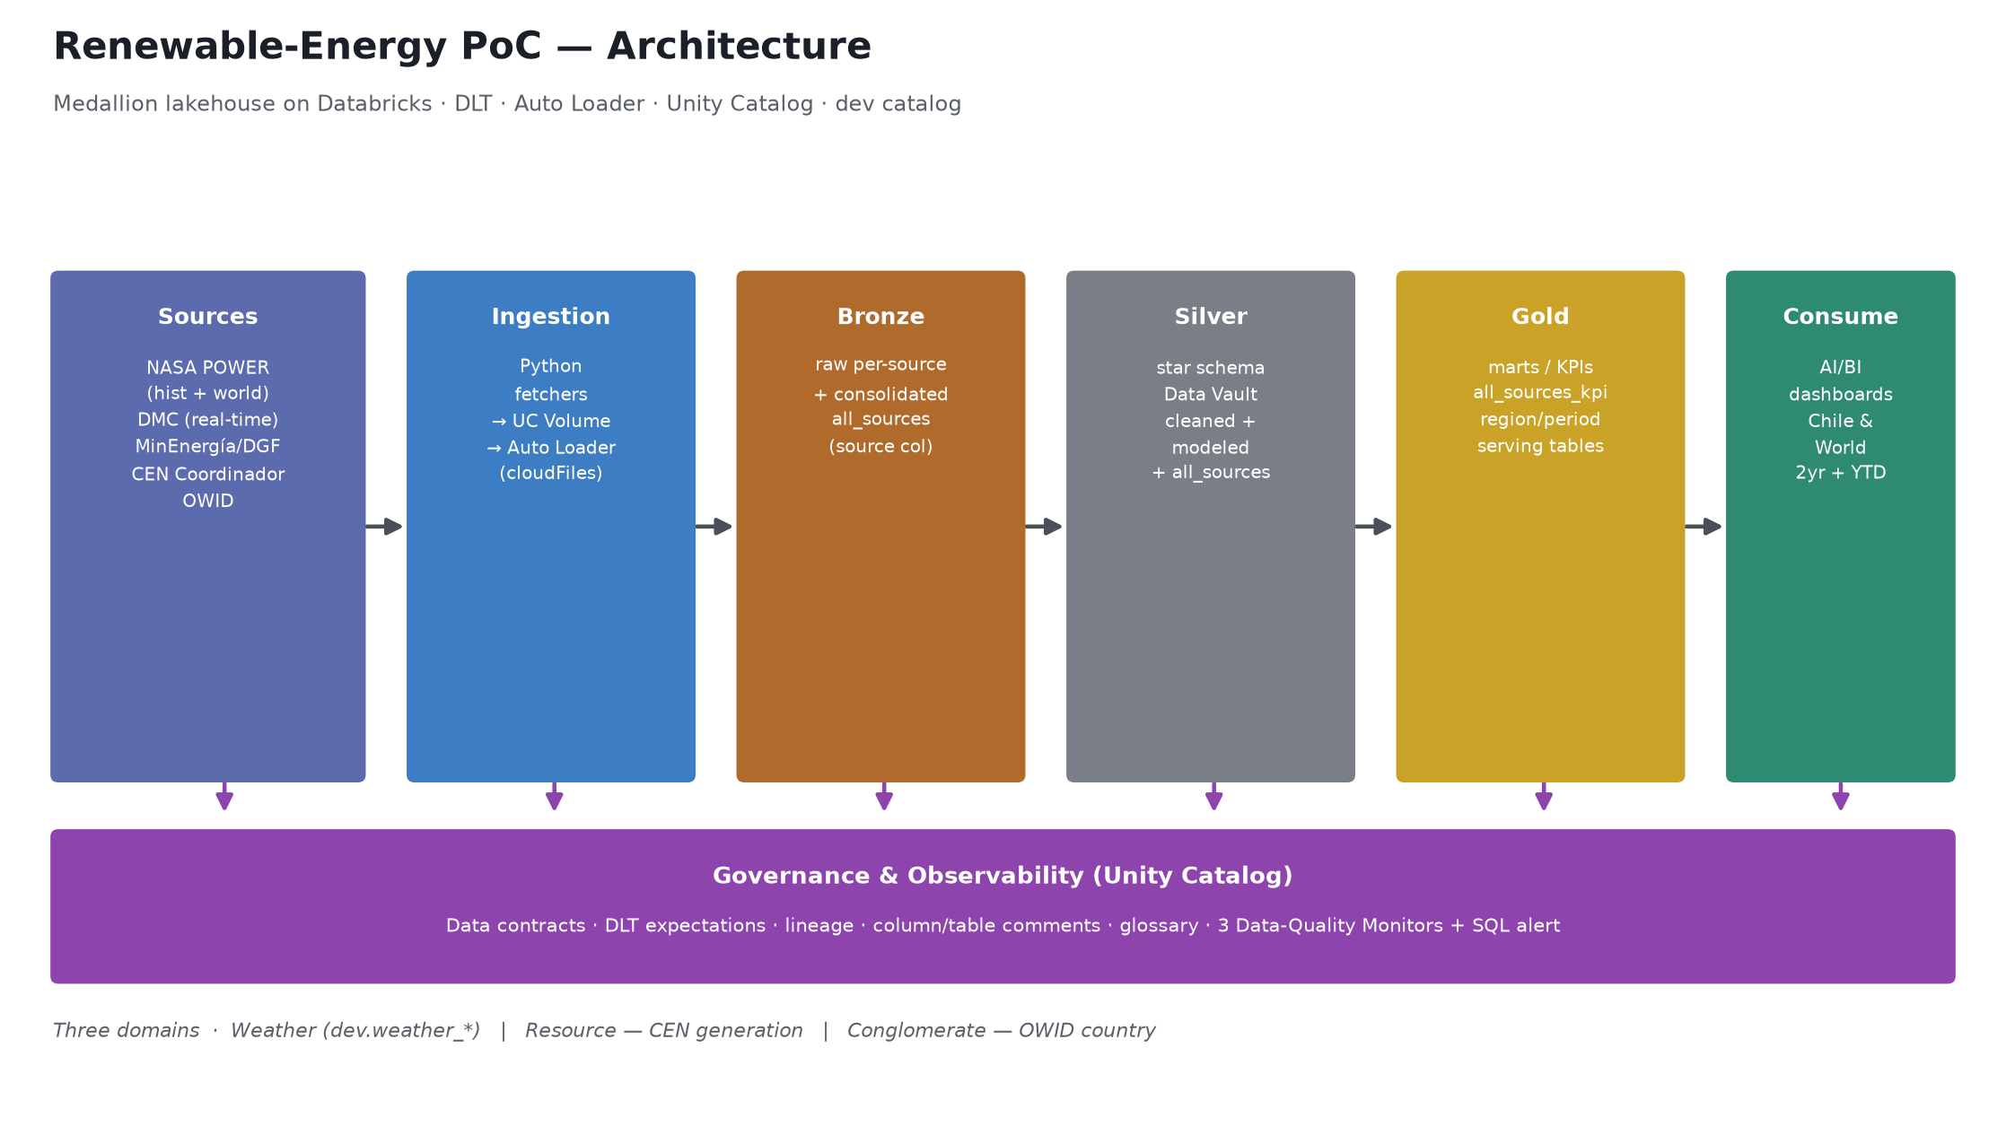
Architecture
Sources → Ingestion → Bronze → Silver → Gold → Consumption · governed by Unity Catalog

Slide 3
Data sources — all on real data
Weather
NASA POWER (hist hourly + 12-city world daily) · DMC (real-time) · MinEnergía/DGF (modeled)
Resource — generation
CEN / Coordinador — public by law (Art. 72-8, Ley 20.936), public key, no cost
Conglomerate — country
Our World in Data (OWID) — open CSV, Chile vs LATAM / World
Key unblock: CEN generation is public by law (no paid SIPUB account needed); NASA POWER serves clean history + a world benchmark.

Slide 4
Weather officialized in dedicated schemas
dev.weather_bronze / _silver / _gold — per-source + one consolidated all_sources per layer
weather_bronze
weather_silver
weather_gold
nasa_power · dmc · dgf
+ all_sources (882k)
raw ingested
nasa dim/fact · dmc dim/fact
dgf · + all_sources (881k)
cleaned + modeled
per-source KPIs
+ all_sources_kpi
chile/world daily (2yr + YTD)
Consolidated shape: source, location, resource, lat, lon, momento, ghi, temperatura, humedad, presion, viento, ...
Schemas & key tables carry Unity Catalog COMMENTs; symmetric naming by region/period.

Slide 5
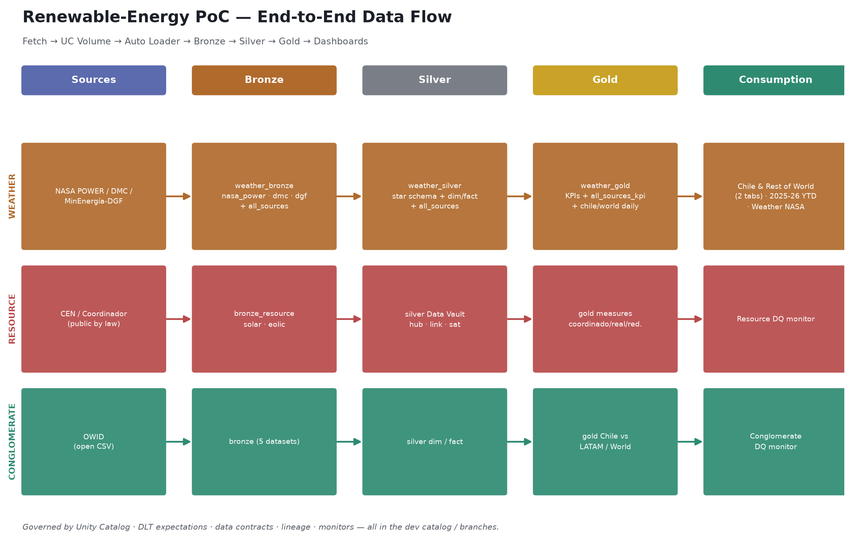
End-to-end data flow
Fetch → UC Volume → Auto Loader → Bronze → Silver → Gold → Dashboards

Slide 6
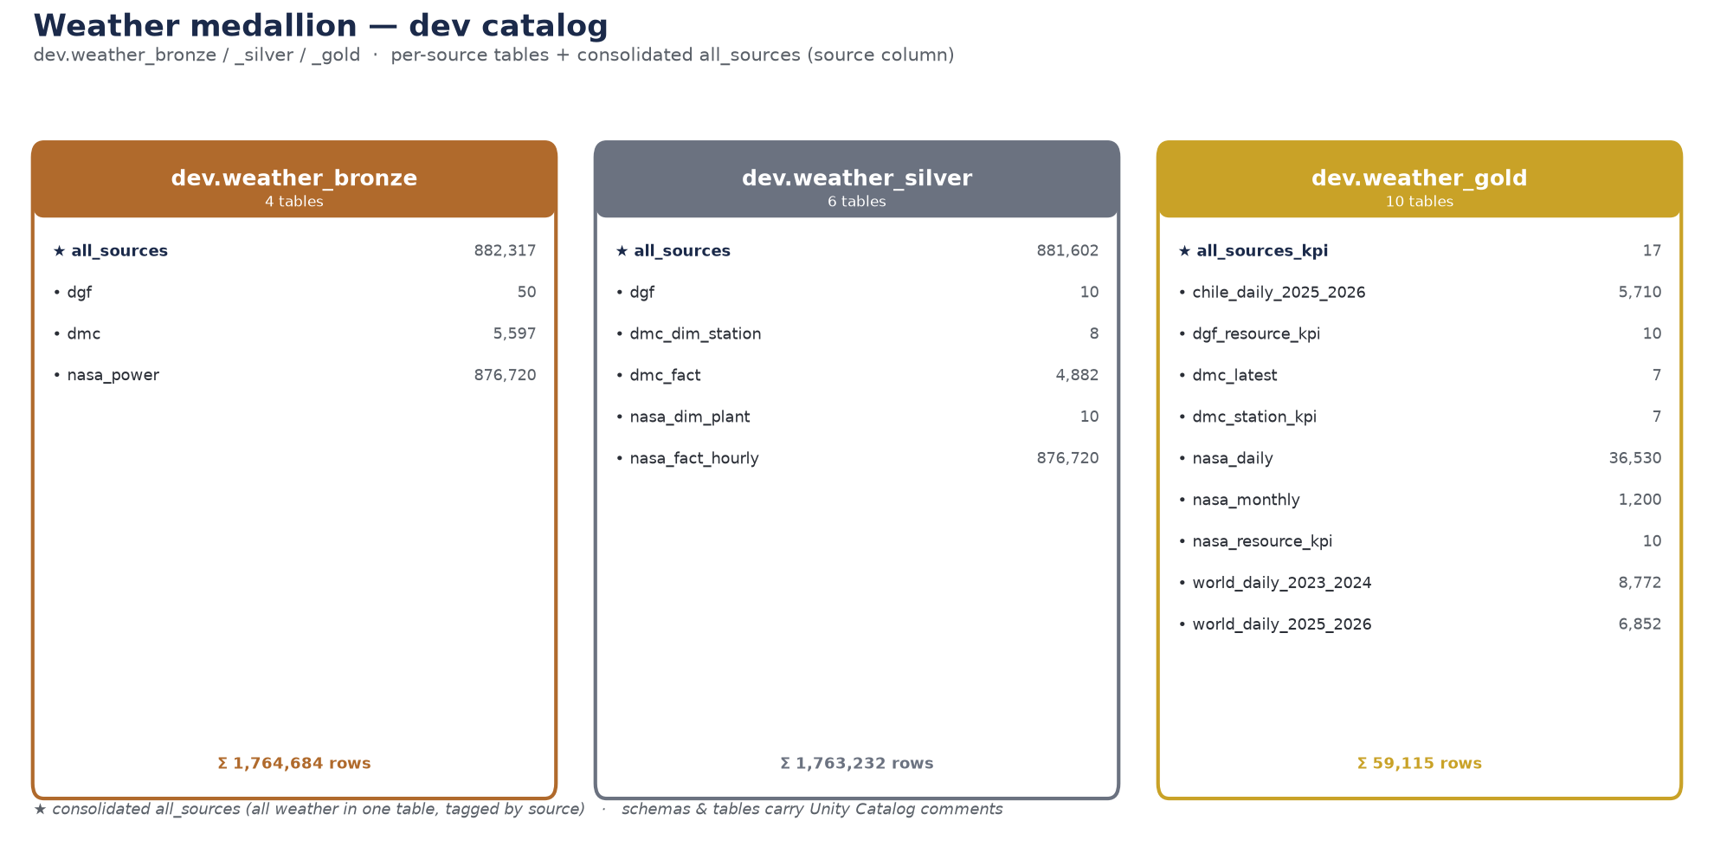
Weather medallion — tables & row counts
dev.weather_bronze / _silver / _gold · per-source + consolidated all_sources

Slide 7
AI/BI dashboards (Lakeview)
Weather — Chile & Rest of World (2 tabs)
Seasonality, trends, max/min/means of temperature, GHI, pressure, wind; per-location & per-city; hemisphere inversion (12 world cities).
Weather — Chile & Rest of World, 2025–2026 YTD
Same views on the latest NASA POWER data (2025-01 → 2026-07).
Weather NASA (time series + KPIs)
Monthly GHI/wind per plant + resource-KPI table (rank, A/B/C tier).
3 Data-Quality Monitors + SQL alert
Profiling + drift on gold, per domain, auto-generated dashboards.

Slide 8
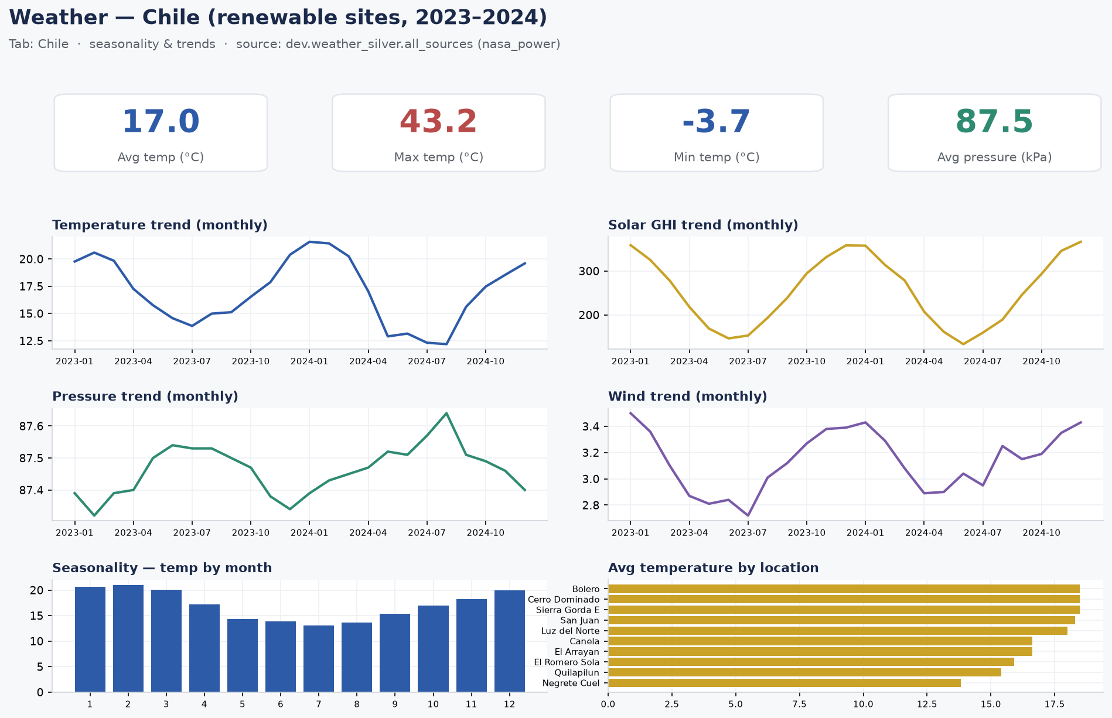
Dashboard — Chile tab
Seasonality & trends · rendered from dev.weather_silver.all_sources

Slide 9
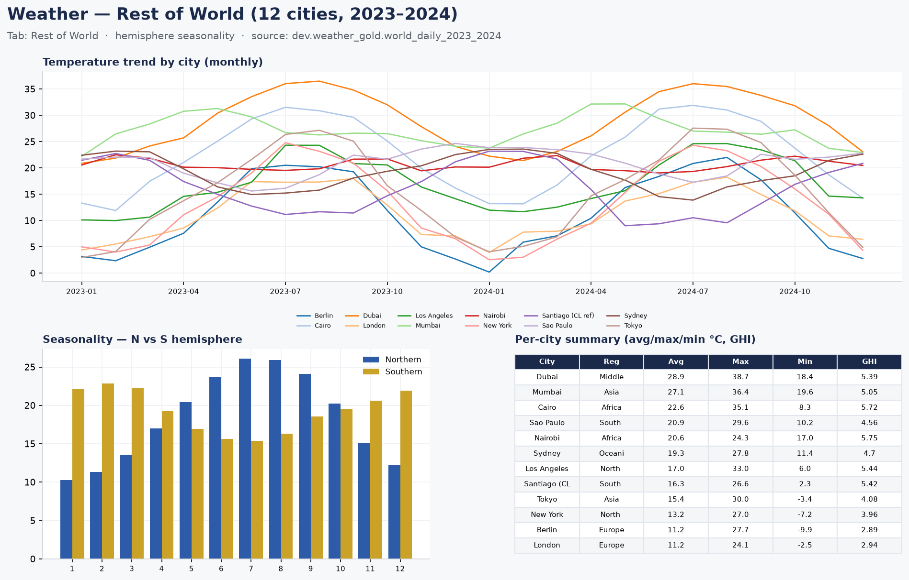
Dashboard — Rest of World tab
Hemisphere seasonality · 12 cities · dev.weather_gold.world_daily_2023_2024

Slide 10
Governance & data quality — Databricks-native
• Data contracts documented for every medallion step (docs/data-contracts.md).
• DLT @dlt.expect_* on silver (Chile-bounds coords, known resource, valid keys/dates) + Delta constraints.
• Unity Catalog automatic lineage + column & table comments; business/technical glossary.
• 3 Lakehouse Data-Quality Monitors on gold (profiling + drift) + a SQL alert on failed expectations.

Slide 11
Status & next steps
Delivered & verified in dev — consolidated in delivery ticket Trello #74.
Weather complete across the medallion (raw / silver / gold) in dedicated schemas + dashboards.
PRs #24–#28 were closed without merge (team's main advanced separately); work lives on fork branches, ready to re-integrate.
Priority: CI fix (#27) — old CI deploys to prod on approval and runs no tests.
Next: wire DMC real-time as a job; make fetchers incremental; re-integrate branches with the project lead.
All work in dev + branches; production is the project lead's.

