Slide 1

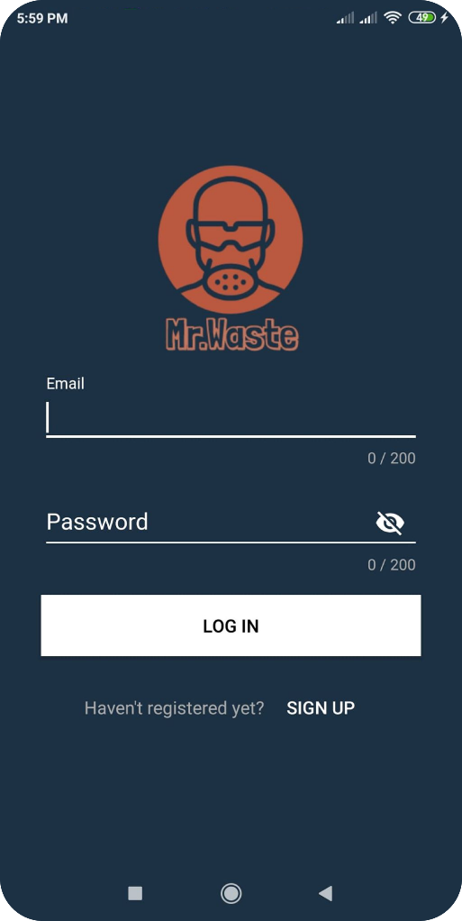

Space Apps COVID-19 Challenge

Slide 2





Covid-19
Total cases(Worldwide): 5,817,385
Total cases(Bangladesh): 42 844

