Slide 1

TaskMaster
Presented by:
Fuad Ahammed-221002078
Abdullha Hill Oneir-221002044
Presented to:
Mr. Montaser Abdul Quader
Lecturer, Dept. of CSE.

Slide 2
Introduction
TaskMaster is a smart and user-friendly task management app, helps users organize tasks, set priorities, and track deadlines. Addresses common time management challenges. Designed with simplicity and useful features.

Slide 3
Objectives
To provide a simple yet advanced task organizer
Supporting due dates
Allowing categorization (Work, Home, Study, etc.)
Prioritizing tasks (High / Medium / Low)

Slide 4
System Features
Add, edit, delete tasks
Mark as complete
Due date picker & overdue/today filter
Priority tagging (High/Medium/Low)
Task categories
Search & filter tasks

Slide 5
Architecture / Workflow
User Input → Add Task (title, category, due date, priority)
Storage → Saved in DB
Task List → Display with filters/sorting
Actions → Mark complete, edit, delete

Slide 6
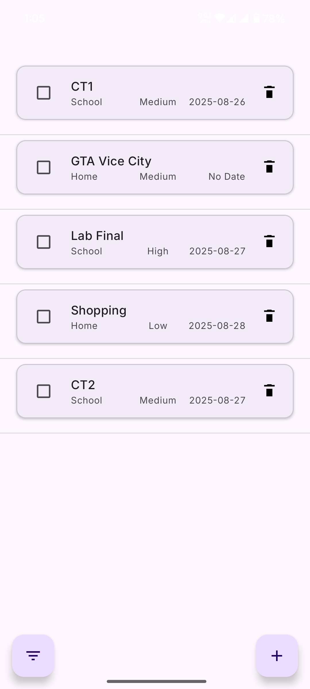
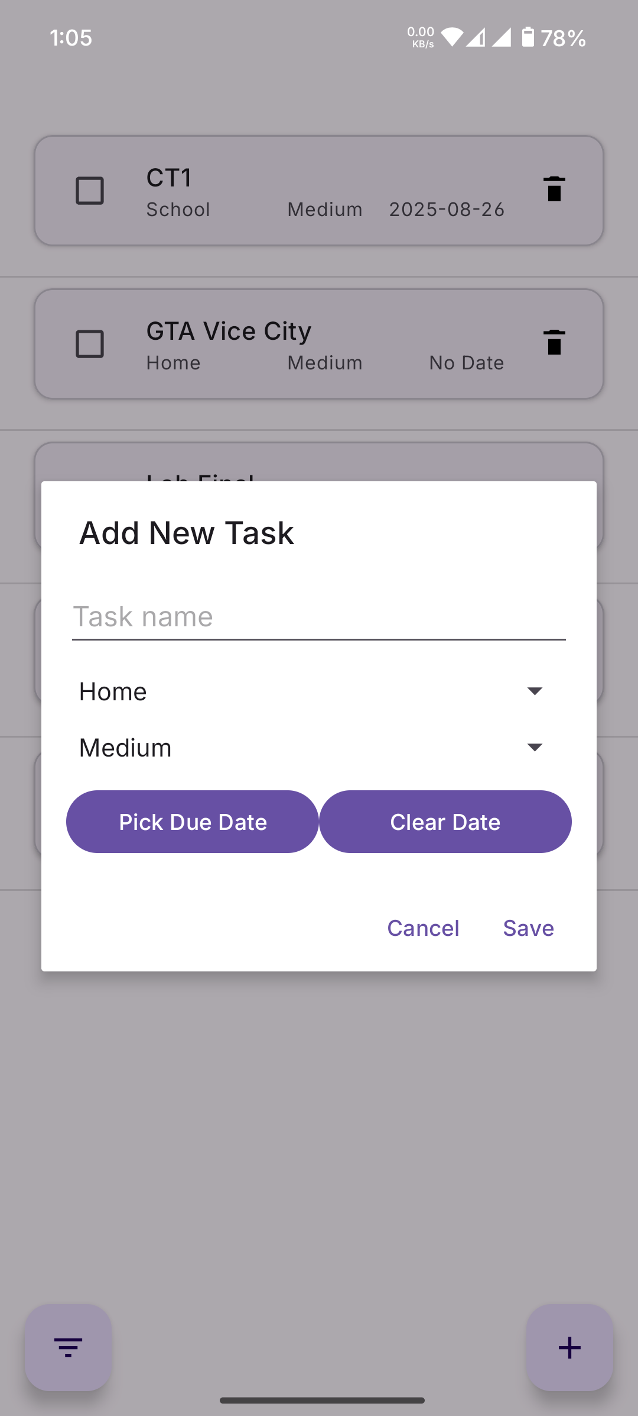
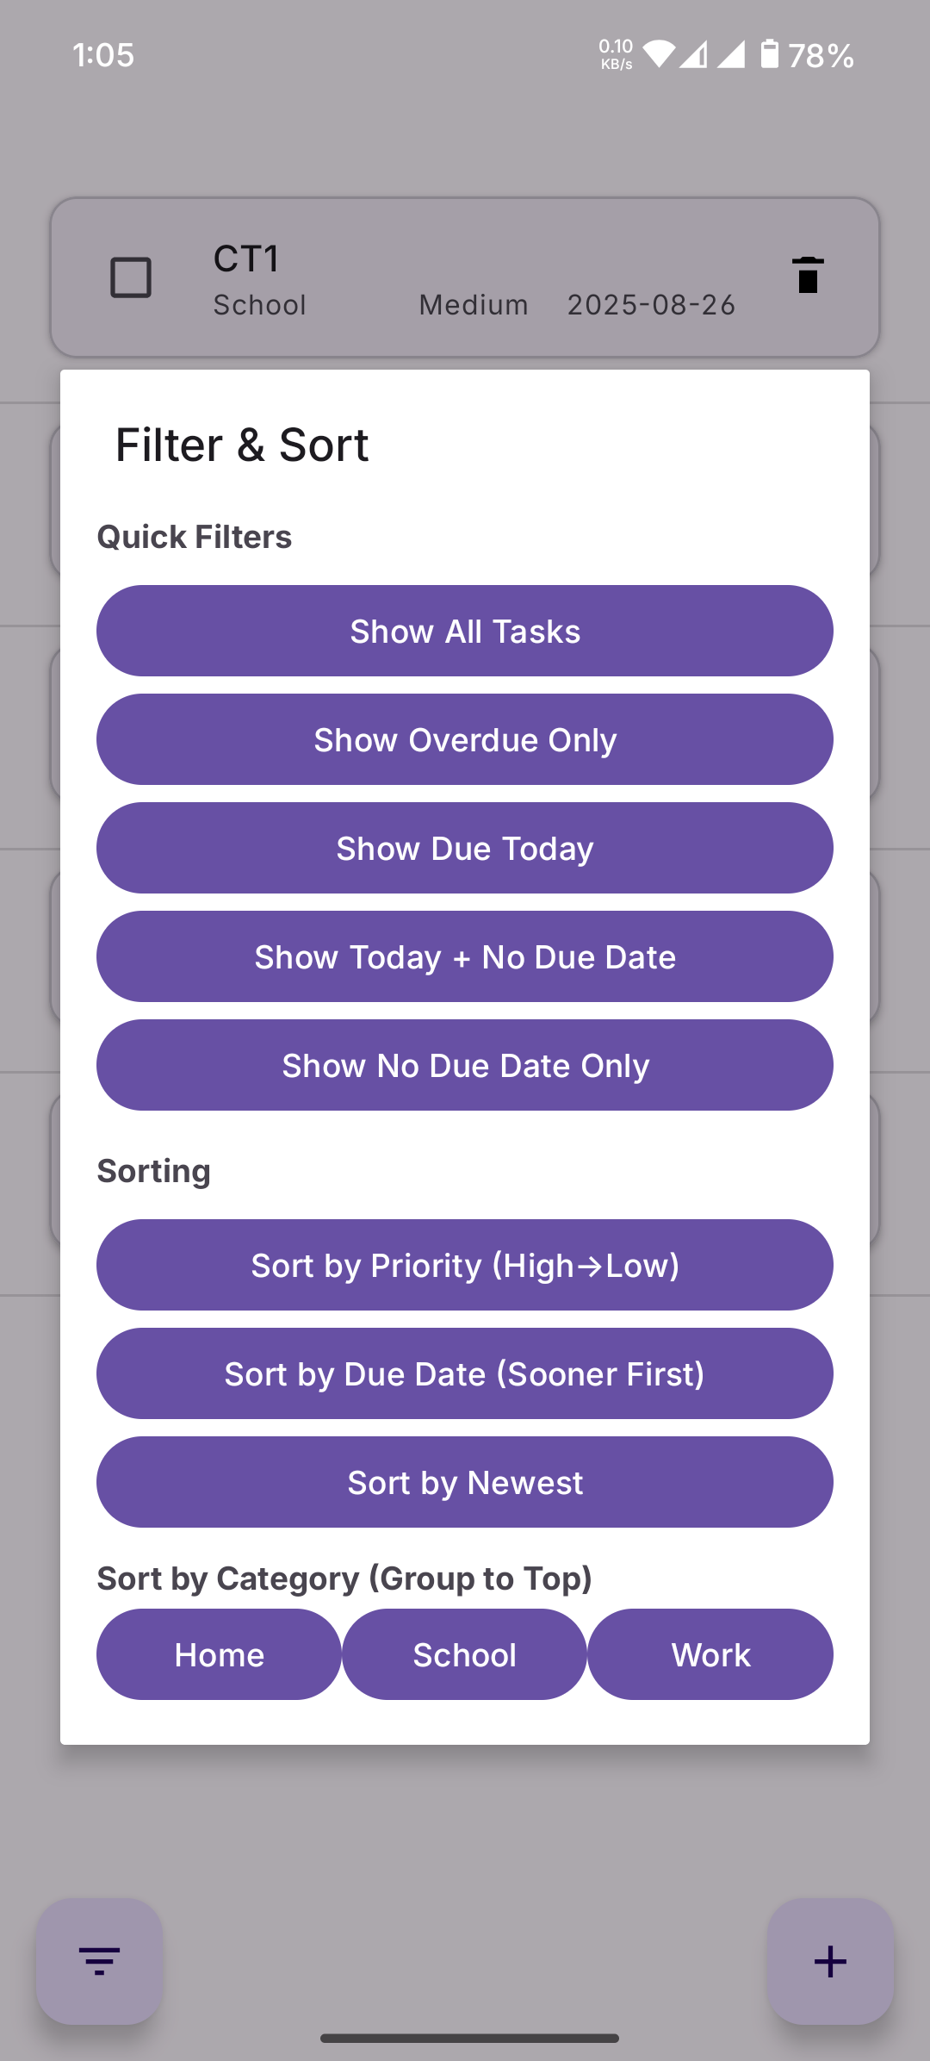
UI

Slide 7
Technology Stack
Language: Java
UI: XML
Database: SQLite
IDE: Android Studio
Target SDK: Android 14 / 15

Slide 8
Conclusion & Future Scope
TaskMaster provides productivity boost via a clean UI + smart features.
Future Enhancements:
Cloud sync & backup
Notifications & reminders
Collaboration / shared tasks

Slide 9
Reference
https://www.4do.app/
https://www.youtube.com/watch?v=p8sMBrtCxLA&ab_channel=BharatIntern
Keep Notes

