Slide 1
Chapter 3
Measures for evaluation of
investment opportunities
Benninga and Mofkadi, Principles of Finance with Excel 3e Copyright © 2018 Oxford University Press

Slide 2
This chapter
Net present value (NPV)
Internal rate of return (IRR)
Modified IRR (MIRR)
Equivalent annual cash flows (EAC)
Profitability index (PI)
Excel functions: FV, PV, NPV, IRR, MIRR, PMT, RANK, IF
Benninga and Mofkadi, Principles of Finance with Excel 3e Copyright © 2018 Oxford University Press

Slide 3
Net present value (NPV)
Net present value of series of future cash flows is the PV of the cash flows minus the initial investment required to obtain them.
Example: Pay $1,000 today to get $100 in year 1, $150 in year 2, . . . $300 in year 5. Discount rate = 10%.
Benninga and Mofkadi, Principles of Finance with Excel 3e Copyright © 2018 Oxford University Press

Slide 4
The Net Present Value = -$777.83: The cost of $1,000 is $277.83 more than the Present Value of the future cash flows.
Therefore, it’s not worth spending $1,000 to buy the future cash flows. The NPV < 0!
Benninga and Mofkadi, Principles of Finance with Excel 3e Copyright © 2018 Oxford University Press

Slide 5
Excel note
We use NPV(B2,B6:B10) to compute the present value of the future cash flows.
The NPV = B5 + NPV(B2,B6:B10)
B5 is the cost (-$1,000)
Benninga and Mofkadi, Principles of Finance with Excel 3e Copyright © 2018 Oxford University Press

Slide 6
Using NPV to make a “Yes−No” investment decision
An investment is worthwhile if its NPV>0.
Note that this depends both on the cash flows and the discount rate!
Investment is worthwhile since its NPV > 0.
Benninga and Mofkadi, Principles of Finance with Excel 3e Copyright © 2018 Oxford University Press

Slide 7
Using NPV to choose between investments
When faced with two mutually exclusive investments, choose the one with the largest NPV.
Investment B is preferred to Investment A.
Benninga and Mofkadi, Principles of Finance with Excel 3e Copyright © 2018 Oxford University Press

Slide 8
Internal rate of return (IRR)
IRR is the discount rate for which the NPV = 0.
Excel has an IRR function.
Benninga and Mofkadi, Principles of Finance with Excel 3e Copyright © 2018 Oxford University Press

Slide 9
Benninga and Mofkadi, Principles of Finance with Excel 3e Copyright © 2018 Oxford University Press

Slide 10
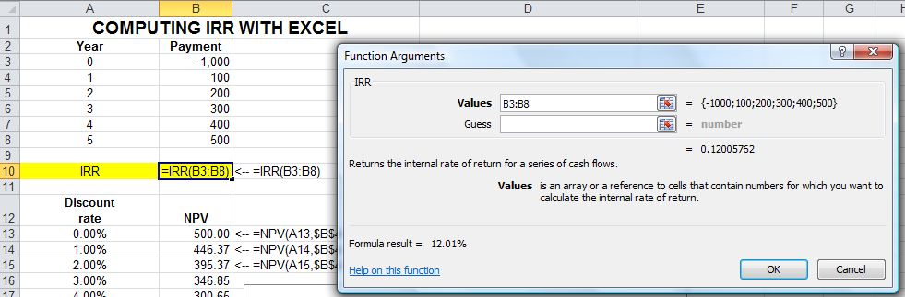
IRR dialog box
Benninga and Mofkadi, Principles of Finance with Excel 3e Copyright © 2018 Oxford University Press

Slide 11
Using IRR to make a “Yes−No” investment decision
An investment is worthwhile if its IRR>discount rate.
Note that this depends both on the cash flows and the discount rate!
Investment is worthwhile since its IRR>11% (the discount rate)
Benninga and Mofkadi, Principles of Finance with Excel 3e Copyright © 2018 Oxford University Press

Slide 12
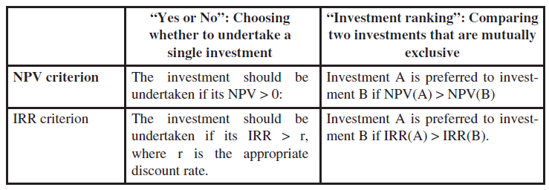
NPV and IRR
The two basic capital budgeting tools
Note: We usually prefer NPV to IRR, but IRR is a handy tool
Later: IRR and NPV may not always rank two investments in the same way. In this case, use NPV to rank the investments.
Benninga and Mofkadi, Principles of Finance with Excel 3e Copyright © 2018 Oxford University Press

Slide 13
“Yes−No” and NPV
NPV rule: A project is worthwhile if the NPV > 0.
According to the NPV rule:
If NPV > 0, project is worthwhile
If NPV < 0, project should not be undertaken
Benninga and Mofkadi, Principles of Finance with Excel 3e Copyright © 2018 Oxford University Press

Slide 14
Technical notes
CF₀ is usually negative (the project cost).
CF₁, CF₂, . . . are usually positive (future payoffs of project).
CF₁, CF₂, … are expected or anticipated cash flows.
r is a discount rate appropriate to the project’s risk (see Chapter 6).
Benninga and Mofkadi, Principles of Finance with Excel 3e Copyright © 2018 Oxford University Press

Slide 15
“Yes−No” and IRR
IRR rule: A project is worthwhile if the IRR > discount rate.
According to the IRR rule:
If IRR > r, then the project is worthwhile
If IRR < r, project should not be undertaken
Benninga and Mofkadi, Principles of Finance with Excel 3e Copyright © 2018 Oxford University Press

Slide 16
Basic “Yes−No” example
This project is worthwhile by both NPV and IRR rules:
NPV > 0
IRR > discount rate of 12%
Benninga and Mofkadi, Principles of Finance with Excel 3e Copyright © 2018 Oxford University Press

Slide 17
Basic “Ranking” example
“Yes−No”: Both projects are worthwhile
NPV_{A}, NPV_{B} > 0
IRRA, IRR_{B} > discount rate of 12%
“Ranking”: If you can choose only one project, B is preferred by both NPV and IRR
NPV_{B} > NPV_{A}
IRR_{B} > IRR_{A}
Benninga and Mofkadi, Principles of Finance with Excel 3e Copyright © 2018 Oxford University Press

Slide 18
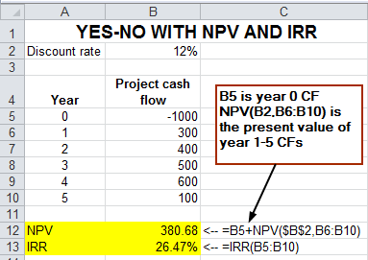
Excel’s NPV function
Chapter 2: Excel’s NPV function is really the present value of future cash flows!
To compute the actual NPV, add in the initial cash flow as shown below:
Benninga and Mofkadi, Principles of Finance with Excel 3e Copyright © 2018 Oxford University Press

Slide 19
Summing up
Note: IRR and NPV may not always rank two investments the same. In this case, use NPV to rank the investments.
Benninga and Mofkadi, Principles of Finance with Excel 3e Copyright © 2018 Oxford University Press

Slide 20
In this example:
Both A and B are worthwhile by both NPV and IRR criteria
If discount rate = 6%
A is preferred to B by NPV rule
B preferred to A by IRR rule
Benninga and Mofkadi, Principles of Finance with Excel 3e Copyright © 2018 Oxford University Press

Slide 21
IRR_{A} is always < IRR_{B}: By IRR rule, B is always preferred to A
For discount rates < 8.5128%: NPV_{A} > NPV_{B} (ranking conflict)
For discount rates > 8.51285: NPV_{A} < NPV_{B} (no ranking conflict)
Benninga and Mofkadi, Principles of Finance with Excel 3e Copyright © 2018 Oxford University Press

Slide 22
When IRR and NPV conflict, use NPV
Why: IRR gives the rate of return.
NPV gives the wealth increment
Benninga and Mofkadi, Principles of Finance with Excel 3e Copyright © 2018 Oxford University Press

Slide 23
Back to last example: Calculating the crossover point
Crossover point is the IRR of the differential cash flows (column D).
Benninga and Mofkadi, Principles of Finance with Excel 3e Copyright © 2018 Oxford University Press

Slide 24
Choosing between projects with diﬀerent lifespans (EAC)
When choices involve projects with different lifespans: Suppose your company is considering buying one of two tank trucks to haul high-tech liquid materials
Truck A is a relatively cheap truck. It costs $100,000 and has a 6-year life, during which it will produce an annual cash ﬂow of $150,000.
Truck B is much more expensive. It costs $250,000 and has only a 3-year life, after which it has to be replaced. However, truck B is much more efficient than truck A, and during each of the 3 years of its life, it produces a cash ﬂow of $300,000.
The cost of capital r=12%.
Benninga and Mofkadi, Principles of Finance with Excel 3e Copyright © 2018 Oxford University Press

Slide 25
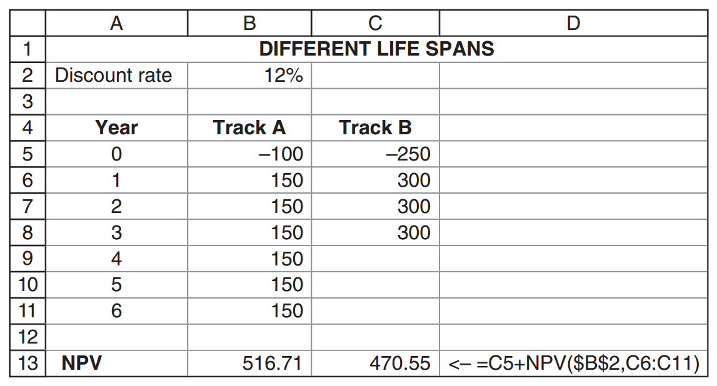
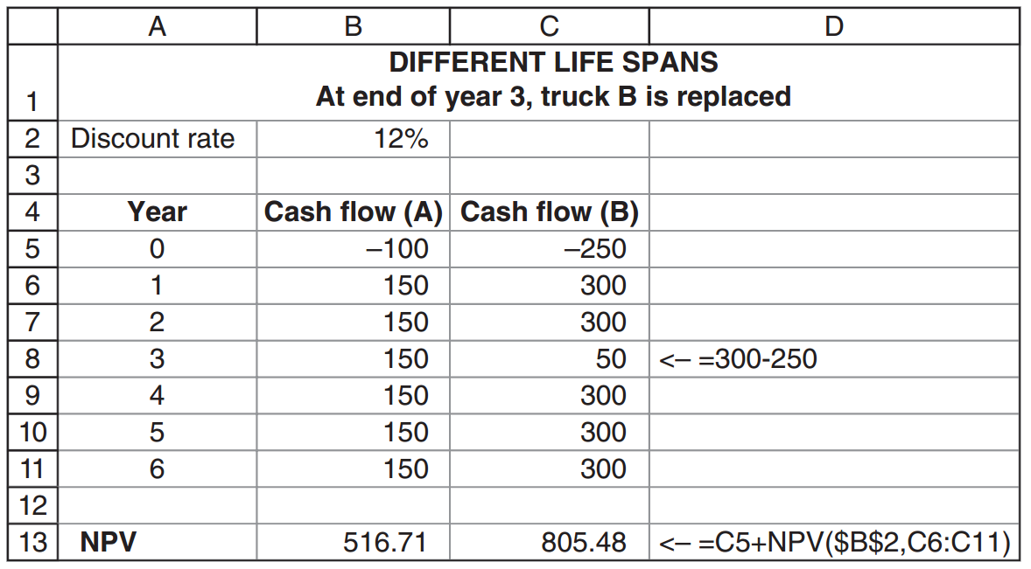
Using NPV rule with different lifespans
A simple (misleading) way:
Because of the different lifespans, we assume that at the end of Year 3, we will replace truck B with another, similar truck:
Benninga and Mofkadi, Principles of Finance with Excel 3e Copyright © 2018 Oxford University Press

Slide 26
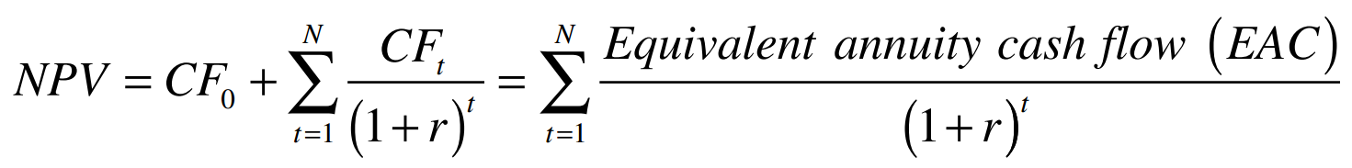
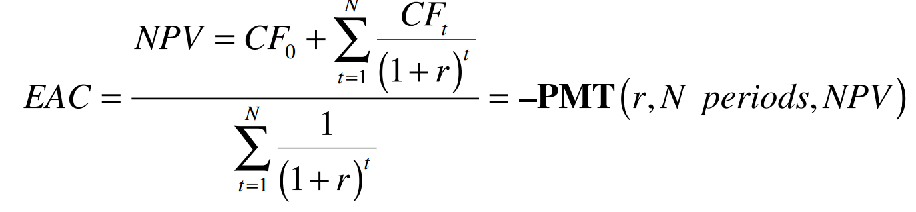
A more efficient way: EAC
A constant future cash ﬂow whose present value is equal to the NPV of the project:
where N is the project life.
Benninga and Mofkadi, Principles of Finance with Excel 3e Copyright © 2018 Oxford University Press

Slide 27
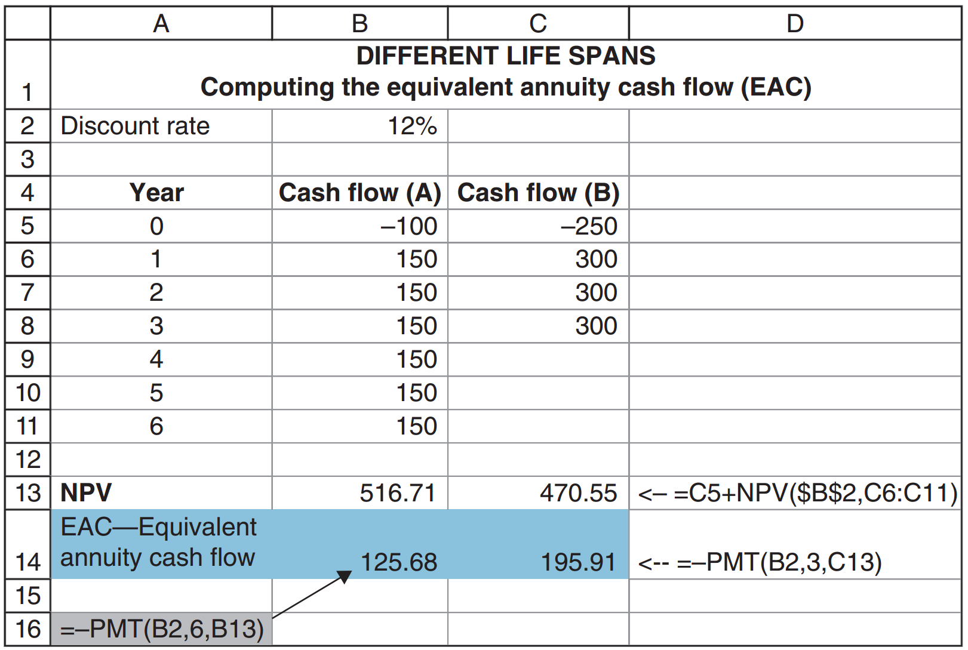
Implementing the EAC in our example
Since every time you buy truck B you get $195.91 per year, and every time you buy truck A you get $125.68 per year, it is clear that truck B is preferred.
Benninga and Mofkadi, Principles of Finance with Excel 3e Copyright © 2018 Oxford University Press

Slide 28
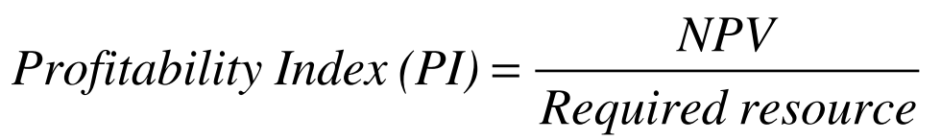
Prioritizing projects using the Profitability Index (PI)
In many cases, we face a set of projects that can be taken at the same time, meaning they are not mutually exclusive.
We would like to maximize the profit from the limiting resource.
Usually, the resource constraint is a budget constraint, but it may also result from limited management availability, manufacturing capacity, and other such constraints.
Benninga and Mofkadi, Principles of Finance with Excel 3e Copyright © 2018 Oxford University Press

Slide 29
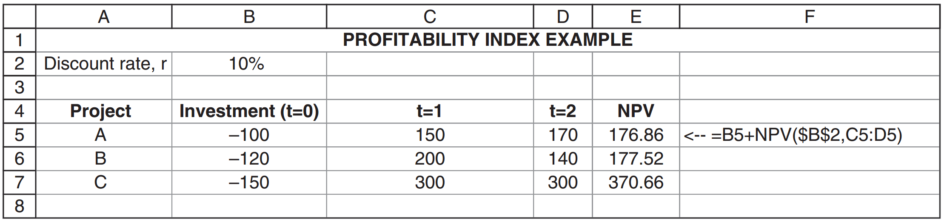
Prioritizing project with PI
Assume r = 10%
Assume we have a budget constraint of $200
Benninga and Mofkadi, Principles of Finance with Excel 3e Copyright © 2018 Oxford University Press

Slide 30
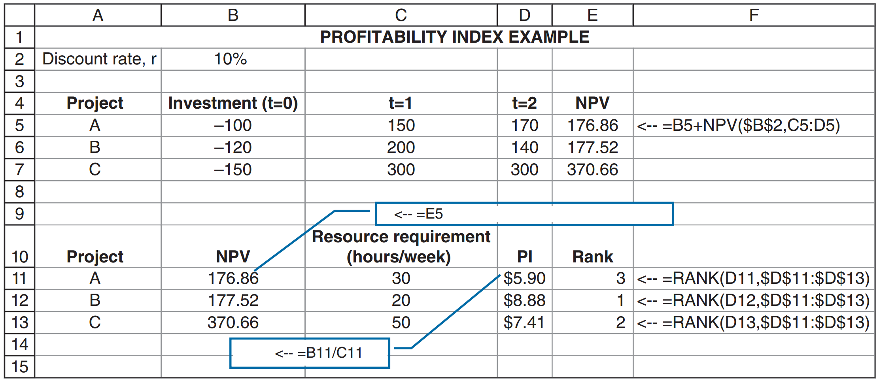
Solving the example
Benninga and Mofkadi, Principles of Finance with Excel 3e Copyright © 2018 Oxford University Press

