Slide 1
Chapter 4 Loans and Amortization Tables

Slide 2
This chapter
Loans
Amortization tables
Loan types (“interest-only loan”, “equal amortization term loan”, “mortgage loan”, “balloon loan” and “bullet loan”).
Loan contractual value
Loan market value
Refinancing a loan
Excel functions: PMT, PV, RATE, IRR, NPV, Goal seek
Benninga and Mofkadi, Principles of Finance with Excel 3e Copyright © 2018 Oxford University Press

Slide 3
The loans discussed
Interest-only loan: In every period we pay the periodic interest on the loan. The principal is repaid at the end of the terminal year.
Equal amortization term loan: In every period the borrower repays an equal amount of the loan principal. The interest in each period is the paid on the outstanding principal at the beginning of the period.
Term loan (also called a “mortgage loan” or “an equal payment term loan.”): Equal payments are paid in every period. The breakdown of the payments between interest and repayment of principal varies by period.
Balloon loan: The periodic payments on a balloon loan are relatively small over the years. The last payment of principal is large. Interest is computed on the initial loan principal balance of every year.
Benninga and Mofkadi, Principles of Finance with Excel 3e Copyright © 2018 Oxford University Press

Slide 4
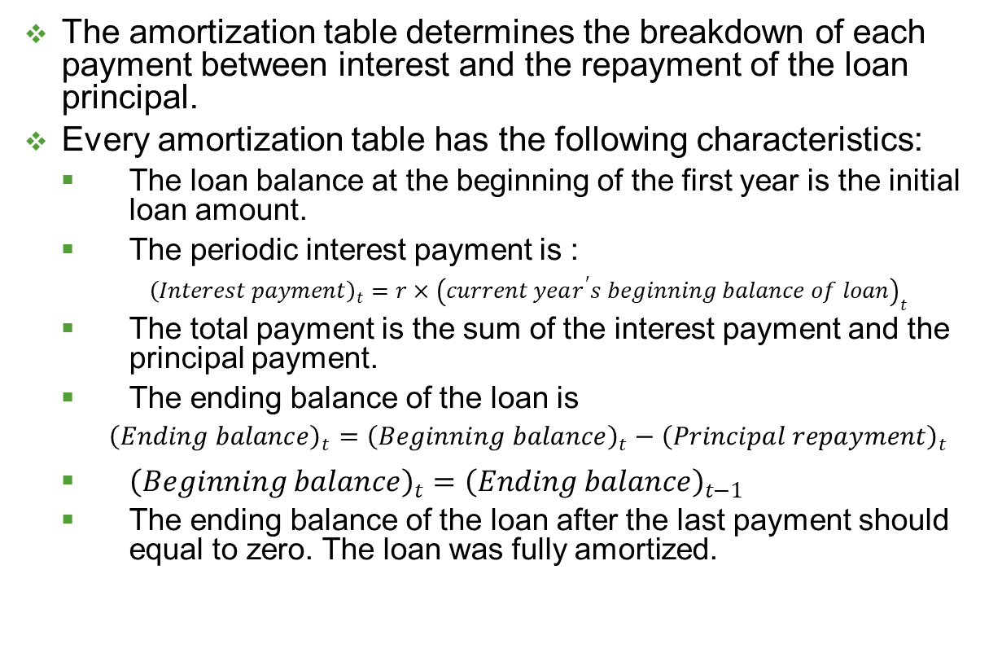
Amortization table
The amortization table determines the breakdown of each payment between interest and the repayment of the loan principal.
Every amortization table has the following characteristics:
The loan balance at the beginning of the first year is the initial loan amount.
The periodic interest payment is :
${\left(Interest payment\right)}_{t}=r×{\left(current year^{′}s beginning balance of loan\right)}_{t}$
The total payment is the sum of the interest payment and the principal payment.
The ending balance of the loan is
${\left(Ending balance\right)}_{t}={\left(Beginning balance\right)}_{t}−{\left(Principal repayment\right)}_{t}$
${\left(Beginning balance\right)}_{t}={\left(Ending balance\right)}_{t−1}$
The ending balance of the loan after the last payment should equal to zero. The loan was fully amortized.
Benninga and Mofkadi, Principles of Finance with Excel 3e Copyright © 2018 Oxford University Press

Slide 5
An interest-only loan
In an interest-only loan the borrower repays the loan principal only in the last payment. In each period, the borrower pays only the interest on the outstanding principal at the beginning of the period.
Benninga and Mofkadi, Principles of Finance with Excel 3e Copyright © 2018 Oxford University Press

Slide 6
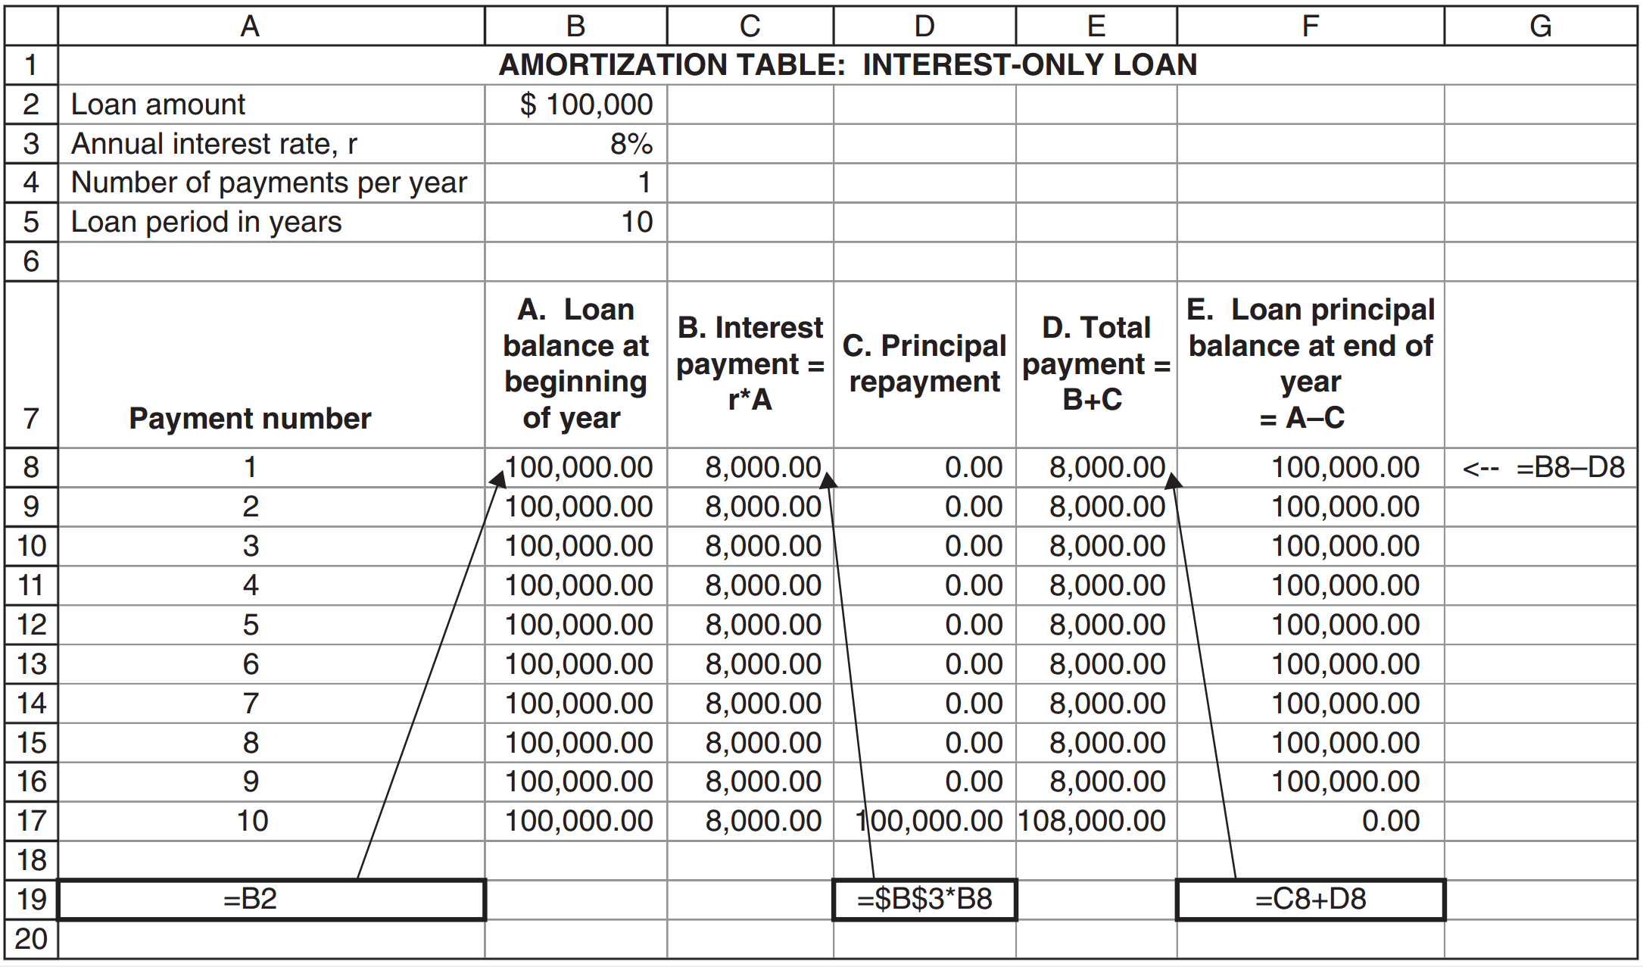
Amortization table
Benninga and Mofkadi, Principles of Finance with Excel 3e Copyright © 2018 Oxford University Press

Slide 7
An interest-only loan (discussion)
What is the remaining balance of a loan after n payments?
After every payment the remaining balance of the loan is $100,000.
This is because we do not repay any principal until the last payment.
What is the n^{th} payment of the loan?
In every period 1-9 the borrower pays only the interest: 8% of $100,000 = $8,000. The last payment is constructed of $8,000 of interest and the $100,000 loan principal for a total of $108,000.
Benninga and Mofkadi, Principles of Finance with Excel 3e Copyright © 2018 Oxford University Press

Slide 8
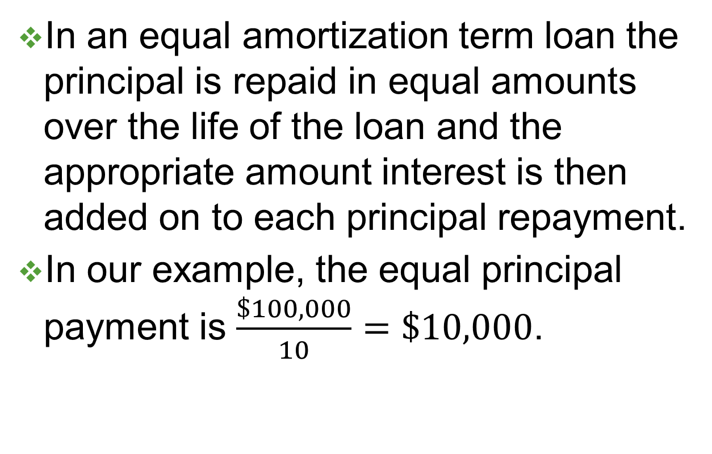
An equal amortization term loan
In an equal amortization term loan the principal is repaid in equal amounts over the life of the loan and the appropriate amount interest is then added on to each principal repayment.
In our example, the equal principal payment is $\frac{\$100,000}{10}=\$10,000$.
Benninga and Mofkadi, Principles of Finance with Excel 3e Copyright © 2018 Oxford University Press

Slide 9
Amortization table
Benninga and Mofkadi, Principles of Finance with Excel 3e Copyright © 2018 Oxford University Press

Slide 10
An equal amortization loan (discussion)
What is the remaining balance of an equal amortization loan after n payments?
In every payment the borrower repays $10,000 of principal. You can see the decline in the loan’s principal balance (labelled “E” in the above amortization table) by this amount.
What is the n^{th} payment of an equal amortization loan?
For example – in year 7. To find the total payment, we start by calculating its components – the principal payment and the interest payment.
The principal repayment in this type of loans is each year is $100,000/10=$10,000. Thus at the beginning of year 7, the loan principal balance₇ = 100,000-6*10,000 = 40,000.
The interest payment in each period is the 8% interest times the loan principal balance_{t}. Thus the interest payment in year 7 is 8%*40,000 = 3,200.
The total payment at the end of year 7 is 10,000+3,200 = 13,200.
Benninga and Mofkadi, Principles of Finance with Excel 3e Copyright © 2018 Oxford University Press

Slide 11
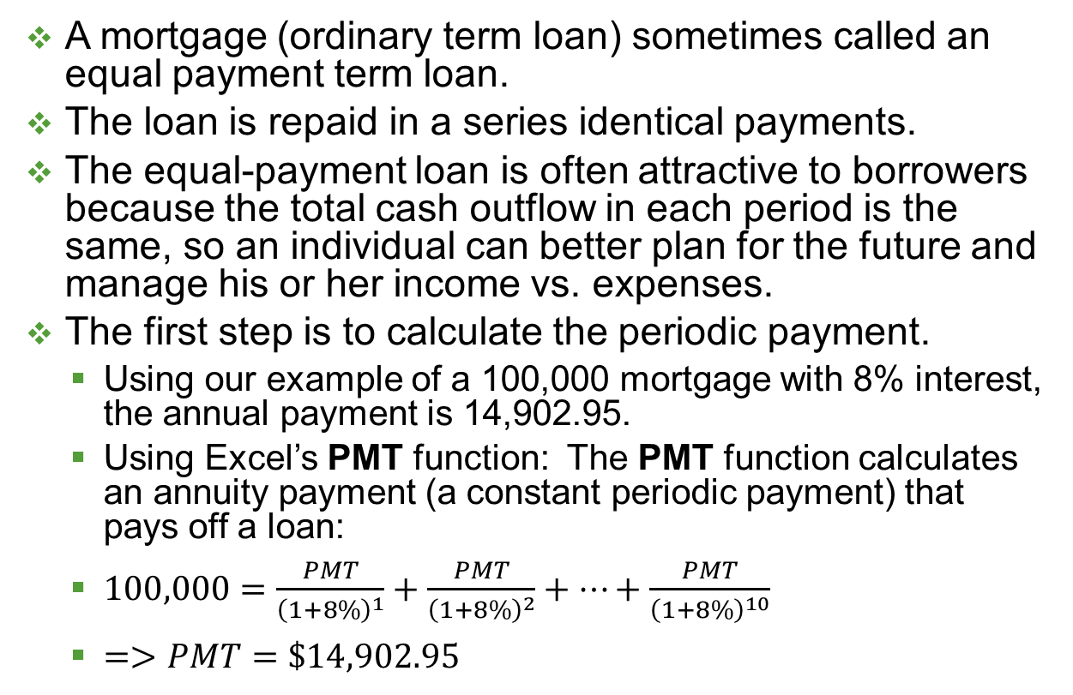
An equal payment term loan (mortgage)
A mortgage (ordinary term loan) sometimes called an equal payment term loan.
The loan is repaid in a series identical payments.
The equal-payment loan is often attractive to borrowers because the total cash outflow in each period is the same, so an individual can better plan for the future and manage his or her income vs. expenses.
The first step is to calculate the periodic payment.
Using our example of a 100,000 mortgage with 8% interest, the annual payment is 14,902.95.
Using Excel’s PMT function: The PMT function calculates an annuity payment (a constant periodic payment) that pays off a loan:
$100,000=\frac{PMT}{{\left(1+8\%\right)}^{1}}+\frac{PMT}{{\left(1+8\%\right)}^{2}}+…+\frac{PMT}{{\left(1+8\%\right)}^{10}}$
$=>PMT=\$14,902.95$
Benninga and Mofkadi, Principles of Finance with Excel 3e Copyright © 2018 Oxford University Press

Slide 12
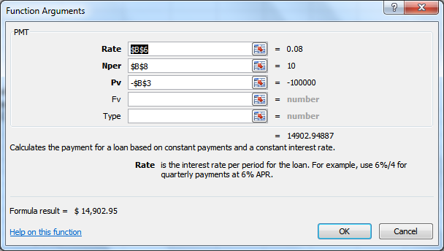
Dialog box for the PMT function
Rate is the interest rate on the loan, Nper is the number of repayment periods, and Pv is the loan principal.
Note: if the loan principal is written as a positive number, Excel presents the payment as a negative number; to avoid this, we write Pv as a negative number.
Benninga and Mofkadi, Principles of Finance with Excel 3e Copyright © 2018 Oxford University Press

Slide 13
Amortization table
Note that in this type of loan, we know the total payment (14,902.95) and the principal payment is the difference between the total payment and the interest payment.
Benninga and Mofkadi, Principles of Finance with Excel 3e Copyright © 2018 Oxford University Press

Slide 14
Mortgage (Discussion 1)
What is the remaining balance of a term loan after n payments?
The loan balance is the present value of all the future loan payments. Can be computed using NPV function or, if the future payments are the same, by using the PV function.
Benninga and Mofkadi, Principles of Finance with Excel 3e Copyright © 2018 Oxford University Press

Slide 15
Shorter method for mortgages
For loans that have a constant annual payment (like a mortgage), we can create the following spreadsheet (no amortization table!):
Benninga and Mofkadi, Principles of Finance with Excel 3e Copyright © 2018 Oxford University Press

Slide 16
Balloon Loan
A balloon loan is a loan which does not fully amortize over the period of the loan.
This means that the final loan payment is relatively large compared to the intermediate loan payments.
Benninga and Mofkadi, Principles of Finance with Excel 3e Copyright © 2018 Oxford University Press

Slide 17
Amortization Table
Benninga and Mofkadi, Principles of Finance with Excel 3e Copyright © 2018 Oxford University Press

Slide 18
Balloon loans with negative principal repayments
Suppose in the previous example, the borrower wants to limit her annual repayment in years 1-9 to $6,000
Benninga and Mofkadi, Principles of Finance with Excel 3e Copyright © 2018 Oxford University Press

