Slide 1
Chapter 5 Effective Interest Rates

Slide 2
This chapter
Eﬀective annual interest rate (EAIR)
Internal rate of return (IRR)
Annual percentage rate (APR)
Loan tables
Mortgage points
Lease versus purchase
Excel functions: IRR, PMT, IPMT, PPMT, Rate, NPV, PV, Data-Table, Max, Exp, Ln, If
Benninga and Mofkadi, Principles of Finance with Excel 3e Copyright © 2018 Oxford University Press

Slide 3
Interest rate often used as a cost
“My mortgage costs 12.2%”
“I pay 18.1% on unpaid credit card balances”
This chapter:
Use IRR as a cost
Do this intelligently
Benninga and Mofkadi, Principles of Finance with Excel 3e Copyright © 2018 Oxford University Press

Slide 4
EAIR
“Effective Annual Interest Rate”
EAIR: IRR calculated on annual basis, taking account of all relevant costs
Not to be confused with “annual percentage rate” (APR).
APR is a confusing concept with no well-defined meaning
Benninga and Mofkadi, Principles of Finance with Excel 3e Copyright © 2018 Oxford University Press

Slide 5
Be careful! Example 1
You’re considering a loan from either West Hampton Bank or East Hampton Bank
West Hampton charges 8%
East Hampton charges 6%. BUT they have a “loan initiation charge” of 4%
Which is cheaper?
Benninga and Mofkadi, Principles of Finance with Excel 3e Copyright © 2018 Oxford University Press

Slide 6
West Hampton is cheaper
Benninga and Mofkadi, Principles of Finance with Excel 3e Copyright © 2018 Oxford University Press

Slide 7
Be careful! Example 2
Loan Shark Inc. charges 14.4% annual interest on a monthly basis.
When you ask them: this means 14.4%/12 = 1.2% per month.
Is Loan Shark cheaper than your bank, which charges 15% annually?
Benninga and Mofkadi, Principles of Finance with Excel 3e Copyright © 2018 Oxford University Press

Slide 8
Loan Shark is more expensive!
Benninga and Mofkadi, Principles of Finance with Excel 3e Copyright © 2018 Oxford University Press

Slide 9
Be careful! Example 3
You’re buying a Junkmobile for $2,000.
You don’t have any money.
Dealer offers two options:
Pay cash, get 15% discount
“Zero percent financing”: Pay nothing today, pay full price of $2,000 in one year
Uncle Frank will loan you money for 10%.
Benninga and Mofkadi, Principles of Finance with Excel 3e Copyright © 2018 Oxford University Press

Slide 10
Dealer’s “0% financing” is really 17.65%! You’re better off paying cash to the dealer and borrowing the $1,700 from Uncle Frank at 10%.
Benninga and Mofkadi, Principles of Finance with Excel 3e Copyright © 2018 Oxford University Press

Slide 11
Cost of a mortgage
Simple mortgage:
Borrow $100,000 for 10 years, 8% interest
Annual payments
PMT will compute the payment
Benninga and Mofkadi, Principles of Finance with Excel 3e Copyright © 2018 Oxford University Press

Slide 12
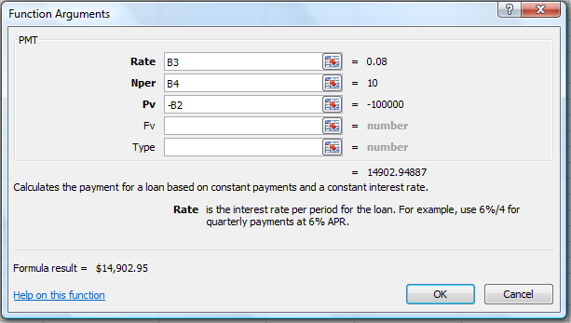
Mortgage (continued)
PMT function: We put in PV as a negative number in order to get a positive mortgage payment. (This was discussed in Chapter 2.)
Benninga and Mofkadi, Principles of Finance with Excel 3e Copyright © 2018 Oxford University Press

Slide 13
Mortgage amortization table
The table splits each payment of $14,902.95 into interest and return of principal.
Interest = 8.34%*Principal at beginning of year
Repayment of principal = Payment ($14,902.95) – Interest
You can see that at 10 years the mortgage is repaid.
Benninga and Mofkadi, Principles of Finance with Excel 3e Copyright © 2018 Oxford University Press

Slide 14
Excel functions PPMT and IPMT
Compute directly the principal and interest portions of the annual payment
Work like PMT.
Benninga and Mofkadi, Principles of Finance with Excel 3e Copyright © 2018 Oxford University Press

Slide 15
Benninga and Mofkadi, Principles of Finance with Excel 3e Copyright © 2018 Oxford University Press

Slide 16
Longer-term mortgages
30-year mortgage, $100,000 principal
8% interest, computed monthly (meaning 8%/12 = 0.6667% per month)
Points: 1;
“origination fee” = 0.5%
Meaning: You get $98,500, but are charged as if you borrowed $100,000
Benninga and Mofkadi, Principles of Finance with Excel 3e Copyright © 2018 Oxford University Press

Slide 17
30-year mortgage
Note use of Rate to compute EAIR (next slide).
Benninga and Mofkadi, Principles of Finance with Excel 3e Copyright © 2018 Oxford University Press

Slide 18
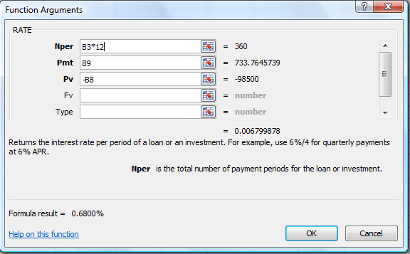
Excel function Rate
Rate computes the IRR for constant payments.
In this example: 360 monthly payment of $733.76 against an initial loan of $98,500: Rate gives the monthly IRR at 6.799%.
Rate is preferable to IRR when there are many payments and they are constant.
Benninga and Mofkadi, Principles of Finance with Excel 3e Copyright © 2018 Oxford University Press

Slide 19
Lease vs. purchase
Common financial problem
In this simple example:
Buy computer for $4,000
Lease it for 3 years for $1,500 annually.
Catch: You pay $1,500 now and $1,500 at the end of years 1, 2, 3
To compute the cost of the lease, use the differential cash flows (next slide)
The differential cash flows show that lease is like borrowing $2,500 with payments of $1,500 in years 1, 2, 3
Benninga and Mofkadi, Principles of Finance with Excel 3e Copyright © 2018 Oxford University Press

Slide 20
The example assumes that you can borrow at 15% from the bank. Cell D13 decides lease or purchase depending on which is cheaper.
Payments on bank loan are cheaper, same amount borrowed!
Benninga and Mofkadi, Principles of Finance with Excel 3e Copyright © 2018 Oxford University Press

Slide 21
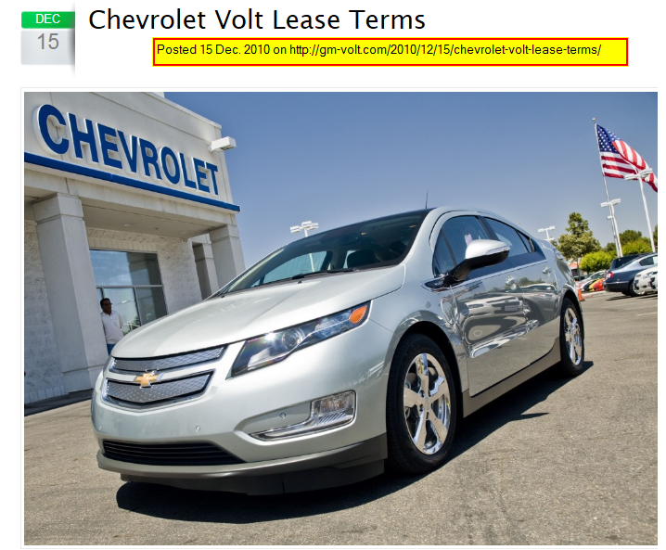
Auto lease
Benninga and Mofkadi, Principles of Finance with Excel 3e Copyright © 2018 Oxford University Press

Slide 22
Auto Lease Problem
Today, the first Volts have arrived to dealerships from Detroit, and are being picked up by customers across the nation. People taking ownership now have to now decide whether to buy or lease the car.
At an MRSP of $41,000 the cutting-edge Volt comes in at a relatively affordable $33,500 after the $7500 federal tax credit it deducted. GM’s banking partners have formulated some creative methods for dealing with the credit such as floating the buyer a zero interest separate $7500 loan that comes due when they get their tax refund.
The lease option was created to make the car even more affordable, making the car available to a larger group of drivers. The terms of the lease were spelled out in the Summer as $350 per month with $2500 down for a 36 month lease with 36,000 miles. What hasn’t been known is what the car’s residual value will be at the end of the lease, and what the customer could then buy it for.
Gordon Lai, a sales manager at Singh Chevrolet in Riverside, California, offers us the following details which he said came directly from GM. “The figures above are SPECIFICALLY for a Base Model Volt sold at MSRP only ($41,000),” said Lai. “Add any options, dealer markups, increases in Sales Tax, etc… and the Payment goes up, or the ‘Out-of-Pocket’ down payment goes up. ”
Benninga and Mofkadi, Principles of Finance with Excel 3e Copyright © 2018 Oxford University Press

Slide 23
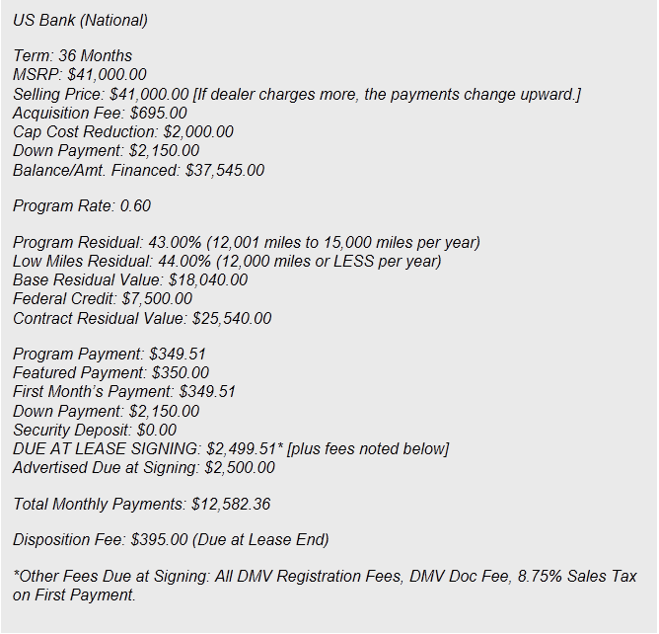
Benninga and Mofkadi, Principles of Finance with Excel 3e Copyright © 2018 Oxford University Press

Slide 24
Benninga and Mofkadi, Principles of Finance with Excel 3e Copyright © 2018 Oxford University Press

Slide 25
Notes: Some lines of the spreadsheet are hidden.
Benninga and Mofkadi, Principles of Finance with Excel 3e Copyright © 2018 Oxford University Press

Slide 26
Advanced topic: More frequent compounding
THE FOLLOWING IS TAKEN FROM THE WEBSITE OF CITIBANK (South Dakota). It describes the interest rate (APR = “annual percentage rate”) on credit cards.
Variable APRs Based on Prime. If any APR is based on the U.S. Prime Rate ("Prime Rate"), the APR will equal the Prime Rate plus an additional amount. If the Prime Rate increases, it will cause the APR to increase. If the Prime Rate decreases, it will cause the APR to decrease. For each billing period we use the Prime Rate published in The Wall Street Journal two business days before the Statement Closing Date. If the Prime Rate causes an APR to change, we put the new APR into effect as of the first day of the billing period for which we calculate the APR. We apply the new APR to any existing balances, subject to any promotional rate that may apply. If The Wall Street Journal does not publish the Prime Rate, we will use a similar published rate.
Very difficult to understand!
https://www.accountonline.com/ACQ/DisplayPage?docId=InitDisclosurePop&sc=6UJZQ6701000MDM290W&app=UNSOL&siteId=AC&langId=EN&BUS_TYP_CD=CONSUMER&DOWNSELL_LEVEL=0&BALCON_SC=&B=M&DOWNSELL_BRANDS=&t=&uc=
Benninga and Mofkadi, Principles of Finance with Excel 3e Copyright © 2018 Oxford University Press

Slide 27
Citibank goes on to say
APR for Purchases. There is a standard purchase APR. It equals the Prime Rate plus 9.74%. As of 09/01/2010 this APR is 12.99%. This APR equals a daily periodic rate of 0.0356%.
APR for Cash Advances. There is a standard cash advance APR. It equals the Prime Rate plus 21.99%. As of 09/01/2010, this APR is 25.24%. This APR equals a daily periodic rate of 0.0692%.
Benninga and Mofkadi, Principles of Finance with Excel 3e Copyright © 2018 Oxford University Press

Slide 28
What does this mean?
The APR understates dramatically the actual interest cost. The effective annual interest rate on purchases is 13.869% and not the APR of 12.99%; on cash advances 28.7% and not the APR of 25.24%. Shame on you Citibank!
Benninga and Mofkadi, Principles of Finance with Excel 3e Copyright © 2018 Oxford University Press

Slide 29
What is the effective annual interest rate (EAIR)
Continuous compounding can simplify the computations of EAIR when the compounding periods are very short. In this example: daily compounding.
Benninga and Mofkadi, Principles of Finance with Excel 3e Copyright © 2018 Oxford University Press

Slide 30
Homework
Citibank states:
The Penalty APR is the Prime Rate plus up to 26.74%. As of 09/01/2010, the highest Penalty APR is 29.99%. This equals a daily periodic rate of 0.0822%. We set your Penalty APR based on your creditworthiness.
Question: How much is the EAIR for the “Penalty APR” of 29.99%?
Benninga and Mofkadi, Principles of Finance with Excel 3e Copyright © 2018 Oxford University Press
30

