Slide 1
物质流分析
刘欣

Slide 2
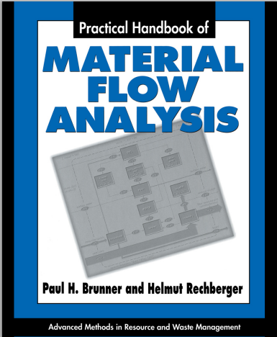
Material Flow Analysis
“Material flow analysis (MFA) is a systematic assessment of the flows and stocks of materials within a system defined in space and time.”
——Brunner and Rechberger, 2004

Slide 3
物质流分析
Substance flow analysis（简称SFA）是一种理解和刻画特定物质（通常为元素、化合物或一类物质等）在某一特定系统内的流动状况的分析工具。
SFA遵循物质守恒定律，它通过量化某一物质或某一类物质流入、流出特定系统和在该系统内部的流动和贮存状况，建立该系统内经济与环境之间的定量关系。

Slide 4
Definitions
Material: substances and goods
Substance: single type of matter (elements, compounds)
Goods: substances or mixtures of substances that have economic values assigned by markets
Process: transport, transformation, or storage of materials (natural or man-made)
Stocks: material reservoirs within the analyzed system
Flows: mass per time (link processes) 流量
Fluxes: mass per time and cross section 流速

Slide 5
Definitions （续）
Imports/exports: flows/fluxes across system boundaries
Inputs/outputs: flows/fluxes across process boundaries
System: sets of material flows, stocks, and processes within a defined boundary

Slide 6
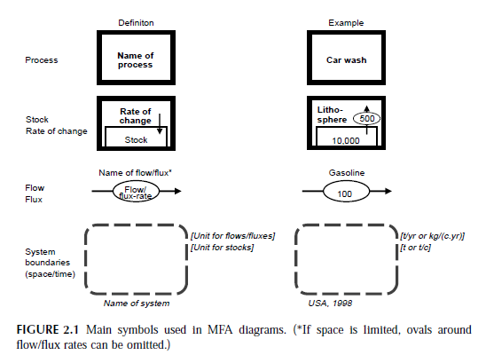
MFA图表标识

Slide 7
System boundary
The temporal boundary depends on the kind of system inspected and the given problem
The spatial system boundary is usually fixed by the geographical area in which the processes are located
For most studies, it is necessary to define the spatial system boundary also for the third dimension (vertically). Above the Earth’s surface, usually the first 500 m of the atmosphere are considered. Within this layer (so-called planetary boundary layer), the main exchange of air (and pollutants) between regions takes place, and there is negligible material exchange with the air compartment above.

Slide 8
物质代谢分析框架

Slide 9
基本程序
SFA的基本程序概括提炼为：
（1）目标和系统界定：首先必须明确所要解决的问题，然后根据问题确定研究目标。系统的界定主要包括三个方面，即物质、时间、空间，另外在有必要的情况下也要对系统内的子系统进行界定（包括系统内一系列的过程和系统内的流与库存，一般会用流程图表示）；
（2）SFA分析框架确定：确定SFA所涉及的系统的拓扑结构，识别需要分析的过程单元和流股；（最重要）
（3）数据获取与计算；
（4）SFA结果的解释。

Slide 10
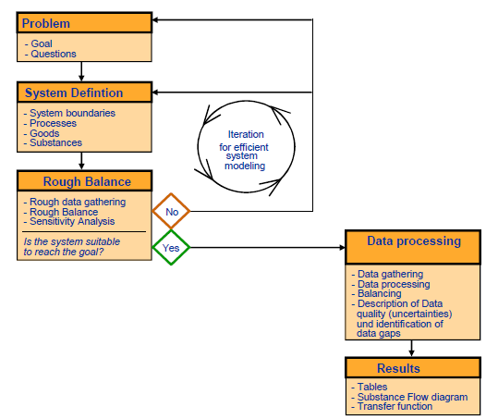
基本程序

Slide 11
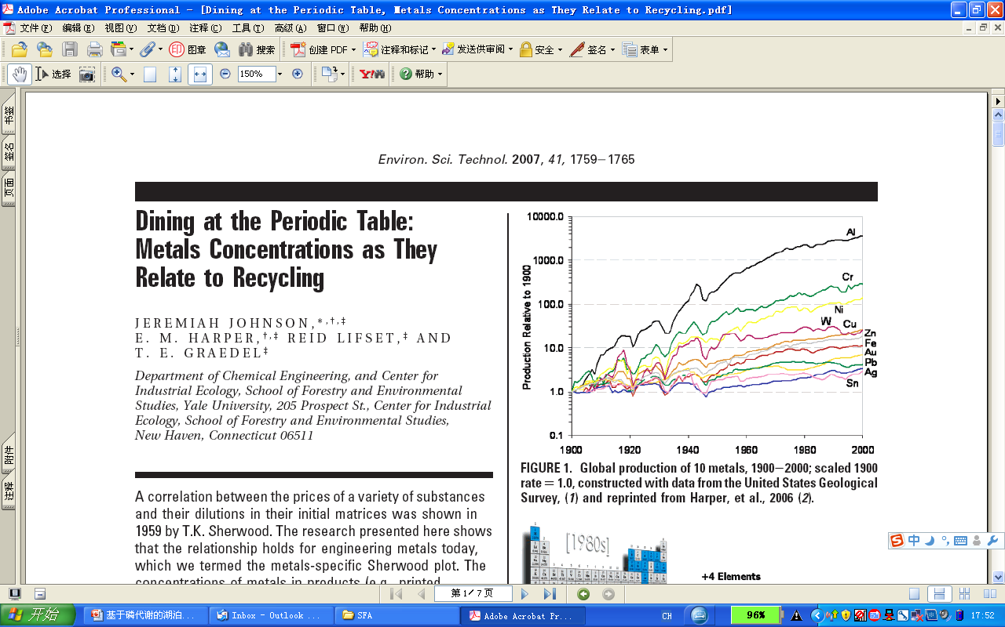

Slide 12
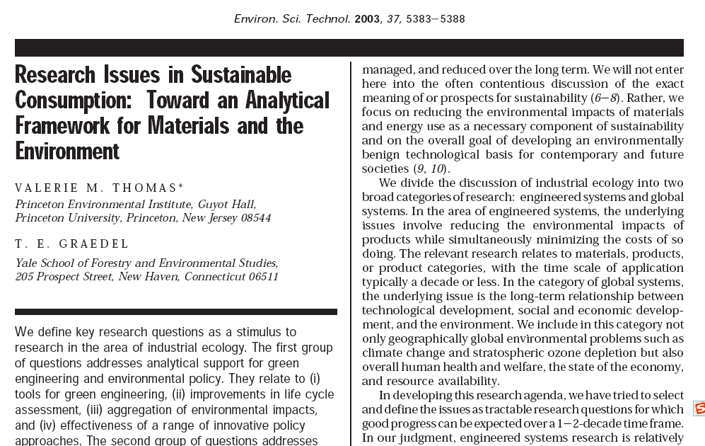

Slide 13
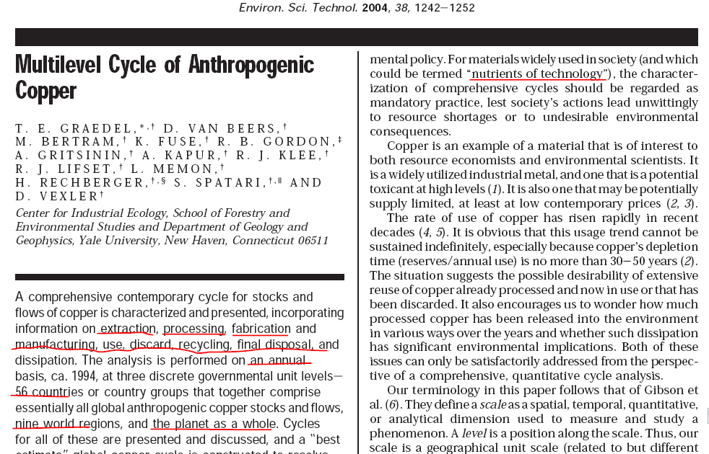

Slide 14
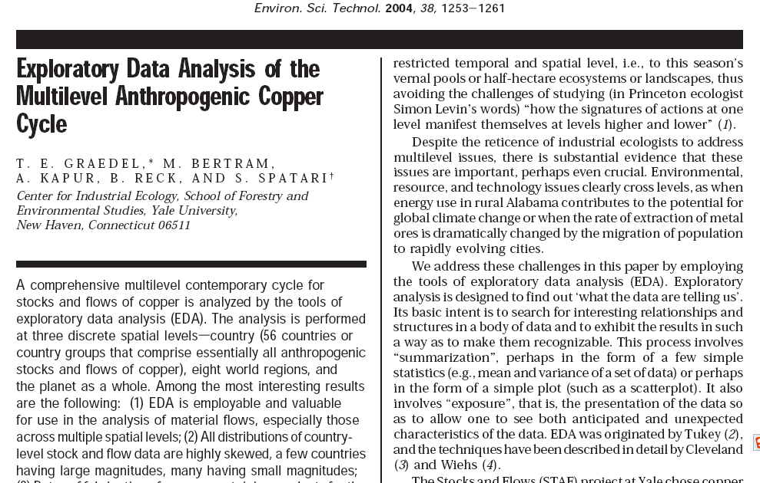

Slide 15
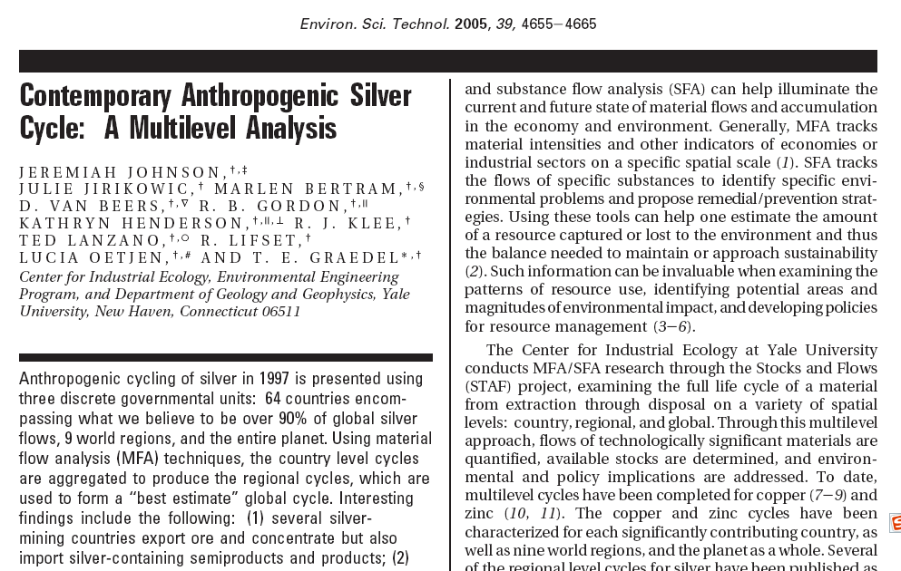

Slide 16
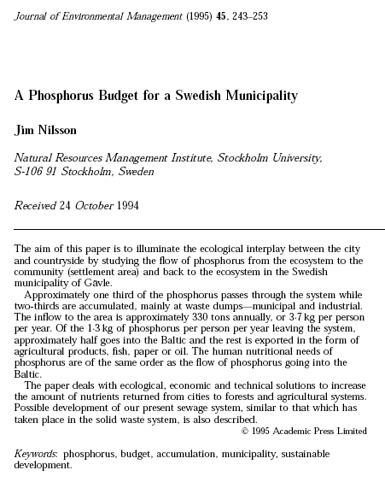
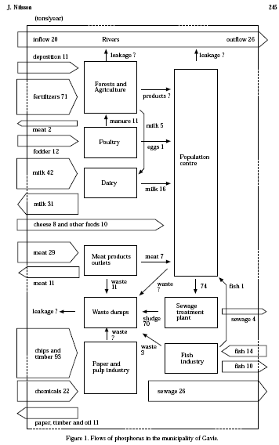

Slide 17
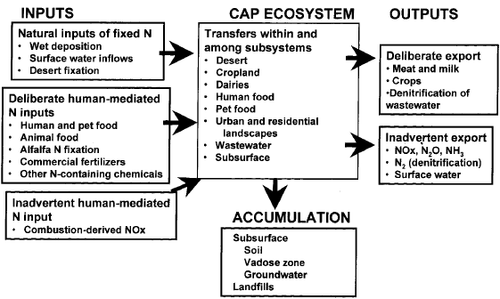
Lawrence A. Baker, Diane Hope, Ying Xu, Jennifer Edmonds and Lisa Lauver. Nitrogen Balance for the Central Arizona–Phoenix Ecosystem. Ecosystems (2001) 4: 582–602

Slide 18
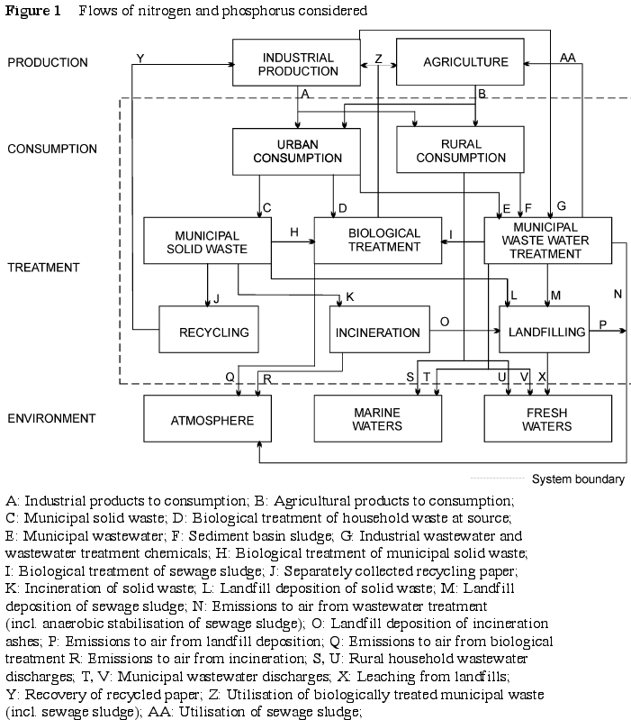
Laura Sokka, Riina Antikainen, Pekka Kauppi. Flows of nitrogen and phosphorus in municipal waste: a substance flow analysis in Finland. Progress in Industrial Ecology,2004,1(1/2/3):165 - 186

Slide 19
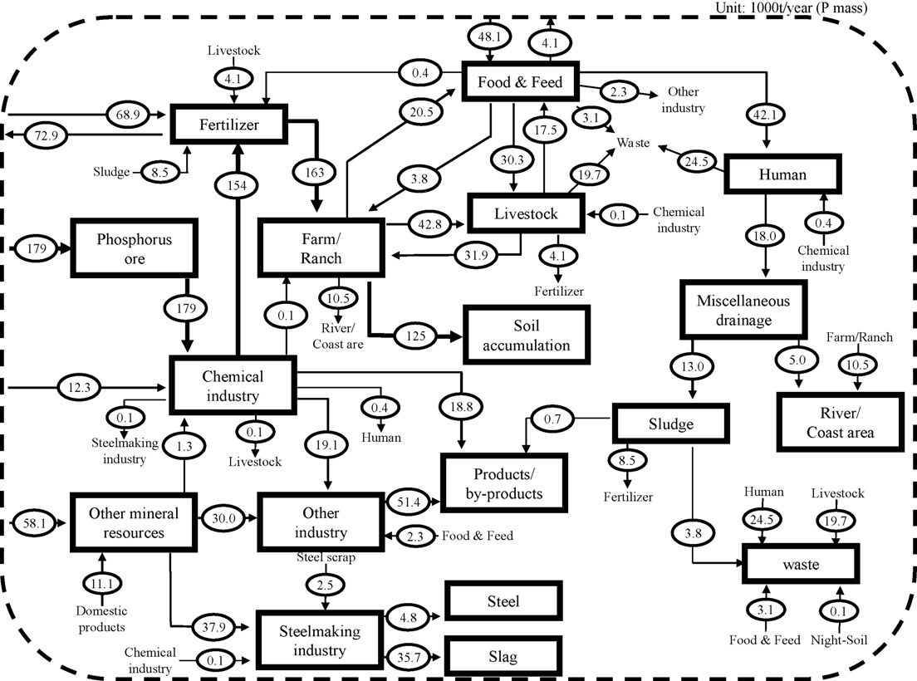
Domestic material flow of phosphorus in South Korea（2006）

Slide 20
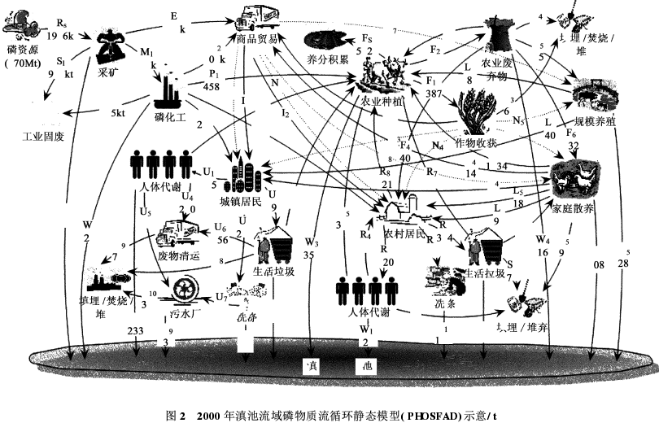

Slide 21
国家层面的磷物质流核算

