Slide 1

IQTREE
Software for Phylogenomic Inference
28.05.2024
Zohre Changizi, Manuela Prior

Slide 2
IQTREE
Open source
Reconstruction of phylogenetic trees based on sequence data that is best explained by input data
Works with aligned sequences (if raw/unaligned → first run alignment program like MAFFT)
Efficient and fast → suitable for big data sets and complex model calculations
Automatic model selection for tree reconstruction possible (default is MFP - ModelFinder Plus)
Different evolutionary models can be used (DNA-, Protein-, Codon-Models,..)
Output data can be visualized into trees

Slide 3
Input and Output Data
Input
Output
FASTA
NEXUS
PHYLIP
CLUSTAL
→ Files with homologue sequences to compare
.iqtree: main report file, computational results of run
.treefile: Maximum likelihood tree in NEWICK format, can be visualized with treeviewer programs
.log: logfile of the entire run, reports bugs,..

Slide 4
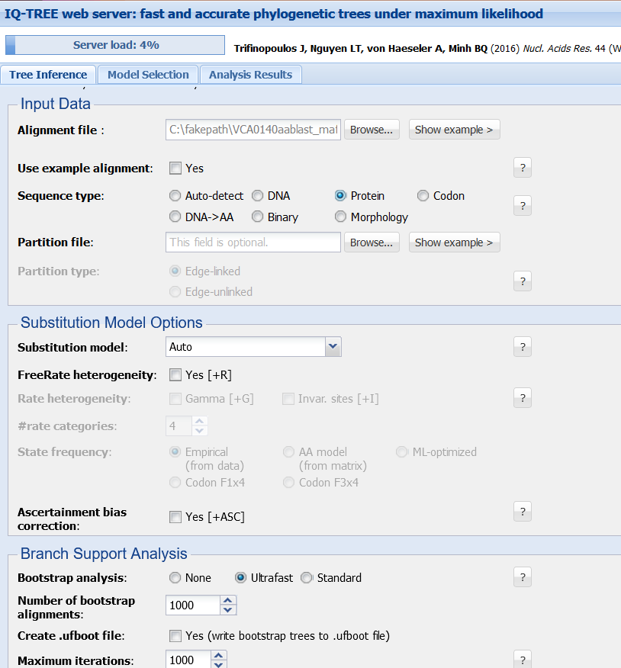
How to use it – Web Version
Web Version: http://iqtree.cibiv.univie.ac.at/
http://www.iqtree.org/doc/Web-Server-Tutorial
Tab “Tree Inference”
Choose Input Data
Optional: put Email in to get Output Data
Click “Submit Job”

Slide 5
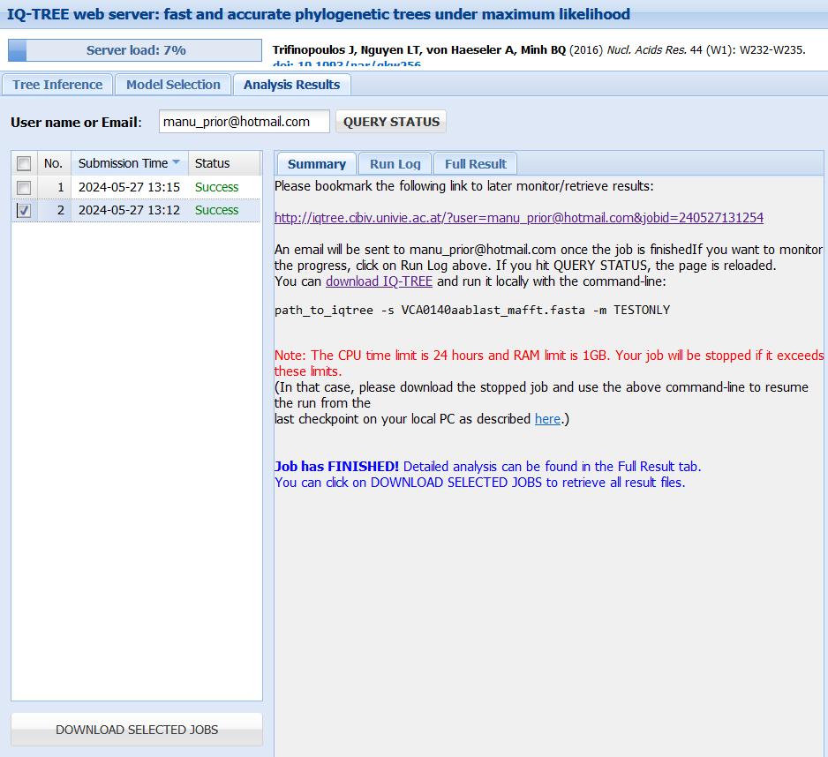
How to use it – Web Version
Tab “Analysis Results”
Click “Query Status” to update until Status changes to “Success”

Slide 6
How to use it – Web Version
Tab “Analysis Results”
Click “Query Status” to update until Status changes to “Success”
To see Results and Tree click Tab “Full Result”
Download of Output Files possible

Slide 7
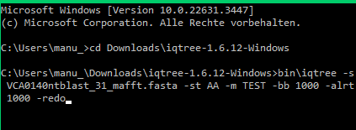
How to use it – Download Version
-s VCA0140ntblast_31_mafft.fasta -st AA -m TEST -bb 1000 -alrt 1000
Download Version (Stable release 1.6.12): http://www.iqtree.org/ and extract .zip folder
Put file to analyse into the folder “iqtree-1.6.12-Windows”
Options: “bin\iqtree –h”
Open command prompt
Set directory, choose file
Tutorials: http://www.iqtree.org/doc/Tutorial
http://www.iqtree.org/doc/Quickstart#minimal-command-line-examples

Slide 8
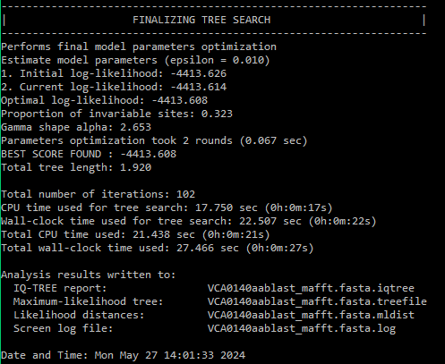
How to use it – Download Version
Long Output in Cmd
Creates 4 Output files saved to the same folder as Input file is located
Can only be run once, to run second time use command “iqtree -s VCA0140aablast_mafft.fasta -redo“
Tutorials: http://www.iqtree.org/doc/Tutorial
http://www.iqtree.org/doc/Quickstart#minimal-command-line-examples

Slide 9
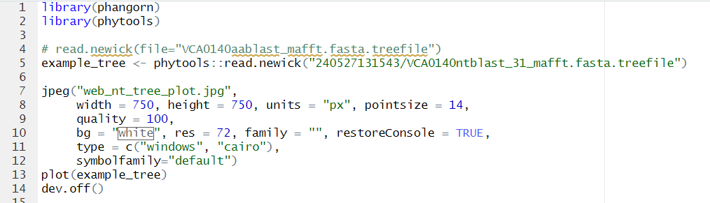
Visualization with RStudio
Read generated .treefile into Rstudio
Selected Models:
Aa: Best-fit model: WAG+I+G4 chosen according to BIC
Nt: Best-fit model: K2P+G4 chosen according to BIC

Slide 10
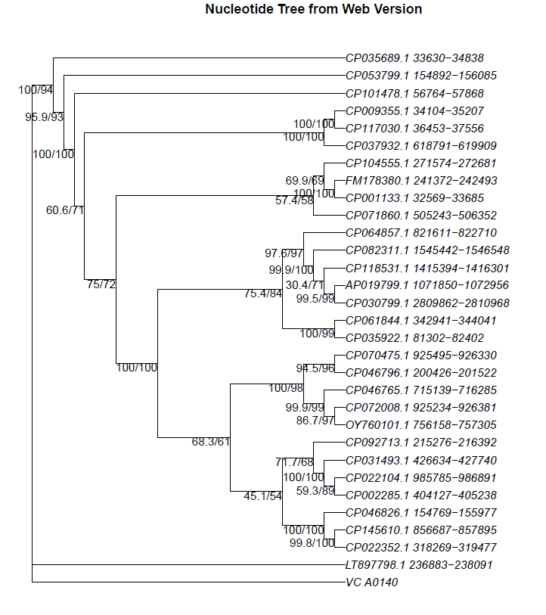
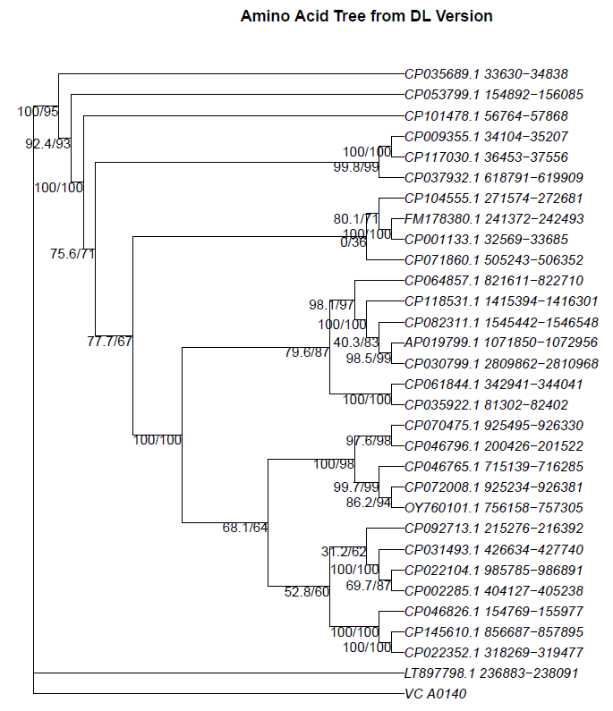
Comparison Web and Download Version Nucleotides

Slide 11
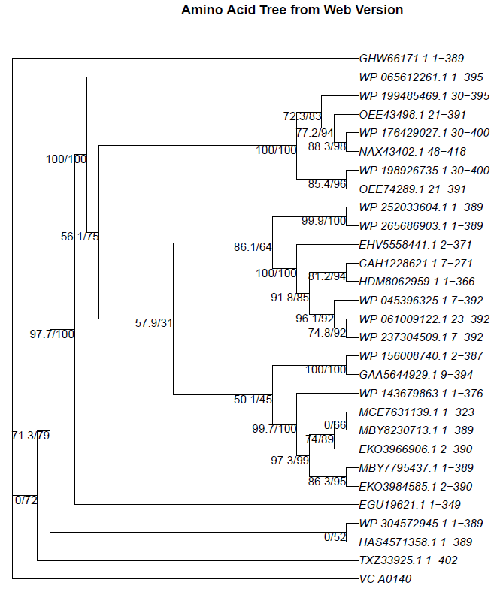
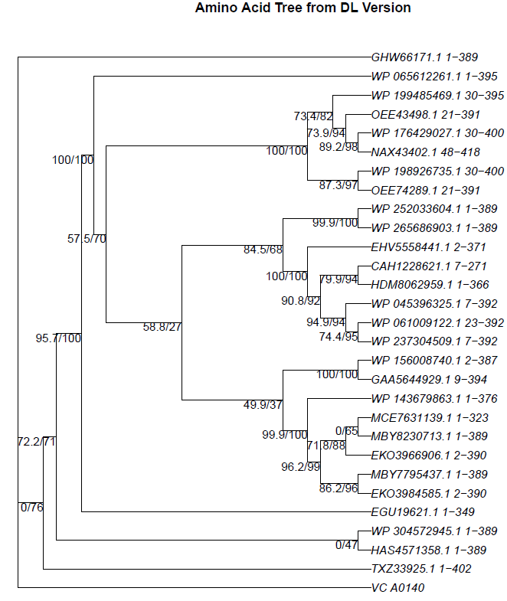
Comparison Web and Download Version Amino Acids

