Slide 1
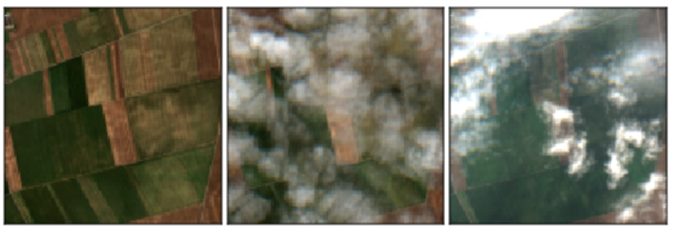
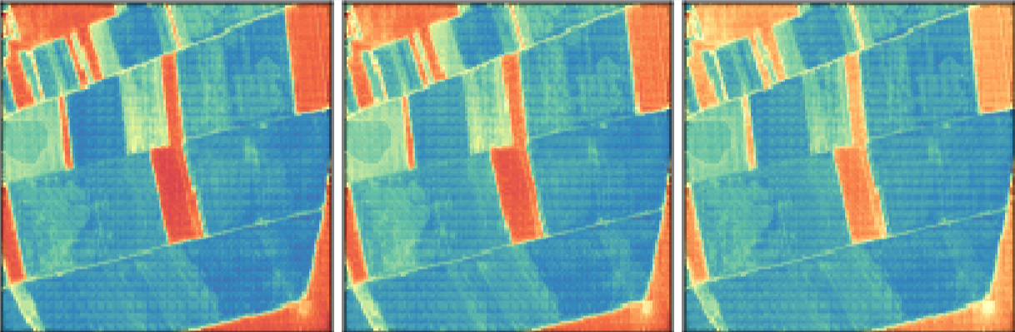
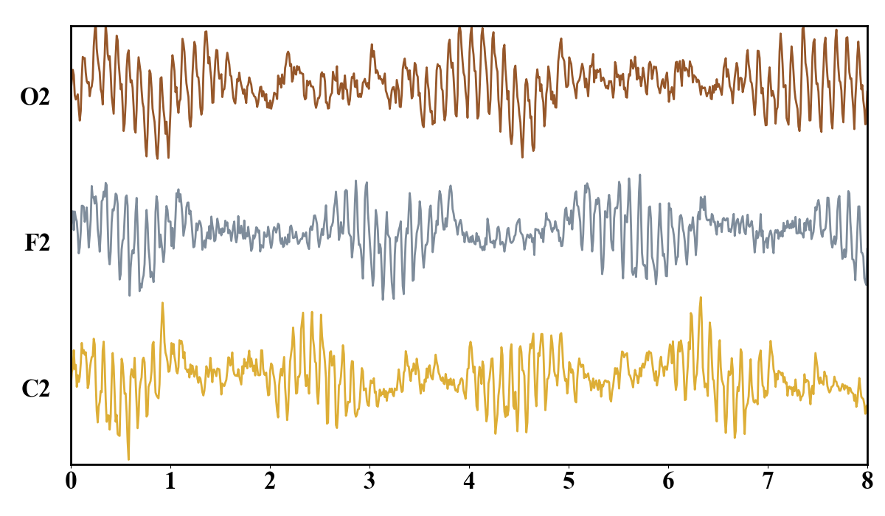
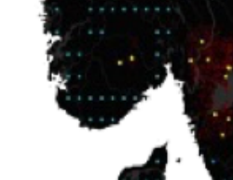
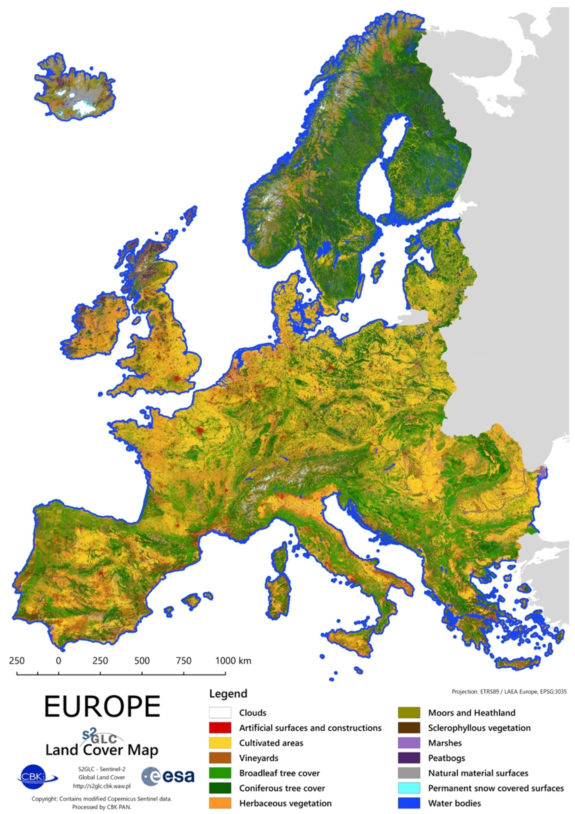
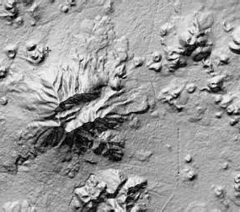
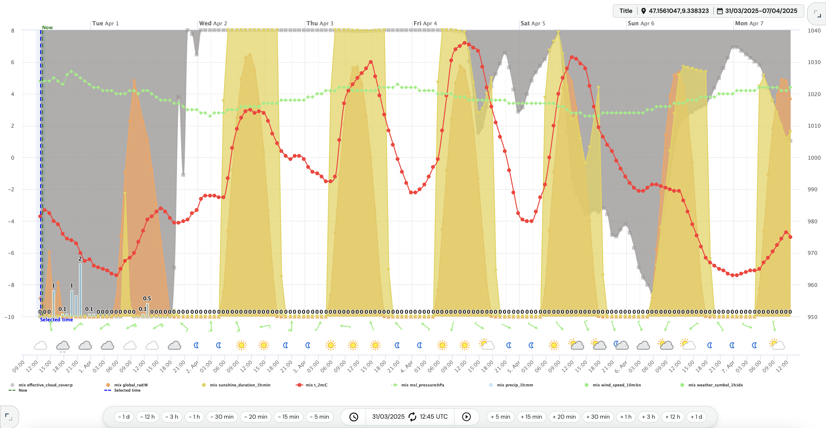
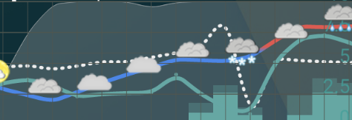
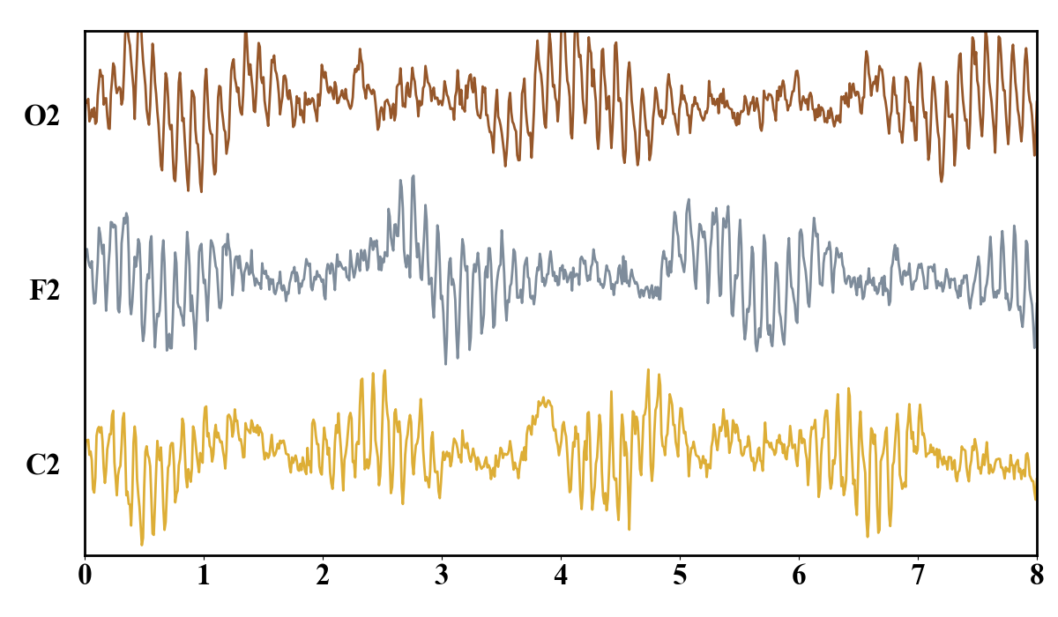
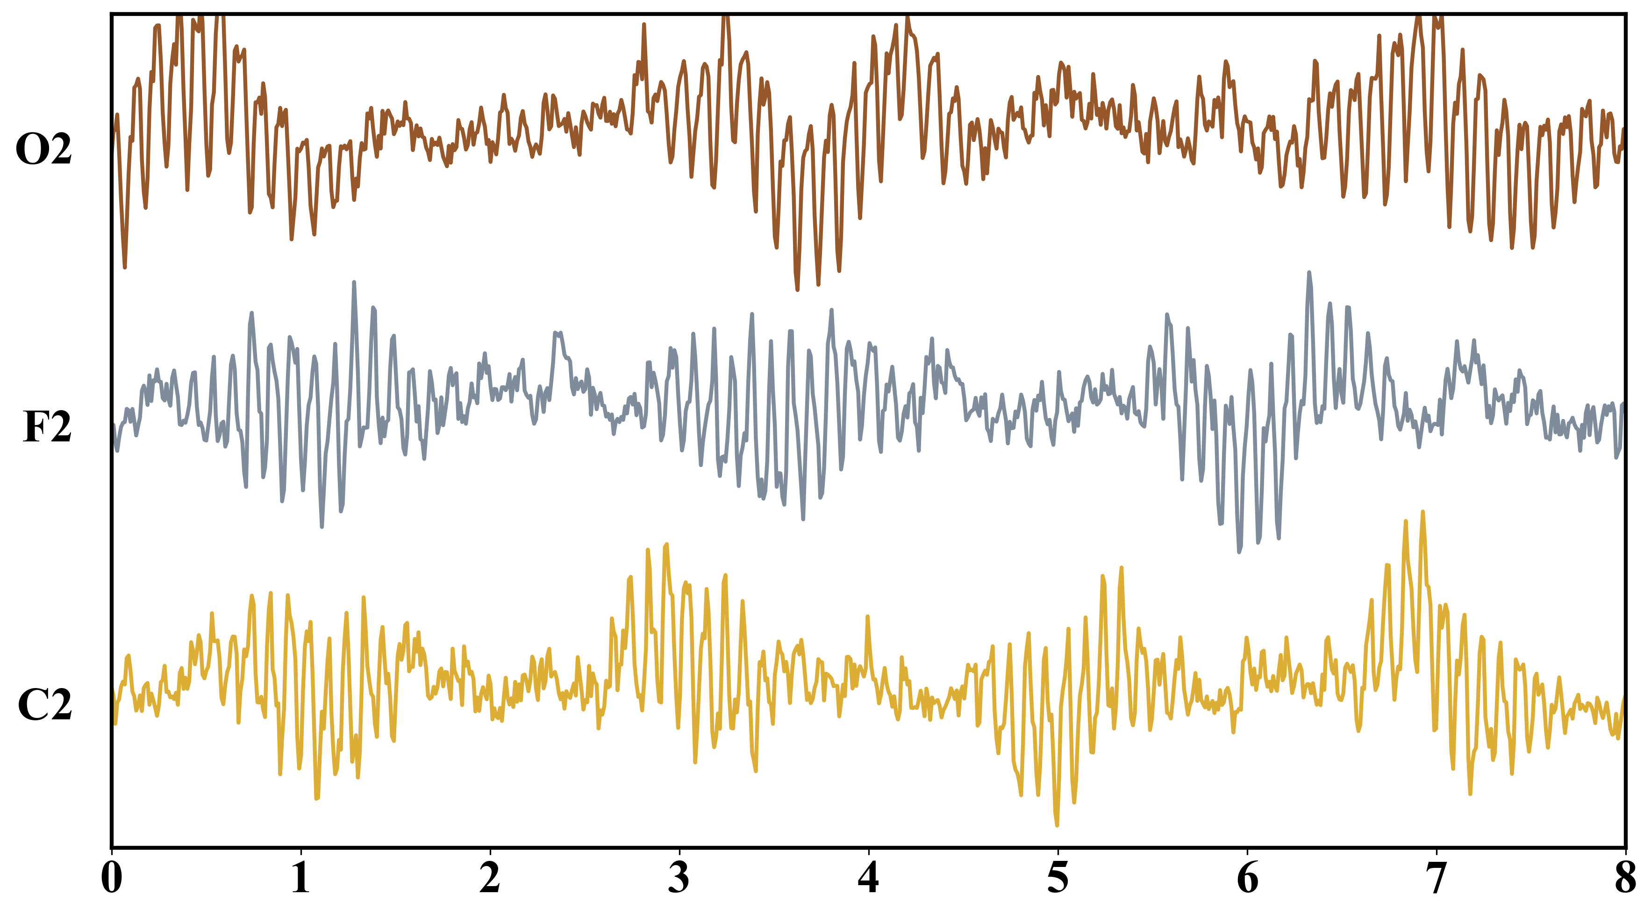
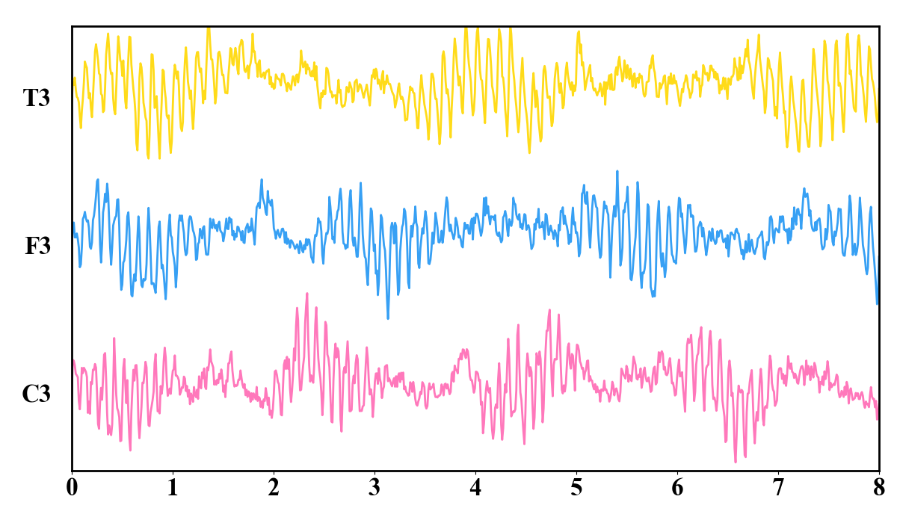
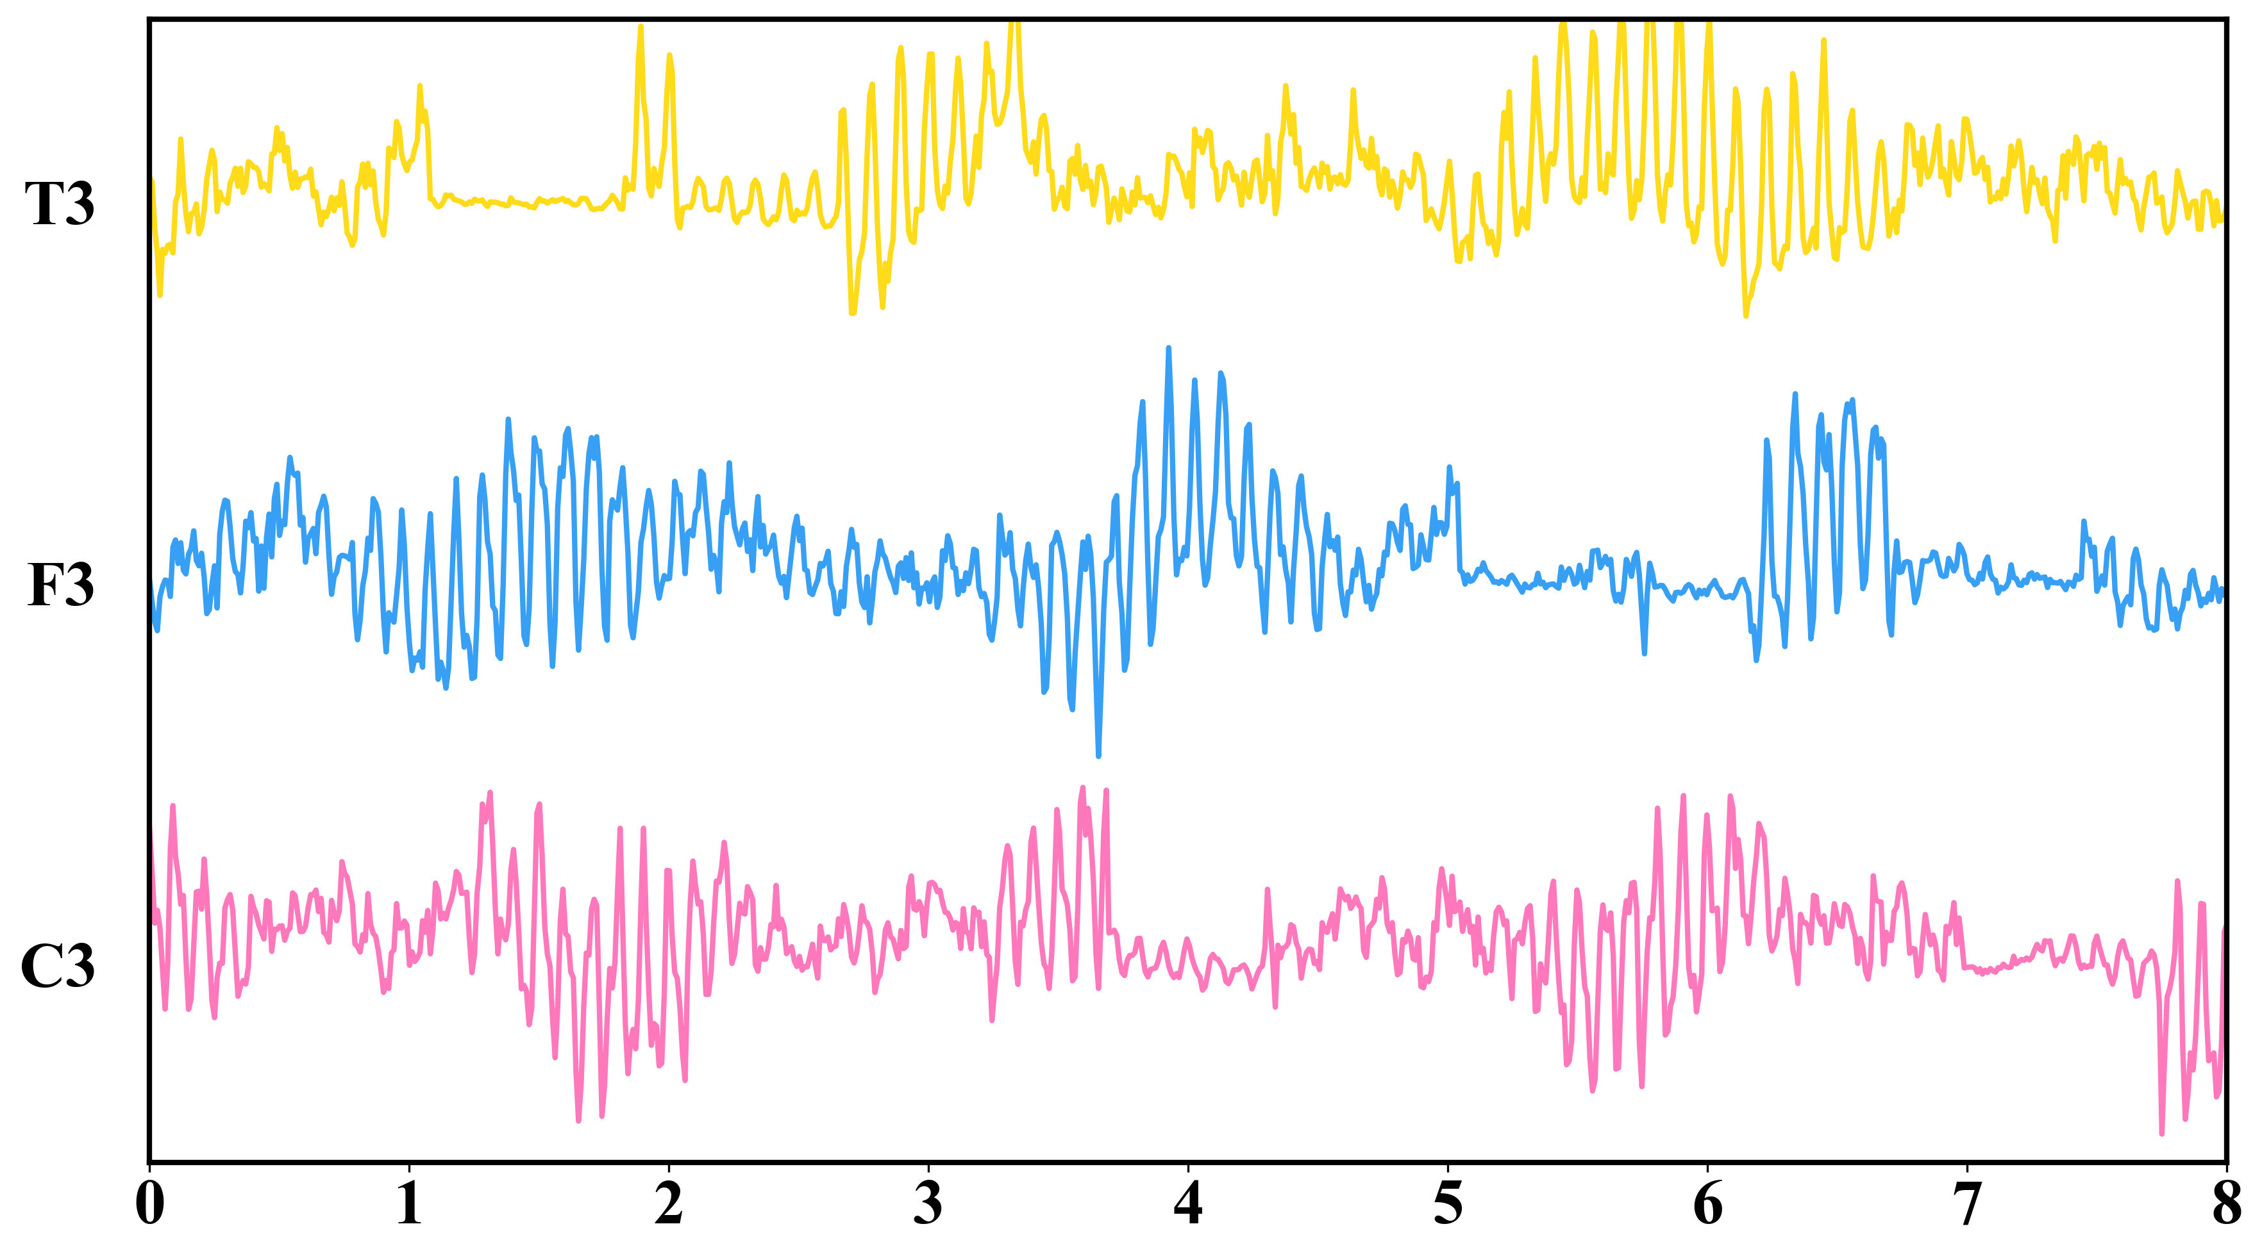
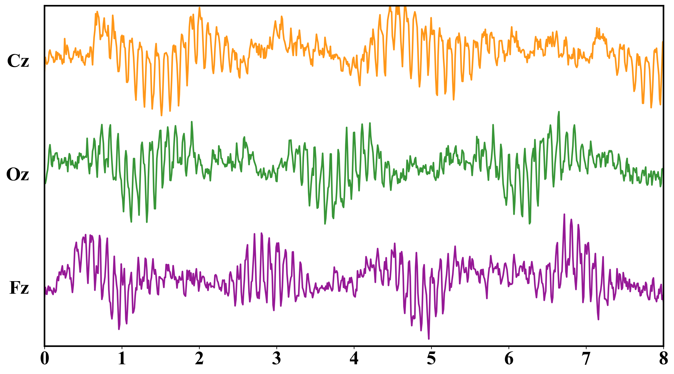
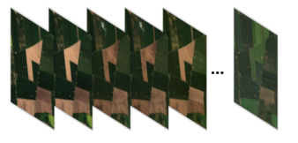

(a) Multimodal context
(b) History encoding & state construction
History encoder
State-construction branch
Historical Earth observations
P State projector
Historical environmental context
Predictive state
Tokenization
Context-forecast branch
Static geographic attributes
Future meteorological forcing
Context-only forecasts
Future meteorological forcing
Shared transition
State readout
weather tokens
State contribution
weather
state tokens
Evolved predictive state
Weather intervention
geography
actual
donor
D3 Vegetation forecast
horizon
mean
(d) Readout & forecast
(c) Weather-conditioned shared dynamics

