Slide 1
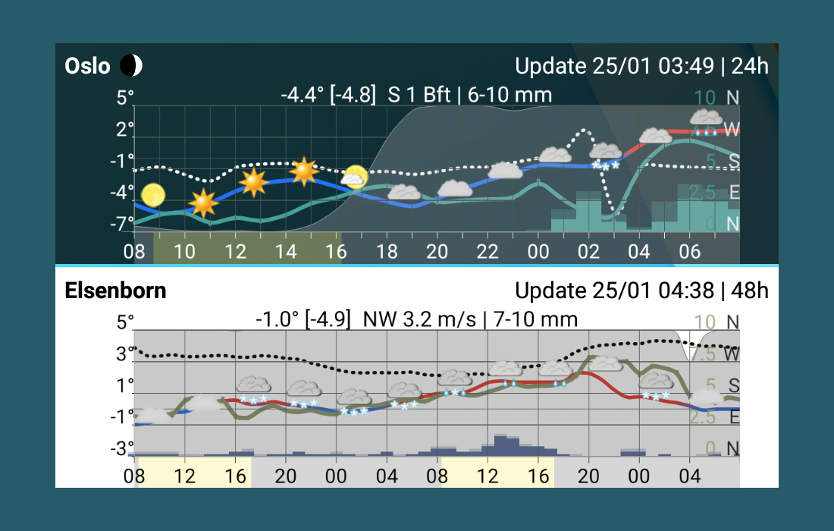
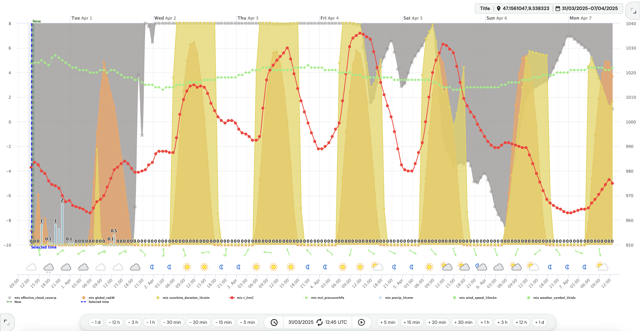
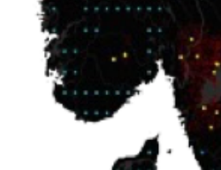
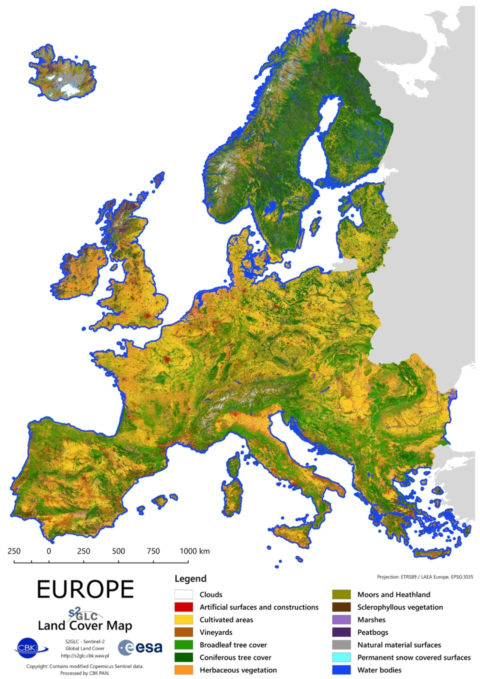
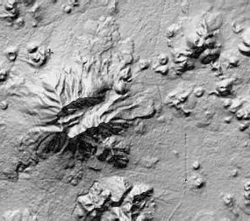
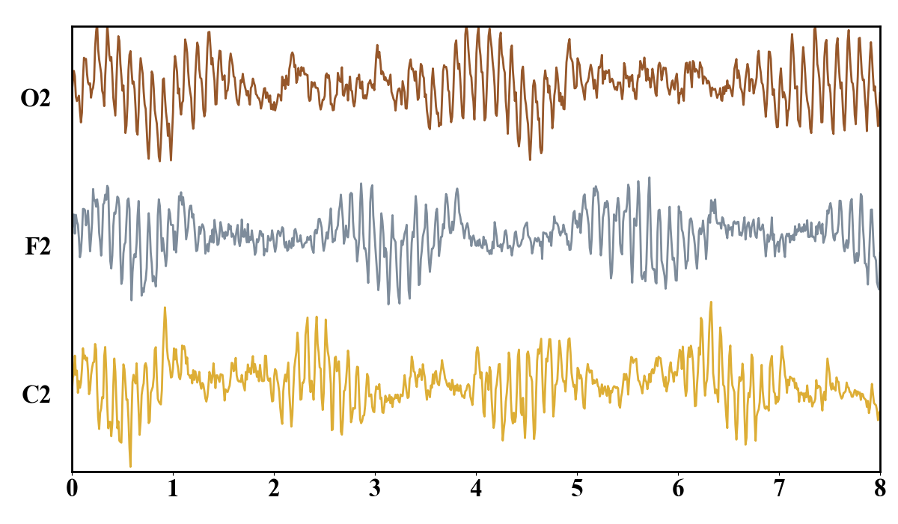
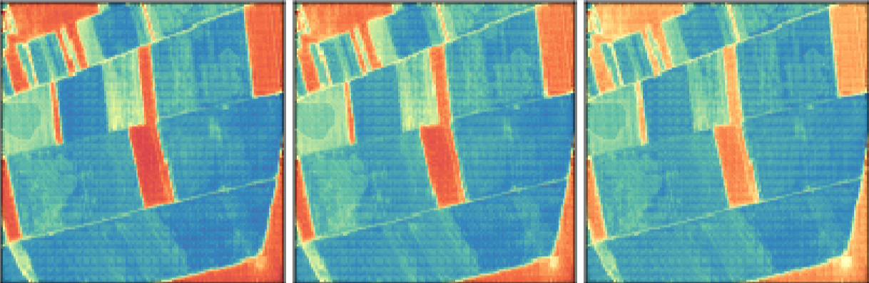
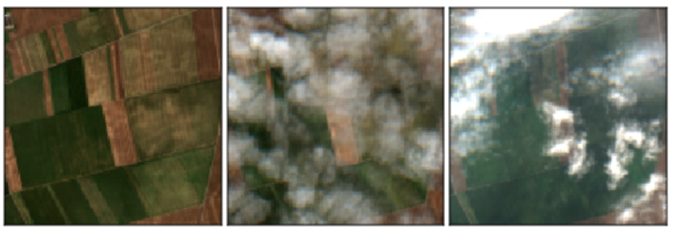
(a) Endpoint prediction
(b) TerraState world model
(c) Testable properties
T
P
R
Fₕ
future weather u
1
State carries forecast information
history
q→P
zₜ
T
zₜ₊ₕ
O
history
future
EO
EO
2
Weather changes the predicted response
Endpoint score only
Explicit state path under exogenous forcing
One selected model, three increasingly specific questions
Q1
Forecast utility
Q2
Load-bearing state
Q3
Weather-response fidelity
Does the complete model retain useful EO forecasting skill?
Does removing the state contribution degrade the forecast?
Does replacing future weather alter the response correctly?
full state path
state removed
T
T
Δ
P
→ Δŷ
P
R
R
forecast
target
actual u
replaced u′
NDVI
NDVI

Slide 2
(a) Multimodal context
(b) History encoding & state construction
(c) Weather-conditioned shared dynamics
(d) Readout & forecast
History Encoder
P Projector
Historical Earth observations
Historical environmental context
Tokenization
Historical environmental context
Future meteorological forcing u_{t:t+h}

Slide 3
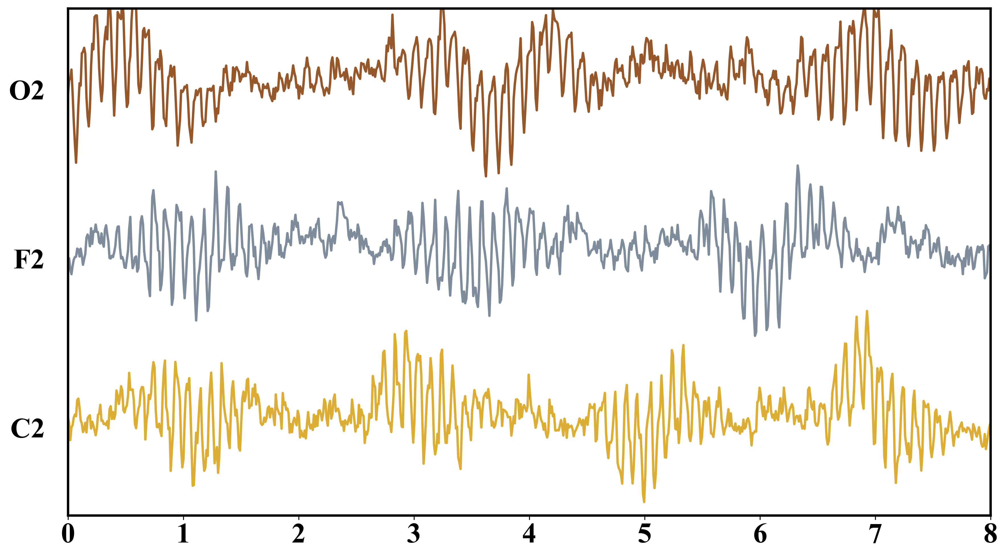
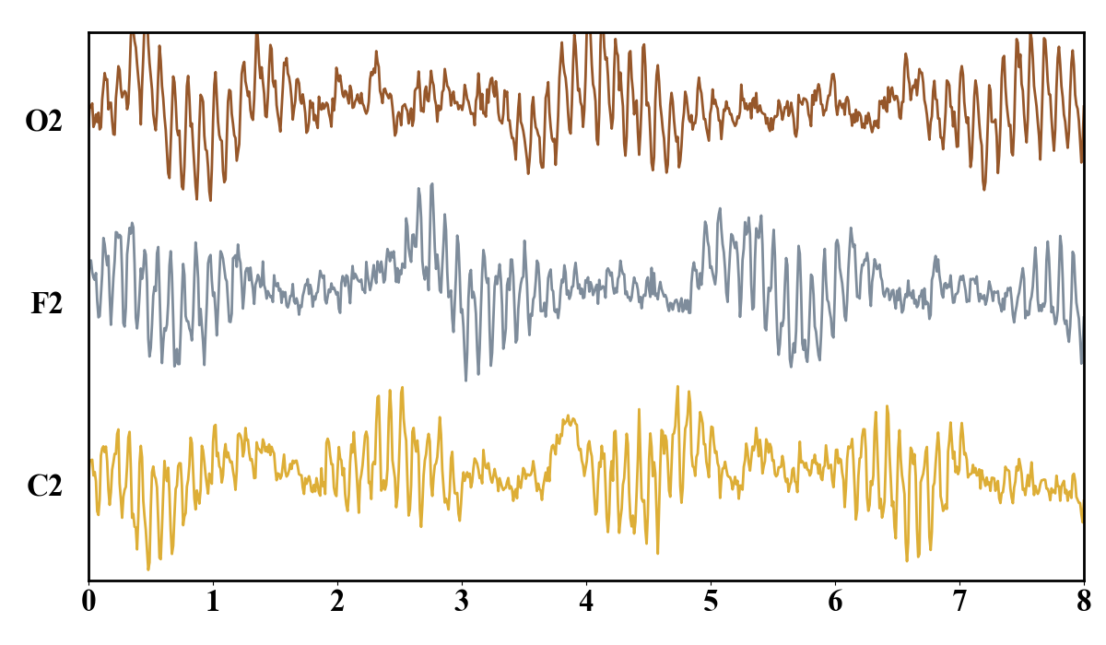
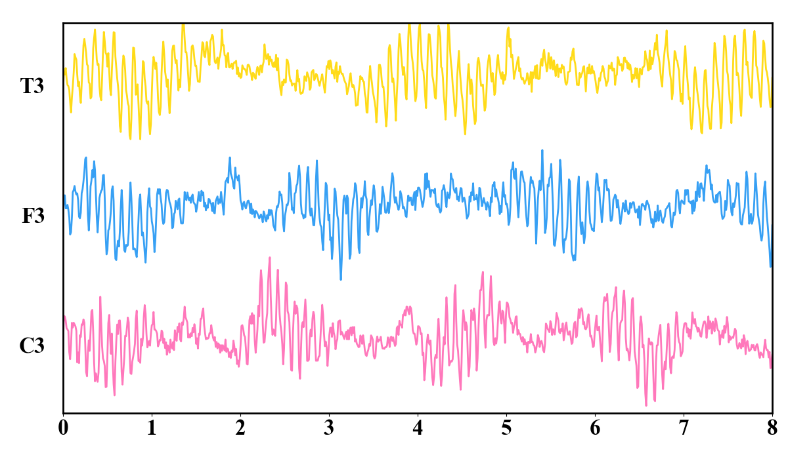
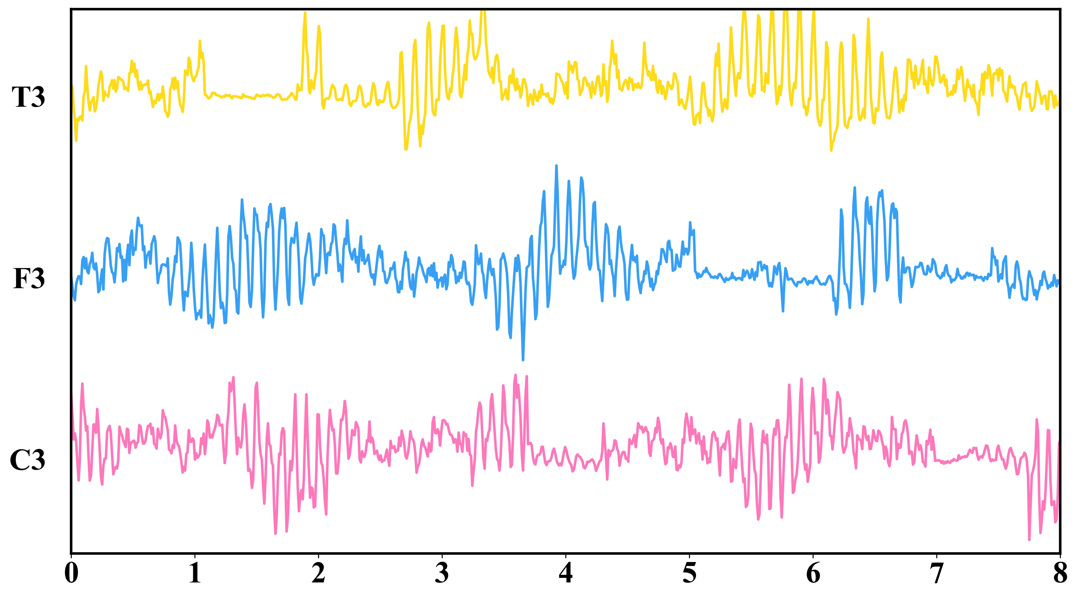
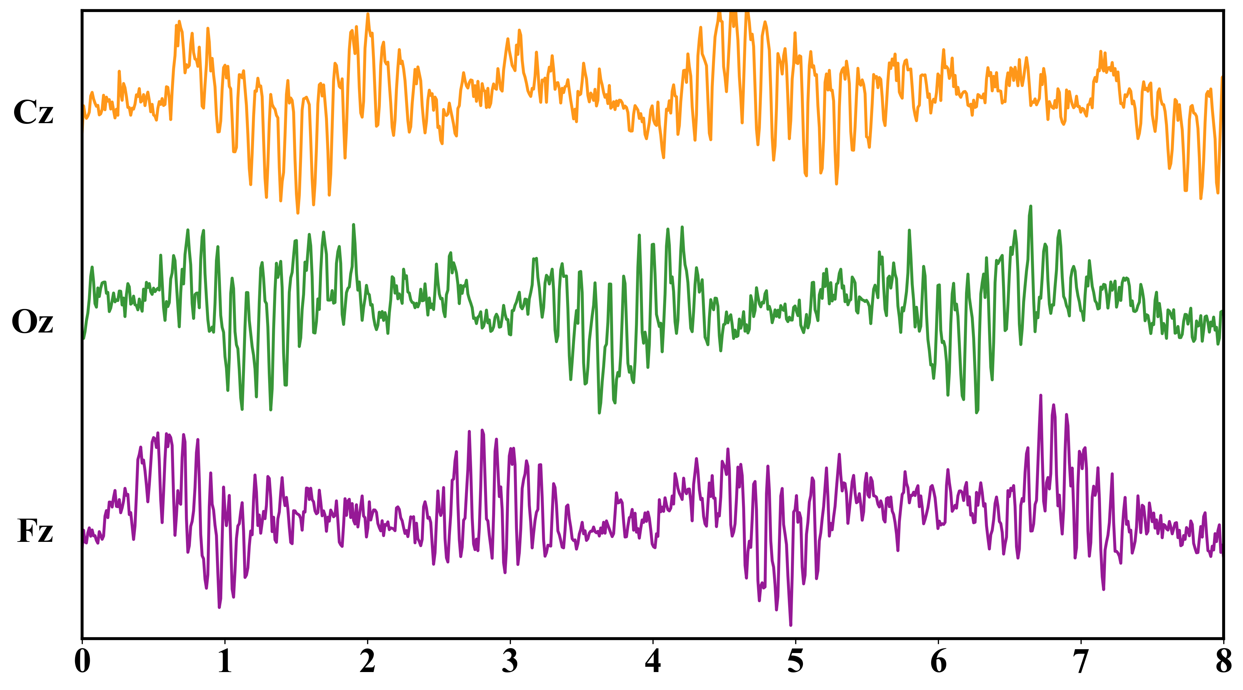
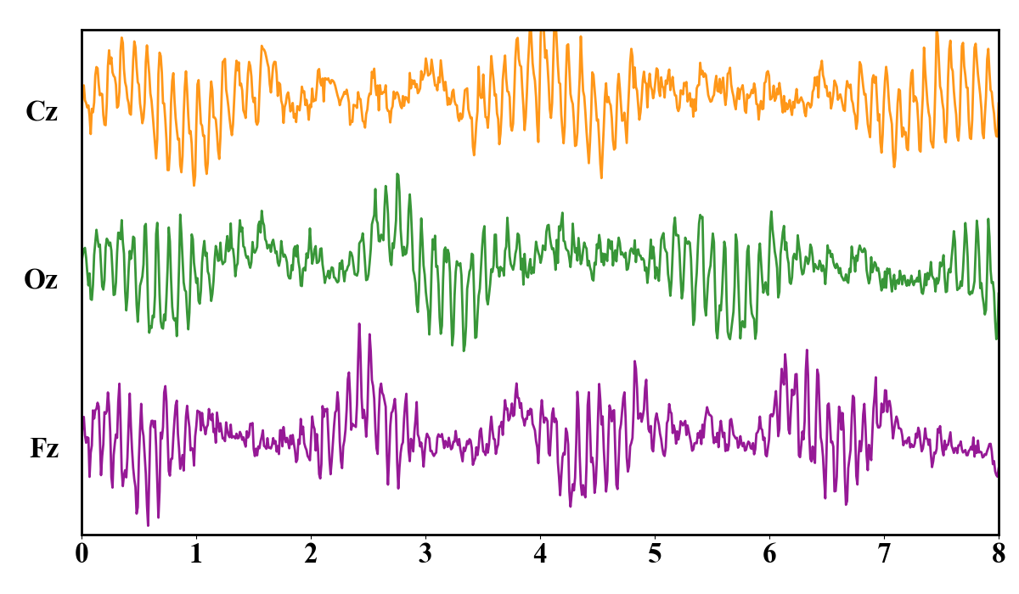

Raw EEG Data
Augmentation
Heterogeneous Feature Projection Module
MoE-Trans. Block
Time Path
Frequence Path
Raw Path
Different Tasks
Add & LN
……
Random Time Shift
Time Encoder
Freq. Encoder
Linear
Expert1
Expert2
Expert3
……
Tokenization
Channel Dropout
Tokenization
Tokenization
Router
MoE Block
……
Time Patches
Frequence Patches
Raw Patches
Contains 84 channels
Add Gaussian Noise
Query
Key & Value
Key & Value
Query
Add & LN
Time Encoder
Freq. Encoder
……
……
Fused Features
Multi-Head Attention
……
K1
Kn
K1
Kn
……
Q1
Qn
……
……
Q1
Qn
V1
Vn
V1
Vn
Embedding_1
Time2Freq.
Freq.2Time
region_ embedding
FFT
Frontal
Conv1d
Parietal
RoPE
……
BN
×N
Rfft_freq
Topological Embedding
Res
Res
Embedding_2
ReLU
reg_pos_embedding
α
(Frontal) Fz
β
γ
(Parietal) Pz
Linear
Energy
FFN
FFN
……
Query
Key
Value
δ
θ
Embedding_3
LN
Linear
positional_embedding
LN
Fz: 0
Topologicalembedding
Pz: 1
LN
Dual-domain Cross-attention Module
……
Semantic Features

Slide 5
Raw EEG Data
(a) Augmentation
(b) Heterogeneous Feature Projection Module
(e) MoE-Trans. Block
Time Path
Frequence Path
Raw Path
Different Tasks
Add & LN
……
Random Time Shift
Time Encoder
Freq. Encoder
Linear
Expert1
Expert2
Expert3
……
Tokenization
Channel Dropout
Tokenization
Tokenization
Router
MoE Block
……
Time Patches
Frequence Patches
Raw Patches
Contains 84 channels
Add Gaussian Noise
Query
Key & Value
Key & Value
Query
Add & LN
Time Encoder
Freq. Encoder
……
……
Fused Features
Multi-Head Attention
……
K1
Kn
K1
Kn
……
Q1
Qn
……
……
Q1
Qn
V1
Vn
V1
Vn
Embedding_1
Time2Freq.
Freq.2Time
region_ embedding
FFT
Frontal
Conv1d
Parietal
RoPE
……
BN
×N
Rfft_freq
(d) Topological Embedding
Res
Res
Embedding_2
ReLU
reg_pos_embedding
α
(Frontal) Fz
β
γ
(Parietal) Pz
Linear
Energy
FFN
FFN
……
Query
Key
Value
δ
θ
Embedding_3
LN
Linear
positional_embedding
LN
Fz: 0
Topologicalembedding
Pz: 1
LN
(c) Dual-domain Cross-attention Module
……
Semantic Features

Slide 6
Raw EEG Data
Heterogeneous Feature Projection Module
Time Path
Frequence Path
Raw Path
……
Contains 84 channels
Time Encoder
Freq. Encoder
Data augmentation
Linear
Tokenization
Tokenization
Tokenization
Add Gaussian Noise
Channel Dropout
Random Time Shift
Time Patches
Frequence Patches
Raw Patches
Query
Key & Value
Key & Value
Query
……
……
Fused Features
……
K1
Kn
K1
Kn
……
Q1
Qn
……
……
Q1
Qn
V1
Vn
V1
Vn
Embedding_1
Time2Freq.
Freq.2Time
region_embedding
Frontal
Parietal
……
Topological Embedding
Embedding_2
Res
Res
reg_pos_embedding
(Frontal) Fz
(Parietal) Pz
FFN
FFN
……
Embedding_3
Linear
positional_embedding
Fz: 0
Pz: 1
Dual-domain Cross-attention Module
……

Slide 7


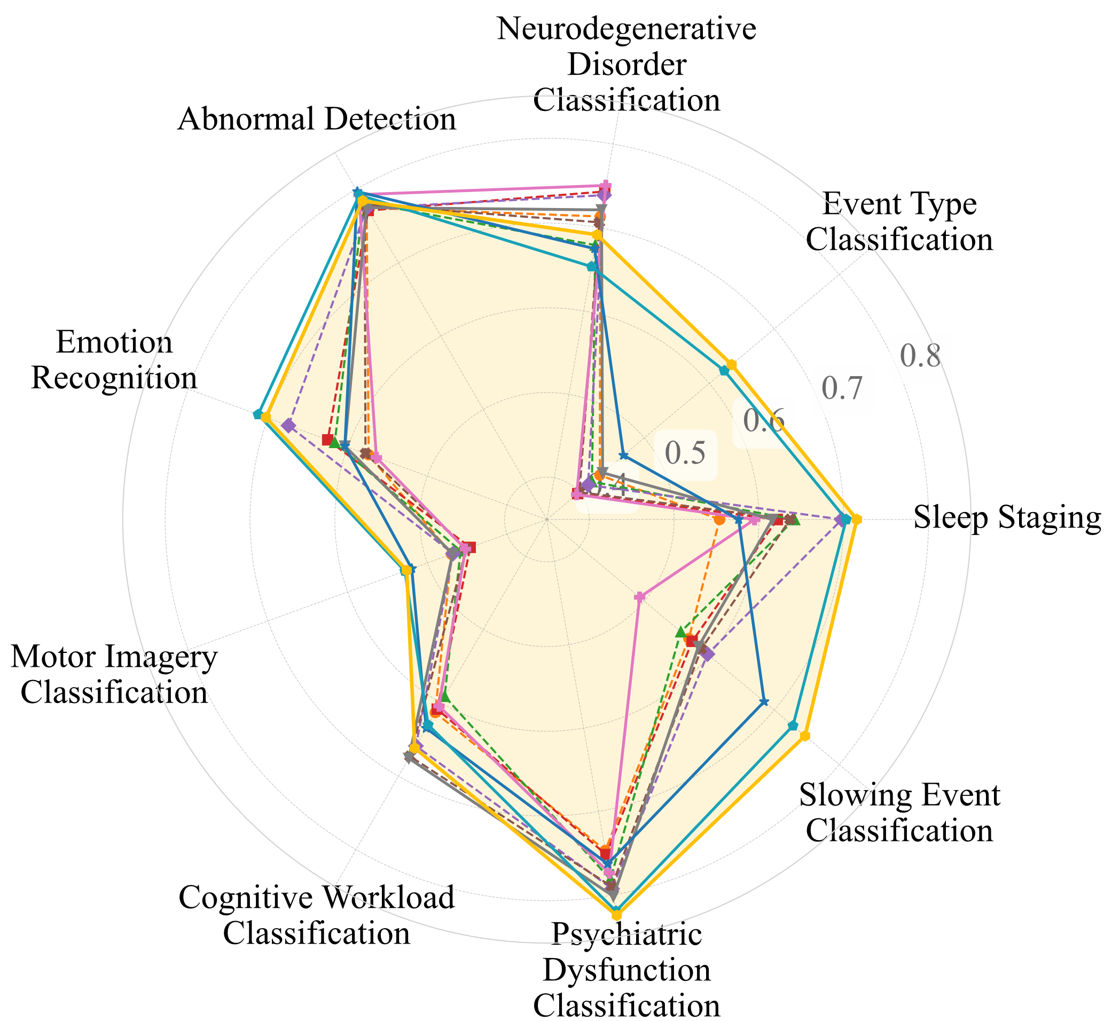
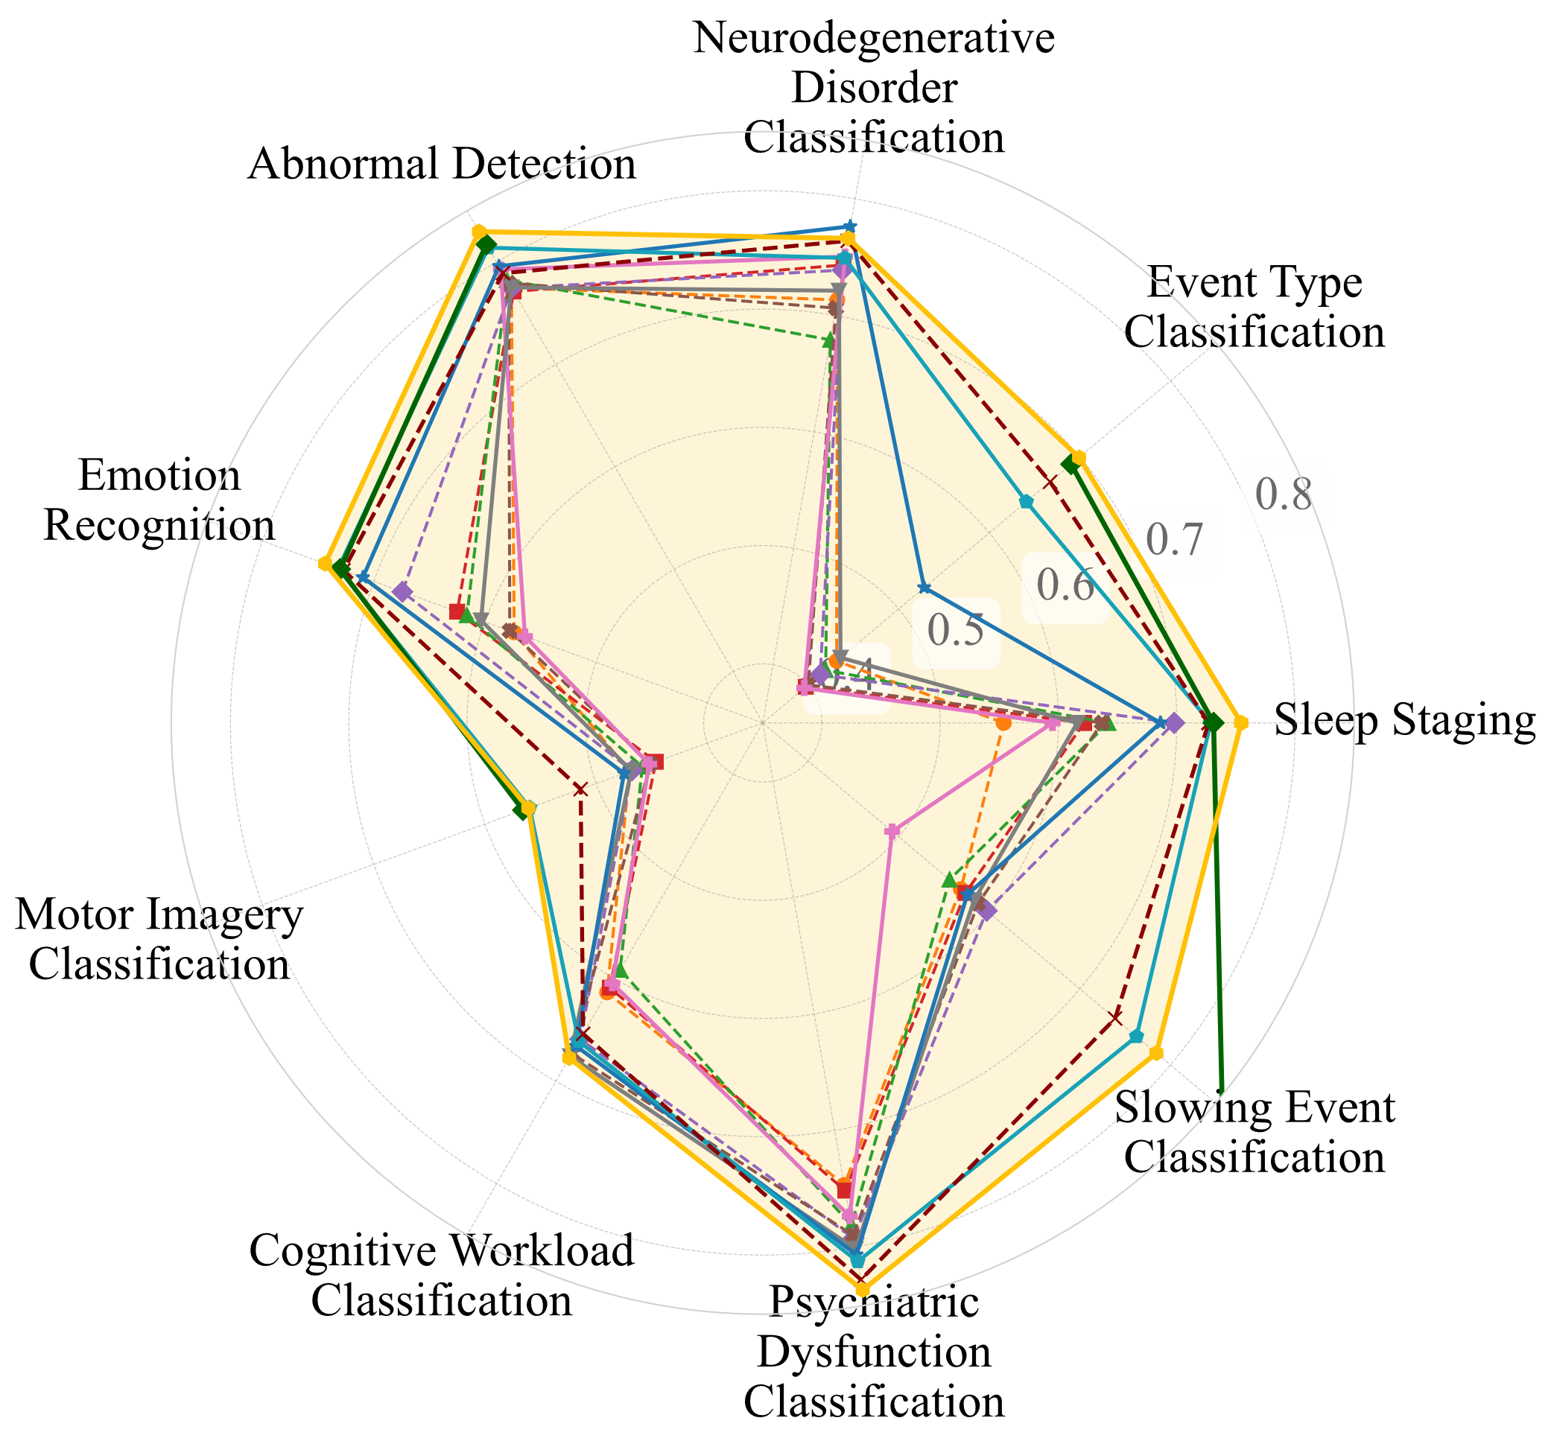

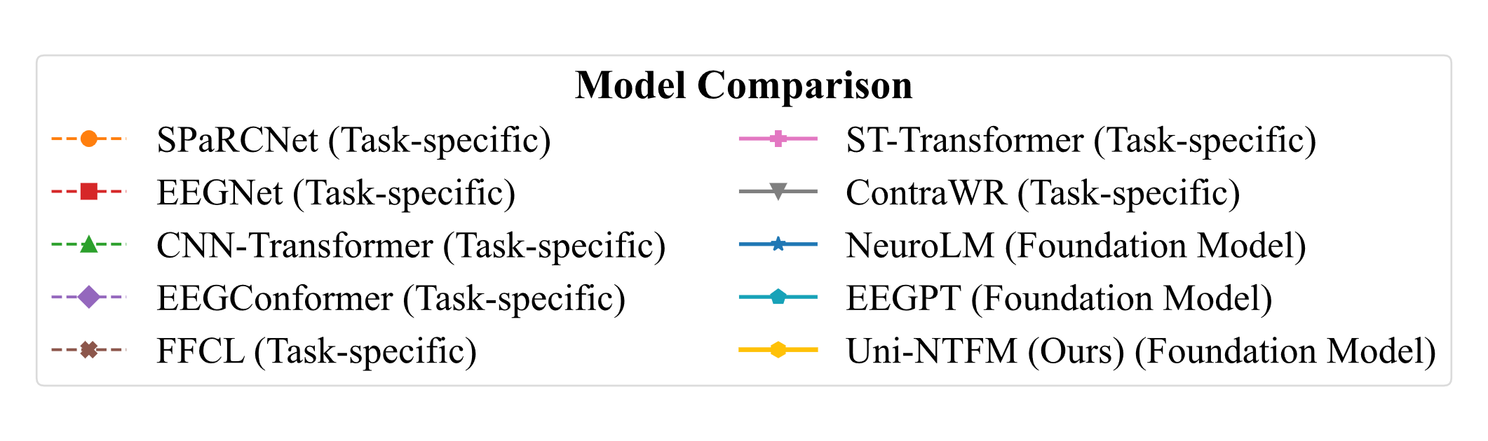
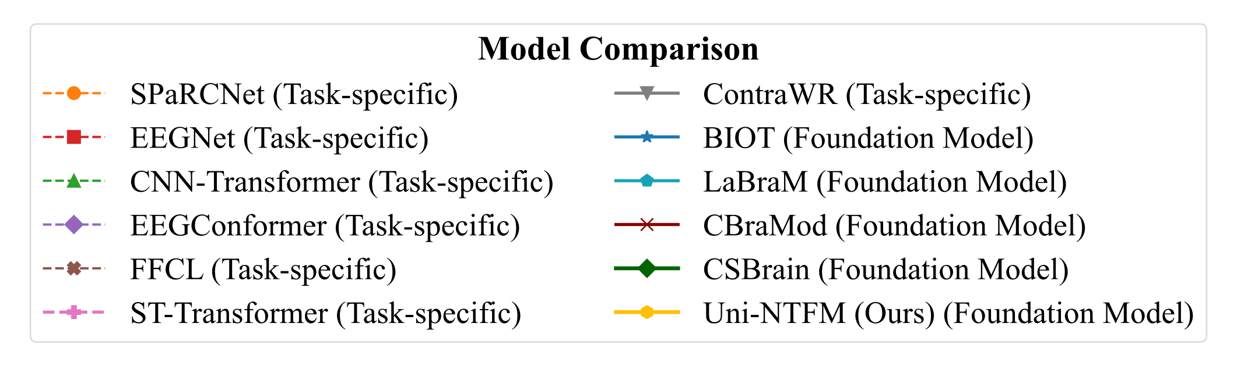
Uni-NTFM: Unified Neural Topological Foundation Model
Only pretrained performance across 9 tasks.
Fine-tuned performance across 9 tasks.
Q1: What does the title ‘Unified’ mean?
Q2: How to generate spatial topology for different brain regions and different electrodes?
Q3: How to prove the superior performance of the Uni-NTFM?
A1: The term "Unified" refers to the unification of different international electrode standards and task paradigms.
A2: We implement spatial topology modeling via a structured prior injection strategy, encoding each electrode signal with three types of embedding, which enables the model establish dynamic, global functional interaction across all electrodes.
A3: We evaluated Uni-NTFM by conducting linear probing and fine-tuning on datasets covering nine different tasks. The radar chart on the right qualitatively demonstrates the model's superior performance.
Single-task
Multi-tasks

Slide 8
Uni-NTFM: Unified Neural Topological Foundation Model
Only pretrained performance across 9 tasks.
Fine-tuned performance across 9 tasks.
Single-task
Multi-tasks

Slide 9
数据获取
变化检测
结果分析
原始EEG信号
睡眠分期任务
（a）数据增强
随机时间漂移+电极信号丢失+环境噪声干扰
专家混合网络（MoE1）
专家混合网络（MoE2）
…
（b）异构特征投射模块
时域动态波形编码
频域稳态节律编码
标准无损参考编码
查询
（Query）
键
（Key）
值（Value）
（c）双域交叉注意力模块
（d）拓扑嵌入模块
（e）专家混合Transformer网络

