Slide 1
(a) Overall TerraState inference path
horizon h
Q3
Q2
T
replace u
remove rₕ
P
Shared T
R
q → P
future u
O
rₕ
ŷ = bₕ + rₕ
+
EO history
ŷ(t+h)
Sentinel-2
zₜ
zₜ₊ₕ
NDVI
context-only forecast bₕ
geo g
(b) History-only state construction
(c) Shared weather-conditioned transition
(d) Explicit forecast closure
Cloud-aware context tokens are shared by both branches.
T
O
rₕ
ŷ(t+h) = bₕ+rₕ
P
weather · geo · time encoders
+
R
ordered u
P
Δψ residual MLP
zₜ
fusion
history-only bₕ
context tokens
geography g
context forecast bₕ
horizon h
zₜ₊ₕ = zₜ + Δψ(zₜ,u,g,h)
h=5
h=10
h=20
NDVI
NDVI
NDVI

Slide 2
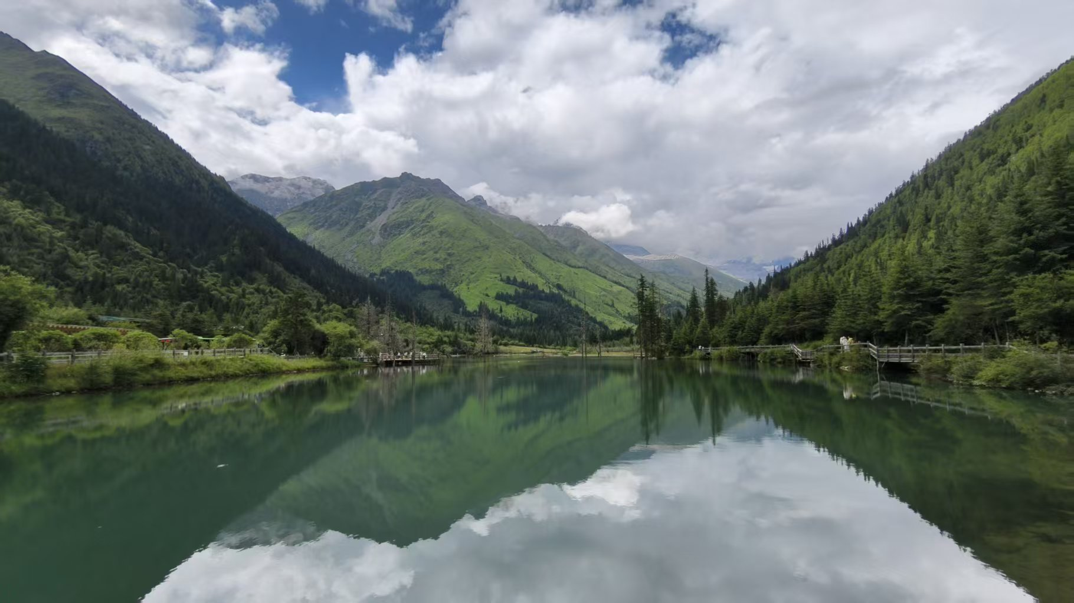






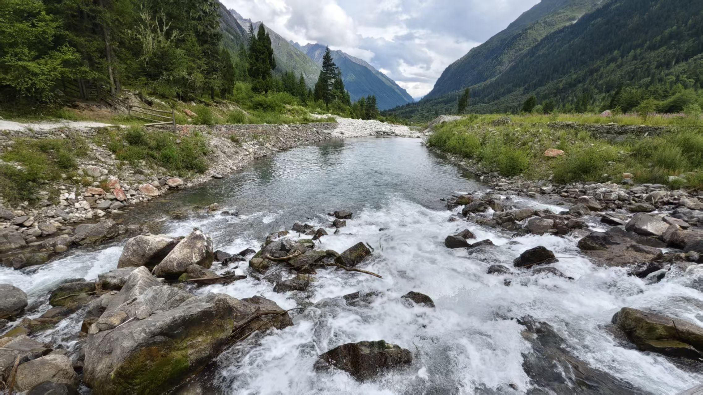









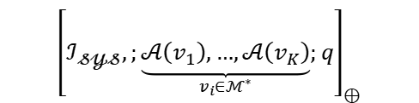



















When were these two photos taken, and what are the differences in the types of trees depicted?
Qwen
Intern
The photos were taken in early autumn, and both pictures show cedar trees.
Training-Free Polarized Latent Graph Memory
Deepseeek
LLaVA
(A1) Visual Pathway
(A2) Textual Pathway
(C) Retrieval &Calibrated Inference
$$𝓂_{ℐ}$$
$$𝓂_{𝒯}$$
$$...$$
$$φ_{ℯ𝓍𝓉}$$
Multi-modal Memory
Coherent Chunks
$$\{k_{𝒿}\}$$
Semantic Entities
$$𝓖_{𝓹𝓸𝓵𝓪𝓻}=\left(𝓥,𝓔,Ω\right)$$
$$E_{𝒿}$$
Optional
Patch
$$ℰ_{𝒶𝓁𝒾ℊ𝓃}=\{\left(k_{𝒿},c\right)∣c∈E_{𝒿}∩\left(𝒞_{𝓅ℴ𝓈}∪𝒞_{𝓃ℯℊ}\right)\}$$
Verification
Retrieval
(B) Polarized Graph Memory
Logic-Aware Retrieval
Sparse Concept Sets
$$𝒢_{𝓅ℴ𝓁𝒶𝓇}=\left(𝒱,ℰ,Ω\right)$$
$$\left|𝒞_{𝓅𝓇ℴ𝓅}\right|$$
$$...$$
$$𝓔_{𝓗𝓐𝓢}$$
$$𝓔_{𝓝𝓞𝓣_𝓗𝓐𝓢}$$
$$𝒞_{1}$$
$$𝒞_{2}$$
$$𝒞_{3}$$
$$𝒞_{𝓃}$$
$$𝓔_{𝓗𝓐𝓢}$$
Textual Nodes
Visual Nodes
Concept Nodes
$$𝓔_{𝓝𝓞𝓣_𝓗𝓐𝓢}$$
Verifiable Memory
Dynamic Uncertainty Margin
Multi-modal Serialization
$${\left[ℐ_{\text{𝓈𝓎𝓈}},;\underset{v_{i}∈ℳ^{∗}}{\underbrace{𝒜\left(v_{1}\right),…,𝒜\left(v_{K}\right)}};q\right]}_{⊕}$$
$$𝓔_{𝓗𝓐𝓢}$$
System
Textual
Visual
Query
$$𝒞_{𝒫ℴ𝓈𝒾𝓉𝒾𝓋ℯ}$$
$$𝒞_{𝒩ℯℊ𝒶𝓉𝒾𝓋ℯ}$$
$$𝒞_{𝒰𝓃𝒸ℯ𝓇𝓉𝒶𝒾𝓃}$$
$$𝓔_{𝓝𝓞𝓣_𝓗𝓐𝓢}$$
$$...$$
$$𝓔_{𝓗𝓐𝓢}$$
$$𝓔_{𝓝𝓞𝓣_𝓗𝓐𝓢}$$
Inference

Slide 3
When were these two photos taken, and what are the differences in the types of trees depicted?
Qwen
Intern
The photos were taken in early autumn, and both pictures show cedar trees.
Training-Free Polarized Latent Graph Memory
Deepseeek
LLaVA
(A1) Visual Pathway
(A2) Textual Pathway
(C) Retrieval &Calibrated Inference
$$𝓂_{ℐ}$$
$$𝓂_{𝒯}$$
$$...$$
$$φ_{ℯ𝓍𝓉}$$
Multi-modal Memory
Coherent Chunks
$$\{k_{𝒿}\}$$
Semantic Entities
$$𝓖_{𝓹𝓸𝓵𝓪𝓻}=\left(𝓥,𝓔,Ω\right)$$
$$E_{𝒿}$$
Optional
Patch
$$ℰ_{𝒶𝓁𝒾ℊ𝓃}=\{\left(k_{𝒿},c\right)∣c∈E_{𝒿}∩\left(𝒞_{𝓅ℴ𝓈}∪𝒞_{𝓃ℯℊ}\right)\}$$
Verification
Retrieval
(B) Polarized Graph Memory
Logic-Aware Retrieval
Sparse Concept Sets
$$𝒢_{𝓅ℴ𝓁𝒶𝓇}=\left(𝒱,ℰ,Ω\right)$$
$$\left|𝒞_{𝓅𝓇ℴ𝓅}\right|$$
$$...$$
$$𝓔_{𝓗𝓐𝓢}$$
$$𝓔_{𝓝𝓞𝓣_𝓗𝓐𝓢}$$
$$𝒞_{1}$$
$$𝒞_{2}$$
$$𝒞_{3}$$
$$𝒞_{𝓃}$$
$$𝓔_{𝓗𝓐𝓢}$$
Textual Nodes
Visual Nodes
Concept Nodes
$$𝓔_{𝓝𝓞𝓣_𝓗𝓐𝓢}$$
Verifiable Memory
Dynamic Uncertainty Margin
Multi-modal Serialization
$${\left[ℐ_{\text{𝓈𝓎𝓈}},;\underset{v_{i}∈ℳ^{∗}}{\underbrace{𝒜\left(v_{1}\right),…,𝒜\left(v_{K}\right)}};q\right]}_{⊕}$$
$$𝓔_{𝓗𝓐𝓢}$$
System
Textual
Visual
Query
$$𝒞_{𝒫ℴ𝓈𝒾𝓉𝒾𝓋ℯ}$$
$$𝒞_{𝒩ℯℊ𝒶𝓉𝒾𝓋ℯ}$$
$$𝒞_{𝒰𝓃𝒸ℯ𝓇𝓉𝒶𝒾𝓃}$$
$$𝓔_{𝓝𝓞𝓣_𝓗𝓐𝓢}$$
$$...$$
$$𝓔_{𝓗𝓐𝓢}$$
$$𝓔_{𝓝𝓞𝓣_𝓗𝓐𝓢}$$
Inference

