Slide 1
Random variable – Common distribution
Fu-Ching Yang

Slide 2
Common distribution in R
Prefix | Continuous | Discrete
d | density | probability (pmf)
p | probability (cdf) | probability (cdf)
q | quantile | quantile
r | random | random
Data type | Distribution | R function
Discrete | Binomial | binom
 | Negative Binomial | nbinom
 | Geometric | geom
 | Poisson | pois
 | Hypergeometric | hyper
Continuous | Uniform | unif
 | Exponential | exp
 | Gamma | gamma
 | Beta | beta
 | Normal | norm
 | Weibull | weibull
 | Cauchy | cauchy
 | Chi-square | chisq
 | t | t
 | F | F

Slide 3
Discrete Random Variable

Slide 4
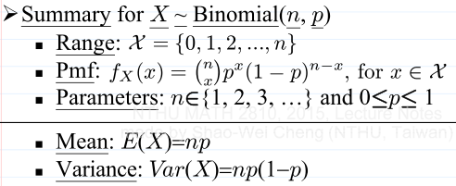

Binomial
Intuition
每次嘗試的成功機率為prob，在size次嘗試中，成功x次的機率
每次嘗試都視為獨立事件
若size==1，則Binomial可稱為Bernoulli
R function
dbinom(x, size, prob, log = FALSE)
pbinom(q, size, prob, lower.tail = TRUE, log.p = FALSE)
qbinom(p, size, prob, lower.tail = TRUE, log.p = FALSE)
rbinom(n, size, prob)

Slide 5
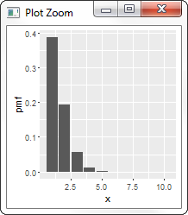
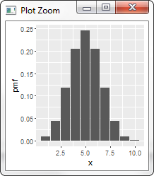
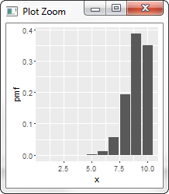
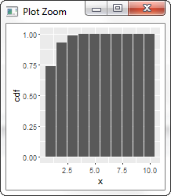
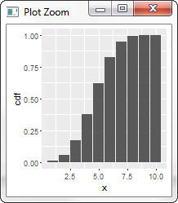
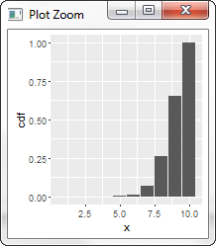
pmf/cdf
x = {1, 2, .., 10}
size = 10
p = 0.1
mean = 1
variance = 0.55
x = {1, 2, .., 10}
size = 10
p = 0.5
mean = 5
variance = 2.48
x = {1, 2, .., 10}
size = 10
p = 0.9
mean = 9
variance = 0.9
機率平均分配給成功和失敗
機率集中在偏低的成功次數
成功1次的機率是38.74%
玩10次，每次成功機率是0.5，成功5次的機率是24.61%

Slide 6
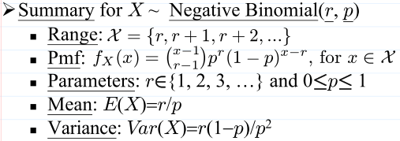

Negative Binomial
Intuition
每次嘗試的成功機率為prob，要成功size次，總共需要嘗試x次的機率值
每次嘗試都視為獨立事件
R的size = 課堂的r
R的x = 課堂的x-r (失敗次數)
若size==1，則Negative Binomial可稱為Geometric
R function
dnbinom(x, size, prob, mu, log = FALSE)
pnbinom(q, size, prob, mu, lower.tail = TRUE, log.p = FALSE)
qnbinom(p, size, prob, mu, lower.tail = TRUE, log.p = FALSE)
rnbinom(n, size, prob, mu)

Slide 7
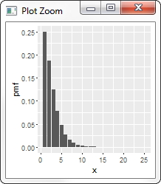
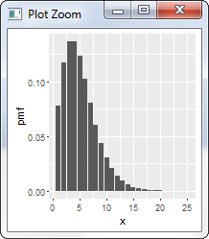
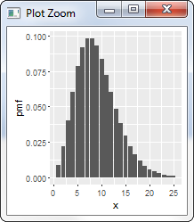
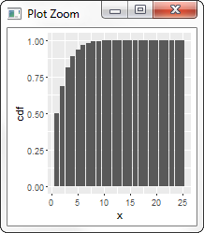
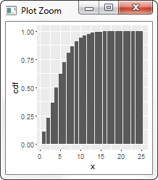
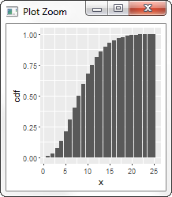
pmf/cdf
x = {1, 2, .., 25}
size = 2
p = 0.5
mean = 2.00
variance = 3.00
x = {1, 2, .., 25}
size = 5
p = 0.5
mean = 5.00
variance = 9.20
x = {1, 2, .., 25}
size = 9
p = 0.5
mean = 8.96
variance = 17.32
只需2次就成功的機率是最高的 (25%)
成功機率0.5，只要求2次成功。預期總共嘗試次數可以壓低
隨著要求成功的次數增加，所需要的總嘗試次數也跟著增加

Slide 8
Geometric
Intuition
每次嘗試的成功機率為prob，成功第1次時，總共需要嘗試x次的機率值
每次嘗試都視為獨立事件
有memoryless特性
Negative Binomial的size為1時的特例
R的x = 課堂的x-1 (失敗次數)
R function
dgeom(x, prob, log = FALSE)
pgeom(q, prob, lower.tail = TRUE, log.p = FALSE)
qgeom(p, prob, lower.tail = TRUE, log.p = FALSE)
rgeom(n, prob)
r = 1

Slide 9
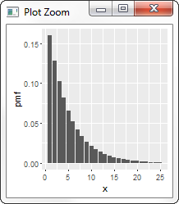
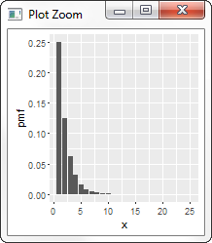
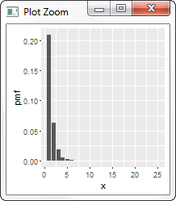
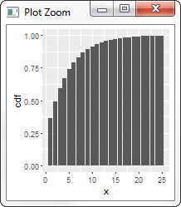
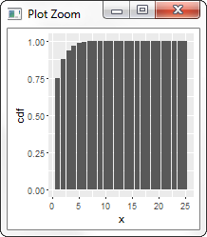
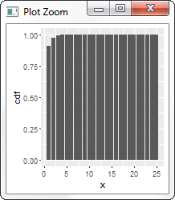
pmf/cdf
x = {1, 2, .., 25}
size = 1
p = 0.2
mean = 3.91
variance = 14.83
x = {1, 2, .., 10}
size = 1
p = 0.5
mean = 1.00
variance = 1.50
x = {1, 2, .., 25}
size = 1
p = 0.7
mean = 0.43
variance = 0.48
因為成功機率偏低(0.2)，所以第一次成功的次數偏多
隨著成功機率提高，第一次成功所需的總次數會減少

Slide 10
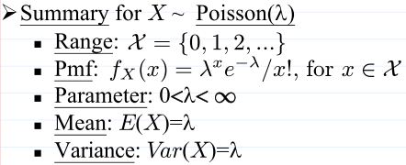
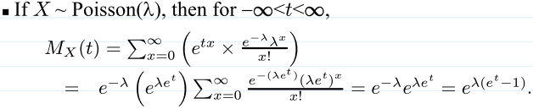
Poisson
Intuition
每次嘗試的成功機率為prob，在size次嘗試中，成功x次的機率
必須條件: size很大, x很小, prob很小
lambda = size x prob
每次嘗試都視為獨立事件
R function
dpois(x, lambda, log = FALSE)
ppois(q, lambda, lower.tail = TRUE, log.p = FALSE)
qpois(p, lambda, lower.tail = TRUE, log.p = FALSE)
rpois(n, lambda)

Slide 11
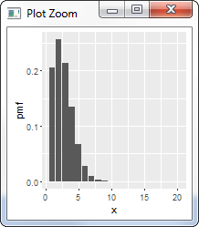
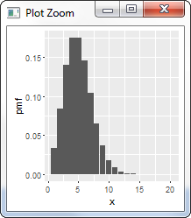
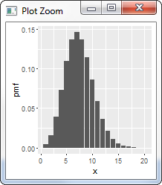
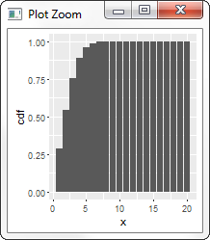
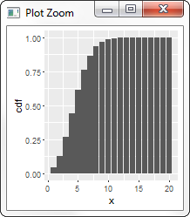
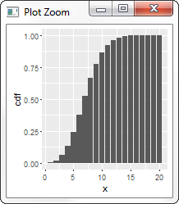
pmf/cdf
x = {1, 2, .., 20}
size = 2500
p = 0.001
mean = 2.50
variance = 1.99
x = {1, 2, .., 20}
size = 2500
p = 0.002
mean = 5.00
variance = 4.83
x = {1, 2, .., 20}
size = 2500
p = 0.003
mean = 7.50
variance = 7.46
LNp5-33 example, 發生5次錯誤以上的機率是0.108822
隨著成功率提升，成功次數也提升

Slide 12
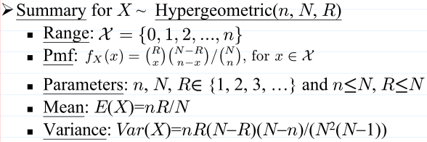
Hypergeometric
Intuition
盒子中共有m個白球、n個黑球，從盒子中要抽k球，其中x個白球的機率
抽球後不放回
每次嘗試的成功機率不是獨立事件
若抽球有放回，則是Binomial
運用在工業上，用來了解產品瑕疵率
m: 壞掉的產品
n: 好的產品
k: 抽驗產品數
R function
dhyper(x, m, n, k, log = FALSE)
phyper(q, m, n, k, lower.tail = TRUE, log.p = FALSE)
qhyper(p, m, n, k, lower.tail = TRUE, log.p = FALSE)
rhyper(nn, m, n, k)

Slide 13
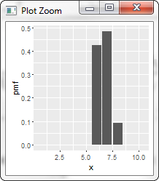
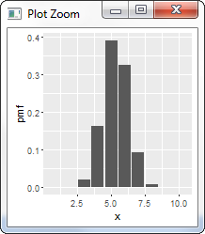
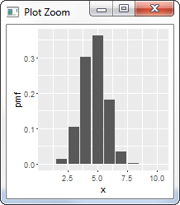
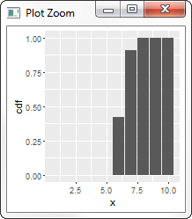
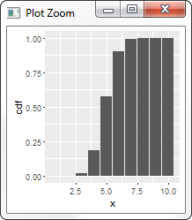
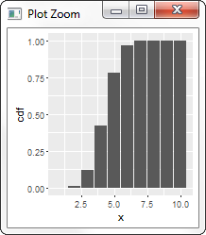
pmf/cdf
x = {1, 2, .., 10}
m = 10
n = 2
k = 8
mean = 6.67
variance = 0.40
x = {1, 2, .., 10}
m = 10
n = 5
k = 8
mean = 5.33
variance = 0.89
x = {1, 2, .., 10}
m = 10
n = 7
k = 8
mean = 4.71
variance = 1.09
增加黑球的數量時，抽到白球的機率會下降

Slide 14
CONTINUOUS Random Variable

Slide 15
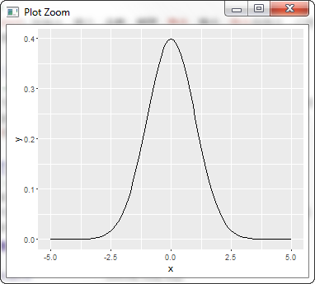
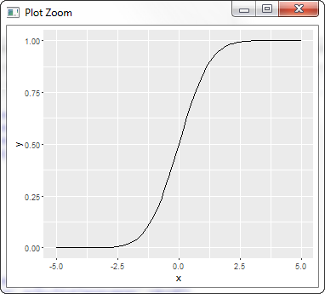
pdf and cdf
0.9938
0.0175
積分
微分
0.9938

Slide 16
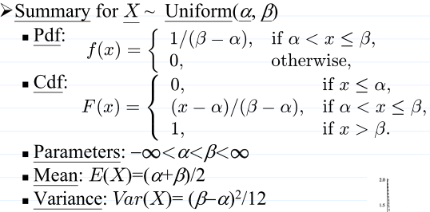

Uniform
Intuition
介於min到max之間的值的機率是一樣的
對應Lecture note
α: min
β: max
R function
dunif(x, min = 0, max = 1, log = FALSE)
punif(q, min = 0, max = 1, lower.tail = TRUE, log.p = FALSE)
qunif(p, min = 0, max = 1, lower.tail = TRUE, log.p = FALSE)
runif(n, min = 0, max = 1)

Slide 17
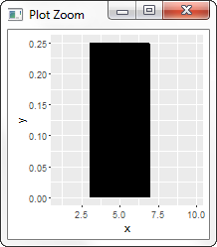
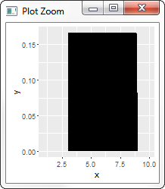
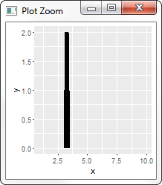
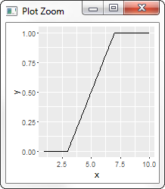
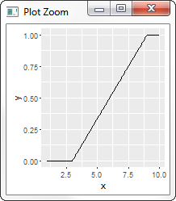
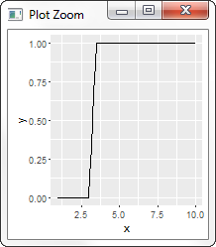
pdf/cdf
x = {1, 2, .., 10}
min = 3
max = 7
mean = 5
variance = 1.33
x = {1, 2, .., 10}
min = 3
max = 9
mean = 6
variance = 3
x = {1, 2, .., 10}
min = 3
max = 3.5
mean = 3.25
variance = 0.02
R的integrate算這個有困難。
{TBD}
pdf的值不是機率；積分面積才是機率
e.g., pdf的值>1
總面積必為1;
總機率值為1
0.17
高
低
(7.5-5.0) x 0.17
=0.43
窄
積分
寬
微分
0.75
pdf的高度是cdf的斜率
機率
=cdf的高度差 =pdf的面積
0.42
0.33

Slide 18
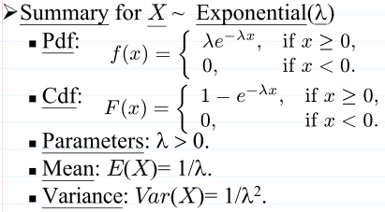
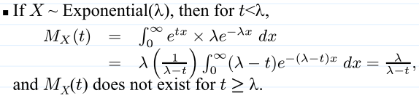
Exponential
Intuition
單位時間內成功次數為rate，成功第1次時，總共需要多少時間的機率值
有memoryless特性
rate: 事件發生次數/單位時間
對應Lecture note
λ: rate
R function
dexp(x, rate = 1, log = FALSE)
pexp(q, rate = 1, lower.tail = TRUE, log.p = FALSE)
qexp(p, rate = 1, lower.tail = TRUE, log.p = FALSE)
rexp(n, rate = 1)

Slide 19
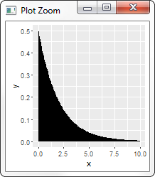
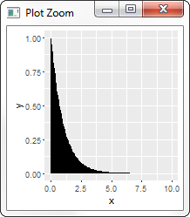
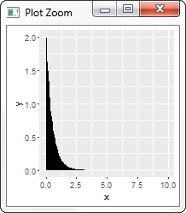
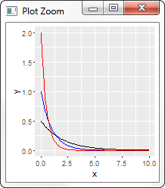



pdf/cdf
x = {1, 2, .., 10}
rate=0.5
mean = 2
variance = 4
x = {1, 2, .., 10}
rate=1
mean = 1
variance = 1
x = {1, 2, .., 10}
rate=2
mean = 0.5
variance = 0.25
rate=2
rate=1
rate=0.5
因為底下總面積都是1，所以當rate變小時，x比較會有大值
隨著事件發生機率變小，等待時間會變長

Slide 20


Gamma
Intuition
單位時間內成功次數為rate，要成功第shape次，總共需要多少時間的機率值
若shape==1，則Gamma為Exponential
對應Lecture note
α: shape: 第幾次事件發生
λ: scale: 單位時間發生次數
當α=n/2， λ=1/2，Gamma稱為Chi-squared distribution with n degree of freedom
n是正整數
R function
dgamma(x, shape, rate = 1, scale = 1/rate, log = FALSE)
pgamma(q, shape, rate = 1, scale = 1/rate, lower.tail = TRUE, log.p = FALSE)
qgamma(p, shape, rate = 1, scale = 1/rate, lower.tail = TRUE, log.p = FALSE)
rgamma(n, shape, rate = 1, scale = 1/rate)

Slide 21




pdf/cdf
x = {0, 1, 2, .., 25}
shape = 1
rate = 1
mean = 1
variance = 1
x = {0, 1, 2, .., 10}
shape = 1/2/4
rate = 1
mean = 1/2/4
variance = 1/2/4
x = {0, 1, 2, .., 25}
shape = 2
rate = 2/1/0.5
mean = 1/2/4
variance = 0.5/2/8
shape=1
rate=2
rate=1
shape=2
shape=4
rate=0.5
shape都不一樣
因為shape指的是第幾次成功，而因為該成功會包含前幾次成功的機率分佈，所以形狀會因為shape不同而改變。
shape都一樣，但scale不同
可以觀察到跟exponential有同樣現象：當rate較小的時候，因為事件較不容易發生，所以發生時間會拉長
shape: 成功第幾次
scale: 單位時間內成功次數

Slide 22
Stochastic Process (隨機過程)
N(t)
S_{k} ~ Gamma(k, λp) = 第k次事件出現時，總共要多久
e.g., 第4次事件發生時，要S₄時間
S₁
S₄
相鄰兩個事件之間，間隔多少時間 T_{k}~exponential(λ)
T₁
T₂
T₃
T₄
事件發生次數:
N(t_{i}) - N(t_{i-1})
=Poisson(λ(t_{i}-t_{i-1}))
Continuous time
0
t_{i-1}
t_{i}
t
Poisson: t_{i-1}~t_{i}之間事件發生多少次
negative binomial(r, p) = 第k次事件出現時，總共要做多少次
e.g., 第4次事件發生時，要做k₁+k₂+k₃+k₄次 (geometric的值相加)
geometric(p) = 相鄰2個事件之間，間隔幾次ki
Discrete time
1
2
k₁
1
2
k₂
1
k₃
1
2
k₄
0
binomial =
事件發生次數
0
+
0
+
+
+
+
+
+
+
+
+
+
1
0
0
1
0
1
1
0
0
t/n
2t/n
3t/n
(n-1)t/n
t = nt/n

Slide 23


Beta
Intuition
計算等待α次的時間和等待β次的時間，之間的比例關係機率值
一定介於0~1
由Beta數學式而來
對應Lecture note
α: shape1
β: shape2
R function
dbeta(x, shape1, shape2, ncp = 0, log = FALSE)
pbeta(q, shape1, shape2, ncp = 0, lower.tail = TRUE, log.p = FALSE)
qbeta(p, shape1, shape2, ncp = 0, lower.tail = TRUE, log.p = FALSE)
rbeta(n, shape1, shape2, ncp = 0)

Slide 24





pdf/cdf
x = {0, 1}
shape1 = 10
shape2 = 10
mean = 0.5
variance = 0.011
x = {0, 1}
shape1 = shape2 = 10/3/1
mean = 0.5/0.5/0.5
variance = 0.011/0.036/0.083
x = {0, 1}
shape1 = 6/0.67
shape2 = 114/12.67
mean = 0.05/0.05
variance = 0.00039/0.00331
x = {0, 1}
shape1 = 114/12.67
shape2 = 6/0.67
mean = 0.95/0.95
variance = 0.00039/0.00331
當shape增加時pdf會往中央集中。因總面積為1，variance會變小
shape1/2=10
shape1=6
shape2=6*19
shape1=6*19
shape2=6
shape1/2=3
shape1/2=1
shape1=2/3
shape2=2/3*19
shape1=2/3*19
shape2=2/3
一定限制在0~1之間
當shape1和shape2一樣時，pdf會呈現symmetry
若shape1和shape2都為1，則會成為uniform(0, 1)
維持相同重心=α/(α+β)=1/20
但讓β 大於α
Skewed
pdf會左偏；傾向於0
維持相同重心=α/(α+β)=1/20
但讓α 大於β
Skewed
pdf會右偏；傾向於1

Slide 25

Normal (Gaussian)
Intuition
?
對應Lecture note
μ: mean
σ²: sd
Standard normal distribution’s cdf is denoted as Φ
LNp.6-35 says table lookup to find the value
One can use pnorm(x, 0, 1) to get the value
R function
dnorm(x, mean = 0, sd = 1, log = FALSE)
pnorm(q, mean = 0, sd = 1, lower.tail = TRUE, log.p = FALSE)
qnorm(p, mean = 0, sd = 1, lower.tail = TRUE, log.p = FALSE)
rnorm(n, mean = 0, sd = 1)

Slide 26





pdf/cdf
x = {-6, -5, -4, .., 6}
mean = 0
sd = 0.5
mean = 0
variance = 0.25
x = {-6, -5, -4, .., 6}
mean=0
sd = 0.5/1/5
mean = 0/0/0
variance = 0.25/1/25
x = {-5, -4, -3, .., 5}
mean=0
sd = 1
mean = 0
variance = 1
Bell-shaped
一定對稱
sd=0.5
mean=5
sd=0.5
mean=5
sd=0.5
Y=X+3
sd=1
mean=5
sd=0.5
Y=2X
sd=5
mean=5
sd=0.5
Y=2X+3
最大值一定在重心
sd是fall-off rate
sd值越小，掉下越快，分散越小 (比較尖)
Standard normal distribution
mean = 0
sd = 1

Slide 27


Weibull
Intuition
建構在exponential(1)的基礎上，做平移、scale、指數的transformation
是對比於exponential，無memoryless特性
exponential: 單位時間內成功次數為rate，成功第1次時，總共需要多少時間的機率值
0 < β < 1: 早期失效出現在產品壽命的初期
β = 1: 失敗率保持不變，隨機失效
β = 1.5: 早期磨損失效
β = 2: 磨損失效的風險在產品壽命內穩步上升
3 < β < 4: 快速磨損失效。當大多數的失效都出現後，對產品壽命的最後時間段建模
β > 10: 非常快速的磨損失效。當大多數的失效都出現後，對產品壽命的最後時間段建模
對應Lecture note
α: scale: 時間尺度不同
β: shape
ν: location，平移。(在R function中沒用到)
R function
dweibull(x, shape, scale = 1, log = FALSE)
pweibull(q, shape, scale = 1, lower.tail = TRUE, log.p = FALSE)
qweibull(p, shape, scale = 1, lower.tail = TRUE, log.p = FALSE)
rweibull(n, shape, scale = 1)
因為λX是exponential(1)，所以Weibull其實是對exponential(1)做平移(ν)，scale(α)，和指數運算(β)

Slide 28





pdf/cdf
x = {0, 1, 2, 3, 4, 5}
shape=2
scale=0.5
mean = 0.443
variance = 0.054
x = {0, 1, 2, 3, 4, 5}
shape=2/2/3/4
scale=0.5/1.0/1.5/3.0
mean = 0.443/0.886/1.339/2.719
variance = 0.054/0.215/0.237/0.582
x = {0, 1, 2, 3, 4, 5}
shape=2/3/4/5
scale=3.0
mean = 2.659/2.679/2.719/2.755
variance = 1.931/0.948/0.581/0.398
x = {0, 1, 2, 3, 4, 5}
shape=2
scale=0.5/1.0/1.5/2.0
mean = 0.443/0.886/1.329/1.772
variance = 0.054/0.215/0.483/0.858
shape=2
scale=0.5
shape=5
scale=3.0
shape=2
scale=0.5
shape=4
scale=3.0
shape=2
scale=1.0
shape=2
scale=1.0
shape=3
scale=1.5
shape=3
scale=3.0
shape=2
scale=1.5
shape=4
scale=3.5
shape=2
scale=3.0
shape=2
scale=2.0
從0開始
shape(β)相同，scale(α)不同
shape(β)不同，scale(α)相同

Slide 29

Cauchy
Intuition
與Normal distribution一樣有location和scale，但是有長尾特性
財富分布
mean和variance不存在
對應Lecture note
μ: location: 中心
σ: scale: 分散
R function
dcauchy(x, location = 0, scale = 1, log = FALSE)
pcauchy(q, location = 0, scale = 1, lower.tail = TRUE, log.p = FALSE)
qcauchy(p, location = 0, scale = 1, lower.tail = TRUE, log.p = FALSE)
rcauchy(n, location = 0, scale = 1)

Slide 30



pdf/cdf
x = {-15, -14, -13, .., 15}
location = 5
scale = 0.5
mean = N/A
variance = N/A
x = {-15, -14, -13, .., 15}
location=0
scale = 1
mean = N/A
variance = N/A
Standard Normal distribution
mean=0
sd=1
Cauchy
location=0
scale=1
Cauchy相較於Normal，其有長尾特性
適用於model黑天鵝效應: 某一事件極少發生
有人超有錢的財富分配
假日車流量
不適用於描述身高，因為不會有人身高超高(2000m)

Slide 31

Chi-square
Intuition
是n個i.i.d. standard normal distribution(N(0,1))做平方的相加
若把n個N(0, 1)視為n維的vector，而因為N(0,1)的可能值是-∞~+ ∞，所以Chi-square其實是在描述點可以在n維空間移動的自由度
是Gamma(n/2, 1/2)特例
α=n/2: 第n/2次事件發生
λ=1/2: 單位時間發生1/2次數
對應Lecture note
n: df: degree of freedom
R function
dchisq(x, df, ncp = 0, log = FALSE)
pchisq(q, df, ncp = 0, lower.tail = TRUE, log.p = FALSE)
qchisq(p, df, ncp = 0, lower.tail = TRUE, log.p = FALSE)
rchisq(n, df, ncp = 0)

Slide 32



pdf/cdf
x = {-5, -4, -3, .., 25}
df = 5
mean = 5
variance = 10
x = {0, 1, 2, .., 25}
df=1/2/5/10
mean = 1/2/5/10
variance = 2/4/10/20
n=1
n=2
n=5
n=10
n越大，distribution越往大的延伸 (等待時間越久)

Slide 33


t
Intuition
是N(0,1)除以chi-square平均的開根號
跟N(0,1)很像，但有heavier tail，較N(0, 1)比較有極值可能性
是Cauchy(0, 1)特例，就是T1
location: 0
scale: 1
Tn當n很大時，會變成N(0, 1)
對應Lecture note
n: df: degree of freedom
R function
dt(x, df, ncp, log = FALSE)
pt(q, df, ncp, lower.tail = TRUE, log.p = FALSE)
qt(p, df, ncp, lower.tail = TRUE, log.p = FALSE)
rt(n, df, ncp)

Slide 34



pdf/cdf
x = {-5, -4, -3, .., 5}
df = 5
mean = 0
variance = 1.67
x = {0, 1, 2, .., 25}
df=5/10/30
mean = 0/0/0
variance = 1.67/1.25/1.07
N(0, 1)
n=30
n=10
n=5
是對稱的
當degree of freedom小時，在尾巴的機率比較大。
比起N(0, 1)，較容易吐出極端值
Degree of freedom越小, sd越大 => 資訊越少，Standard error越大
n=5
n=10
n=30
N(0, 1)
degree of freedom越大，越往N(0, 1)靠近

Slide 35


f
Intuition
Chi-square的平均相除的感覺
F(1, n)是Tn平方
對應Lecture note
m: df1: degree of freedom
n: df2: degree of freedom
R function
df(x, df1, df2, ncp, log = FALSE)
pf(q, df1, df2, ncp, lower.tail = TRUE, log.p = FALSE)
qf(p, df1, df2, ncp, lower.tail = TRUE, log.p = FALSE)
rf(n, df1, df2, ncp)

Slide 36




pdf/cdf
x = {0, 1, 2, .., 10}
df1 = 5
df2 = 5
mean = 1.67
variance = 8.89
x = {0, 1, 2, .., 10}
df1=10
df2=1/2/3/4/…/10
mean = {TBD}
variance = {TBD}
x = {0, 1, 2, .., 10}
df1=1/2/3/4/…/10
df2=10
mean = {TBD}
variance = {TBD}
df2=10
df1=10
df2=1
df1=1

Slide 37
Overview
Discrete
Continuous
Hypergeometric
Uniform
抽球不放回，抽第幾球的機率
α和β兩值間機率均勻分布
抽球放回，抽第幾球的機率
抽球放回，抽第幾球的時間
Binomial
Poisson
Normal
隨
機
過
程
自然界常出現，鐘型
事件第一次發生，共需試幾次的機率
事件第k次發生，共需試幾次的機率
事件第一次發生，共需時間的機率
事件第k次發生，共需時間的機率
與Normal對應，有長尾
Geometric
Negative Binomial
Exponential
Gamma
Cauchy
memoryless
From Gamma function
without memoryless
From Beta function
Weibull
Beta

Slide 38


Slide 39
Jointly Distributed Random Variable

Slide 40




Joint distribution
LNp.7-3 example
joint cdf
joint pmf

Slide 41




Joint PDF
exponential
x = {0, 1, 2, .., 10}
rate=0.5
exponential
y = {0, 1, 2, .., 10}
rate=0.5
Assume X and Y are independent

Slide 42





Joint CDF
CDF介於0~1
所有維度都趨進於無限大時，CDF為1 (機率為1)
exponential
x = {0, 1, 2, .., 10}
rate=0.5
exponential
y = {0, 1, 2, .., 10}
rate=0.5
點高度=機率值
任一個維度趨進於負無限大時，CDF為0 (機率為0)
Assume X and Y are independent

Slide 43


Convolution
The probability distribution of the sum of two or more independent random variables is the convolution of their individual distributions

