Slide 1
Random variable – Common distribution
Fu-Ching Yang

Slide 2
Common distribution in R
Prefix | Continuous | Discrete
d | density | probability (pmf)
p | probability (cdf) | probability (cdf)
q | quantile | quantile
r | random | random
Data type | Distribution | R function
Discrete | Binomial | binom
 | Negative Binomial | nbinom
 | Geometric | geom
 | Poisson | pois
 | Hypergeometric | hyper
Continuous | Uniform | unif
 | Exponential | exp
 | Gamma | gamma
 | Beta | beta
 | Normal | norm
 | Weibull | weibull
 | Cauchy | cauchy
 | Chi-square | chisq
 | t | t
 | F | F

Slide 3
Discrete Random Variable

Slide 4
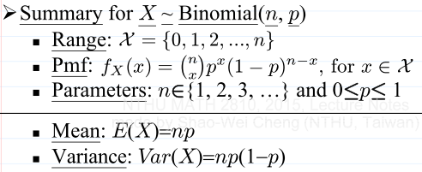
Binomial
Intuition
每次嘗試的成功機率為prob，在size次嘗試中，成功x次的機率
每次嘗試都視為獨立事件
若size==1，則Binomial可稱為Bernoulli
R function
dbinom(x, size, prob, log = FALSE)
pbinom(q, size, prob, lower.tail = TRUE, log.p = FALSE)
qbinom(p, size, prob, lower.tail = TRUE, log.p = FALSE)
rbinom(n, size, prob)

Slide 5
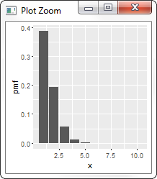
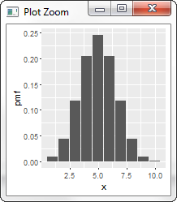
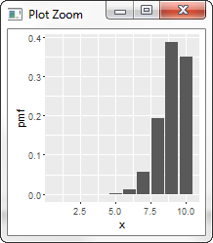
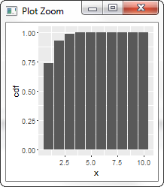
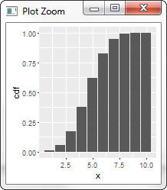
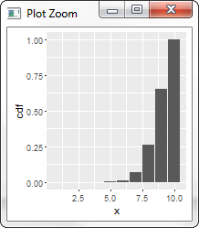
pmf/cdf
x = {1, 2, .., 10}
size = 10
p = 0.1
mean = 1
variance = 0.55
x = {1, 2, .., 10}
size = 10
p = 0.5
mean = 5
variance = 2.48
x = {1, 2, .., 10}
size = 10
p = 0.9
mean = 9
variance = 0.9
機率平均分配給成功和失敗
機率集中在偏低的成功次數
成功1次的機率是38.74%
玩10次，每次成功機率是0.5，成功5次的機率是24.61%

Slide 6
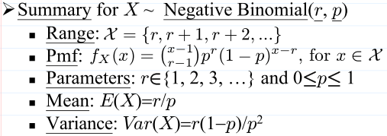
Negative Binomial
Intuition
每次嘗試的成功機率為prob，要成功r次，總共需要嘗試x次的機率值
每次嘗試都視為獨立事件
R的size = 課堂的r
R的x = 課堂的x-r (失敗次數)
若size==1，則Negative Binomial可稱為Geometric
R function
dnbinom(x, size, prob, mu, log = FALSE)
pnbinom(q, size, prob, mu, lower.tail = TRUE, log.p = FALSE)
qnbinom(p, size, prob, mu, lower.tail = TRUE, log.p = FALSE)
rnbinom(n, size, prob, mu)

Slide 7
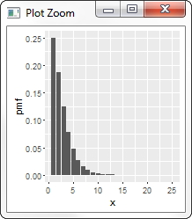
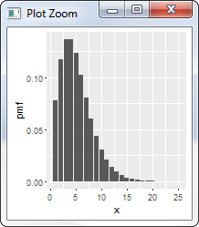
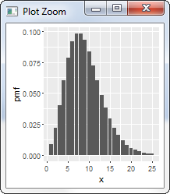
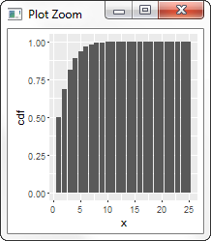
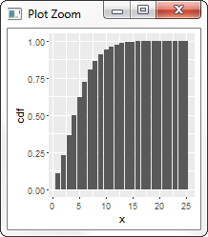
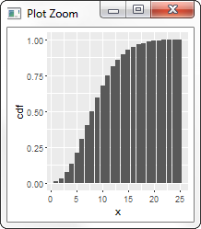
pmf/cdf
x = {1, 2, .., 25}
size = 2
p = 0.5
mean = 2.00
variance = 3.00
x = {1, 2, .., 10}
size = 5
p = 0.5
mean = 5.00
variance = 9.20
x = {1, 2, .., 25}
size = 9
p = 0.5
mean = 8.96
variance = 17.32
只需2次就成功的機率是最高的 (25%)
成功機率0.5，只要求2次成功。預期總共嘗試次數可以壓低
隨著要求成功的次數增加，所需要的總嘗試次數也跟著增加

Slide 8
Geometric
Intuition
每次嘗試的成功機率為prob，成功第1次時，總共需要嘗試x次的機率值
每次嘗試都視為獨立事件
有memoryless特性
Negative Binomial的size為1時的特例
R的x = 課堂的x-1 (失敗次數)
R function
dgeom(x, prob, log = FALSE)
pgeom(q, prob, lower.tail = TRUE, log.p = FALSE)
qgeom(p, prob, lower.tail = TRUE, log.p = FALSE)
rgeom(n, prob)
r = 1

Slide 9
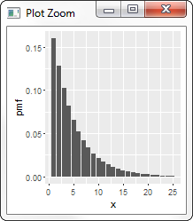
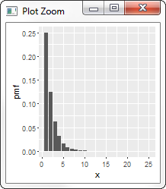
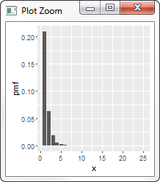
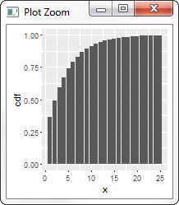
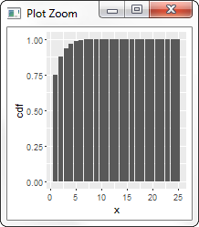
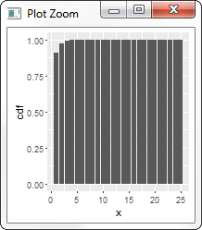
pmf/cdf
x = {1, 2, .., 25}
size = 1
p = 0.2
mean = 3.91
variance = 14.83
x = {1, 2, .., 10}
size = 1
p = 0.5
mean = 1.00
variance = 1.50
x = {1, 2, .., 25}
size = 1
p = 0.7
mean = 0.43
variance = 0.48
因為成功機率偏低(0.2)，所以第一次成功的次數偏多
隨著成功機率提高，第一次成功所需的總次數會減少

Slide 10
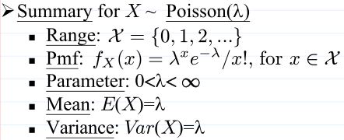
Poisson
Intuition
每次嘗試的成功機率為prob，在size次嘗試中，成功x次的機率
必須條件: size很大, x很小, prob很小
lambda = size x prob
每次嘗試都視為獨立事件
R function
dpois(x, lambda, log = FALSE)
ppois(q, lambda, lower.tail = TRUE, log.p = FALSE)
qpois(p, lambda, lower.tail = TRUE, log.p = FALSE)
rpois(n, lambda)

Slide 11
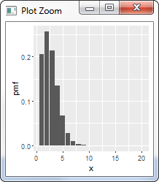
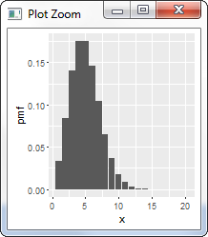
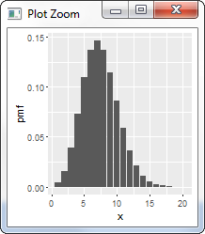
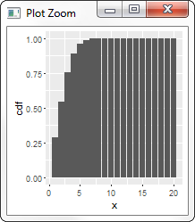
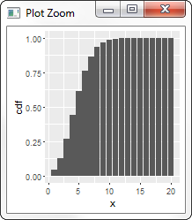
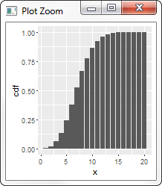
pmf/cdf
x = {1, 2, .., 20}
size = 2500
p = 0.001
mean = 2.50
variance = 1.99
x = {1, 2, .., 20}
size = 2500
p = 0.002
mean = 5.00
variance = 4.83
x = {1, 2, .., 20}
size = 2500
p = 0.003
mean = 7.50
variance = 7.46
LNp5-33 example, 發生5次錯誤以上的機率是0.108822
隨著成功率提升，成功次數也提升

Slide 12
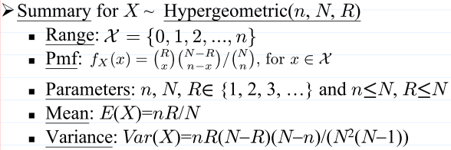
Hypergeometric
Intuition
盒子中共有m個白球、n個黑球，從盒子中要抽k球，其中x個白球的機率
抽球後不放回
每次嘗試的成功機率不是獨立事件
若抽球有放回，則是Binomial
R function
dhyper(x, m, n, k, log = FALSE)
phyper(q, m, n, k, lower.tail = TRUE, log.p = FALSE)
qhyper(p, m, n, k, lower.tail = TRUE, log.p = FALSE)
rhyper(nn, m, n, k)

Slide 13
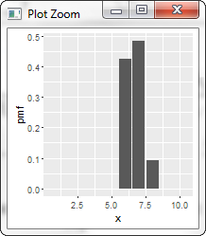
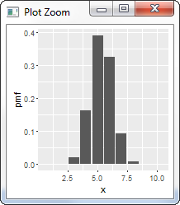
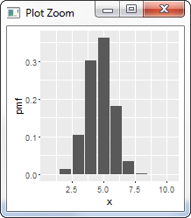
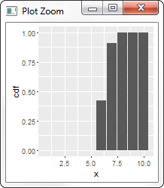
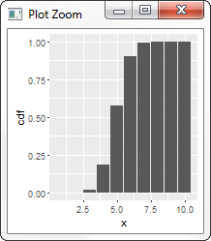
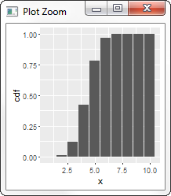
pmf/cdf
x = {1, 2, .., 10}
m = 10
n = 2
k = 8
mean = 6.67
variance = 0.40
x = {1, 2, .., 10}
m = 10
n = 5
k = 8
mean = 5.33
variance = 0.89
x = {1, 2, .., 10}
m = 10
n = 7
k = 8
mean = 4.71
variance = 1.09
增加黑球的數量時，抽到白球的機率會下降

Slide 14
CONTINUOUS Random Variable

Slide 15
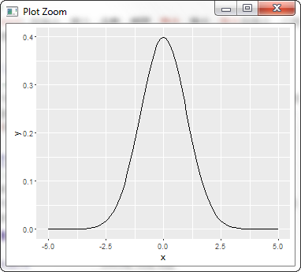
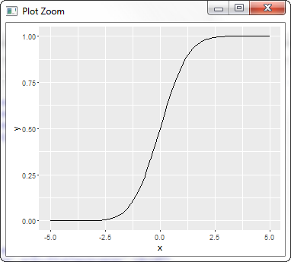
pdf and cdf
0.9938
0.0175
積分
微分
0.9938

Slide 16
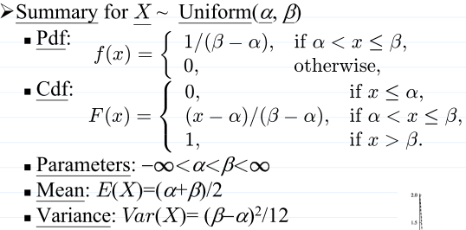
Uniform
Intuition
介於min到max之間的值的機率是一樣的
對應Lecture note
α: min
β: max
R function
dunif(x, min = 0, max = 1, log = FALSE)
punif(q, min = 0, max = 1, lower.tail = TRUE, log.p = FALSE)
qunif(p, min = 0, max = 1, lower.tail = TRUE, log.p = FALSE)
runif(n, min = 0, max = 1)

Slide 17
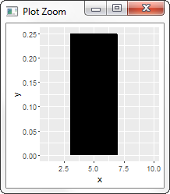
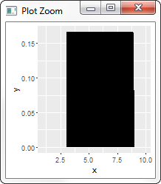
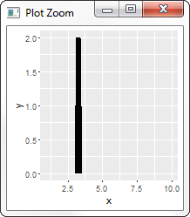
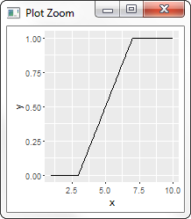
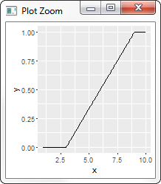
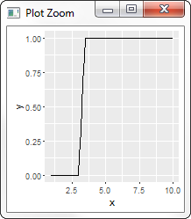
pdf/cdf
x = {1, 2, .., 10}
min = 3
max = 7
mean = 5
variance = 1.33
x = {1, 2, .., 10}
min = 3
max = 9
mean = 6
variance = 3
x = {1, 2, .., 10}
min = 3
max = 3.5
mean = 3.25
variance = 0.02
R的integrate算這個有困難。
{TBD}
pdf的值不是機率；積分面積才是機率
e.g., pdf的值>1
總面積必為1;
總機率值為1
0.17
高
低
(7.5-5.0) x 0.17
=0.43
窄
積分
寬
微分
0.75
pdf的高度是cdf的斜率
機率
=cdf的高度差 =pdf的面積
0.42
0.33

Slide 18
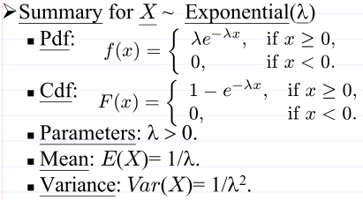
Exponential
Intuition
單位時間內成功次數為rate，成功第1次時，總共需要多少時間的機率值
有memoryless特性
rate: 事件發生次數/單位時間
對應Lecture note
λ: rate
R function
dexp(x, rate = 1, log = FALSE)
pexp(q, rate = 1, lower.tail = TRUE, log.p = FALSE)
qexp(p, rate = 1, lower.tail = TRUE, log.p = FALSE)
rexp(n, rate = 1)

Slide 19
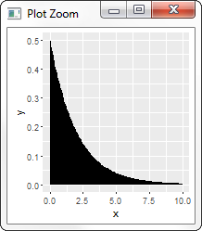
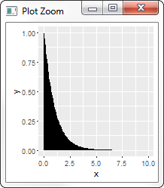
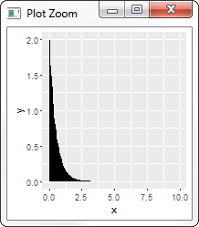
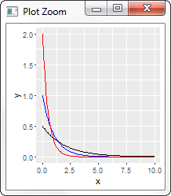
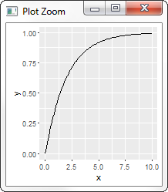
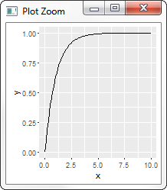

pdf/cdf
x = {1, 2, .., 10}
rate=0.5
mean = 2
variance = 4
x = {1, 2, .., 10}
rate=1
mean = 1
variance = 1
x = {1, 2, .., 10}
rate=2
mean = 0.5
variance = 0.25
rate=2
rate=1
rate=0.5
因為底下總面積都是1，所以當rate變小時，x比較會有大值
隨著事件發生機率變小，等待時間會變長

Slide 20

Gamma
Intuition
單位時間內成功次數為rate，要成功第shape次，總共需要多少時間的機率值
若shape==1，則Gamma為Exponential
對應Lecture note
α: shape: 第幾次事件發生
λ: scale: 單位時間發生次數
當α=n/2， λ=1/2，Gamma稱為Chi-squared distribution with n degree of freedom
n是正整數
R function
dgamma(x, shape, rate = 1, scale = 1/rate, log = FALSE)
pgamma(q, shape, rate = 1, scale = 1/rate, lower.tail = TRUE, log.p = FALSE)
qgamma(p, shape, rate = 1, scale = 1/rate, lower.tail = TRUE, log.p = FALSE)
rgamma(n, shape, rate = 1, scale = 1/rate)

Slide 21




pdf/cdf
x = {0, 1, 2, .., 25}
shape = 1
rate = 1
mean = 1
variance = 1
x = {0, 1, 2, .., 10}
shape = 1/2/4
rate = 1
mean = 1/2/4
variance = 1/2/4
x = {0, 1, 2, .., 25}
shape = 2
rate = 2/1/0.5
mean = 1/2/4
variance = 0.5/2/8
shape=1
rate=2
rate=1
shape=2
shape=4
rate=0.5
shape都不一樣
因為shape指的是第幾次成功，而因為該成功會包含前幾次成功的機率分佈，所以形狀會因為shape不同而改變。
shape都一樣，但scale不同
可以觀察到跟exponential有同樣現象：當rate較小的時候，因為事件較不容易發生，所以發生時間會拉長
shape: 成功第幾次
scale: 單位時間內成功次數

Slide 22
Stochastic Process (隨機過程)
N(t)
S_{k} ~ Gamma(k, λp) = 第k次事件出現時，總共要多久
e.g., 第4次事件發生時，要S₄時間
S₁
S₄
相鄰兩個事件之間，間隔多少時間 T_{k}~exponential(λ)
T₁
T₂
T₃
T₄
事件發生次數:
N(t_{i}) - N(t_{i-1})
=Poisson(λ(t_{i}-t_{i-1}))
Continuous time
0
t_{i-1}
t_{i}
t
Poisson: t_{i-1}~t_{i}之間事件發生多少次
negative binomial(r, p) = 第k次事件出現時，總共要做多少次
e.g., 第4次事件發生時，要做k₁+k₂+k₃+k₄次 (geometric的值相加)
geometric(p) = 相鄰2個事件之間，間隔幾次ki
Discrete time
1
2
k₁
1
2
k₂
1
k₃
1
2
k₄
0
binomial =
事件發生次數
0
+
0
+
+
+
+
+
+
+
+
+
+
1
0
0
1
0
1
1
0
0
t/n
2t/n
3t/n
(n-1)t/n
t = nt/n

Slide 23


Beta
Intuition
由數學式而來
對應Lecture note
α: shape1
β: shape2
R function
dbeta(x, shape1, shape2, ncp = 0, log = FALSE)
pbeta(q, shape1, shape2, ncp = 0, lower.tail = TRUE, log.p = FALSE)
qbeta(p, shape1, shape2, ncp = 0, lower.tail = TRUE, log.p = FALSE)
rbeta(n, shape1, shape2, ncp = 0)

Slide 24





pdf/cdf
x = {0, 1}
shape1 = 10
shape2 = 10
mean = 0.5
variance = 0.011
x = {0, 1}
shape1 = shape2 = 10/3/1
mean = 0.5/0.5/0.5
variance = 0.011/0.036/0.083
x = {0, 1}
shape1 = 6/0.67
shape2 = 114/12.67
mean = 0.05/0.05
variance = 0.00039/0.00331
x = {0, 1}
shape1 = 114/12.67
shape2 = 6/0.67
mean = 0.95/0.95
variance = 0.00039/0.00331
當shape增加時pdf會往中央集中。因總面積為1，variance會變小
shape1/2=10
shape1=6
shape2=6*19
shape1=6*19
shape2=6
shape1/2=3
shape1/2=1
shape1=2/3
shape2=2/3*19
shape1=2/3*19
shape2=2/3
一定限制在0~1之間
當shape1和shape2一樣時，pdf會呈現symmetry
若shape1和shape2都為1，則會成為uniform(0, 1)
維持相同重心=α/(α+β)=1/20
但讓β 大於α
Skewed
pdf會左偏；傾向於0
維持相同重心=α/(α+β)=1/20
但讓α 大於β
Skewed
pdf會右偏；傾向於1

Slide 25

Normal (Gaussian)
Intuition
?
對應Lecture note
μ: mean
σ²: sd
Standard normal distribution’s cdf is denoted as Φ
LNp.6-35 says table lookup to find the value
One can use pnorm(x, 0, 1) to get the value
R function
dnorm(x, mean = 0, sd = 1, log = FALSE)
pnorm(q, mean = 0, sd = 1, lower.tail = TRUE, log.p = FALSE)
qnorm(p, mean = 0, sd = 1, lower.tail = TRUE, log.p = FALSE)
rnorm(n, mean = 0, sd = 1)

Slide 26





pdf/cdf
x = {-6, -5, -4, .., 6}
mean = 0
sd = 0.5
mean = 0
variance = 0.25
x = {-6, -5, -4, .., 6}
mean=0
sd = 0.5/1/5
mean = 0/0/0
variance = 0.25/1/25
x = {-5, -4, -3, .., 5}
mean=0
sd = 1
mean = 0
variance = 1
Bell-shaped
一定對稱
sd=0.5
mean=5
sd=0.5
mean=5
sd=0.5
Y=X+3
sd=1
mean=5
sd=0.5
Y=2X
sd=5
mean=5
sd=0.5
Y=2X+3
最大值一定在重心
sd是fall-off rate
sd值越小，掉下越快，分散越小 (比較尖)
Standard normal distribution
mean = 0
sd = 1

Slide 27


Weibull
Intuition
建構在exponential(1)的基礎上，做平移、scale、指數的transformation
是對比於exponential，無memoryless特性
exponential: 單位時間內成功次數為rate，成功第1次時，總共需要多少時間的機率值
0 < β < 1: 早期失效出現在產品壽命的初期
β = 1: 失敗率保持不變，隨機失效
β = 1.5: 早期磨損失效
β = 2: 磨損失效的風險在產品壽命內穩步上升
3 < β < 4: 快速磨損失效。當大多數的失效都出現後，對產品壽命的最後時間段建模
β > 10: 非常快速的磨損失效。當大多數的失效都出現後，對產品壽命的最後時間段建模
對應Lecture note
α: scale: 時間尺度不同
β: shape
ν: location，平移。(在R function中沒用到)
R function
dweibull(x, shape, scale = 1, log = FALSE)
pweibull(q, shape, scale = 1, lower.tail = TRUE, log.p = FALSE)
qweibull(p, shape, scale = 1, lower.tail = TRUE, log.p = FALSE)
rweibull(n, shape, scale = 1)
因為λX是exponential(1)，所以Weibull其實是對exponential(1)做平移(ν)，scale(α)，和指數運算(β)

Slide 28





pdf/cdf
x = {0, 1, 2, 3, 4, 5}
shape=2
scale=0.5
mean = 0.443
variance = 0.054
x = {0, 1, 2, 3, 4, 5}
shape=2/2/3/4
scale=0.5/1.0/1.5/3.0
mean = 0.443/0.886/1.339/2.719
variance = 0.054/0.215/0.237/0.582
x = {0, 1, 2, 3, 4, 5}
shape=2/3/4/5
scale=3.0
mean = 2.659/2.679/2.719/2.755
variance = 1.931/0.948/0.581/0.398
x = {0, 1, 2, 3, 4, 5}
shape=2
scale=0.5/1.0/1.5/2.0
mean = 0.443/0.886/1.329/1.772
variance = 0.054/0.215/0.483/0.858
shape=2
scale=0.5
shape=5
scale=3.0
shape=2
scale=0.5
shape=4
scale=3.0
shape=2
scale=1.0
shape=2
scale=1.0
shape=3
scale=1.5
shape=3
scale=3.0
shape=2
scale=1.5
shape=4
scale=3.5
shape=2
scale=3.0
shape=2
scale=2.0
從0開始
shape(β)相同，scale(α)不同
shape(β)不同，scale(α)相同

Slide 29

Cauchy
Intuition
與Normal distribution一樣有location和scale，但是有長尾特性
財富分布
mean和variance不存在
對應Lecture note
μ: location: 中心
σ: scale: 分散
R function
dcauchy(x, location = 0, scale = 1, log = FALSE)
pcauchy(q, location = 0, scale = 1, lower.tail = TRUE, log.p = FALSE)
qcauchy(p, location = 0, scale = 1, lower.tail = TRUE, log.p = FALSE)
rcauchy(n, location = 0, scale = 1)

Slide 30



pdf/cdf
x = {-15, -14, -13, .., 15}
location = 5
scale = 0.5
mean = N/A
variance = N/A
x = {-15, -14, -13, .., 15}
location=0
scale = 1
mean = N/A
variance = N/A
Standard Normal distribution
mean=0
sd=1
Cauchy
location=0
scale=1
Cauchy相較於Normal，其有長尾特性
適用於model黑天鵝效應: 某一事件極少發生
有人超有錢的財富分配
假日車流量
不適用於描述身高，因為不會有人身高超高(2000m)

Slide 31
Overview
Discrete
Continuous
Hypergeometric
Uniform
抽球不放回，抽第幾球的機率
α和β兩值間機率均勻分布
抽球放回，抽第幾球的機率
抽球放回，抽第幾球的時間
Binomial
Poisson
Normal
隨
機
過
程
自然界常出現，鐘型
事件第一次發生，共需試幾次的機率
事件第k次發生，共需試幾次的機率
事件第一次發生，共需時間的機率
事件第k次發生，共需時間的機率
與Normal對應，有長尾
Geometric
Negative Binomial
Exponential
Gamma
Cauchy
memoryless
From Gamma function
without memoryless
From Beta function
Weibull
Beta

Slide 32
Todo
比較discrete和continuous的pmf/pdf圖
機率如果可以，要等價
溫習
Normal approximation to the Binomial (LNp.6-36)
Continuity correction

Slide 33




Joint distribution
LNp.7-3 example
joint cdf
joint pmf

Slide 34




Joint PDF
exponential
x = {0, 1, 2, .., 10}
rate=0.5
exponential
y = {0, 1, 2, .., 10}
rate=0.5
Assume X and Y are independent

Slide 35





Joint CDF
CDF介於0~1
所有維度都趨進於無限大時，CDF為1 (機率為1)
exponential
x = {0, 1, 2, .., 10}
rate=0.5
exponential
y = {0, 1, 2, .., 10}
rate=0.5
點高度=機率值
任一個維度趨進於負無限大時，CDF為0 (機率為0)
Assume X and Y are independent

