Slide 1
Wood-Concrete Sandwich Beam
StructOpt Project WS12/13

Slide 2
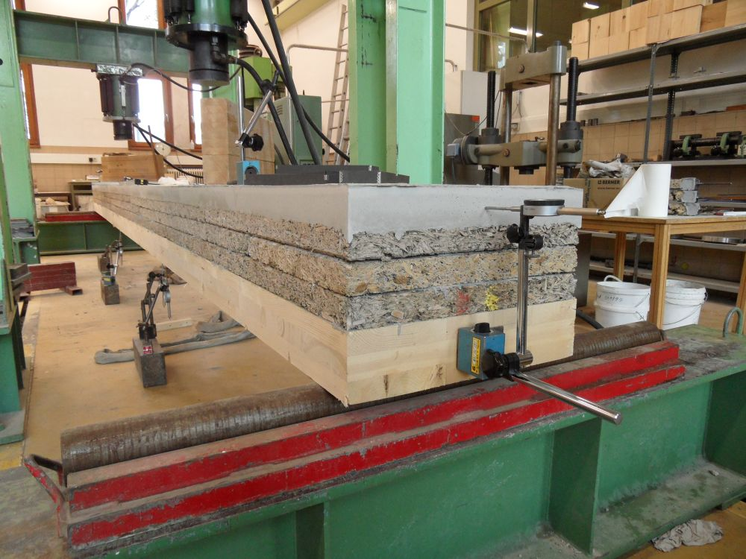
The Beam
Layers
1: Concrete (SCC)
2: Wood-Concrete (Velox)
3: Wood (CLT)

Slide 3
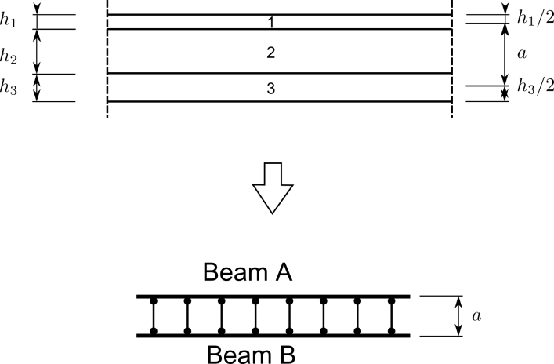
The Analogy
Layers
1: Concrete (SCC)
2: Wood-Concrete (Velox)
3: Wood (CLT)

Slide 4

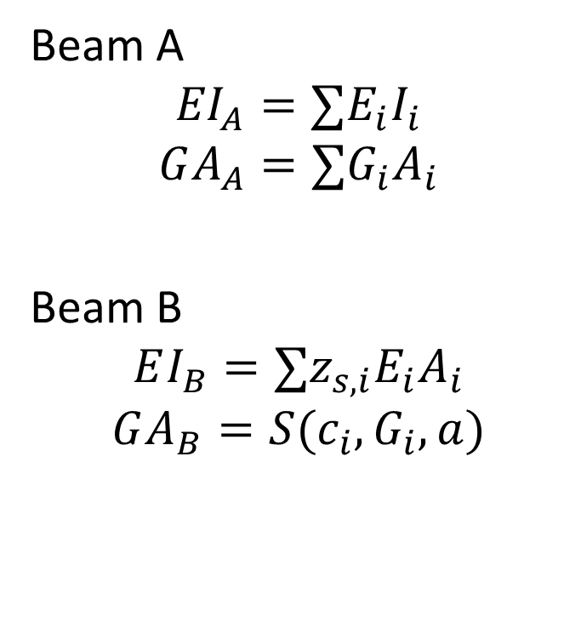



The Analogy
Beam A
$${EI}_{A}=∑{E_{i}I}_{i}$$
$$GA_{A}=∑G_{i}A_{i}$$
Beam B
$$EI_{B}=∑z_{s,i}E_{i}A_{i}$$
$$GA_{B}=S(c_{i},G_{i},a)$$
$${h_{1};E}_{1},G_{1}$$
$${h_{2};E}_{2},G_{2}(ρ_{2})$$
$${h_{3};E}_{3},G_{3}$$

Slide 5
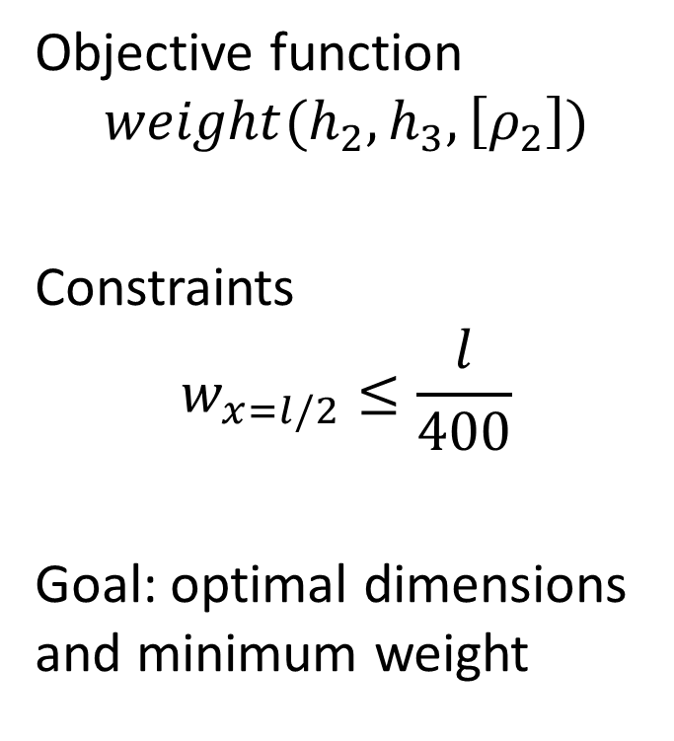



The Analogy
Objective function
$$weight(h_{2}, h_{3}, \left[ρ_{2}\right])$$
Constraints
$$w_{x=l/2}≤\frac{l}{400}$$
Goal: optimal dimensions and minimum weight
$${h_{1};E}_{1},G_{1}$$
$${h_{2};E}_{2},G_{2}(ρ_{2})$$
$${h_{3};E}_{3},G_{3}$$

