Slide 1
Wood-Concrete Sandwich Beam
Structural Optimization
Project „VelOpt“
WS12/13
Fuchs Michael, Kazemi Mehrad, Lampert Ralf

Slide 2
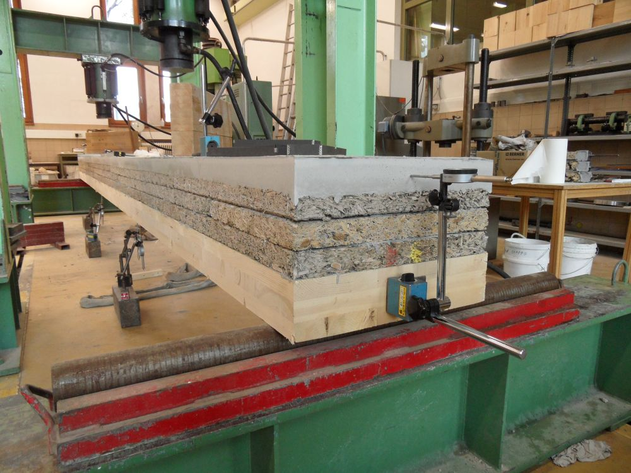
The Beam
Layers
1: Concrete (SCC)
2: Wood-Concrete (Velox)
3: Wood (CLT)

Slide 3
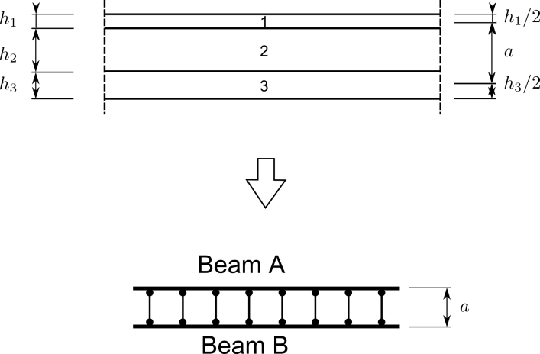
The Analogy
Materials and Layers:
1: Concrete (SCC)
2: Wood-Concrete (Velox)
3: Wood (CLT)
Calculation:
Deflection and stresses of the beam are calculated with a finite element method.

Slide 4

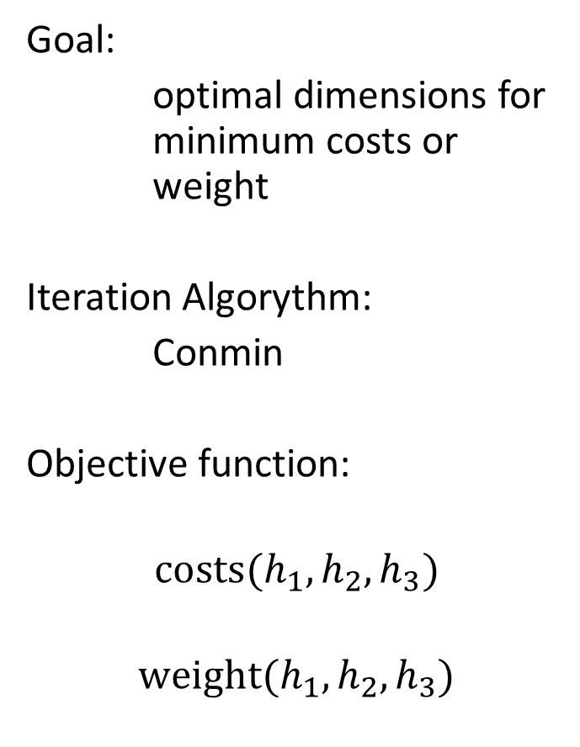
The Optimization Algorythm:
Goal:
optimal dimensions for minimum costs or weight
Iteration Algorythm:
Conmin
Objective function:
$$costs({h_{1},h}_{2}, h_{3})$$
$$weight({h_{1},h}_{2}, h_{3})$$
6 Constraints:
$$h_{1,2,3}≥3 cm$$
$$u_{max}≤\frac{l}{400}$$
$${\text{σ}}_{c}≤f_{c,d}$$
$${\text{σ}}_{w}≤f_{m,d}$$

Slide 5
The Solution:
Experienced data:
Optimizing for costs, Velox thickness goes to minimum and concrete goes to a maximum
If optimized for costs Velox has to be cheaper than 80€/m³ to be considered at all
Optimizing for weight, thickness of wood goes to maximum and all others to minimum
Conclusion:
Velox has a bad ratio of material properties to its price
To improve the results this ratio has to improve too

