Slide 1
Microprocessors
Exercise 4
Jonas Sticha, Thorsten Fuchs, Florian Reichhold

Slide 2
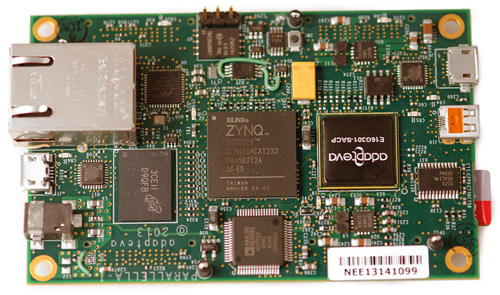
Hardware
Parallella with xilinx zynq 7020
Armv7

Slide 3
Approaches
C
Lookup Table
Neon

Slide 4
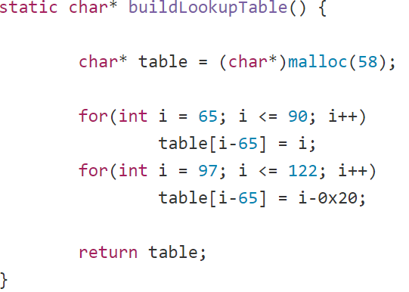
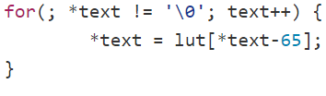
Lookup Table
Constant
Correction of the Characters
Dynamic

Slide 5
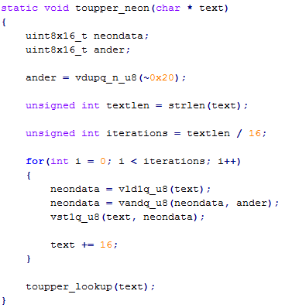
Neon

Slide 6
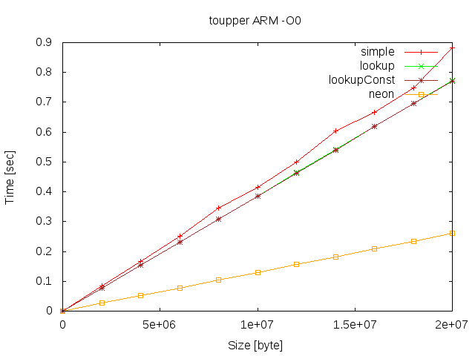
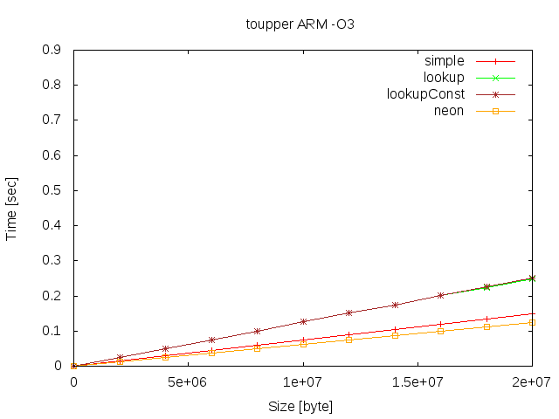
Comparison Graphs
No Optimisation (-O0)
-O3

Slide 7
Speedup Comparison
-o0 | 2 mio | 10 mio | 20 mio
simple | 0.084252 | 0.416362 | 0.881698
lookup | 0.077285 | 0.386410 | 0.773060
Neon | 0.026469 | 0.130149 | 0.259948
speedup (simple/neon) | ~ 3x | ~ 3x | ~ 3x
-o3 | 2mio | 10mio | 20mio
simple | 0.014930 | 0.074668 | 0.148655
lookup | 0.025215 | 0.125688 | 0.249551
Neon | 0.012073 | 0.061231 | 0.123108
speedup (simple/neon) | ~ 1x | ~ 1x | ~ 1x

Slide 8
Speedup Comparison
-o0 | 2 mio | 10 mio | 20 mio
simple | 0.084252 | 0.416362 | 0.881698
lookup | 0.077285 | 0.386410 | 0.773060
Neon | 0.026469 | 0.130149 | 0.259948
speedup (simple/neon) | ~ 3x | ~ 3x | ~ 3x
-o3 | 2mio | 10mio | 20mio
simple | 0.014930 | 0.074668 | 0.148655
lookup | 0.025215 | 0.125688 | 0.249551
Neon | 0.012073 | 0.061231 | 0.123108
speedup (simple/neon) | ~ 1x | ~ 1x | ~ 1x
-o0 | 2 mio | 10 mio | 20 mio
simple | 0.012293 | 0.061624 | 0.123405
asm | 0.007894 | 0.039501 | 0.079033
lookupConst | 0.004766 | 0.023870 | 0.047762
mmx | 0.003004 | 0.015570 | 0.031069
sse | 0.001071 | 0.005786 | 0.011582
avx | 0.000598 | 0.003400 | 0.006728
speedup (simple/avx) | ~ 20x | ~ 18x | ~ 18x
Speedup –o0 20 mio
Neon/avx: ~38x

Slide 9
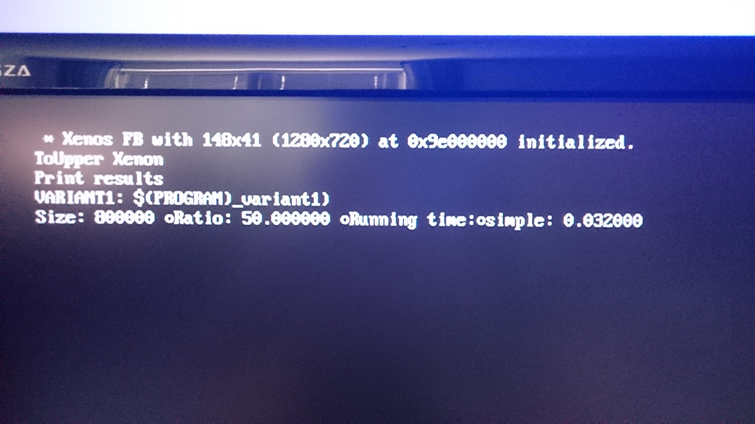
Xbox experiment

