Slide 1
Microprocessors
Exercise 2
Jonas Sticha, Thorsten Fuchs, Florian Reichhold

Slide 2
Topics
Cacheline
Cachesize

Slide 3
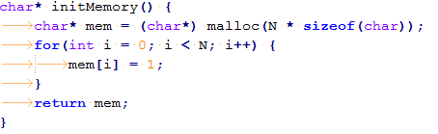
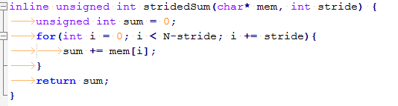
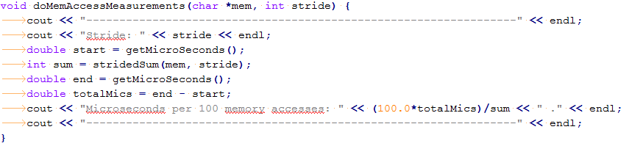
Cachline - Code

Slide 4
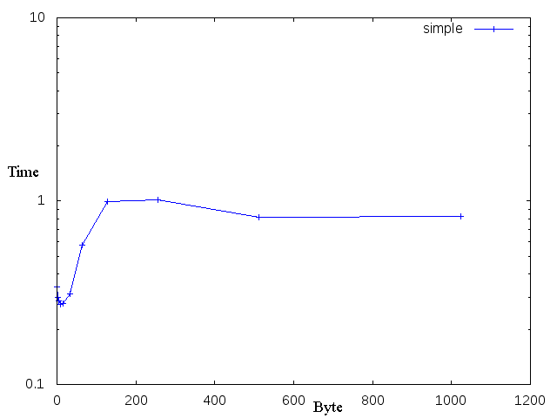
Cacheline - Plot
I7 SandyBridge
Time in microseconds per 100 accesses
Result: 64 byte

Slide 5

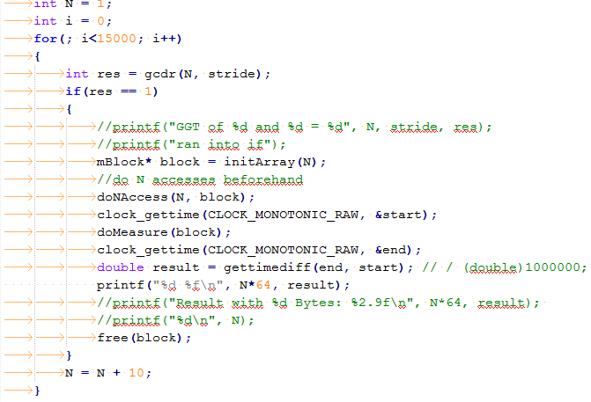
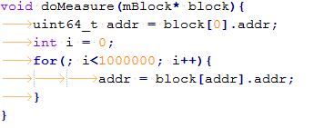
Cachesize - Code

Slide 6
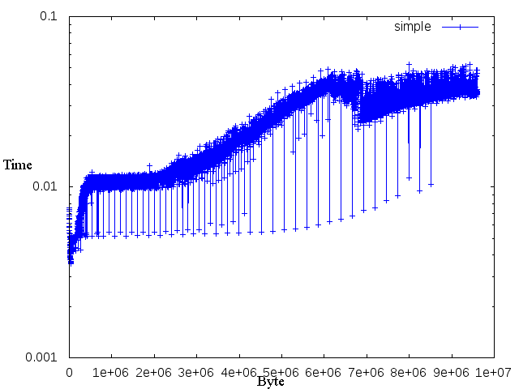
Cachesize - Plot
I7 SandyBridge
Time in seconds per 1 mio accesses
Results:
L1: 64kB (per core)
L2: 256kB (per core)
L3: 6144kb (unified)

Slide 7
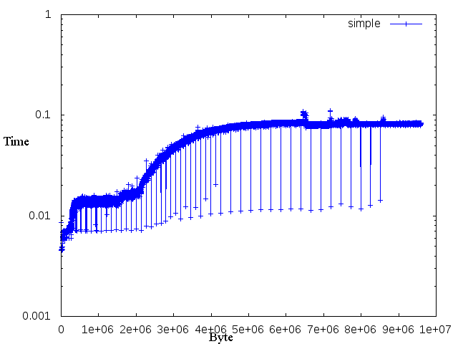
Cachesize - Plot
I5 SandyBridge
Time in seconds per 1 mio accesses
Results:
L1: 64kB (per core)
L2: 256kB (unified)
L3: 6144kb (unified)

