Slide 1
Microprocessors
Exercise 1
Jonas Sticha, Thorsten Fuchs, Florian Reichhold

Slide 2
Approaches
C
Lookup Table
ASM
Intrinsics

Slide 3
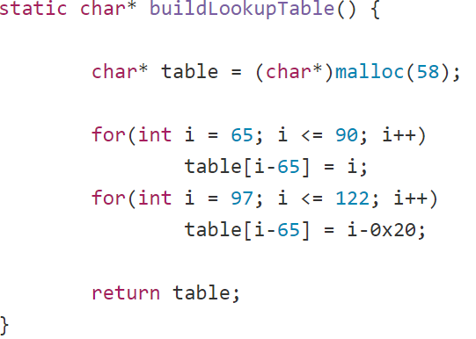
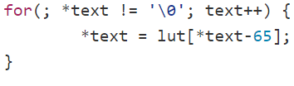
Lookup Table
Constant
Correction of the Characters
Dynamic

Slide 4
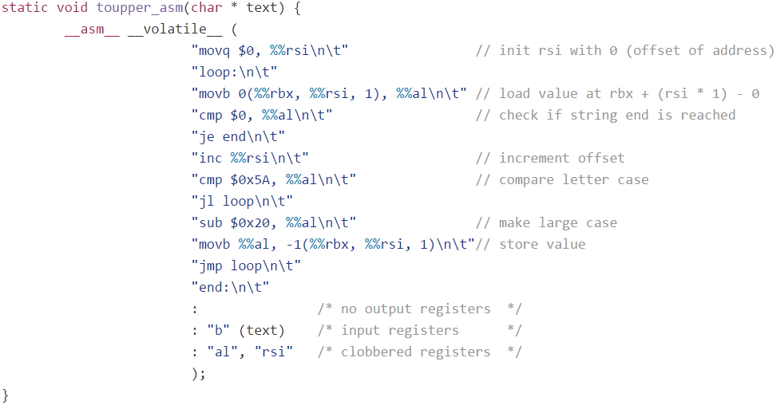
ASM

Slide 5
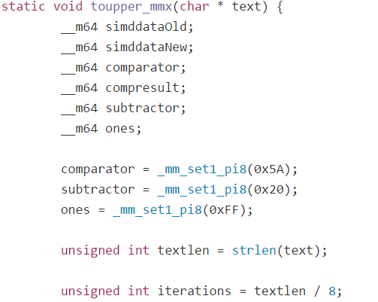
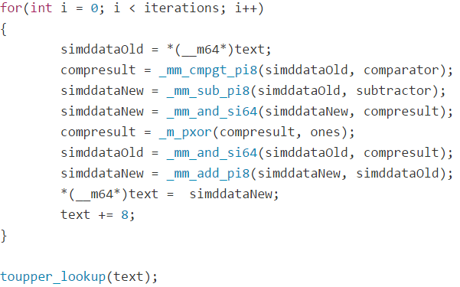
Intrinsics - MMX

Slide 6
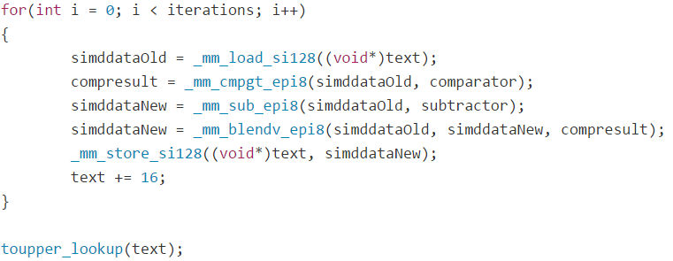
Intrinsics - SSE

Slide 7
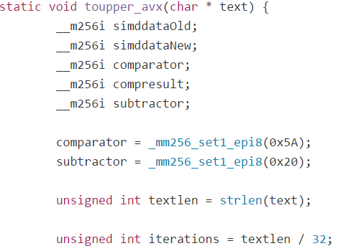
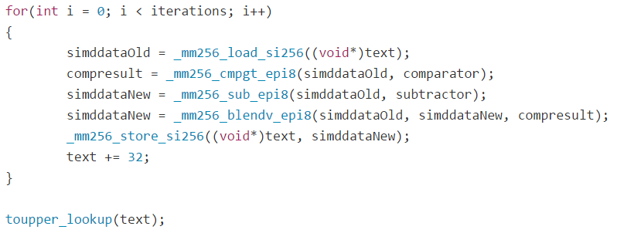
Intrinsics - AVX2

Slide 8
Comparison Graphs

