Slide 1
Microprocessors
Exercise 1
Jonas Sticha, Thorsten Fuchs, Florian Reichhold

Slide 2
Approaches
C
Lookup Table
ASM
Intrinsics

Slide 3
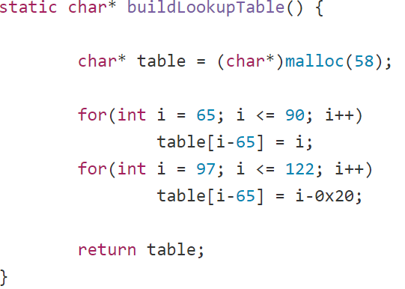
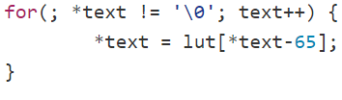
Lookup Table
Constant
Correction of the Characters
Dynamic

Slide 4
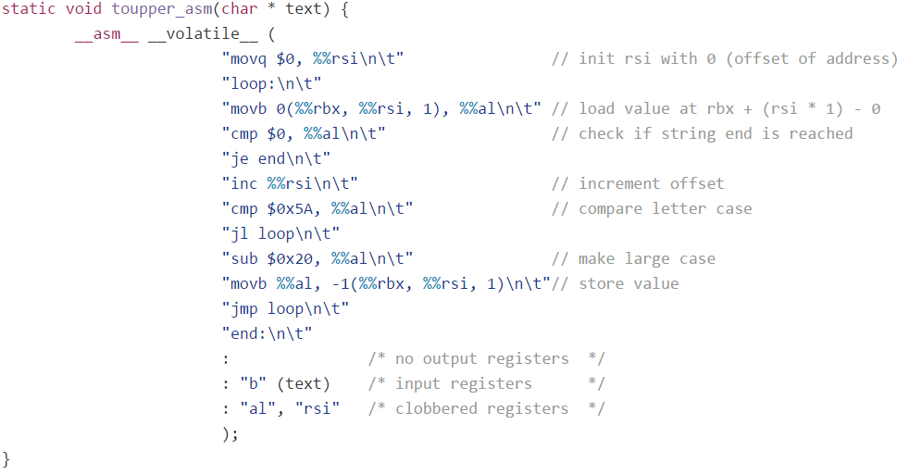
ASM

Slide 5
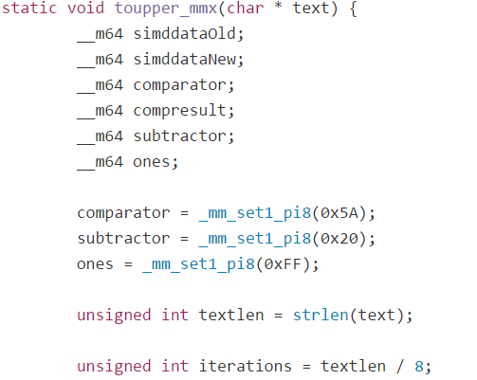
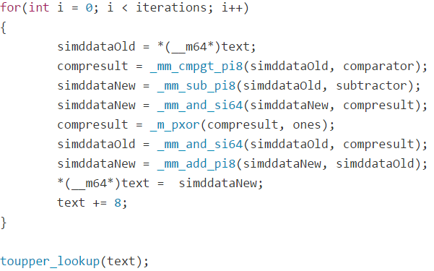
Intrinsics - MMX

Slide 6
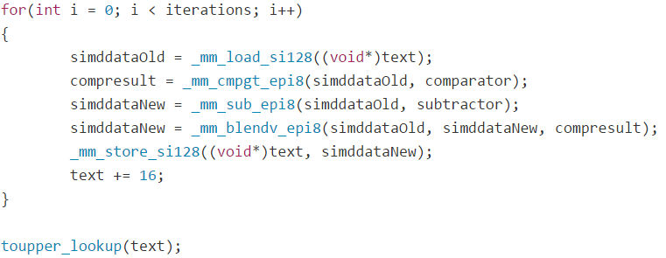
Intrinsics - SSE

Slide 7
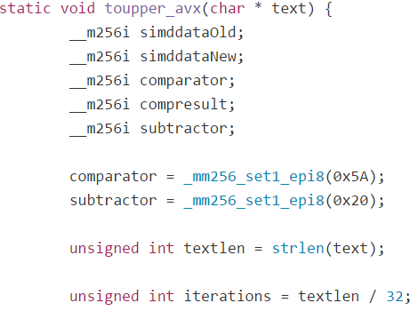
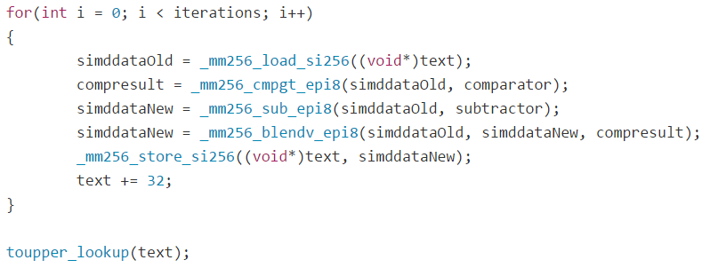
Intrinsics - AVX2

Slide 8
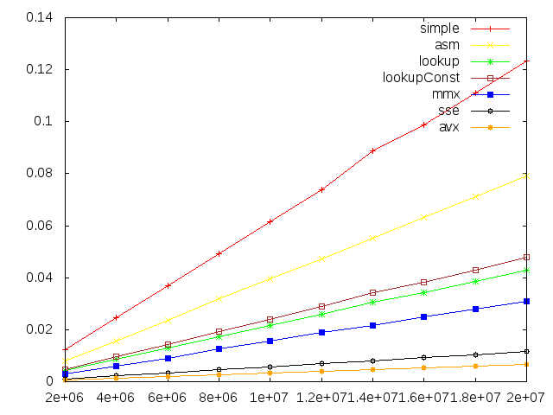
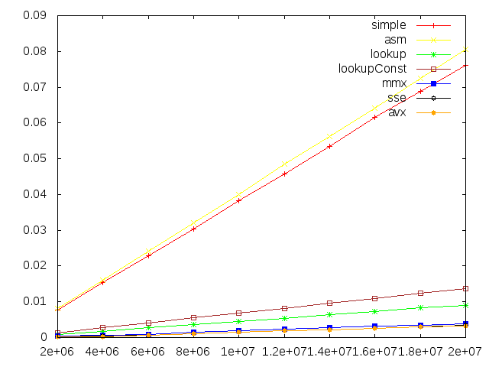
Comparison Graphs
No Optimisation (-O0)
-O3

Slide 9
Speedup Comparison
-o0 | 2 mio | 10 mio | 20 mio
simple | 0.012293 | 0.061624 | 0.123405
asm | 0.007894 | 0.039501 | 0.079033
lookupConst | 0.004766 | 0.023870 | 0.047762
mmx | 0.003004 | 0.015570 | 0.031069
sse | 0.001071 | 0.005786 | 0.011582
avx | 0.000598 | 0.003400 | 0.006728
speedup (simple/avx) | ~ 20x | ~ 18x | ~ 18x
-o3 | 2mio | 10mio | 20mio
simple | 0.007703 | 0.038173 | 0.076197
asm | 0.008024 | 0.040065 | 0.080496
lookupConst | 0.001360 | 0.006793 | 0.013692
mmx | 0.000380 | 0.001887 | 0.003872
sse | 0.000292 | 0.001580 | 0.003373
avx | 0.000142 | 0.001590 | 0.003293
speedup (simple/avx) | ~ 54x | ~ 24x | ~ 23x

