Slide 1
Microprocessors
Exercise 2
Jonas Sticha, Thorsten Fuchs, Florian Reichhold

Slide 2
Topics
Cacheline
Cachesize

Slide 3
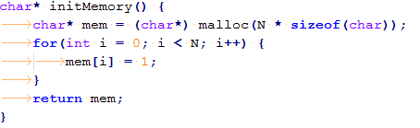
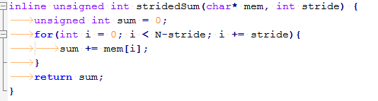
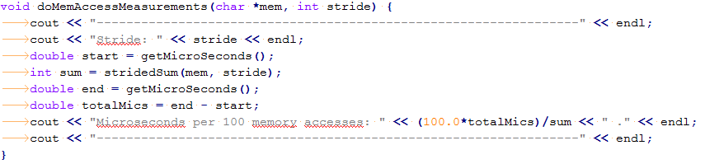
Cachline - Code

Slide 4
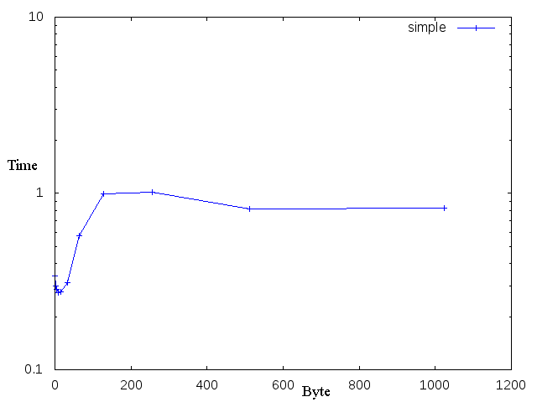
Cacheline - Plot
i7 Haswell
Time in microseconds per 100 accesses
Result: 64 Byte

Slide 5

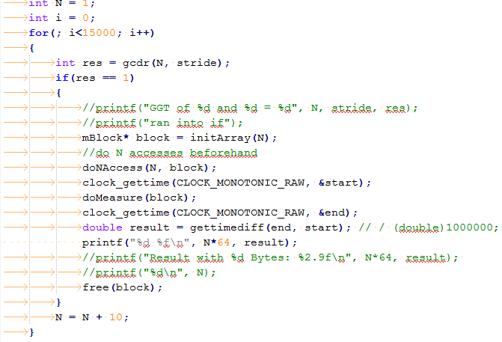
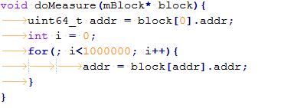
Cachesize - Code

Slide 6
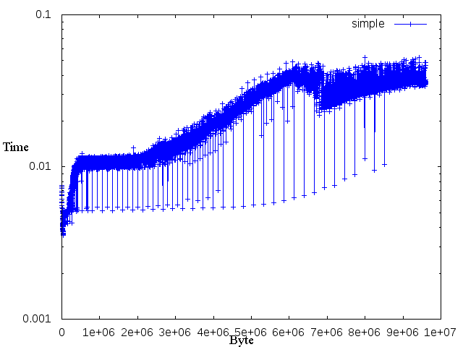
Cachesize - Plot
i7 Haswell
Time in seconds per 1 mio accesses
Cache:
L1: 32kB (per core, data cache)
L2: 256kB (per core)
L3: 6144kB (unified)
Minimum spikes:
3461184, 3727424, 3993664, ...

Slide 7
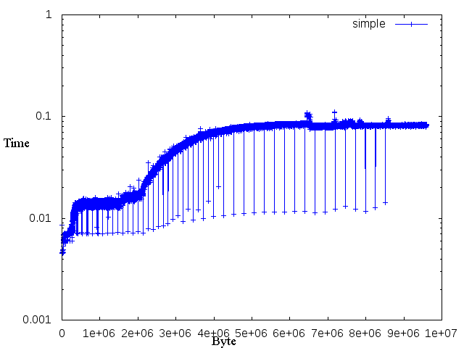
Cachesize - Plot
i5 SandyBridge
Time in seconds per 1 mio accesses
Cache:
L1: 32kB (per core, data cache)
L2: 256kB (per core)
L3: 6144kB (unified)
Minimum spikes:
3461184, 3727424, 3993664, ...

Slide 8
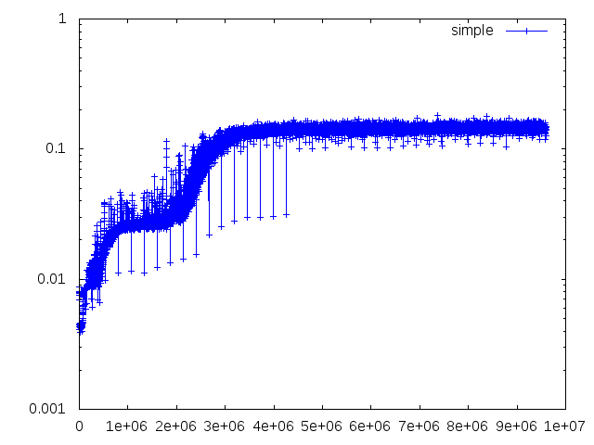
Cachesize - Plot
Quad-Core AMD Opteron(tm) Processor 2352
Time in seconds per 1 mio accesses
Cache:
L1: 64kB (per core, data cache)
L2: 512kB (per core)
L3: 2048kB (unified)
Minimum spikes:
3461184, 3727424, 3993664, ...

Slide 9
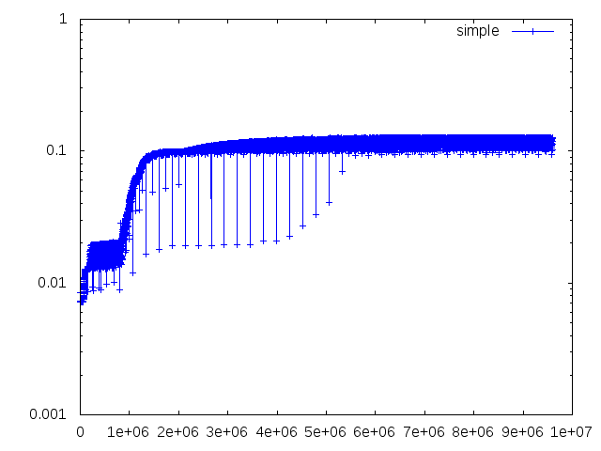
Cachesize - Plot
AMD Turion II Neo N40L
Time in seconds per 1 mio accesses
Cache:
L1: 64kB (per core, data cache)
L2: 1024kB (per core)
L3: -
Minimum spikes:
3461184, 3727424, 3993664, ...

Slide 10
Unexpected Spikes
Similar behavior on all processors
Somewhat deterministic for each processor
Also, correlation between AMD and Intel processors
e.g. N=3727424 Bytes (= 58241 Memory Blocks)
Stepsize: 266240 Bytes (= 4160 Memory Blocks)
x → (x + 4160) % 58241 (?)
Also: Spikes at Stepsize of 4160/2 = 2080 Mblocks
(More obvious on Intel)

