Slide 1
Unit OS C: Interoperability
C.1. File and Command Interoperability

Slide 2
Copyright Notice
© 2000-2005 David A. Solomon and Mark Russinovich
These materials are part of the Windows Operating System Internals Curriculum Development Kit, developed by David A. Solomon and Mark E. Russinovich with Andreas Polze
Microsoft has licensed these materials from David Solomon Expert Seminars, Inc. for distribution to academic organizations solely for use in academic environments (and not for commercial use)

Slide 3
Roadmap for Section C.1
Windows Services for UNIX 3.5
NFS client/server
Lightweight Directory Access Protocol (LDAP) / Network Information System (NIS) integration
Password synchronization
SMB/CIFS Resource sharing:
Samba – de.samba.org
Notes:
There are two main aspects regarding interoperability among different operating systems. The first aspect considers interoperability from a user‘s perspective. Most interesting is the question whether different operating systems can share resources, such as files, printers, or tape drives. Here, we will focus on CIFS (the common internet file system) and NFS (network file system) implementations available on Windows OS and UNIX platforms.
The second aspect is developer-centric. Here the most important question is about portability: what does it take to port one application from one OS (UNIX) to another (Windows OS) or vice versa. Compatibility libraries are a classical solution to porting applications from one OS to another - this is discussed in detail in Section C.2

Slide 4
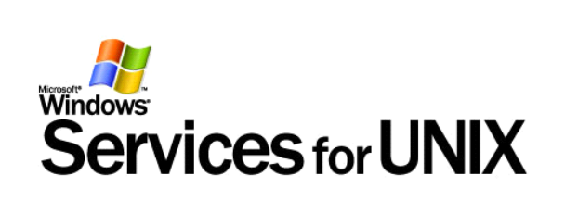
Services for UNIX
Windows Services for UNIX 3.5 (SFU)
  provides the ability to share network resources among Windows and UNIX-based operating systems
SFU has the following components:
  Client for Network File System (NFS)
    Allows Windows clients to mount exported file systems directly from UNIX NFS servers
  Server for NFS
    Shares directories from Windows based servers as if they were native UNIX exports
  Gateway for NFS
    Shares UNIX NFS exports as Windows-based shared directories
  Server for PCNFS
    Enables Windows to act as a PCNFS daemon (PCNFSD) server, seamless user authentication when connecting to NFS servers
Windows Server 2003 R2 includes an updated NFS client and server (performance improvements, bug fixes over SFU)
Notes:
The growing adoption of the Windows operating systems in established UNIX environments has created the need for platform integration. One of the biggest challenges for an organization is to integrate existing UNIX-based systems already present in their enterprise, with information technology advances occurring rapidly on inexpensive PCs. As organizations expand, it becomes more challenging to find solutions that provide easy access to information from multiple sources, reduce software development time/cost, increase application usability and re-use, and incorporate new technologies while leveraging existing investments. This has resulted in the creation of a strong vendor market that provides platform integration services and solutions.
In addition to a host of third-party products, Microsoft has products available today that facilitate UNIX interoperability and migration. Windows Services for UNIX and Microsoft Interix provide additional features to Windows that enable greater interoperability with existing UNIX-based environments.

Slide 5
Windows/UNIX Interoperability
Microsoft Interoperability Framework
Leverage Existing Network Resources
Simplify Account Management
Leverage Existing UNIX Expertise
Simplify Network Administration
Notes:
In order to communicate and fill out its interoperability strategy, Microsoft has defined a framework for the technologies which enable Microsoft products to work in a heterogeneous environment. This framework is divided into 4 layers - Network, Data, Applications, and Management. Standards, which play a key role in enabling interoperability between systems, span all 4 layers of the framework.
Network- core foundation; ability for multi-vendor systems to communicate with each other using common protocols
Data- access and query information that is stored; file systems and databases
Applications- business logic; transactions; presentation services
Management- user accounts management; security; directory services

Slide 6

SFU Utilities and Commands
Microsoft Windows Services for UNIX 3.5 provides
  Korn Shell and C Shell command interpreters to give UNIX users and administrators their familiar set of tools and shell environment
Over 350 UNIX Utilities
  Enables you to run familiar UNIX commands such as cat, grep, ls, ps, rshsvc, and vi natively from Windows
Korn Shell & C Shell
  Allow to run UNIX shell scripts from Windows
  Windows command line applications can be called from within SFU command interpreters

Slide 7
SFU Tools for Remote Access and Administration
Windows Services for UNIX 3.5 simplifies
  local and remote network administration, and supports either graphical or character-based administration
Telnet Client
  Enables faster character-based and script-based remote access and administration
Telnet Server
  Provides security and simplified logins, and supports both stream and console mode
Microsoft Management Console
  Enables administrators to centralize all Windows Services for UNIX 3.5 management from a single application, as well as from the command line
ActiveState ActivePerl
  Provides the ability to automate network administrative tasks by running new or existing Perl scripts natively on Windows

Slide 8
Integration of Windows and UNIX Account Management
SFU Server for Network Information System (NIS)
  Enables a Windows domain controller to act as the primary NIS server, integrating NIS domains with Windows domains, allowing administrators to manage an NIS domain from Active Directory.
NIS to Active Directory Migration Wizard
  Consolidates account management by moving UNIX source files, such as password and host files, from NIS domains into the Windows Active Directory service
2-way Password Synchronization
  Provides the ability to synchronize passwords from both platforms, making it easier for users to maintain one password for both Windows and UNIX
User Name Mapping
  Associates Windows and UNIX user names, allowing users to connect to NFS network resources seamlessly

Slide 9
Network File System Support
(Windows Server 2003 R2 includes NFS client and server updated from SFU)
UNIX NFS Servers
SFU NFS Servers
SFU NFS
Gateway
SFU NFS Clients
UNIX NFS Clients
Notes:
Services for UNIX NFS supports NFS Client Access, NFS Server functionality and an NFS Gateway:
Adding Windows machines with NFS client allows them to share data mounted on the NFS servers.
Adding Windows systems with SFU NFS server running allows them to share data to existing NFS client.
Adding a Windows system with SFU NFS Gateway allows one to NFS Client mount existing NFS server resources, then reflect them as SMB mounts to other Windows clients.

Slide 10
Client for NFS
Provides seamless access to NFS servers
  Allows for access to NFS servers using Windows credentials
  Maps Windows name to UNIX UID
Integrates NFS with Windows UI
  NFS network, servers and shares can be browsed from standard Windows tools (i.e.; Explorer)
Supports Windows file system semantics
  Case sensitivity, 8.3 naming, share locks, access to NFS via DFS, UNC naming, ‘net’ commands

Slide 11
Server for NFS
UNIX NFS clients can access files on Windows servers exported via NFS
UNIX user IDs (UIDs) and group IDs (GIDs) are acknowledged with appropriate access rights
  UIDs are mapped to Windows domain users
  File access privileges are set according to mapped user
  Need special user mapping files when not running in a domain
Files exported via Windows NFS can be accessed with just UNIX sign-on
Standard conformant NFS semantics
  Support for NFS v2/v3 via TCP/UDP with locking

Slide 12
Gateway for NFS
Translates SMB requests onto NFS requests and vice versa (acting as a bridge)
  Exports NFS mounted file systems as SMB shares
  Allows for access to NFS file systems from plain Windows clients
    Low cost solution with low administration overhead
    Good solution for smaller installations
    Simple way for older OSes (Win9X) to access NFS-exported file systems
    May become a performance bottleneck
Provides for authenticated access
  Each Windows user is mapped to a Unix user
  File privileges are determined by the mapped user
  Each user is authenticated on the client

Slide 13
User Name Mapping in SFU
Implemented as central mapping mechanism
  Allows Windows domain users to access NFS servers with Windows credentials
  Allows Unix users to access NFS files on Windows servers
  Implements consistent mapping rules for file access across all NFS clients and servers (in contrast to client-specific mapping files)
Windows user
Windows domain
Unix user
Unix domain
UID/GID
JohnDoe
Indwindows
Johnd
Indunix
1090/201
Maryjane
Indwindows
Maryj
Indunix
1223/201
…

Slide 14
Username Mapping Server (Server)
Windows
1- NFS Request
NFS
Server
2
5- NFS Request Fulfilled
3
Username
Mapper
4
On server-side, the username mapping server intercepts incoming NFS requests targeted at Windows-based NFS servers and translates UNIX UID/GID into Windows credentials
NTFS
Notes:
How the Username Mapping Server works for inbound NFS server requests:
NFS Server receives the inbound request.
The UID/GID are extracted from the NFS packet and passed to the Username Mapping Server.
The NT credentials are returned from the Username Mapping Server.
The NFS server accesses the NFS shared drive with the proper credentials for the inbound user.
The NFS request is completed back to the NFS client.

Slide 15
Username Mapping Server (Client)
Windows
3- NFS Request Sent
NFS
Client
1
4- NFS Request Fulfilled
2
Username
Mapper
On client-side, the username mapping server intercepts outgoing NFS requests and translates Windows credentials into UNIX UID/GID information
Notes:
How the Username Mapping Server works for outbound NFS Client Requests:
NFS Client requests UID/GID info for NFS request to be sent for the Windows user sending the request.
Username mapping server returns the appropriate “UNIX” credentials for the NFS packet.
NFS packet is built and sent
NFS request fulfilled from remote NFS server.

Slide 16
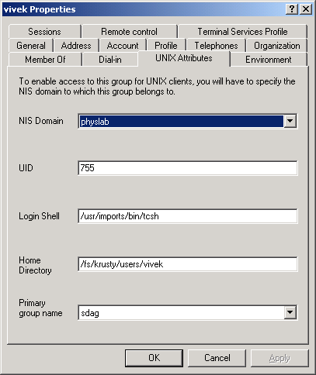
Server for NIS
Network Information System (NIS - also known as yellow pages (YP)) is a widely used directory service on UNIX
Allows migration of NIS maps into Active Directory (AD - Microsoft’s implementation of LDAP) via migration wizard
  NIS passwd, group, and hosts maps
  are mapped onto Users, Groups and
  Computers in AD
  Supports standard & non-standard NIS maps
Stores NIS data in AD
  Extends AD schema for UNIX attributes
  Drawback: no easy way to undo
Turns Windows into a NIS server
  Supports NIS v2.0 and multiple NIS domains
  Allows to manipulate NIS maps via AD
Provides yppasswd command to change
passwords stored in AD from UNIX shells

Slide 17
Migration procedure makes SFU the master server on the NIS domain
UNIX NIS Servers
Windows Servers
Propagating maps
to slave servers
Propagating maps
to slave servers
Propagating maps
to slave servers
Slave
Master
Slave
Slave
Master
Slave
SFU transparently promotes itself to be master server in the NIS domain;
this may be problematic with operational procedures in UNIX shops
Classic NIS operation on UNIX
Introducing SFU NIS Server
NIS operation on Windows
NIS Clients
NIS - SUN Network Information System (i.e.; yellow pages)
Notes:
Server for NIS allows customers to manage all their domain (NIS and AD)accounts from a single point of management. So:
Traditionally UNIX NIS architectures require one of the NIS servers to be the primary or “master” server. All updates to NIS info happen at the master. The master is responsible for updating the secondary or “slave” servers.
Adding Windows servers to the network mix.
We can run the NIS migration wizard which will update the AD of a designated Windows domain controller and migrate the NIS maps (users, groups, hosts, etc.) to the Windows domain controller.
It is now the master, and the original NIS domain master can become a slave. The new Windows domain controller is now the acting NIS master. It updates all secondary (slave) servers appropriately.
As well, other Windows servers can be NIS domain slave servers.

Slide 18
Password Synchronization
Ability to change password from Windows or UNIX (two-way)
Encrypted propagation based on Triple-DES
Ability to send to targeted computers
Ability to filter based on user names when sending and receiving
Limited to users with identical names

Slide 19
Password Synchronization from UNIX to Windows
Pluggable Authentication Module (PAM) integrates with UNIX passwd command and talks to remote SFU’s password synchronization service on Windows
Windows
“UNIX” system
passwd
AD/domain
PAM
3
1
Password Sync
Service
pam_sso.so
2
Notes:
Password synchronization happens from UNIX to Windows as follows:
There’s a PAM (pluggable authentication module) for UNIX that is invoked by the password program and talks to the sync daemon loaded on (a) any NIS or NIS+ server, or (b) any system that needs to sync it’s passwords with the Windows system.
The password sync daemon encrypts the password for the user with a particular key, and sends the password to the password sync service on the Windows domain server.
The password sync service cracks the password and updates the active directory on the domain server.

Slide 20
Password Synchronization from Windows to UNIX
Windows password change is transferred from AD via SFU password synchronization service to a remote UNIX demon that updates NIS or password file
Windows
“UNIX” system
Password change
NIS
AD/domain
passwd
1
3a
Password Sync
Service
2
ssod
3b
Notes:
Password sync from Windows to UNIX happens as follows:
Passwords are entered into Active Directory (AD)
The password sync service encrypts the password and notifies the password sync daemon on the UNIX system (ssod).
The password sync daemon decrypts the password and updates (a) the NIS/NIS+ server or (b) the password database.

Slide 21
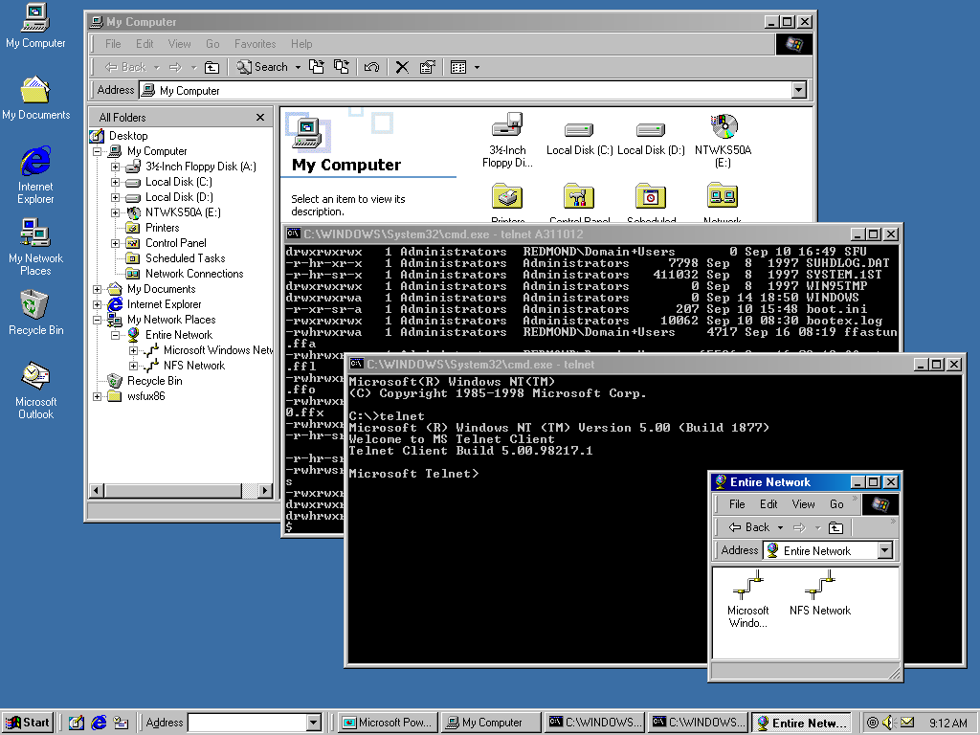
SFU in Action - browsing NFS network
Notes:
SFU provides local and remote administration (a robust Telnet implementation), the ability to run existing PERL and shell scripts on both platforms, and the ability to take advantage of Windows technology.
WMI provides the ability to manage Windows via scripts by exposing more objects to manage via the PERL, WSH, or both.

Slide 22
SFU helps to simplify
Network Administration
SFU implement remote access and scripting tools and command interpreters
  Telnet Client and Server
  PERL, Korn shell and C shell for scripting
  Windows command line tools
SFU interacts with Windows administrative tools
  Windows Installer
  Windows Scripting Host
  Windows Management Instrumentation
  Microsoft Management Console

Slide 23
Telnet
Client has Windows look and feel
  Supports Window resizing
  Scrolling and curses functionality is implemented
  Additional settings can be configured
    bs/del, cr/lf, logging, escape char
  Client can send messages to server (ao, ayt, ip)
Server is run as a Windows service
  Supports Window resizing
  Transmits operator messages such as shutdown

Slide 24
UNIX Utilities
Over 350 UNIX utilities available in SFU 3.5
  Cron, rshsvc, cut, diff, du, kill, nice, od, split, strings, su, tar, top, tr, uuencode/uudecode, wait…
See microsoft.com for complete list
  http://www.microsoft.com/windowsserversystem/sfu/

Slide 25
www.samba.org
Samba is an implementation of the SMB protocol that can be run on a platform other than Microsoft Windows
  For example, UNIX, Linux, IBM System 390, OpenVMS, and other operating systems
  Samba uses the TCP/IP protocol
Samba allows a host to interact with a Microsoft Windows client or server as if it is a Windows file and print server

Slide 26

What's Samba all about?
Samba functionality in detail:
  SMB server, to provide Windows and LAN Manager-style file and print services to SMB clients
  A NetBIOS (rfc1001/1002) nameserver, which amongst other things gives browsing support. Samba can be the master browser on your LAN if you wish.
  A ftp-like SMB client so you can access PC resources (disks and printers) from UNIX, Netware and other operating systems
  Limited command-line tool that supports some of the Windows administrative functionality
Notes:
Samba is an open source software suite that provides seamless file and print services to SMB/CIFS clients. Samba is freely available under the GNU General Public License.
A lot of emphasis has been placed on peaceful coexistence between Unix and Windows. The Usenix Association has even created an annual conference (LISA/NT--July 14-17, 1999) around this theme. Unfortunately, the two systems come from very different cultures and they have difficulty getting along without mediation. ...and that, of course, is Samba's job. Samba runs on Unix platforms, but speaks to Windows clients like a native. It allows a Unix system to move into a Windows "Network Neighborhood”. Windows users can happily access file and print services without knowing or caring that those services are being offered by a Unix host.
All of this is managed through a protocol suite which is currently known as the "Common Internet File System", or CIFS. At the heart of CIFS is the latest incarnation of the Server Message Block (SMB) protocol, which has a long and tedious history. Samba is an open source CIFS implementation, and is available for free from the http://samba.org/ mirror sites.

Slide 27
Samba & related packages
Related packages include:
  smbfs, a linux-only filesystem allowing to mount remote SMB filesystems from PCs on a linux box
    smbfs is included as standard with Linux 2.0 and later
  tcpdump-smb, a extension to tcpdump to allow you to investigate SMB networking problems over netbeui and tcp/ip.
  smblib, a library of smb functions which are designed to make it easy to smb-ise any particular application.
  See ftp://samba.org/pub/samba/smblib.
Notes:
Samba and Windows are not the only ones to provide CIFS networking. OS/2 supports SMB file and print sharing, and there are commercial CIFS products for Macintosh and other platforms (including several others for Unix). Samba has been ported to a variety of non-Unix operating systems, including VMS, AmigaOS, & NetWare. CIFS is also supported on dedicated file server platforms from a variety of vendors.

Slide 28
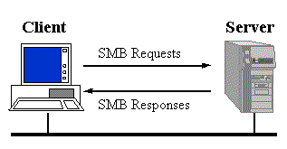
What is SMB
SMB is a client server,
request-response protocol
The only exception to the request-response nature of SMB
is when the client has requested opportunistic locks (oplocks) and the server subsequently has to break an already granted oplock because another client has requested a file open with a mode that is incompatible with the granted oplock
In this case, the server sends an unsolicited message to the client signaling the oplock break
Addl. info at
http://anu.samba.org/
cifs/docs/what-is-smb.html

Slide 29
SMB and the OSI model
OSI
TCP/IP
Application
SMB
Application
Presentation
Session
NetBIOS
NetBEUI
NetBIOS
NetBIOS
Transport
IPX
DECnet
TCP/UDP
TCP/UDP
Network
IP
IP
Data link
802.2
802.3, 802.5
802.2
802.3, 802.5
Ethernet V2
Ethernet V2
Ethernet or
others
Physical
Clients connect to servers using TCP/IP (actually NetBIOS over TCP/IP as specified in RFC1001 and RFC1002), NetBEUI or IPX/SPX
SMB was also sent over the DECnet protocol
Digital (now HP) did this for their PATHWORKS product

Slide 30
SMB Clients and Servers
Clients:
  Included in WfW 3.x, Win 95, Win98, Win ME and Windows NT/2000/XP/Server 2003/Vista.
  smbclient from Samba, smbfs for Linux, SMBlib
Servers:
  Microsoft Windows for Workgroups 3.x, Win95, Win98, Win ME, Windows NT/2000/XP/Server 2003/Vista
  Samba (Linux, Solaris, SunOS, HP-UX, ULTRIX, DEC OSF/1, Digital UNIX, Dynix (Sequent), IRIX (SGI), SCO Open Server, DG-UX, UNIXWARE, AIX, BSDI, NetBSD, NEXTSTEP, A/UX)
  The PATHWORKS family of servers from Digital
  LAN Manager for OS/2, SCO, etc
  VisionFS from SCO
  Advanced Server for UNIX from AT&T (NCR?)
  LAN Server for OS/2 from IBM

Slide 31
Samba (SMB) characteristics
NetBIOS Names
  If SMB is used over TCP/IP, DECnet or NetBEUI, then NetBIOS names must be used in a number of cases
  NetBIOS names are up to 15 characers long, and are usually the name of the computer that is running NetBIOS
  NetBIOS names have to be in upper case, especially when presented to servers as the CALLED NAME
Protocol functionality (Core protocol):
  connecting to and disconnecting from file and print shares
  opening and closing files
  opening and closing print files
  reading and writing files
  creating and deleting files and direcories
  searching directories
  getting and setting file attributes
  Locking and unlocking byte ranges in files

Slide 32
SMB Security
The SMB model defines two levels of security:
  Share level
    Each share can have a password, and a client only needs that password to access all files under that share.
    This was the first security model that SMB had and is the only security model available in the Core and CorePlus protocols.
  User Level
    Protection is applied to individual files in each share and is based on user access rights.
    Each user (client) must log in to the server and be authenticated by the server.
    When it is authenticated, the client is given a UID which it must present on all subsequent accesses to the server.
    This model has been available since LAN Manager 1.0.

Slide 33
CIFS – Common Internet File System
The filesharing protocol at the heart of CIFS is an updated version of the Server Message Block (SMB) protocol
  Dates back to the mid-1980s.
  In 1996/97, Microsoft submitted draft CIFS specifications to the IETF.
The SMB protocol was originally developed to run over NetBIOS (Network Basic Input Output System) LANs.
  Until Windows 2000, NetBIOS support was required for SMB transport.
  The machine and service names visible in the Windows Network Neighborhood are, basically, NetBIOS addresses (Windows 2000 and later use DNS names).
Windows 3.11 (WfW) introduced:
  Service announcement and location system called Browsing.
  The browser service provides the list of available file and print services presented in the Network Neighborhood.
WfW Workgroup concept:
  Simplified network management, user groups users
  Workgroup concept was expanded to create NT Domains.
Notes:
There are also several SMB "dialects". These correspond roughly with major OS product releases or updates from Microsoft, and each adds extensions to the core SMB protocol.
In their IETF CIFS draft Microsoft presented an SMB dialect that was independent of NetBIOS – Windows implements that particular protocol version. As part of the split with NetBIOS, Windows also offers new name resolution, service announcement, authentication, and authorization mechanisms -- all based upon Internet standards.

Slide 34
Samba 3.0 Enhancements
Current stable release - from the release notes:
  Support for several new Windows API rpc pipes
  New 'net rpc service' tool for managing Win32 services
  Capability to set the owner on new files and directories based on the parent's ownership
  Experimental, asynchronous IO file serving support.
  New Winbind IDmap plugin (ad) for retrieving uid and gid from Active Directory servers which maintain the Services For UNIX 3.5 user and group attributes
  Support for Microsoft Print Migrator
  New Windows registry file I/O library
  New user right (SeTakeOwnershipPrivilege) added

Slide 35
Further Reading
Mark E. Russinovich and David A. Solomon,
Microsoft Windows Internals, 4th Edition, Microsoft Press, 2004.
  Multiple Redirector Support (from pp. 815)
  Protocol Drivers /NDIS Drivers (from pp. 821)
Windows Services for UNIX 3.5
  http://www.microsoft.com/windowsserversystem/sfu/
UNIX support in Windows Server 2003 R2
  http://www.microsoft.com/windowsserver2003/R2/
  unixcomponents/default.mspx
Samba Project
  www.samba.org

