Slide 1
Unit OS8: File System
8.2. Windows File Systems

Slide 2
Copyright Notice
© 2000-2005 David A. Solomon and Mark Russinovich
These materials are part of the Windows Operating System Internals Curriculum Development Kit, developed by David A. Solomon and Mark E. Russinovich with Andreas Polze
Microsoft has licensed these materials from David Solomon Expert Seminars, Inc. for distribution to academic organizations solely for use in academic environments (and not for commercial use)

Slide 3
Roadmap for Section 8.2
File Systems supported by Windows
NTFS Design Goals
File System Driver Architecture
NTFS Operation
Windows File System On-Disk Structure
NTFS File Compression
Notes:
From the start, the Windows NT File System (NTFS) was designed to include features required of an enterprise-class file system and meet the requirements to implement POSIX 1003.1. To minimize data loss in the face of an unexpected system outage or crash, a file system must ensure that the integrity of the file system‘s metadata be guaranteed at all times, and to protect sensitive data from unauthorized access, a file system must have an integrated security model.

Slide 4
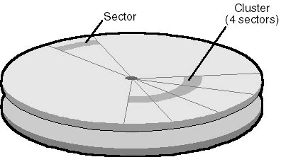
Windows File System - Terminology
Sectors:
  hardware-addressable blocks on a storage medium
  Typical sector size on hard disks for x86-based systems is 512 bytes
File system formats:
  Define the way data is stored on storage media
  Impact a file system features: permissions & security, limitations on file size, support for small/large files/disks
Clusters:
  Addressable blocks that many file system formats use
  Cluster size is always a multiple of the sector size
  Cluster size tradeoff: space efficiency vs. access speed
Metadata:
  Data stored on a volume in support of file system format management
  Metadata includes the data that defines the placement of files and directories on a volume, for example
  Typically not accessible to applications
Notes:
From the start, the Windows NT File System (NTFS) was designed to include features required of an enterprise-class file system. To minimize data loss in the face of an unexpected system outage or crash, a file system must ensure that the integrity of the file system‘s metadata be guaranteed at all times, and to protect sensitive data from unauthorized access, a file system must have an integrated security model. Finally, a file system must allow for software-based data redundancy as a low-cost alternative to hardware-redundant solutions for protecting user data.

Slide 5
Formats Supported by Windows
CD-ROM File System (CDFS)
Universal Disk Format (UDF)
File Allocation Table (FAT12, FAT16, and FAT32)
New Technology File System (NTFS)

Slide 6
CDFS
CDFS, or, is a relatively simple format that was defined in 1988 as the read-only formatting standard for CD-ROM media.
Windows 2000 implements ISO 9660-compliant CDFS in \Winnt\System32\Drivers\Cdfs.sys, with long filename support defined by Level 2 of the ISO 9660 standard
Because of its simplicity, the CDFS format has a number of restrictions
  Directory and file names must be fewer than 32 characters long
  Directory trees can be no more than eight levels deep
CDFS is considered a legacy format because the industry has adopted the Universal Disk Format (UDF) as the standard for read-only media

Slide 7
UDF
OSTA (Optical Storage Technology Association) defined UDF in 1995 as a format to replace CDFS for magneto-optical storage media, mainly DVD-ROM
  The Windows 2000 UDF file system implementation is ISO 13346-compliant and supports UDF versions 1.02 and 1.5
UDF file systems have the following traits:
  Filenames can be 255 characters long
  The maximum path length is 1023 characters
Although the UDF format was designed with rewritable media in mind, the Windows 2000 UDF driver (\Winnt\System32\Drivers\Udfs.sys) provides read-only support

Slide 8
FAT
FAT (File Allocation Table) file systems are a legacy format that originated in DOS and Windows 9x
Reasons why Windows supports FAT file systems:
  to enable upgrades from other versions of Windows
  compatibility with other operating systems in multiboot systems
  as a floppy disk format
Windows FAT file system driver is implemented in \Winnt\System32\Drivers\Fastfat.sys
Each FAT format includes a number that indicates the number of bits the format uses to identify clusters on a disk
Boot sector
File allocation
table 1
File allocation
table 2 (duplicate)
Root directory
Other directories and all files
FAT format organization

Slide 9
FAT12
FAT12's 12-bit cluster identifier limits a partition to storing a maximum of 2¹² (4096) clusters
  Windows uses cluster sizes from 512 bytes to 8 KB in size, which limits a FAT12 volume size to 32 MB
  Windows uses FAT12 as the format for all 5-inch floppy disks and 3.5-inch floppy disks, which store up to 1.44 MB of data

Slide 10
FAT16
FAT16, with a 16-bit cluster identifier, can address 2¹⁶ (65,536) clusters
  On Windows, FAT16 cluster sizes range from 512 bytes (the sector size) to 64 KB, which limits FAT16 volume sizes to 4 GB
  The cluster size Windows uses depends on the size of a volume

Slide 11
FAT32
FAT32 is the most recently defined FAT-based file system format
  it's included with Windows 95 OSR2, Windows 98, and Windows Millennium Edition
FAT32 uses 32-bit cluster identifiers but reserves the high 4 bits, so in effect it has 28-bit cluster identifiers
  Because FAT32 cluster sizes can be as large as 32 KB, FAT32 has a theoretical ability to address 8 TB volumes
  Although Windows works with existing FAT32 volumes of larger sizes (created in other operating systems), it limits new FAT32 volumes to a maximum of 32 GB
  FAT32's higher potential cluster numbers let it more efficiently manage disks than FAT16; it can handle up to 128-MB volumes with 512-byte clusters
Unlike FAT12 and FAT16, root directory is not fixed size or location
  Largest file size on Windows is 4GB (largest on Win9x is 2G)

Slide 12
NTFS
NTFS is the native file system format of Windows
NTFS uses 64-bit cluster indexes
  Theoretical ability to address volumes of up to 16 exabytes (16 billion GB)
  Windows 2000 limits the size of an NTFS volume to that addressable with 32-bit clusters, which is 128 TB (using 64-KB clusters)
Why use NTFS instead of FAT? FAT is simpler, making it faster for some operations, but NTFS supports:
  Larger file sizes and disks
  Better performance on large disks, large directories, and small files
  Reliability
  Security

Slide 13
CIFS – the Common Internet File System
The standard Windows network file system
The file sharing protocol at the heart of CIFS is an updated version of the Server Message Block (SMB) protocol
  dates back to the mid-1980s
  in 1996/97, Microsoft submitted draft CIFS specifications to the IETF
The SMB protocol was originally developed to run over NetBIOS (Network Basic Input Output System) LANs
  Until Windows 2000, NetBIOS support was required for SMB transport
  The machine and service names visible in the Windows Network Neighborhood are, basically, NetBIOS addresses (Windows 2000 and later use DNS names)
Windows 3.11 (WfW) introduced:
  service announcement and location system called Browsing
  The browser service provides the list of available file and print services presented in the Network Neighborhood
  Workgroup concept was expanded to create NT Domains
Notes:
There are also several SMB "dialects". These correspond roughly with major OS product releases or updates from Microsoft, and each adds extensions to the core SMB protocol.
In their IETF CIFS draft Microsoft presented an SMB dialect that was independent of NetBIOS – Windows implements that particular protocol version. As part of the split with NetBIOS, Windows also offers new name resolution, service announcement, authentication, and authorization mechanisms -- all based upon Internet standards.

Slide 14
File System Format Compatibility
FAT12/FAT16 supported on all Microsoft OS’s
FAT32:
  Only Windows 2000/XP/2003
  Winternals FAT32 driver for NT4
NTFS:
  Only Windows NT-based OS’s
  Winternals NTFSDOS for DOS access
  Winternals NTFS for Windows 98 for Win9x/Me

Slide 15
NTFS Design Goals
Overcome limitations inherent in FAT / HPFS
  FAT (File Allocation Table) does not support large disks very well
  FAT16 (MS-DOS file system) supports only up to 2¹⁶ clusters
  and 2 GB disks (with 64 Kb clusters!!)
  FAT / root directory represents single point of failure
  Number of entries in root directory is limited
  HPFS removed some of FAT‘s limitations, but still did not support recoverability, security, data redundancy, and fault-tolerance
  (later versions of HPFS support up to 2TeraByte disks)

Slide 16
NTFS Recoverability
PC disk I/O in the old days: Speed was most important
NTFS changes this view – Reliability counts most:
I/O operations that alter NTFS structure are implemented as atomic transactions
  Change directory structure,
  extend files, allocate space for new files
Transactions are either completed or rolled back
NTFS uses redundant storage for vital FS information
  Contrasts with FAT / HPFS on-disk structures, which have single sectors containing critical file system data
  Read error in these sectors -> volume lost

Slide 17
NTFS Security and Recoverability
NTFS security is derived from Windows object model
Open file is implemented as file object;
security descriptor is stored on disk as part of the file
NT security system verifies access rights when a process tries to open a handle to any object
Administrator or file owner may set permissions
NTFS recoverability ensures integrity of FS structure
No guarantees for complete recovery of user files
Layered driver model + FTDISK driver
  Mirroring of data – RAID level 1
  Striping of data - RAID level 5 (one disk with parity info)

Slide 18
Large Disks and Large Files
Efficient support for large files and disks in NTFS
FAT16:
  16-bit wide table stores allocation status of disk
  Up to 65.536 clusters per volume (#files !!); adjustable cluster size
FAT32:
  New in since Windows 2000
  4kb clusters on volumes up to 8 GB
  Can relocate root directory / use backup copy of FAT
  Root directory is ordinary cluster chain – no limits on #entries
HPFS (support dropped in NT 4.0):
  32 bits to enumerate allocation units; maximum file size: 4GB
  Allocates disk space in terms of physical sectors of 512 bytes;
  problem with some disks (1024 bit sectors)

Slide 19
Large Disks and Large Files (contd.)
NTFS enumerates cluster with 64-bit numbers
Up to 2⁶⁴ clusters of up to 64 Kbytes size
Maximum file size: 2⁶⁴ bytes
Cluster size is adjustable
  512 bytes on small disks
  Maximum of 64Kb on large disks
Multiple data streams
  File info: name, owner, time stamps, type implemented as attribute
  Each attribute consists of a stream – sequence of bytes
  Default data stream has no name
  New streams can be added: myfile.dat:stream2
  File operations manipulate all streams simultaneously
Used to implement
services for Macintosh
in Windows NT Server
Notes:
Lab:
Create a file with an additional data stream. Monitor the size of the file as reported by the ls –l command (alternatively, use the dir command). Copy the file. Try to access the second data stream.
Cat -> file ; ls –l
Cat –> file:1 ; ls –l
Cp file file1
More < file1:1

Slide 20
Other NTFS Features
Multiple data streams
Unicode-based names
Hard links
Junctions
Compression and sparse files
Change logging
Per-user volume quotas
Link tracking
Encryption
POSIX support
Defragmentation

Slide 21
Multiple Data Streams
In NTFS, each unit of information associated with a file, including its name, its owner, its time stamps, its contents, and so on, is implemented as a file attribute (NTFS object attribute)
Each attribute consists of a single stream, that is, a simple sequence of bytes
  This generic implementation makes it easy to add more attributes (and therefore more streams) to a file
  Because a file's data is "just another attribute" of the file and because new attributes can be added, NTFS files (and file directories) can contain multiple data streams

Slide 22
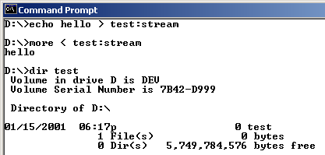
Multiple Data Streams
An NTFS file has one default data stream, which has no name
  An application can create additional, named data streams and access them by referring to their names.
  To avoid altering the Microsoft Windows I/O APIs, which take a string as a filename argument, the name of the data stream is specified by appending a colon (:) to the filename e.g. myfile:stream2

Slide 23
Unicode Names
Like Windows as a whole, NTFS is fully Unicode enabled, using Unicode characters to store names of files, directories, and volumes

Slide 24
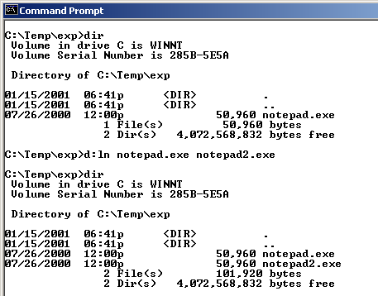
Hard Links
A hard link allows multiple paths to refer to the same file or directory
  If you create a hard link named C:\Users\Documents\Spec.doc that refers to the existing file C:\My Documents\Spec.doc, the two paths link to the same on-disk file and you can make changes to the file using either path
  can create hard links
  with the Windoqs API
  CreateHardLink function
  or the ln POSIX function

Slide 25
Junctions
Junctions, also called symbolic links, allow a directory to redirect file or directory pathname translation to an alternate directory
  If the path C:\Drivers is a junction that redirects to C:\Winnt\System32\Drivers, an application reading C:\Drivers\Ntfs.sys actually reads C:\Winnt\System\Drivers\Ntfs.sys
  Junctions are a useful way to lift directories that are deep in a directory tree to a more convenient depth without disturbing the original tree's structure or contents

Slide 26
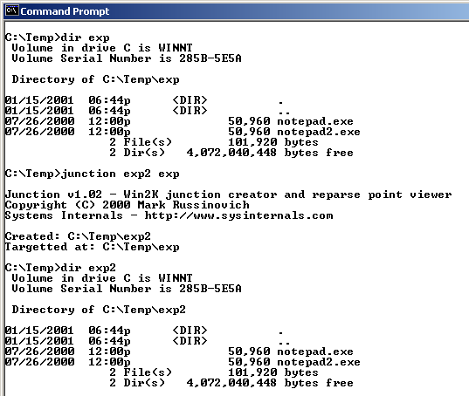
Junctions
You can create junctions with the junction tool from Sysinternals or the linkd tool from the Resource Kits

Slide 27
Change Logging
Many types of applications, such as incremental backup utilities, need to monitor a volume for changes
An obvious way to watch for changes is to perform a full scan
  Very performance inefficient
There is a way for an application to “wait” on a directory and be told of notifications
  An application can miss changes since it must specify a buffer to hold them

Slide 28
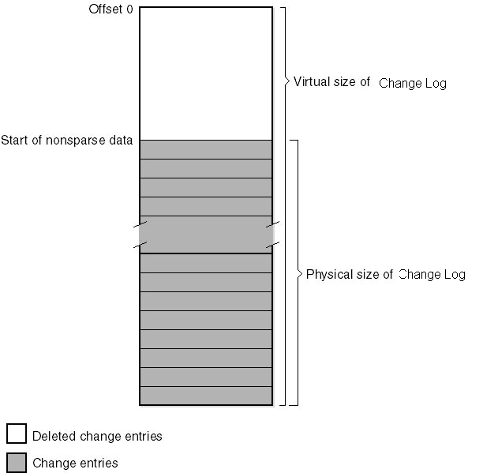
Change Logging
With Windows 2000, NTFS introduces the change log, which is a sparse metadata file that records file system events (not enabled by default)
  As the file exceeds its maximum on-disk size, NTFS frees the disk space for the oldest portions marking them empty
  An application uses Win32 APIs to read events
  The log file is shared, and generally large enough that an application won’t miss changes even during heavy file system activity

Slide 29
Per-User Volume Quotas
NTFS quota-management support allows for per-user specification of quota enforcement
  Can be configured to log an event indicating the occurrence to the system Event Log if a user surpasses his warning limit
  If a user attempts to use more volume storage then her quota limit permits, NTFS can log an event to the system Event Log and fail the application file I/O that would have caused the quota violation with a "disk full" error code
User disk space is tracked on a per-volume basis by summing the logical sizes of all the files and directories that have the user as the owner in their security descriptors

Slide 30
Link Tracking
Several types of symbolic file links are used by layered applications
  Shell shortcuts allow users to place files in their shell namespace (on their desktop, for example) that link to files located in the file system namespace
  Object linking and embedding (OLE) links allow documents from one application to be transparently embedded in the documents of other applications
In the past, these links were difficult to manage
  If someone moved a link source (what a link points to), the link broke
Windows now has a link-tracking service, TrkWks (it runs in services.exe), tags link sources with a unique object ID
  NTFS can return the name of a file given a link, so if the link moves the service can query each of a system’s volume for the object ID
  A distributed link-tracking service, TrkSvr, works to track link source movement across systems

Slide 31
Encryption
While NTFS implements security for files and directories, the security is ineffective if the physical security of the computer is compromised
  Can install a parallel copy of Windows
  NTFSDOS
Encrypting File System (EFS)
  Like compression, its operation is transparent
  Also like compression, encryption is a file and directory attribute
  Files that are encrypted can be accessed only by using the private key of an account's EFS private/public key pair, and private keys are locked using an account's password
While you might think that its implemented as a file system filter driver, it’s a driver that’s tightly connected to NTFS

Slide 32
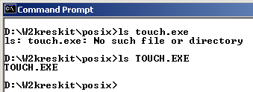
POSIX Support
POSIX support requires two file system features:
  Primary group in security descriptor
  Case-sensitive names

Slide 33
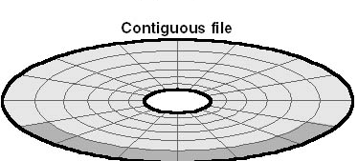
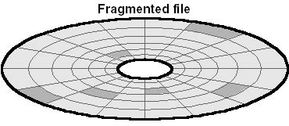
Defragmentation
Fragmentation: A file is fragmented if its data occupies discontiguous clusters

Slide 34
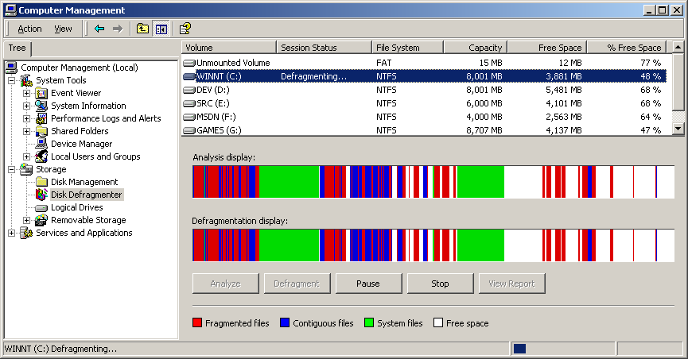
Defragmentation
A common myth is that NTFS doesn’t fragment, but it does
  Defragmentation APIs have been present since NT 4
  Windows 2000 introduced a non-schedulable graphical defragmenter
  A command line interface was added in Windows XP

Slide 35
Compression and Sparse Files
NTFS supports transparent compression of files
  When a directories is marked compressed it means any files or subdirectories are marked compressed
  Compression is performed on 16-cluster blocks of a file
  Use Explorer or the compact tool to compress files (compact shows compression rations for compressed files)
Sparse files are an application-controlled form of compression that define parts of a file as empty – those areas don’t occupy any disk space
  Applications use Windows APIs to define empty areas

Slide 36
NTFS File System Driver
Log file
service
I/O manager
Read/write
a mirrored
or striped
volume
Log the transaction
Read/write the file
NTFS driver
Flush the
log file
Write the
cache
Fault tolerant
driver
Read/write
the disk
Cache
manager
Load data
from disk
into
memory
Disk driver
Access the mapped
file or flush the cache
Virtual memory
manager

Slide 37
Components related to NTFS
Cache Manager
System wide caching
  for NTFS and other file systems drivers
  Including network file system drivers (server and redirectors)
Cached files are mapped into virtual memory
  Specialized interface from Cache Manager to NT virtual memory manager
  Memory manager calls NTFS to access disk driver and obtain file
Log File Service
  2 copies of transaction logs
  Transaction log is flushed to disk before write-data is sent to disk
  Cache manager performs actual flush operation

Slide 38
NTFS & File Objects
Process
Handle table
Stream
control
blocks
File
control
block
File object
Object
manager
data
structures
File object
Data
attribute
Master file
table
User-
defined
attribute
NTFS data
structures
(used to manage
the on-disk
structure)
App accesses files as
NT objects by handles.
Object Manager and security
subsystem verify access rights
NTFS
database
(on disk)

Slide 39
NTFS On-Disk Structure
Volumes correspond to logical partitions on disk
Fault tolerant volumes may span multiple disks
  Windows 2000 Disk Administrator utility
Volume consists of series of files + unallocated space
  FAT volume: some areas specially formatted for file system
  NTFS volume: all data are stored as ordinary files
NTFS refers internally to clusters
  Cluster factor: #sectors/cluster; varies with volume size;
  (integral number of physical sectors; always a power of 2)
Logical Cluster Numbers (LCNs):
  refer to physical location
  LCNs are contiguous enumeration of all clusters on a volume

Slide 40
NTFS Cluster Size
Default cluster size is disk-size dependent
  512 bytes for small disks (up to 512 MB)
  1 KB for disks up to 1 GB
  2 KB for disks between 1 and 2 GB
  4 KB for disks larger than 2 GB
Tradeoff: disk fragmentation versus wasted space
NTFS refers to physical locations via LCNs
  Physical cluster = LCN * cluster-factor
Virtual Cluster Numbers (VCNs):
  Enumerates clusters belonging to a file; mapped to LCNs
  LCNs are not necessarily physically contiguous

Slide 41
Master File Table
All data stored on a volume is contained in a file
MFT: Heart of NTFS volume structure
  Implemented as array of file records
  One row for each file on the volume
  (including one row for MFT itself)
  Metadata files store file system structure information
  (hidden files; $MFT; $Volume...)
  More than one MFT record for highly fragmented files
  Nfi.exe Utility from OEM Support Tools allows to dump MFT content
  (see support.microsoft.com/support/
  kb/articles/Q253/0/66.asp)
MFT
MFT copy (partial)
Log file
NTFS
metadata
file
Volume file
Attribute def. table
Root directory
Bitmap file
Boot file
Bad cluster file
...
User files and dirs.
Notes:
Lab:
View NTFS Metadate files
Nfi.exe c:\ (Dir /a:h $mft)
See http://support.microsoft.com/support/kb/articles/Q253/0/66.asp

Slide 42
NTFS operation
Mounting a volume
NTFS looks in boot file for physical address of MFT ($MFT)
2nd entry in MFT points to copy of MFT ($MFTMirr)
  used to locate metadata files if MFT is corrupted
MFT entry in MFT contains VCN-to-LCN mapping info
NTFS obtains from MFT addresses of metadata files
  NTFS opens these files
NTFS performs recovery operations
File system is now ready for user access

Slide 43
NTFS metadata
NTFS writes to log file ($LogFile)
  Record all commands that change volume structure
Root directory:
  When NTFS tries to open a file, it starts search in the root directory
  Once the file is found, NTFS stores the file‘s MFT file reference
  Subsequent read/write ops. may access file‘s MFT record directly
Bitmap file ($Bitmap):
  stores allocation state volume; each bit represents one cluster
Boot file ($Boot):
  Stores bootstrap code
  Has to be located at special disk address
  Represented as file by NTFS -> file ops. possible (!) (no editing)

Slide 44
NTFS metadata (contd.)
Bad-cluster file ($BadClus)
  Records bad spots on the disk
Volume file ($Volume)
  Contains: volume name, NTFS version
  Bit, which indicates whether volume is corrupted
Attribute Definition Table ($AttrDef)
  Defines attribute types supported on the volume
  Indicates whether they can be indexed, recovered, etc.

Slide 45
File Records &
File Reference Numbers
Sequence
number
File number
63
47
0
File on NTFS volume is identified by file reference
  File number == index in MFT
  Sequence number – used by NTFS for consistency checking;
  incremented each time a reference is re-used
File Records:
  File is collection of attribute/value pairs (one of which is data)
  Unnamed data attribute
  Other attributes: filename, time stamp, security descriptor,...
  Each file attribute is stored as separate stream of bytes within a file

Slide 46
File Records (contd.)
NTFS doesn‘t read/write files:
  It reads/writes attribute streams
  Operations: create, delete, read (byte range), write (byte range)
  Read/write normally operate on unnamed data attribute
Master File Table
Windows optimization: Security descriptors
are stored in a central file and referenced
by each file record (saves disk space)
Standard
information
Security
descriptor
Filename
Data
MFT record for a small file

Slide 47
Standard Attributes for NTFS Files
Attribute | Description
Standard information | File attributes: read-only, archive, etc; time stamps; creation/modification time; hard link count
Filename | Name in Unicode characters; multiple filename attributes possible (POSIX links!!); short names for access by MS-DOS and 16-bin Win applications
Security descriptor | Specifies who owns the file and who can access it
data | Contents of the file; a file has one default unnamed data attribute; directory has no default data attrib.
Index root, index | Three attributes used to implement filename allocation, bitmap index for large directories (dirs. only)
Attribute list | List of attributes that make up the file and first reference of the MFT record in which the attribute is located (for files which require multiple MFT file records)

Slide 48
Attributes (contd.)
Each attribute in a file record has a name and a value
NTFS identifies attributes:
  Uppercase name starting with $: $FILENAME, $DATA
Attribute‘s value: Byte stream
  The filename for $FILENAME
  The data bytes for $DATA
Attribute names correspond to numeric typecodes
File attributes in an MFT record are ordered by typecodes
  Some attribute types may appear more than once (e.g. Filename)

Slide 49
Filenames
POSIX:
  Case-sensitive, trailing periods & spaces
  NTFS namespace equiv. to POSIX space
Win32:
  Long filenames, unicode names
  Multiple dots, embedded spaces, beginning dots
MS-DOS:
  8.3 names, case does not matter
NTFS generates MS-DOS names for Win32 files automatically
  Fully functional aliases for NTFS names
  Stored in same directory as long names; dir /x
Namespaces
POSIX
subsystem
Win32
subsystem
MS-DOS
Win16 clients

Slide 50
MS-DOS filenames in NTFS
Standard info
NTFS filename
MS-DOS filename
Security desc.
Data
MFT file record with MS-DOS filename attribute
NTFS name and MS-DOS name are stored in same file record and refer to same file
  Renaming changes both filenames
  Open, read, write, delete work with both names equally
POSIX hardlinks are implemented in similar way
  Deleting a file with multiple names only decreases link count
Generation of MS-DOS names:
  Remove all illegal chars; remove all but one period; truncate to 6 chars
  Append ~1 to name; truncate extension to 3 chars; all uppercase
  Increment ~1 if filename duplicates an existing name in directory
Notes:
Lab:
Explore the name space for files under NTFS. Watch the 8.3 names automatically created by the system
Touch LongFileName File.Name.With.Dots File.Name.2.With.Dots “Name with spaces“ .begin
Dir /x

Slide 51
Resident & Nonresident Attributes
Small files:
  All attributes and values fit into MFT
  Attribute with value in MFT is called „resident“
  All attributes start with header (always resident)
  Header contains offset to attr. value and length of value
Standard info
NTFS filename
Security desc.
Data
header
„RESIDENT“
Offset: 8h
Length: 14h
MYFILE.DAT
value

Slide 52
Attributes (contd.)
Small directory:
  index root attribute contains index of file references for files and subdirectories
Standard info
NTFS filename
Security desc.
Index root
Empty
Index of files
file1, file2, file3,...
MFT file record for a small directory
If file attribute does not fit into MFT:
  NTFS allocates separate cluster (run, extent) to store the values
  NTFS allocates additional runs if an attribute‘s value later grows
  Those attributes are called „non-resident“
  Header of non-resident attribute contains location info

Slide 53
Large files & directories
Standard info
NTFS filename
Security desc.
Data
HPFS extended attr.
MFT record for large file with 2 data runs
Only attributes that can grow can be non-resident
Filename & standard info are always resident
Index of files for directories forms B+ tree
Standard info
NTFS filename
Security desc.
Index root
Index allocation
Bitmap
Index of files
file4, file8
VCN-to-LCN
mappings
MFT file record for a large directory
with nonresident filename index
file1, file2, file3
file5, file6

Slide 54
Large files (contd.)
NTFS keeps track of runs by means of VCN
(Virtual Cluster Numbers)
  Logical Cluster Numbers represent an entire volume
  Virtual Cluster Numbers represent clusters belonging to one file
  Attribute lists may extend over multiple runs (not only data)
Standard info
NTFS filename
Security desc.
Data
Starting VCN | Starting LCN | Number of clusters
0 | 1355 | 4
4 | 1588 | 4
VCN-to-LCN mappings for a
nonresident data attribute
VCN 0 1 2 3
VCN 4 5 6 7
Data
Data
LCN 1355 1356 1357 1358
LCN 1588 1589 1590 1591

Slide 55
Data Compression
NTFS supports compression
  Per-file, per-directory, per-volume basis
  NTFS compression is performed on user data only,
  not NTFS metadata
Inspect files/volume via Winndows API:
GetVolumeInformation(), GetCompressedFileSize()
Change settings for files/directories:
DeviceIoControl()
with flags
FSCTL_GET_COMPRESSION, FSCTL_SET_COMPRESSION

Slide 56
Compression of sparse files
NTFS zeroes all file contents on creation (C2 req.)
Many sparse files contain large amount of zero-bytes
  These bytes occupy space on disk – unless files are compressed
Standard info
NTFS filename
Security desc.
Data
Starting VCN | Starting LCN | Number of clusters
0 | 1355 | 16
32 | 1588 | 16
48 | 96 | 16
128 | 324 | 16
VCN 0 1 2 3 .... 15
Data
LCN 1355 1356 1357 1358 .... 1370
VCN 32 33 34 35 ... 47
Data
Certain ranges of VCNs have no
disk allocation (16-31, 64-127)
LCN 1588 1589 1590 1591 .... 1603

Slide 57
Compressing Nonsparse Data
NTFS divides the file‘s unprocessed data into
compression units 16 clusters long
Certain sequence might not compress much
  NTFS determines for each compression unit whether it will shrink
  by at least on cluster
  If data does not compress, NTFS allocates cluster space and simply writes data
  If data compresses at least one cluster, NTFS allocates only the clusters needed for compressed data
When writing data, NTFS ensures that each run begins on virtual 16-cluster boundary
  NTFS reads/writes at least one compression unit when accessing a file
  Read-ahead + asynch. decompression improves performance

Slide 58
Data runs of a compressed file
VCN
0
15
Compressed data
LCN
19
20
21
22
16
31
Compressed data
23
24
25
26
27
28
29
30
32
47
Noncompressed data
97 98 99 100 101 102
103 104 105 106 107 108 109 110 111 112
48
63
Starting VCN | Starting LCN | No. of clusters
0 | 19 | 4
16 | 23 | 8
32 | 97 | 16
48 | 113 | 10
Compressed data
113 114 115 116 117 118 119 120 121 122
MFT record for a compressed file

Slide 59
Windows - NTFS Extensions
Disk quotas on per-user bases
Security descriptors (ACLs) can be stored once but referenced in multiple files
Native support for properties (OLE), including indexing
Reparse points – implementation of symbolic links
  Mount points for arbitrary file system volumes
Support for sparse files
Distributed link tracking (via global object Ids)
  Renaming the target file will no longer break links (shortcuts...)
Add disk space to an NTFS volume without reboot
No decompressing when transmitting files over network

Slide 60
File System Driver Architecture
Local File System Drivers (Local FSDs):
  Ntfs.sys, Fastfat.sys, Udfs,sys, Cdfs,sys
  Responsible for registering with the I/O manager and volume recognition/integrity checks
  FSD creates device objects for each mounted file system format
  I/O manager makes connection between volume‘s device objects (Created by storage device) and the FSD‘s device object
  Local FSDs use cache manager to improve file access performance
  Dismount operation permits the system to disconnect FSD from volume object
    When media is changed or when application requires raw device access
    I/O manager reinitiated volume mount operation on next access to media

Slide 61
Layered Drivers -
I/O System Architecture
Environment
subsystem or
DLL
Call I/O service
7)Return I/O pending status
User mode
Kernel mode
2)The I/O manager creates an IRP, initializes first stack location and calls file system driver
Services
I/O manager
IRP
6)Return I/O pending status
3)File system driver fills in a 2nd IRP stack location and calls
the disk driver
File system
driver
IRP
5)Return I/O pending status
Disk
driver
4)Send IRP data to device
(or queue IRP), and return
Optimization: associated IRPs
may work in parallel on a single
I/O request

Slide 62
File System Driver Architecture (contd.)
Remote File System Drivers (Remote FSDs):
Client-side FSD translates I/O requests from applications into network file system protocol commands
Server-side FSD listens for network commands and issues I/O requests to local FSD
Windows client-side remote FSD: LANMan Redirector
  Implemented as port/miniport driver
  Includes Windows service Workstation
Server-side FSD server: LANMan Server
  Includes Windows service Server
  CIFS – common internet file system (enhancement of Server Message Block protocol)
Application
user mode
I/O manager
kernel mode
Remote FSD
(redirector)
client
server
Remote FSD
(server)
Local FSD
volume
Storage device
driver

Slide 63
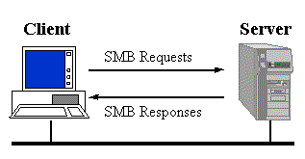
Windows Remote File Drivers:
Server Message Block (SMB) protocol
SMB is a client server,
request-response protocol.
The only exception to the request-response nature of SMB
is when the client has requested opportunistic locks (oplocks) and the server subsequently has to break an already granted oplock because another client has requested a file open with a mode that is incompatible with the granted oplock.
In this case, the server sends an unsolicited message to the client signaling the oplock break.
Addl. info at
http://anu.samba.org/
cifs/docs/what-is-smb.html

Slide 64
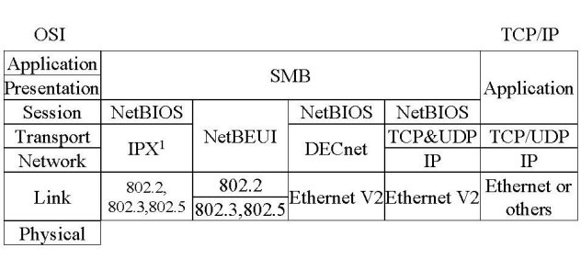
SMB and the OSI model
Clients connect to servers using TCP/IP (actually NetBIOS over TCP/IP as specified in RFC1001 and RFC1002), NetBEUI or IPX/SPX.
SMB was also sent over the DECnet protocol.
Digital (now HP) did this for their PATHWORKS product

Slide 65
SMB characteristics
NetBIOS Names
  If SMB is used over TCP/IP, DECnet or NetBEUI, then NetBIOS names must be used in a number of cases.
  NetBIOS names are up to 15 characters long, and are usually the name of the computer that is running NetBIOS.
  Microsoft, and some other implementers, insist that NetBIOS names be in upper case, especially when presented to servers as the CALLED NAME.
Protocol functionality (Core protocol):
  connecting to and disconnecting from file and print shares
  opening and closing files
  opening and closing print files
  reading and writing files
  creating and deleting files and directories
  searching directories
  getting and setting file attributes
  Locking and unlocking byte ranges in files

Slide 66
SMB characteristics (contd.)
Security
The SMB model defines two levels of security:
Share level.
  Each share can have a password, and a client only needs that password to access all files under that share.
  This was the first security model that SMB had and is the only security model available in the Core and CorePlus protocols.
User Level.
  Protection is applied to individual files in each share and is based on user access rights.
  Each user (client) must log in to the server and be authenticated by the server.
  When it is authenticated, the client is given a UID which it must present on all subsequent accesses to the server.
  This model has been available since LAN Manager 1.0.

Slide 67
SMB Clients and Servers
Clients:
  Included in WfW 3.x, Win 95, Win98, Win ME and Windows NT/2000/XP/Server 2003/Vista.
  smbclient from Samba, smbfs for Linux, SMBlib
Servers:
  Microsoft Windows for Workgroups 3.x, Win95, Win98, Win ME, Windows NT/2000/XP/Server 2003/Vista
  Samba (Linux, Solaris, SunOS, HP-UX, ULTRIX, DEC OSF/1, Digital UNIX, Dynix (Sequent), IRIX (SGI), SCO Open Server, DG-UX, UNIXWARE, AIX, BSDI, NetBSD, NEXTSTEP, A/UX)
  The PATHWORKS family of servers from Digital
  LAN Manager for OS/2, SCO, etc
  VisionFS from SCO
  Advanced Server for UNIX from AT&T (NCR?)
  LAN Server for OS/2 from IBM

Slide 68
Further Reading
Mark E. Russinovich and David A. Solomon,
Microsoft Windows Internals, 4th Edition, Microsoft Press, 2004.
  File Systems supported by Windows (from pp. 689)
  File System Driver Architecture (from pp. 694)
  NTFS Design Goals and Features (from pp. 717)
  NTFS On-Disk Structure (from pp. 732)

Slide 69
Source Code References
Windows Research Kernel sources do not include NTFS
A raw file system driver is included in \base\ntos\raw
Also see \base\ntos\fstrl (File System Run-Time Library)

