Slide 1
Electronic Structure from the top down
Predicting the behavior of materials starting from high temperature
Using Dynamical Mean Field theory
Richard M. Martin
Department of Physics
University of Illinois at Urbana-Champaign
Department of Applied Physics
Stanford University

Slide 2
Goal for this talk
In much of the field of electronic structure, all the theory and methods for calculation are formulated at zero temperature
This is sufficient for much of the work. I am NOT trying to criticize present calculations!!
But consider the goal that electronic structure calculations can predict the transition temperature of ferromagnetic Fe --- and many other cases where temperature is crucial
r

Slide 3
Electronic Structure from the bottom up (starting at low T)
Key words:
Order
Energy
T
Elementary excitations
– phonons, ,magnons, . . .
Ground State – T=0
In principle -- well -understood
Advantage – most straightforward to treat ordered systems

Slide 4
Electronic Structure from the top down (starting at high T)
In principle -- well -understood
Advantage – Higher T – less correlation, shorter range
High temperature
(T >> energy scale /k_{b} )
Uncorrelated
at high T
Key Words:
Disorder
Entropy
Correlation functions
– spin, charge, . . .
T

Slide 5
Electronic Structure from the top down
In principle -- well -understood
Idea – Higher T – less correlation, shorter range
High temperature
(T >> energy scale /k_{b} )
Uncorrelated
at high T
Key Words:
Disorder
Entropy
Correlation functions
– spin, charge, . . .
T
Nice Description by Walter Kohn
“Nearsighted”

Slide 6
Electronic Structure
The big picture
High temperature
( > energy scale /k_{b} )
Uncorrelated
at high T
Key Words:
Disorder
Entropy
Correlation functions
– spin, charge, . . .
T
Key words:
Order
Energy
Free
energy
T
Elementary excitations
– phonons, ,magnons, . . .
Ground State – T=0

Slide 7

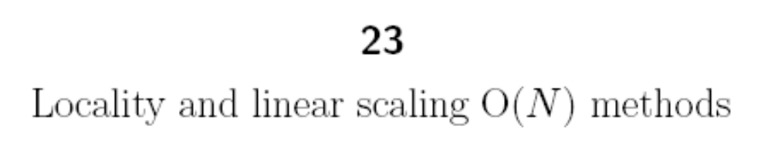
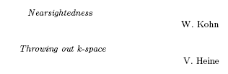
The big picture in perspective “Nearsightedness”
Nearsightedness is a property of a many-body system . . .
In insulators and metals at non-zero temperature, . . .

Slide 8
Theoretical formulation
Partition Function --- Z = Σ_{i} exp( - β E_{i} ), β = 1/kT
= Tr exp( - β H )
Free energy -- F = - kT ln Z
Starting from low T --- more difficult as T increases
→ more eigenstates required
Starting from high T --- more difficult as T decreases
→ longer correlation lengths required

Slide 9
Electronic Temperature scales
Natural --- Hartree/k_{b} ~ 200,000 K
Large effects of valence electronic excitations in typical materials
--- eV/k_{b} ~ 8,000 K
Good reasons to ignore effect of temperature for
electronic excitations in many materials for ordinary T
Practical reasons to ignore effect of temperature for
electronic excitations
Questions for audience

Slide 10
Electronic Temperature scales
Why is it difficult to treat electronic states in “real materials” at non-zero T ?
Difficult to carry out trace --- Z = Tr exp( - β H )
Feasible for small number of states
Applies to a “real material” only if one can establish that a small number of states is relevant for the interesting properties
Questions for audience

Slide 11
Electronic Properties where temperature matters
My list
Magnetism – spins are really electrons
T_{c} ~ 1K – 1000 K sets scale for magnetism
Other scales – band width ~ exchange ~ eV
  Metal – insulator transitions
  Transition metal oxides
  Kondo Effect -- magnetic impurities in metals
  T_{K} can be ~ 10⁻³ K
  Also can be ~ 10⁺³ K
  -- Can cause change in volume by ~ 15% (Ce)
In every case there are also high energy scales – band widths – exchange energies – multiplet energies --

Slide 12
Low energy excitations in magnetic system
Magnetic moments form on atomic sites – disordered at
high temperature
Moments order at a critical temperature to form magnetic order
Ferromagnet
Antiferromagnet
Model: Heisenberg Spin Model – appropriate for Lanthanides – reasonable for 3d transition metals (Fe, Ni, …)

Slide 13
Periodic Table
1
2
H
He
3
4
5
6
7
8
9
10
Li
Be
B
C
N
O
F
Ne
Transition metals
11
12
13
14
15
16
17
18
Na
Mg
Al
Si
P
S
Cl
Ar
19
20
21
22
23
24
25
26
27
28
29
30
31
32
33
34
35
36
K
Ca
Sc
Ti
V
Cr
Mn
Fe
Co
Ni
Cu
Zn
Ga
Ge
As
Se
Br
Kr
37
38
39
40
41
42
43
44
45
46
47
48
49
50
51
52
53
54
Rb
Sr
Y
Zr
Nb
Mo
Tc
Ru
Rh
Pd
Ag
Cd
In
Sn
Sb
Te
I
Xe
55
56
57
72
73
74
75
76
77
78
79
80
81
82
83
84
85
86
Cs
Ba
La
Hf
Ta
W
Re
Os
Ir
Pt
Au
Hg
Th
Pb
Bi
Po
At
Rn
87
88
89
Fr
Ra
Ac
Lanthanides - Actinides
58
59
60
61
62
63
64
65
66
67
68
69
70
71
Ce
Pr
Nd
Pm
Sm
Eu
Gd
Tb
Dy
Ho
Er
Tm
Yb
Lu
90
91
92
93
94
95
96
97
98
99
100
101
102
103
Th
Pa
U
Np
Pu
Am
Cm
Bk
Cf
Es
Fm
Md
No
Lw

Slide 14
Periodic Table
Elements with localized d and f states
Fractional filling → Strong correlation effects
1
2
H
He
3
4
5
6
7
8
9
10
Li
Be
B
C
N
O
F
Ne
Transition metals
11
12
13
14
15
16
17
18
Na
Mg
Al
Si
P
S
Cl
Ar
19
20
21
22
23
24
25
26
27
28
29
30
31
32
33
34
35
36
K
Ca
Sc
Ti
V
Cr
Mn
Fe
Co
Ni
Cu
Zn
Ga
Ge
As
Se
Br
Kr
37
38
39
40
41
42
43
44
45
46
47
48
49
50
51
52
53
54
Rb
Sr
Y
Zr
Nb
Mo
Tc
Ru
Rh
Pd
Ag
Cd
In
Sn
Sb
Te
I
Xe
55
56
57
72
73
74
75
76
77
78
79
80
81
82
83
84
85
86
Cs
Ba
La
Hf
Ta
W
Re
Os
Ir
Pt
Au
Hg
Th
Pb
Bi
Po
At
Rn
87
88
89
Fr
Ra
Ac
Lanthanides - Actinides
58
59
60
61
62
63
64
65
66
67
68
69
70
71
Ce
Pr
Nd
Pm
Sm
Eu
Gd
Tb
Dy
Ho
Er
Tm
Yb
Lu
90
91
92
93
94
95
96
97
98
99
100
101
102
103
Th
Pa
U
Np
Pu
Am
Cm
Bk
Cf
Es
Fm
Md
No
Lw
Need method to treat strong correlation on each atom
and
Correlation between sites that determines order, phase transitions, …

Slide 15

Transition & Rare Earth Elements
More Localized
Empty
Shell
Partially Filled Shell
Filled
Shell
4f
57
58
59
60
61
62
63
64
65
66
67
68
69
70
71
La
Ce
Pr
Nd
Pm
Sm
Eu
Gd
Tb
Dy
Ho
Er
Tm
Yb
Lu
5f
89
90
91
92
93
94
95
96
97
98
99
100
101
102
103
Ac
Th
Pa
U
Np
Pu
Am
Cm
Bk
Cf
Es
Fm
Md
No
Lw
3d
20
21
22
23
24
25
26
27
28
29
30
31
Ca
Sc
Ti
V
Cr
Mn
Fe
Co
Ni
Cu
Zn
Ga
More Localized
4d
38
39
40
41
42
43
44
45
46
47
48
49
Sr
Y
Zr
Nb
Mo
Tc
Ru
Rh
Pd
Ag
Cd
In
5d
56
57
72
73
74
75
76
77
78
79
80
81
Ba
La
Hf
Ta
W
Re
Os
Ir
Pt
Au
Hg
Th
magnetic
enhanced
From J. L. Smith
superconducting

Slide 16
What is “U” in “LDA + U”
How to treat the localized states?
  Selection of a few orbitals
  Partially filled --- “Open Shell”
  Two energy scale -- strong interactions -- U
  low energy excitations -- magnetic moments
  U is a screened interaction – must be determined
  Is the resulting problem unique?
No! – depends upon choice of the localized state
Reasonable choices give reasonable, useful results
This is the problem in making LDA+U quantitative
Impotant – the same problem limits other methods such as DMFT discussed later!

Slide 17
LDA+U
In LDA + U the system is treated as ordered
Assumes the system is ordered – e.g., antiferromagnetic order
This is correct for T=0
very valuable results – e,.g., correcting the usual density functionals (like LDA) which often predict a metal when the correct state is an ordered antiferromagnetic insulator.
What about disordered states?

Slide 18
What about “U” in disordered`states at high temperature?
U does not go away with disorder
Large energy scale
Determined by atomic properties
  This is where DMFT provides a systematic approach
  Starting from High T and working down!

Slide 19
Characteristic issues and applications

Slide 20
Metal-Insulator Transition
Classic Case --- V₂O₃
U
Critical Point
PM - Insulator
T
“Slater”
AF - Insulator
PM – metal
U/W
Pressure
Bottom Up

Slide 21
Metal-Insulator Transition
Classic Case --- V₂O₃
U
Critical Point
PM - Insulator
T
AF - Insulator
PM – metal
U/W
Pressure

Slide 22
Metal-Insulator Transition
Classic Case --- V₂O₃
U
Critical Point
PM - Insulator
T
“Slater”
AF - Insulator
PM – metal
U/W
Pressure
Bottom Up

Slide 23
Metal-Insulator Transition
Classic Case --- V₂O₃
U
Critical Point
PM - Insulator
“Mott”
T
AF - Insulator
PM – metal
U/W
Pressure
Top Down

Slide 24
How to treat Correlation?
Atom in a “bath” of surrounding atoms
Treat correlation on central atom
Treat bath as independent electrons
Old idea – solve for one atom with
some method of averaging over the
environment
Curie-Weiss Mean field for magnetism
Applied idea for spins in a mean field that is the thermal average of neighboring spins -- each spin is in a “bath’ that is an average effect on the spin
Increased correlation as T is decreased – leads` to a phase transition at some T (Must have ordered` structure at T=0 to have zero entropy)

Slide 25
How to treat Correlation?
Atom in a “bath” of surrounding atoms
Treat correlation on central atom
Treat bath as independent electrons
Old idea – solve for one atom with
some method of averaging over the
environment
Gutzwiller – Hubbard – 1960’s
Applied idea at T=0 ---- open shell systems
Correlation included in a clever way –
Each atom treated as strongly correlated
Assume no correlation with surrounding atoms
Kinetic energy - W – reduced due to restriction of hopping by the price of the repulsive interactions
Metal-insulator transition (bootstrap effect)

Slide 26
How to treat Correlation?
Atom in a “bath” of surrounding atoms
Treat correlation on central atom
Treat bath as independent electrons
Old idea – solve for one atom with
some method of averaging over the
environment
Dynamical Mean Field Theory – 1980’s - Present
Applied idea at high T – decreasing to low T
Each atom treated as strongly correlated
Neglect of correlation with surrounding atoms – Justified at high T
Kinetic energy - W – reduced … due to restriction of hopping –
---- Treated by Self-Consistent Green’s function
Add correlation between sites as T decreases
Phase Transitions -- Metal-insulator transition, magnetism, …..

Slide 27
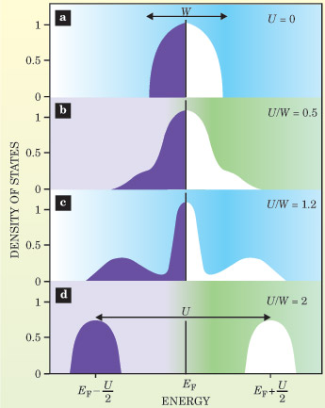
Characteristic energy scales shown by spectra of electron excitations
Evolution with increasing interaction U:
Top: Small U - Band-like spectrum
  W ~ E_{Fermi} ~ 10 eV ~ 10⁵ K
    Increases with pressure
Bottom: Large U >>W
  - Localized, correlated atom-like
  Two types of excitations
  High energy ~ U ~ 10 eV ~ 10⁵ K
    Increases for more localized states
  Low energy magnetic ~J ~ 10² K
    Decreases for more localized states
Middle: Multiple energy scales
  High energy ~ U ~ 10⁵ K
    Increases for more localized states
  Intermediate ~ 10⁻³ K - 10⁵ K
    Can vary over range – low to high
Kotliar and Vollardt,
Physics Today 2004

Slide 28
Dynamical Mean Field Theory
Basic idea – Exact calculation for local system
In presence of “dynamical mean field”
What is dynamical?
  Electrons can enter and leave site
  Dynamics comes from the dependence
  upon the time difference for entering, leaving
  Spectra of the site – which can be calculated exactly
  (or to a good approximation) Easier at high T !
But in a crystal the bath is due to other atoms that are the
same as the central atom
DMFT results from the requirement that the spectrum of the bath
are consistent with spectrum of the site
  The limitation is that correlations between sites are ignored
  These can be included using clusters - expensive in computer time!

Slide 29
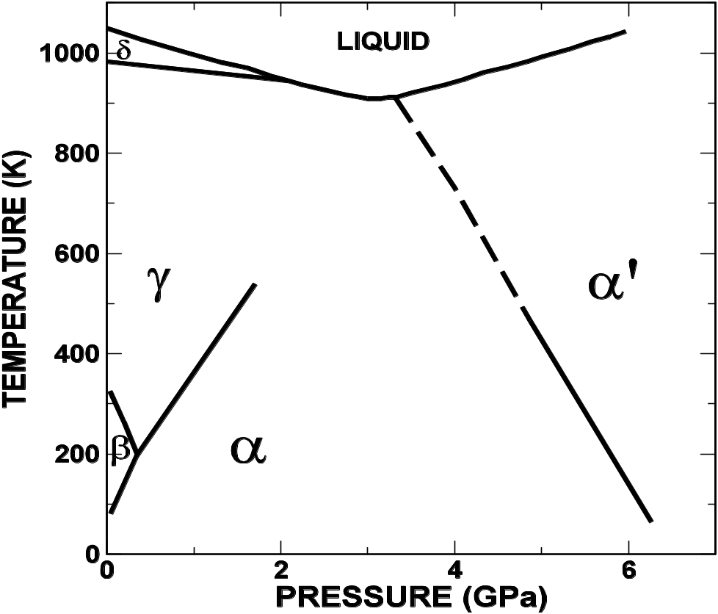
Phase Diagram
Anomalous Lanthanide -- Ce
Critical Point
γ - High
volume
α - Low
volume
15% volume change at low T!
No change in symmetry – fcc metals

Slide 30
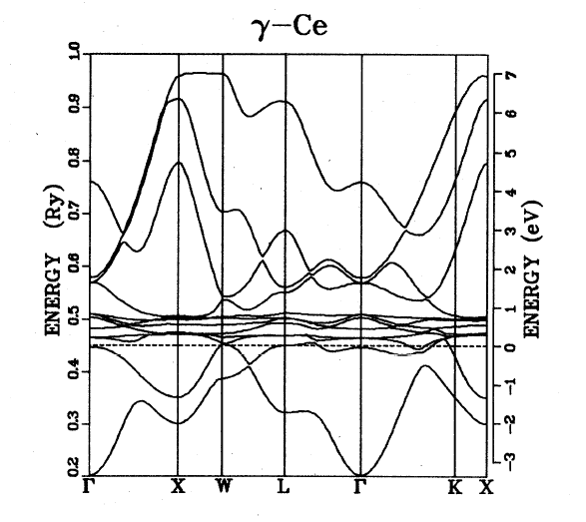
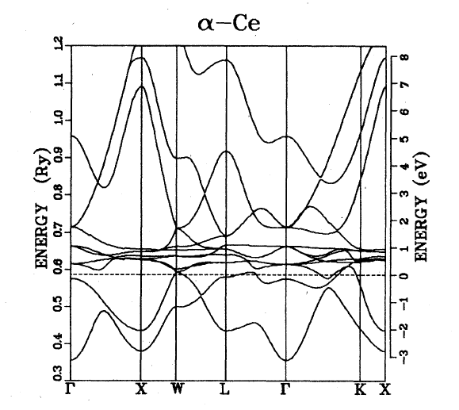
Calculated Bands of Ce
Local Density Approximation
There are 7 4f bands (not counting spin. The 4f bands MUST be at the Fermi energy since they are partially occupied
14 4f
bands
Large volume Gamma phase -- Magnetic (experimental fact)
Low volume Alpha phase
Non-magnetic
(experimental fact)
From: W. E. Pickett, et al., PRB 23, 1266 (1981).

Slide 31
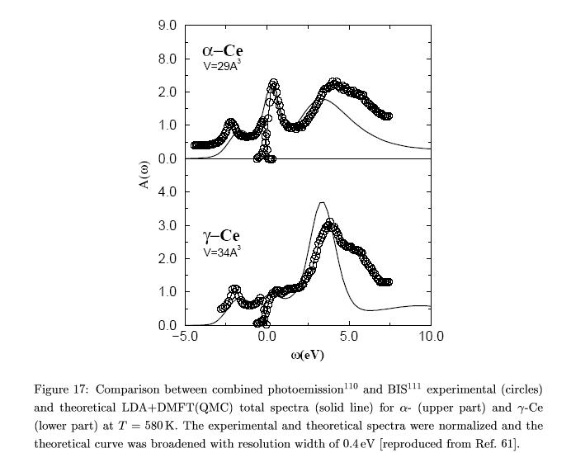
Electronic Spectrum
Anomalous Lanthanide -- Ce
Fermi energy
Inverse
Photoemission
Photoemission
Low volume
High volume
U
“Kondo” peak
- Much narrower than DFT bands
Split bands due to interaction U
- Much wider than DFT bands
Cannot be explained by the usual KS theory
“LDA + DMFT” calculation explains:
Phase diagram, Driven by entropy of moments at high T, Electronic spectrum
McMahan, et al., 2005

Slide 32
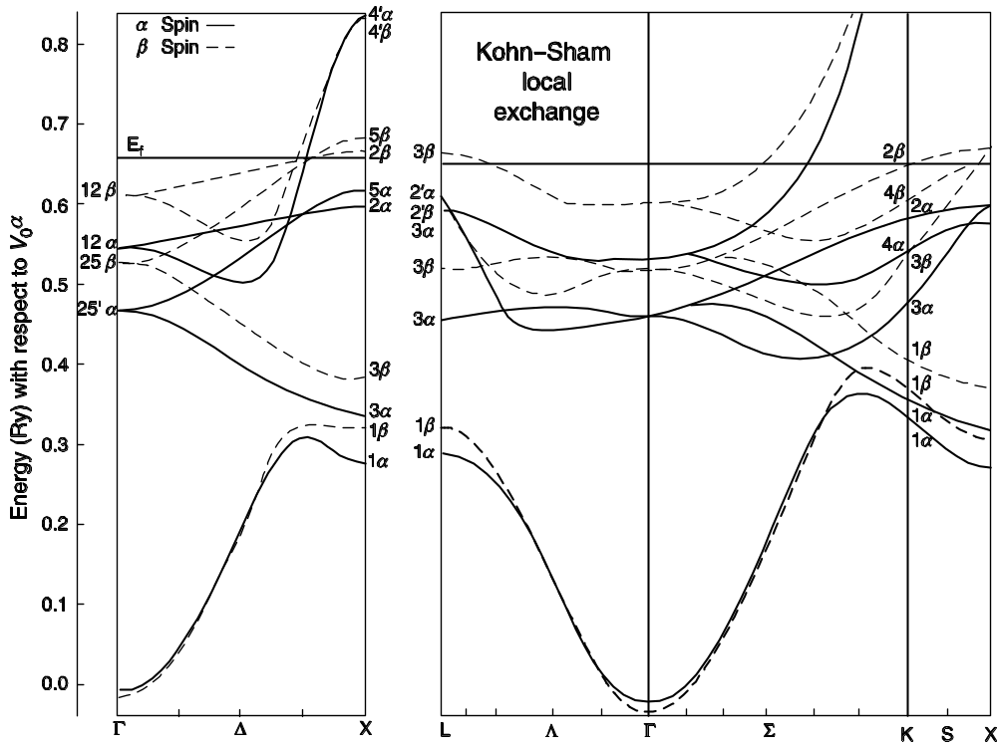
T=0 Approach -- Spin polarized bands in ordered magnetic state - Ni
Spin down
~ 1.5 eV
Spin up
What happens for T > Tc – where spin polarization = 0 ?

Slide 33
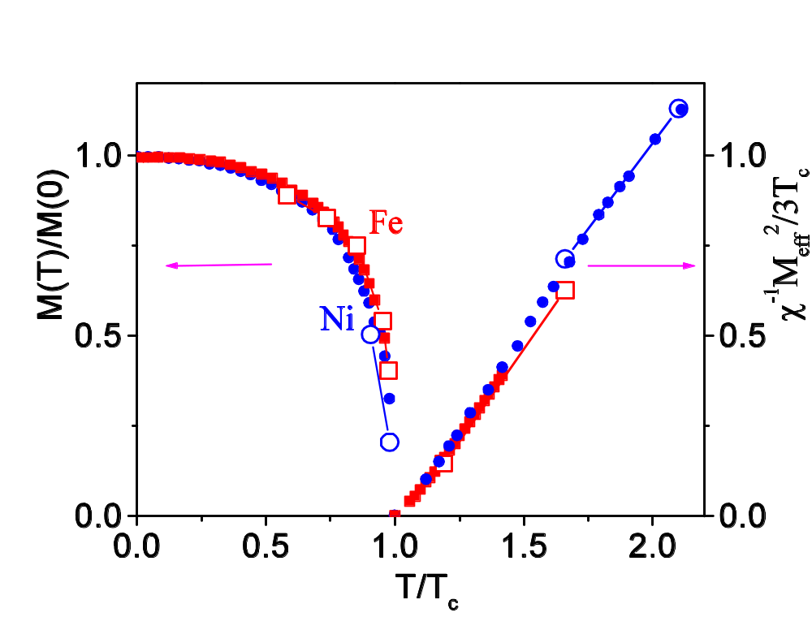
T≠0 -- Magnetism of Fe and Ni calculated from electronic structure theory
T < T_{c} -- Ordered Moments
T=0 Moment scaled to DFT
Close to experiment
T > T_{c} -- Disordered Local Moments
Curie-Weiss χ⁻¹ ~ (T - T_{c})
“LDA + DMFT” calculations
Lichtenstein, et al., 2001

Slide 34
Magnetism of Fe and Ni calculated from electronic structure theory
Quantitative successes:
Ordered Moment
Local Moments at high T
What about T_{c} ?
Calculated Experiment
Ni 700 631 K
Fe 1900 1031
Why is Fe off so much?
Spin wave fluctuations reduce T_{c} in Fe – not taken into account by the localized calculation
Lichtenstein, et al., 2001

Slide 35
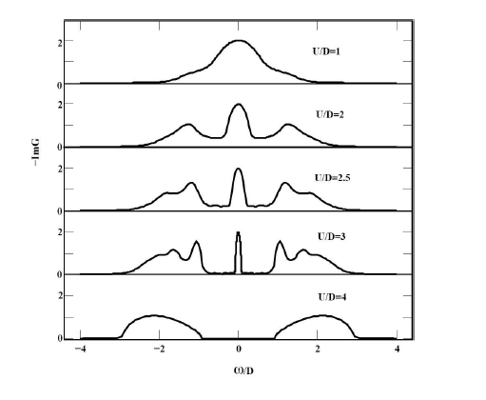
The problem in making DMFT quantitative
U is not uniquely defined!
Simple model for bands - half-filled - D = band width for independent electrons – U = interaction
Fermi energy
U=0 metal
Low energy spin excitations
Large U
insulator

Slide 36
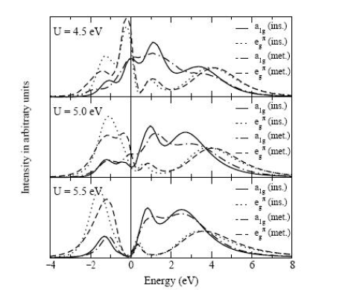
Metal insulator transition
Qualittative explanation from DMFT
SrVO3
Meat or insulator?
Photoemission clearly shows correlation effects – peak at Fermi energy
“LDA + DMFT” calculations --- the results are very sensitive to the value of U!
Lichtenstein, et al., 2001

Slide 37
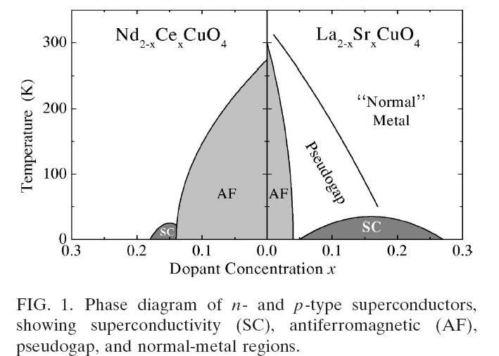
Electronic Structure
The big picture
Starting from Low T or high T:
The limits – small U/W, large U/W - are
relatively straightforward to understand and to treat
The intermediate cases – “strongly correlated” –
multiple energy scales -- are the great challenges
“Classic” examples
U
V₂O₃
PM - Insulator
Critical Point
T
AF - Insulator
PM – metal
U/W
Pressure

Slide 38
Conclusions
Starting from Low T or high T
Low T approach completely justified in
many cases
  Si – no electronic excitations below 1.1 eV ~10,000K
  Phonons are the important excitations – use T=0 phonons
  to calculate specific heat – hard problem at melting
  requires high T approach for atomic motion
High T approach completely justified in
many cases
  Magnetism at temperature ~ Curie temperature limits
  “Kondo effect” – low energy crossover from zero entropy
  state at T=0 to thermally fluctuating spins at T>TK that
  is often very low ~ 1-10 K

